Slide 1
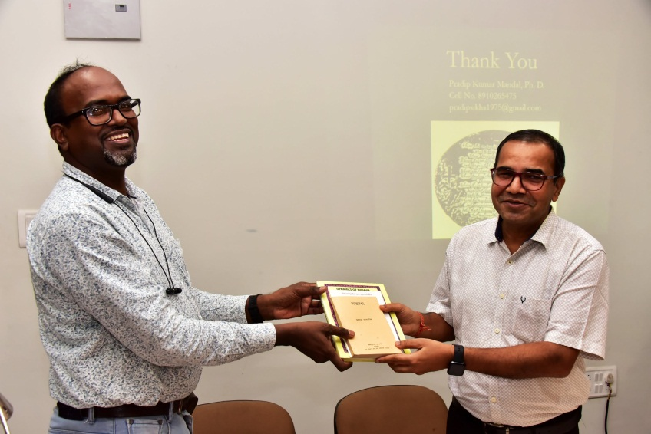
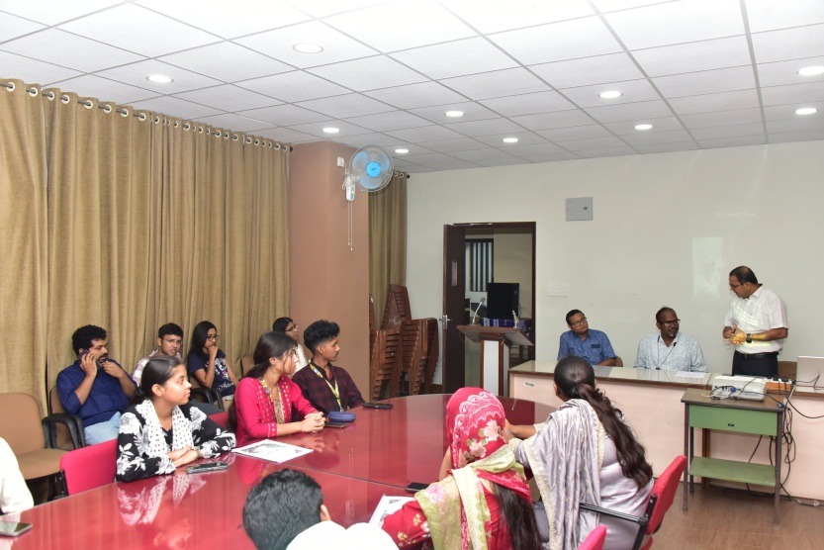
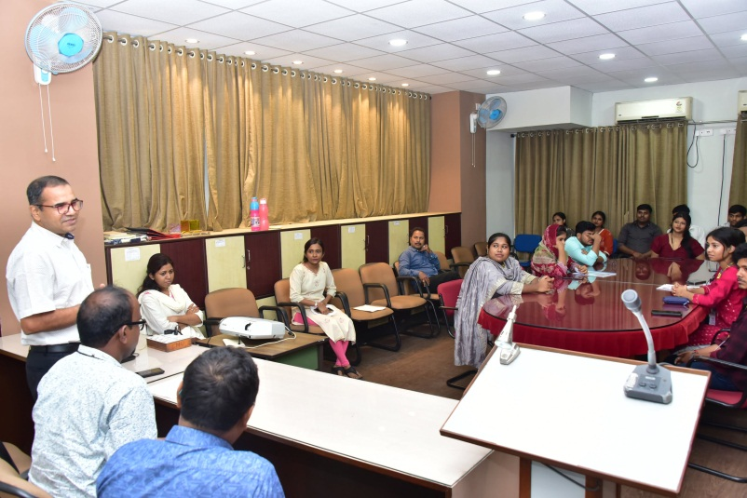

Indian Statistical Institute,Kolkata
Heritage of Santiniketan July 30, 2026
LIBRARY EVENTS
1

