Slide 1

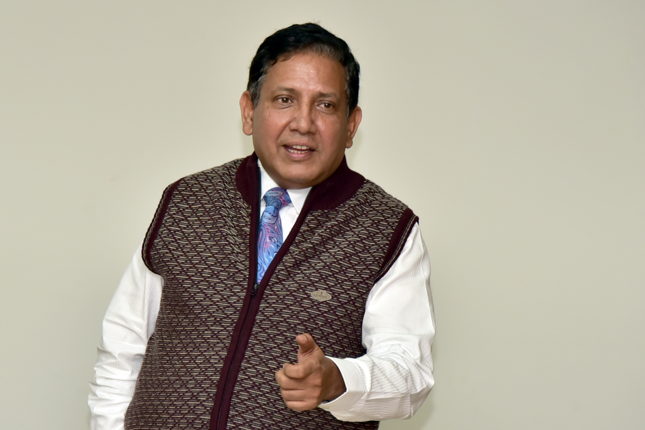
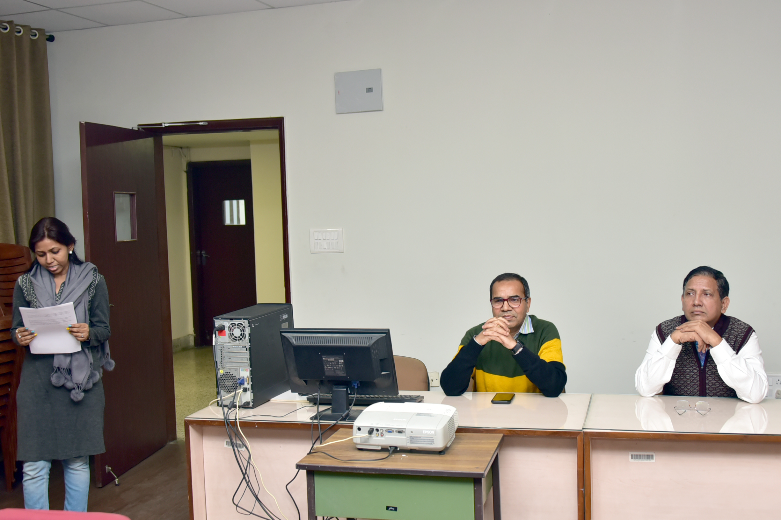
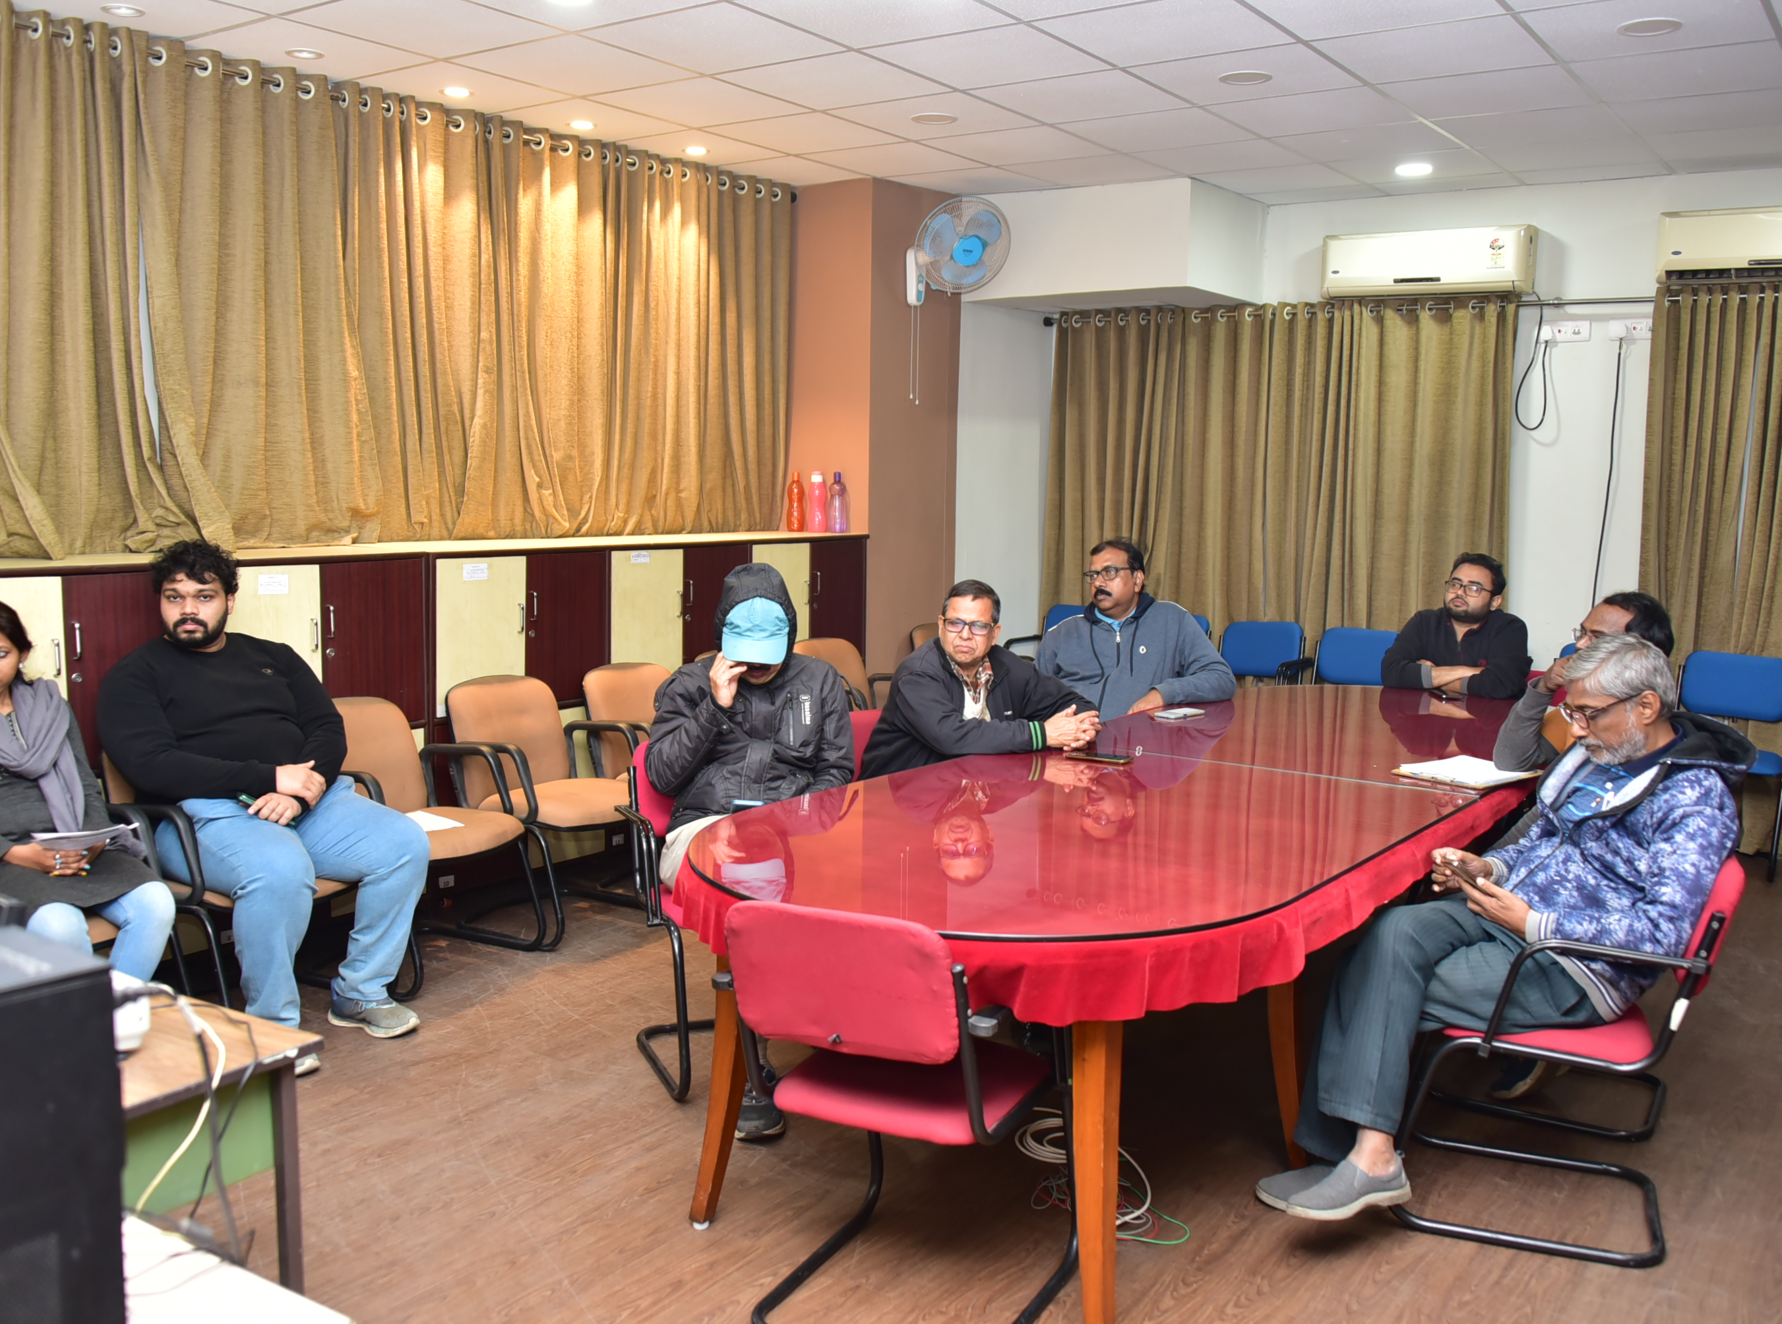
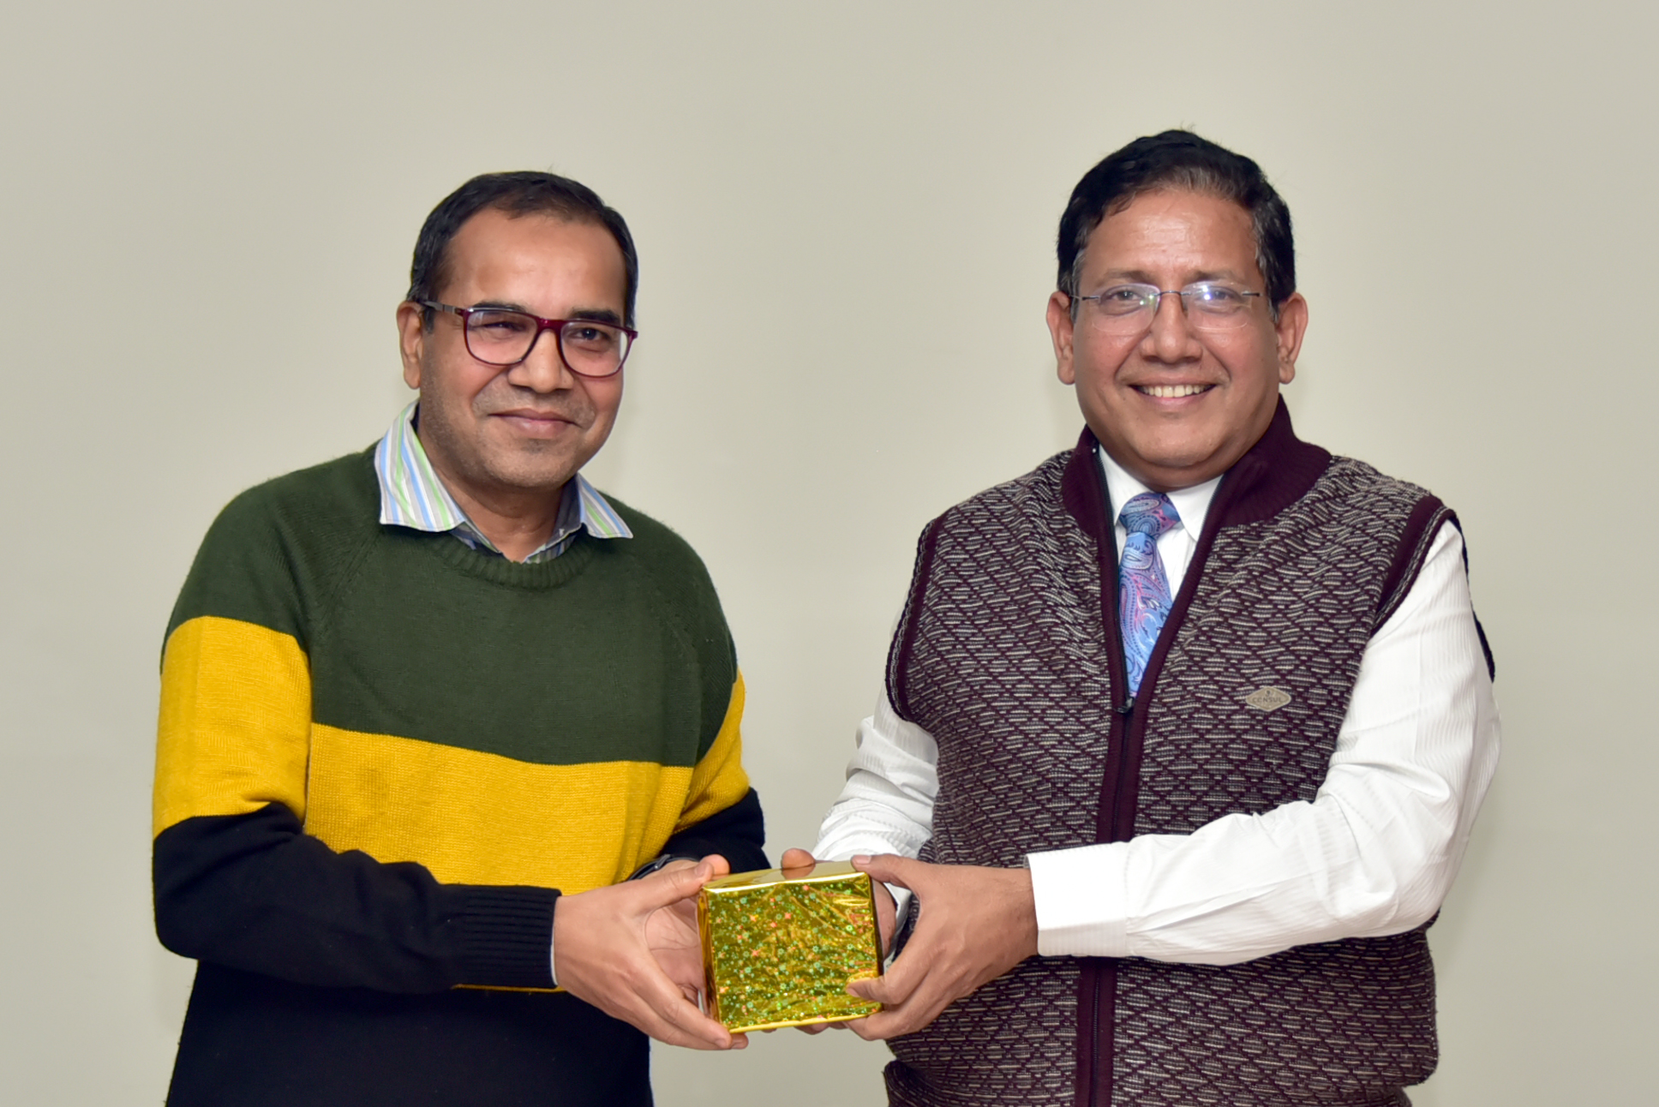

Indian Statistical Institute,Kolkata
“Role of AI in Effective Communication” Special Lecture on December 29, 2025
LIBRARY EVENTS
1

