Slide 1
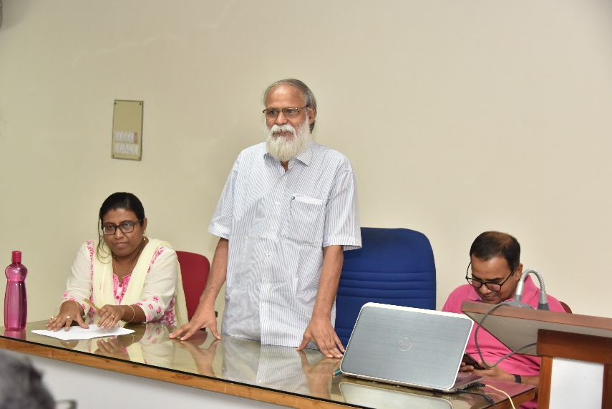
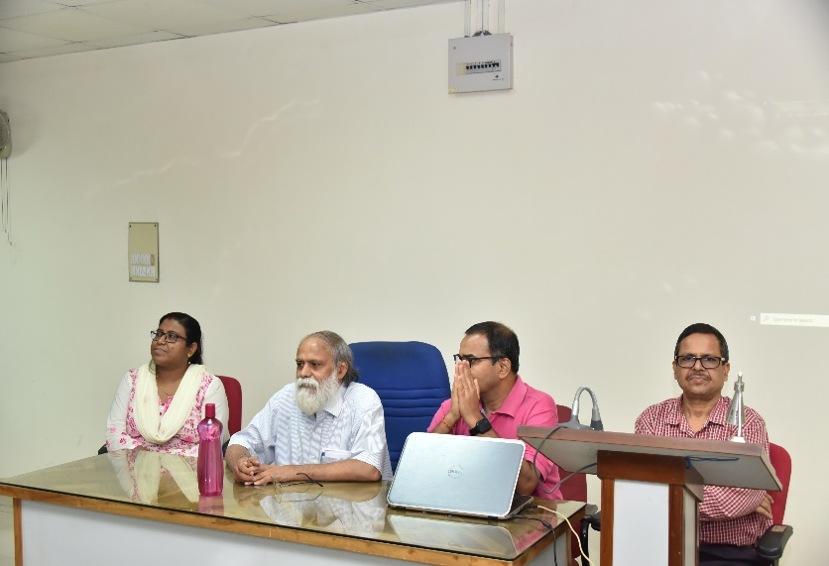
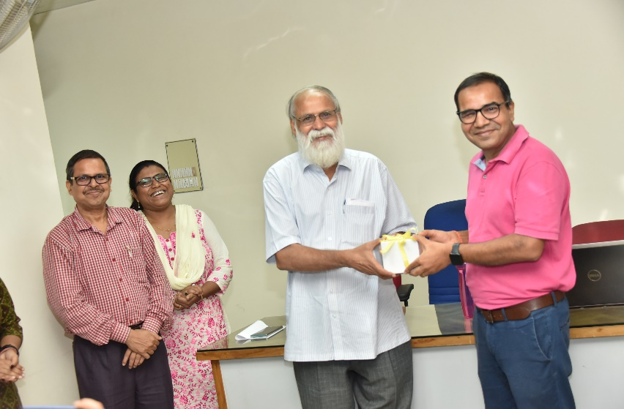
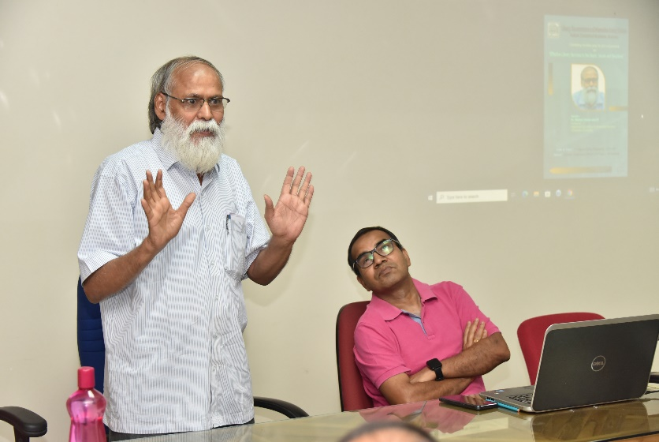
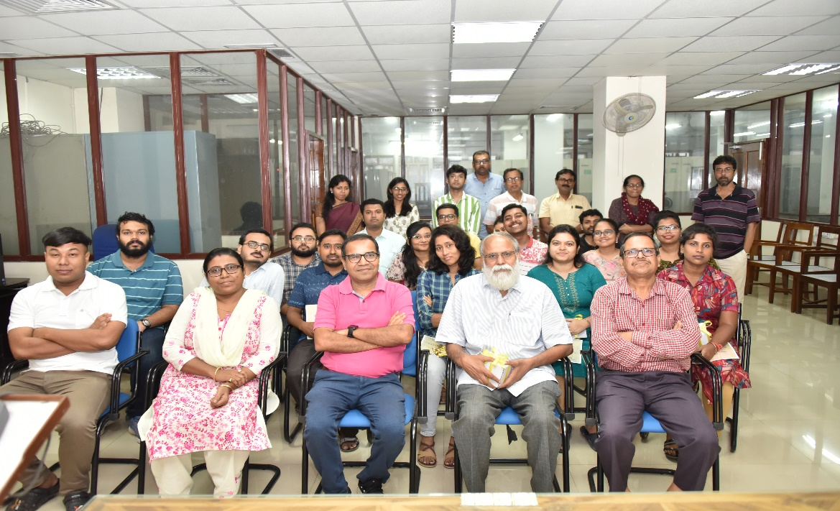

Indian Statistical Institute,Kolkata
Special Lecture on “Effective Library Services to the Users: Issues and Solutions"
August 01, 2024
LIBRARY EVENTS
1

