Slide 1
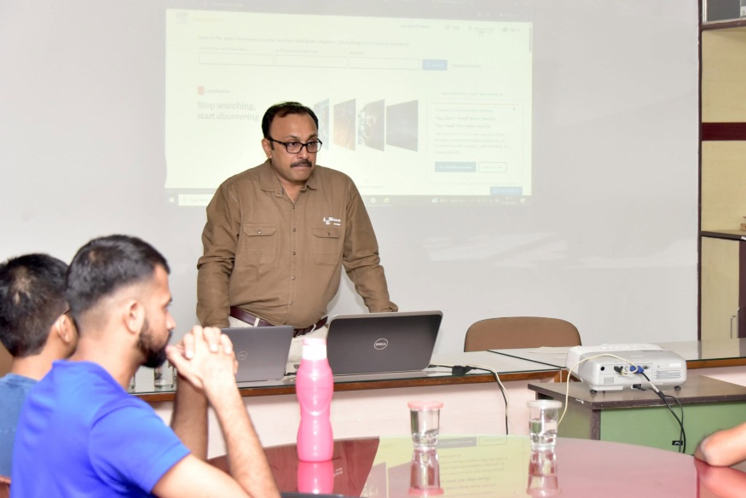
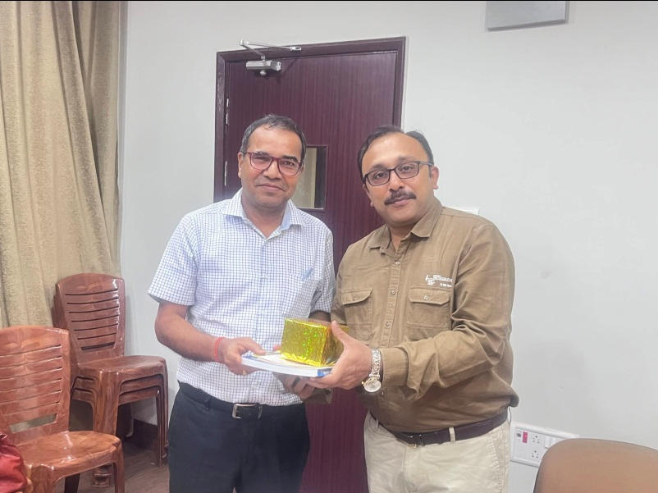
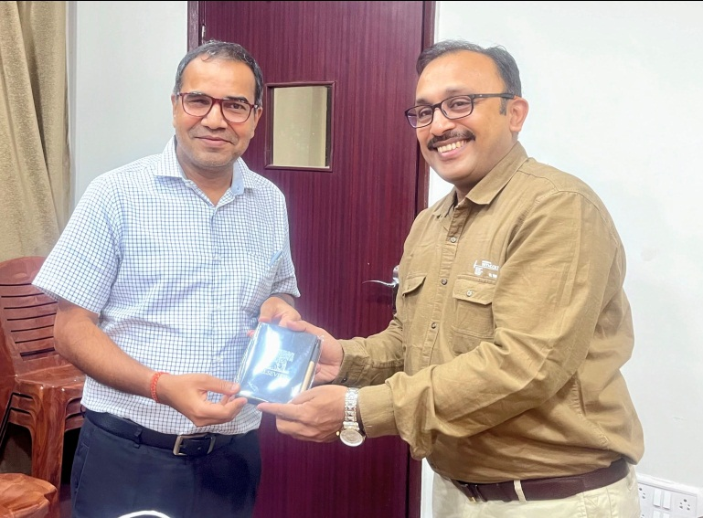
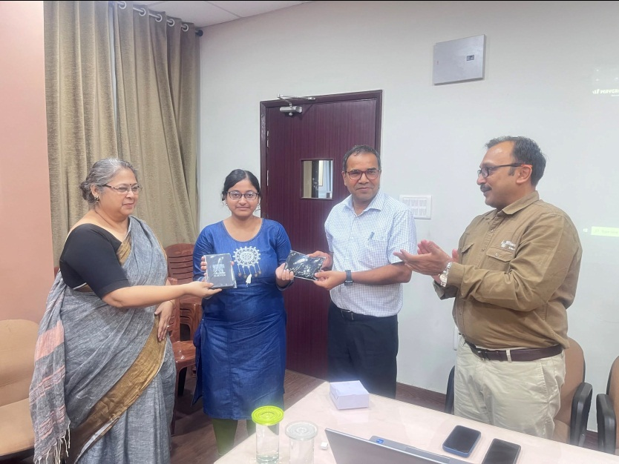

Indian Statistical Institute,Kolkata
Workshop on Advancing Research Excellence: From Publishing Integrity to AI-Powered Workflows on June 11, 2026
LIBRARY EVENTS
1

