Slide 1
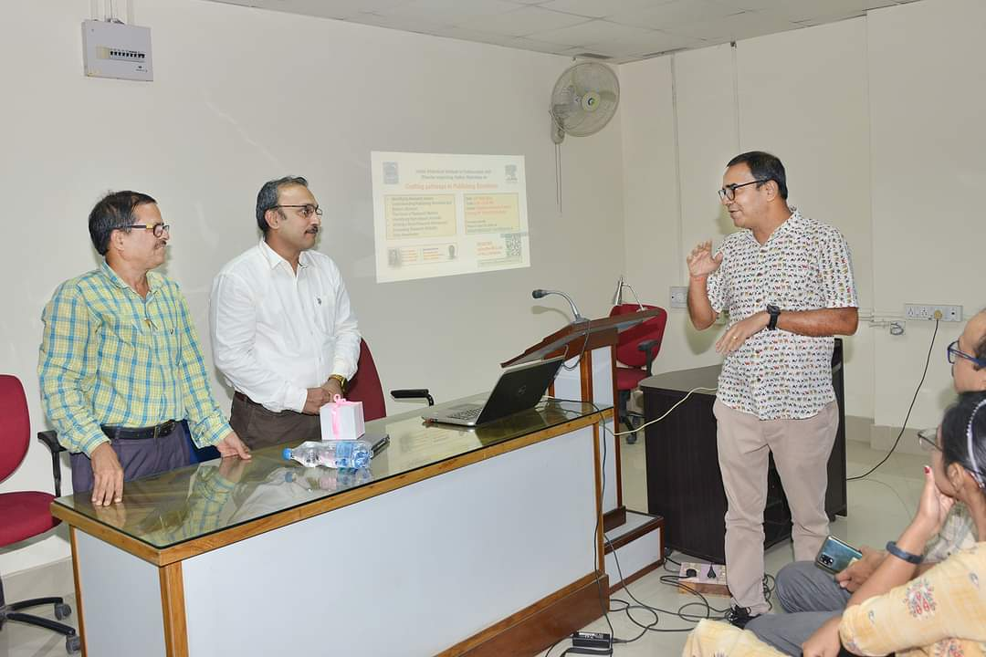
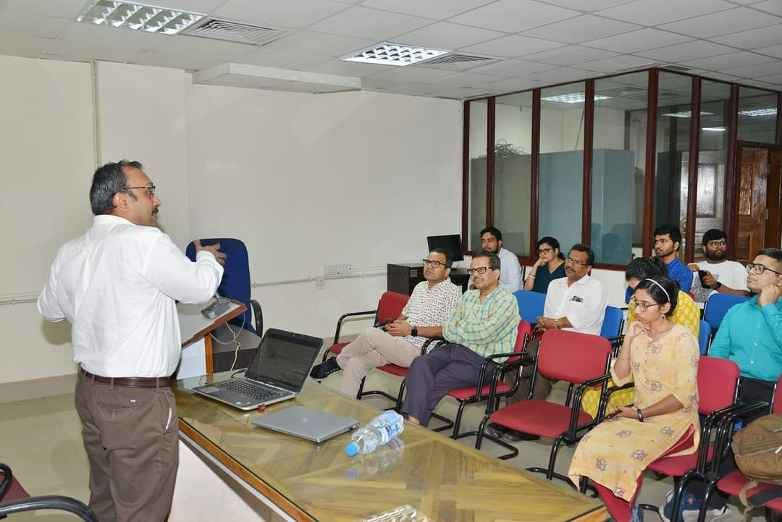
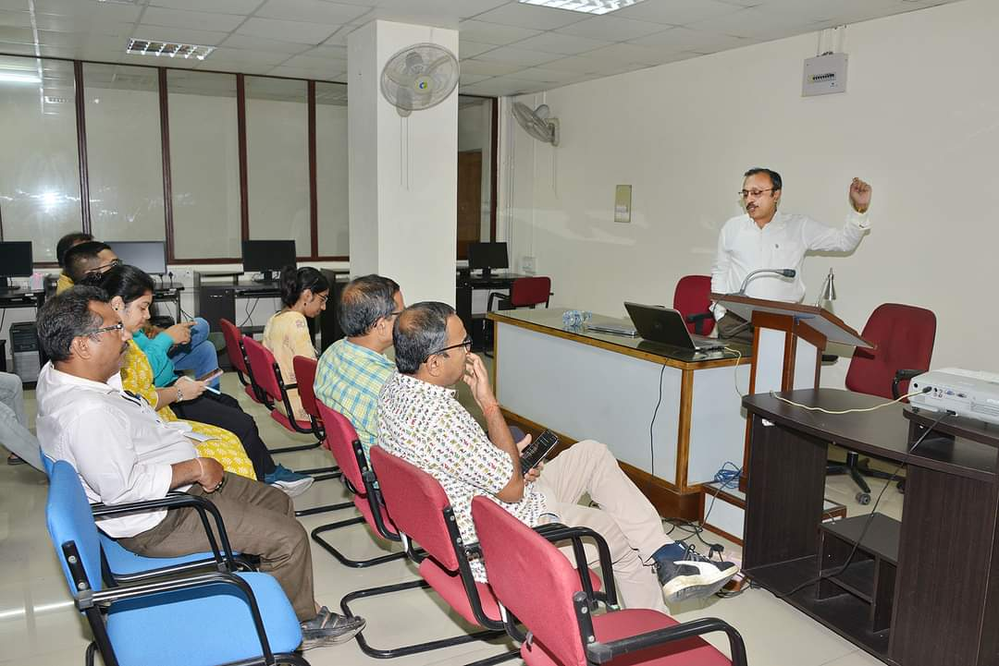
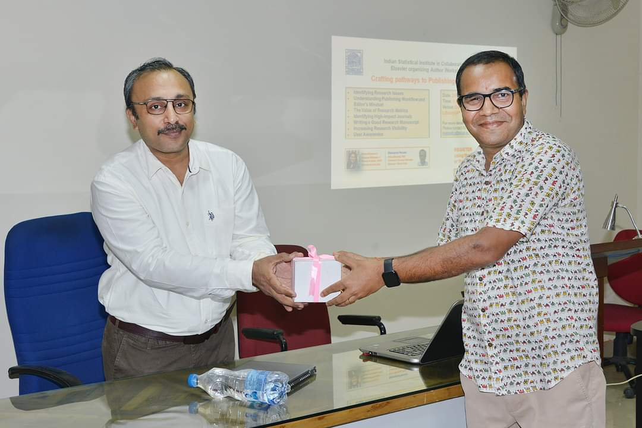

Indian Statistical Institute,Kolkata
“Elsevier” User Orientation Programme on September 24, 2024
LIBRARY EVENTS
1

