Slide 1



J-Gate
TRAINING & PRODUCT
PRESENTATION
Information overload has been an increasing problem since the Renaissance period. Therefore, in this digital age it is crucial to validate and find relevant information from the vast number of available sources.
www.jgateplus.com

Slide 2

What is Research?
The study of materials and sources
to establish facts and reach new conclusions.
Begin
research
Identify keywords,
topics, matter
Study
Understand
Analyse
Discover
Document
Report

Slide 3
Key Concepts
Journal
Bibliography
Commercial
ISSN
Magazine
OPAC
Indexing
e-Journal
Metadata
Abstract
eBook
Periodical
Publisher
Society

Slide 4


Slide 5
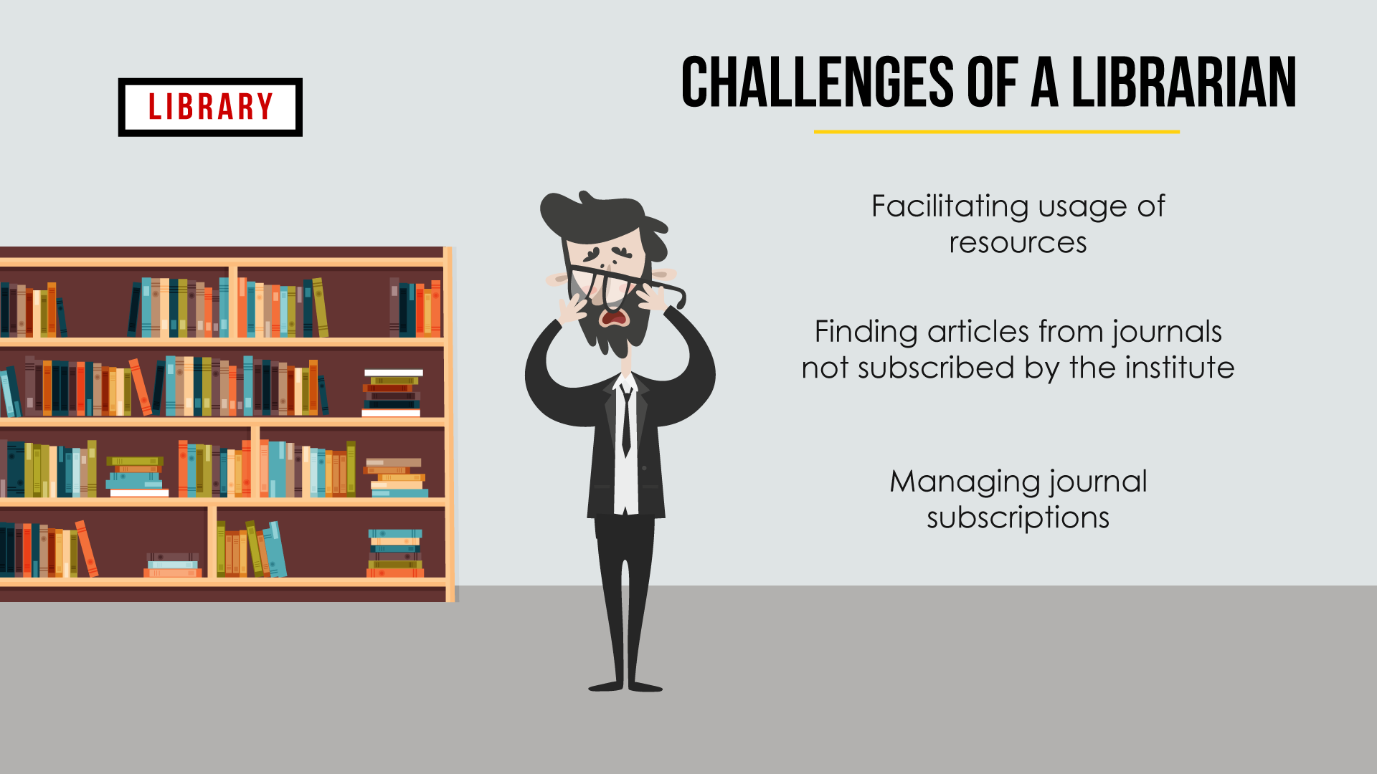

Slide 6
Keywords/Topics/Matter
LIBRARY
OPAC
Catalogue
Card
BIBLIOGRAPHIC
INDEX
STARTING POINT OF RESEARCH IS A “BIBLIOGRAPHIC DATABASE”
JOURNAL 1
JOURNAL 2
JOURNAL 3
JOURNAL 4
JOURNAL …...
JOURNAL 49
JOURNAL 50
ARTCILES
2
5
9
14
….
100

Slide 7

IS THERE A NEED FOR A DISCOVERY SOLUTION ?

Slide 8
JOURNAL 1
JOURNAL 2
JOURNAL 3
JOURNAL 4
JOURNAL …...
JOURNAL 49
JOURNAL 50
ARTCILES
2
5
9
14
….
100

Slide 9

SOLUTION : J-Gate
J-Gate is an access gateway for the discovery of all global e-journals. Launched in 2001 by Informatics Publishing Limited, J-Gate is the world’s largest database of journal articles.
51 million
Journal Articles
47,000+
Indexed Journals
13,000+
Publishers Indexed

Slide 10
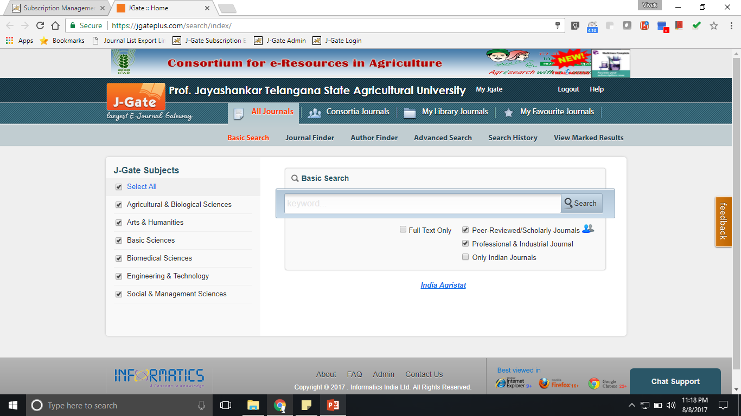
Easy Access and Discovery of Journals Through
J-Gate
Website URL: https://jgateplus.com/
Notes:
10

Slide 11

User Module
Benefits
Single Point Access for all journals
Find In a Library
Multiple Ways to Discover Full Text
Customized Access to Library Subscribed Journals
Customized Access to Personal Library

Slide 12

User Module

Slide 13
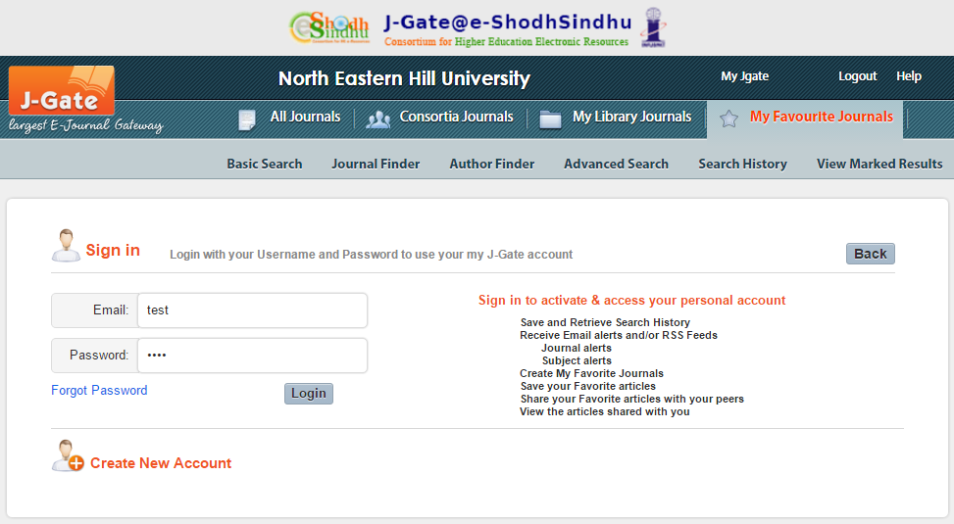
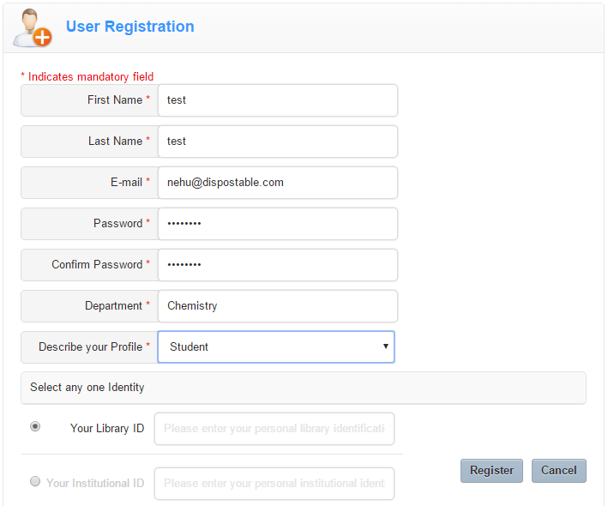
Create Your One Time User Profile Easily
BENEFITS
Save and Retrieve Search History.
Save / Store your favorite articles in personalized folders.
Receive Email alerts and/or RSS Feeds.
  Journal alerts
  Subject alerts
Create My Favorite Journals.
Save your Favorite articles.
Share your Favorite articles with your peers.
View the articles shared with you.
Access J-Gate Bibliographic Content from Anywhere.
Choose Your Own Password for Instant Access

Slide 14
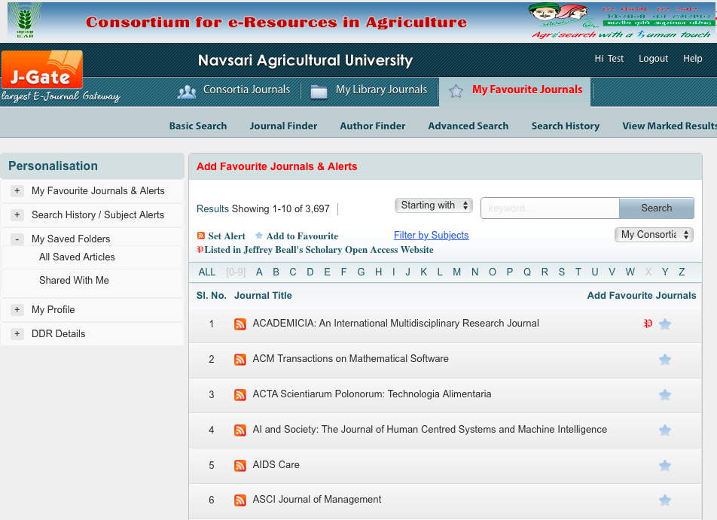
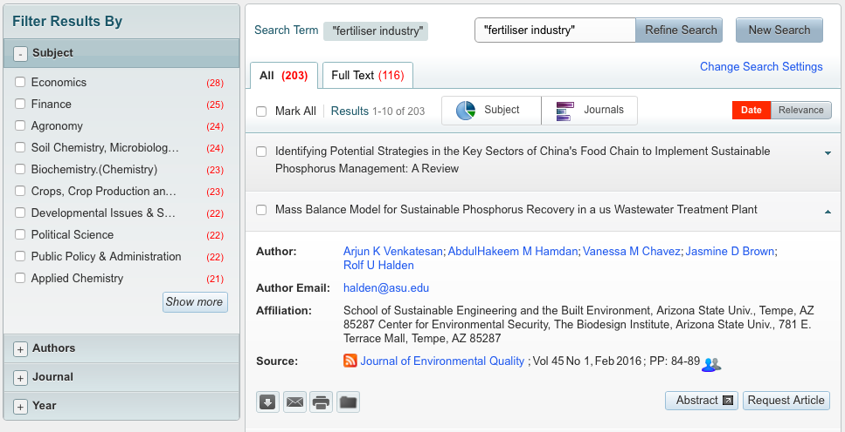
Register Profile for a Personalised Access to
“My Favourite Journals” and Personalisation Features
  Create and Manage Email & RSS alerts for latest Journal Table of Content.
  Save / Store your favourite articles in personalised folders for quick and easy reference.
  Mark Favourite Journals from the Journal Finder page.
  Share your personalised folders with your fellow researchers / peers for collaboration and knowledge sharing.
  Download / e-Mail / Print individual reference, directly from the search result page.
  Off Campus access to Bibliographic Content of J-Gate.
Notes:
14

Slide 15
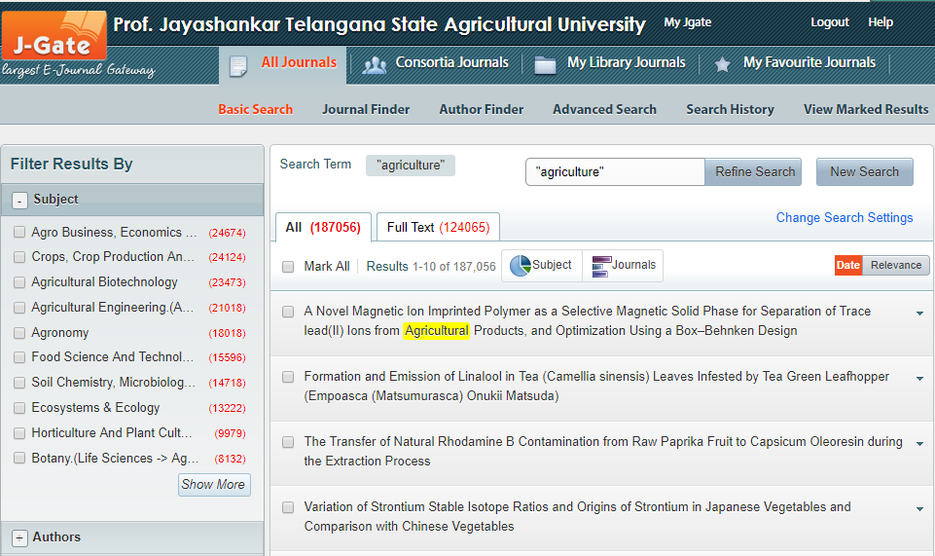
Discover Journal Articles Related to Your Research
Filter Search Results
Refining Results
Sorting Options
Lateral Searches to Perform New Searches
Notes:
15

Slide 16
View Bibliographic Data and Access Full-Text
Online Using Full-Text Links
Print Available in Library
Request Author
Inter Library Loan Using Request Article
Notes:
16

Slide 17
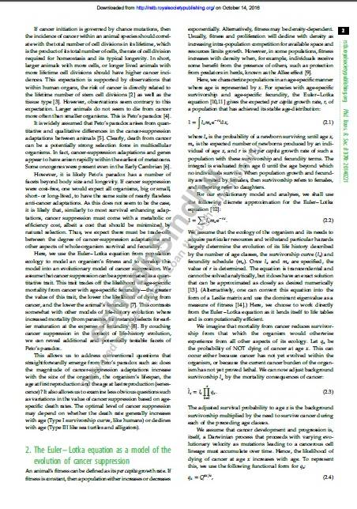

DRM:
Watermarking the document shared via DDR.

Slide 18
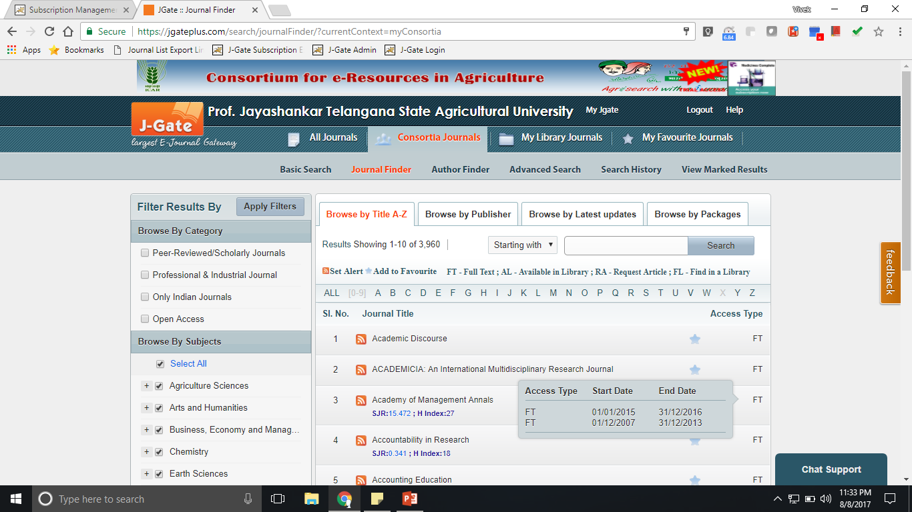
Journal Finder
Browse Table of Contents
Browse By
Category / Subjects
Notes:
18

Slide 19
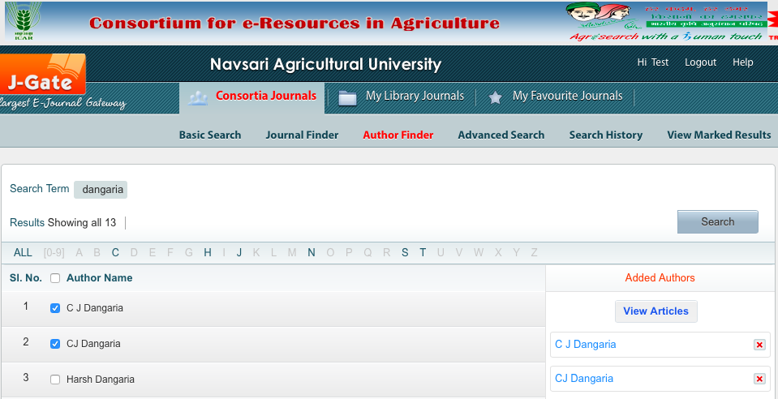
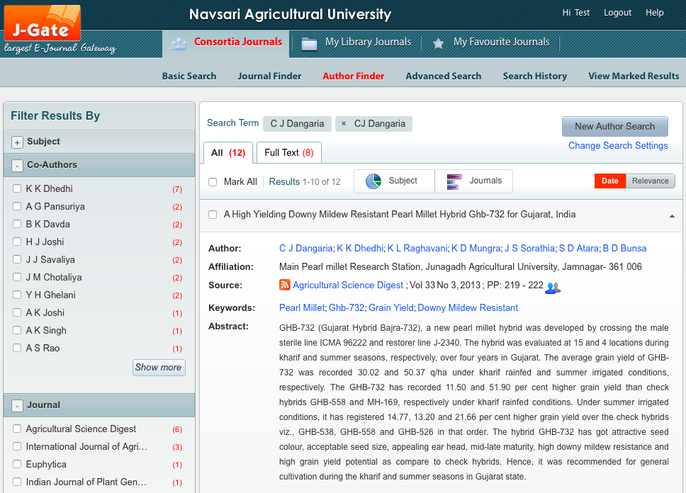
Author Finder
Read Articles of Your Favourite Author
Discover Articles citing Names in Different Ways
Discover Co-Authored Articles
Discover Authors related to the research field of the known author
Notes:
19

Slide 20
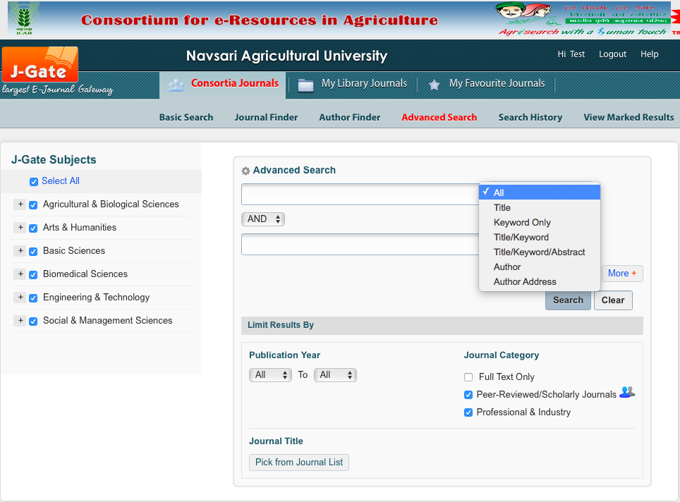
Advanced Search
Advanced Searches For Complex Search Query
Field Directed Search
Use Boolean Operators to Construct Search Query
Pre- Search Limits for Better Relevancy
Singular Plural Searches
Search US/UK Variants
Notes:
20

Slide 21

Constructing a Query to Derive Better Results
A student/faculty comes comes up with a topic
“Role of Fertilizer in Growth of Crops”
How does he/she find relevant articles ?
How do you a keyword search help him/her ?

Slide 22
Building the Search Keyword/Phrase
Think of key words that best describe the topic
Boolean Operators
AND OR NOT
STOPWORD
insignificant
Role of Fertilizer in Growth of Crops
(role) and (fertilizer) and (growth) and (yield) and (quality) and (crops or fruits) : 66
(role) and (pgr or fertilizer) and (growth) and (yield) and (quality) and (crops or fruits) : 279
(role or effect) and (foliar or pgr or "plant growth regulator" or fertiliser or fertilizer) and (growth or development) and (yield) and (quality) and (plants or crops or fruits): 2094

Slide 23
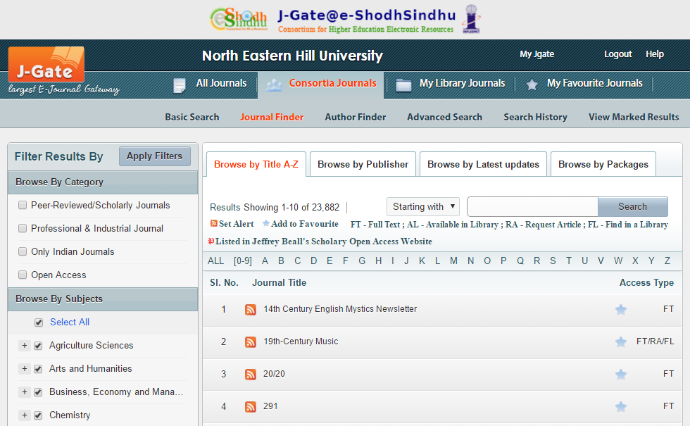
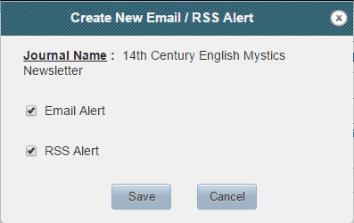
Personalization in J-Gate
  1.
  Create and Manage Email & RSS alerts for latest Journal Table of Content
Click to Set Email / RSS Alert

Slide 24
  2.
  Mark Favorite Journals from the Journal Finder page.
Select to Mark Favorite

Slide 25
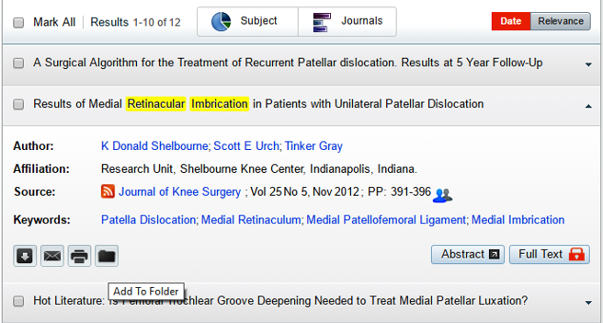
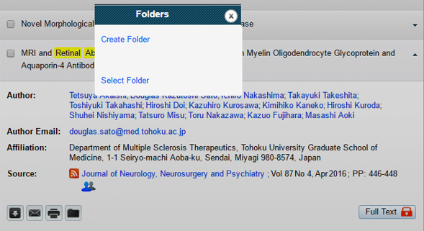
  3.
  Save / Store your favorite articles in personalized folders for quick and easy reference
Click on Folder Icon

Slide 26
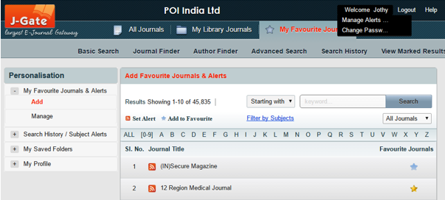
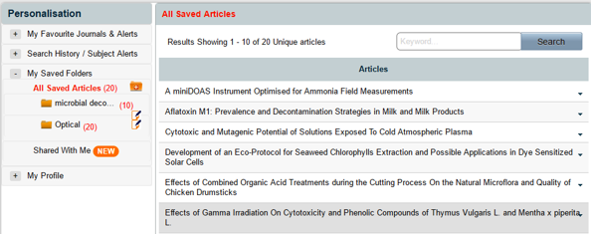
To Access Your Saved Folders
Click on Manage Alerts / Folders

Slide 27
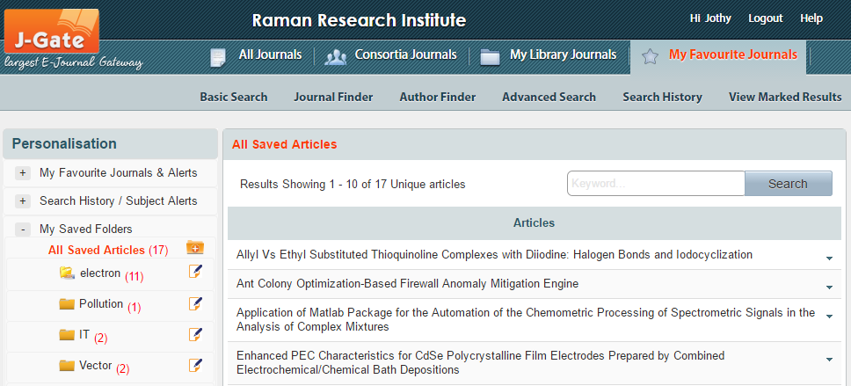
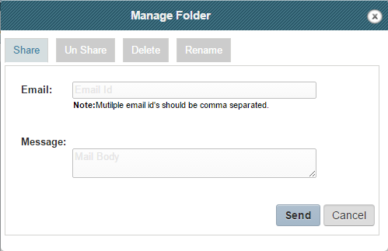
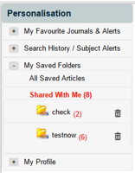
  4.
  Share your personalized folders with your fellow researchers or peers for collaboration and knowledge sharing.
Click Here to Manage Folder

Slide 28
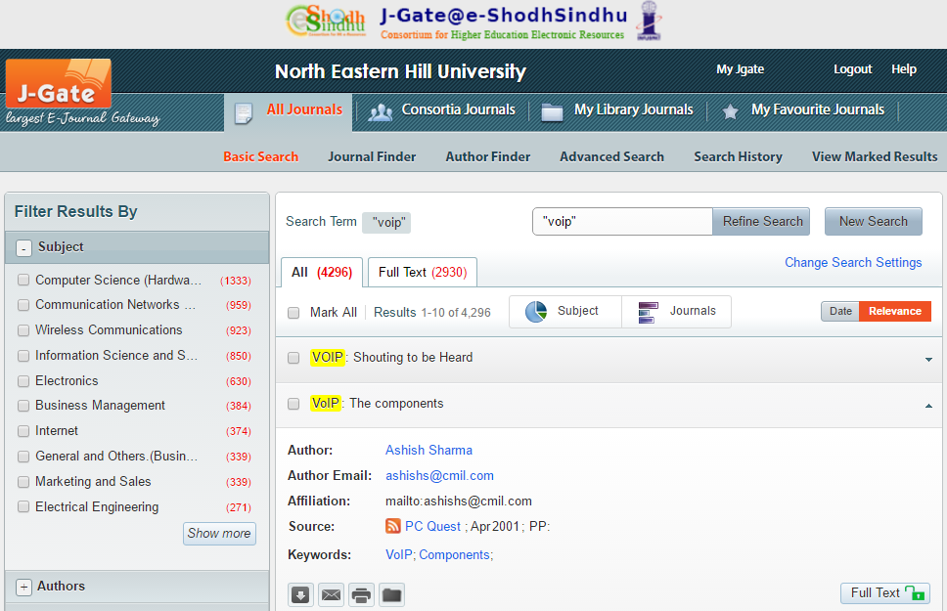
  5.
  Download / e-mail / print individual reference, directly from the search result page.
Selecting Individual Articles and Navigating to “View Marked Results” is Not Required.

Slide 29
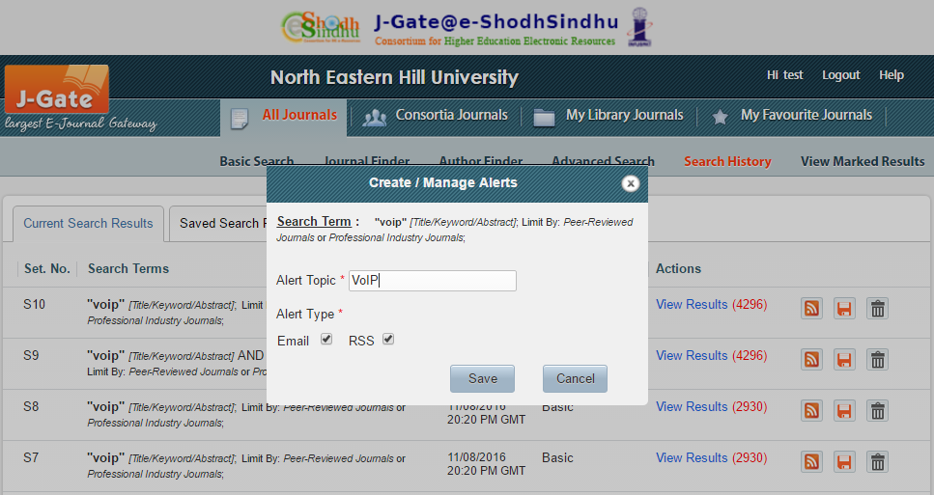
  6.
  Create and manage new article alert for the saved searches (RSS & Email).

Slide 30
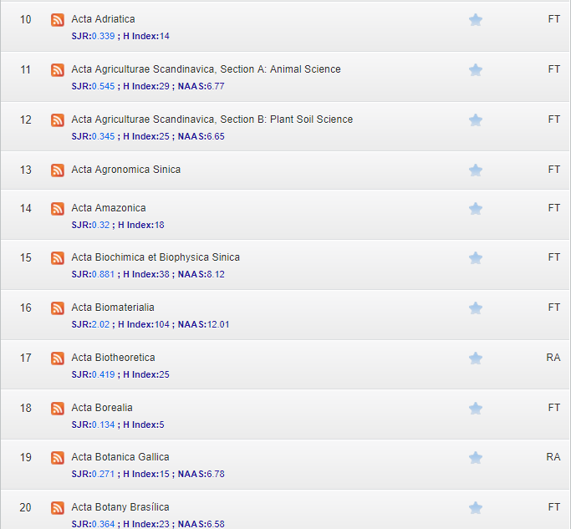
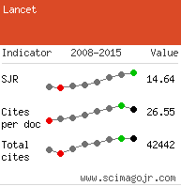
  7.
Display of Scimago Journal Ranking Citations, H-Index and NAAS Rating

Slide 31
About Informatics
Incorporated in 1980, Informatics is an early pioneer
in the business of e-Information in India. Built on nearly
4 decades of trust , driven by excellence, we pride
ourselves on providing a passage to knowledge and
a one stop solution for e-information worldwide.

Slide 32







Products of Informatics
Publishing Services:
Digitization
OJMS

Slide 33
www.jgateplus.com
ANY QUERIES???
jcoordinator@informaticsglobal.com

