Slide 1
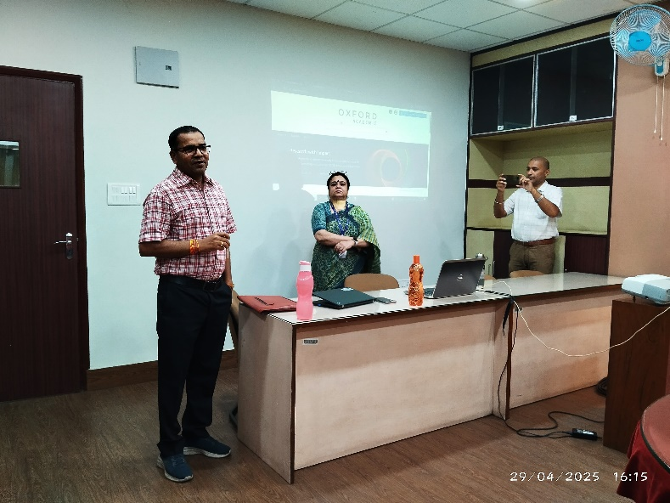
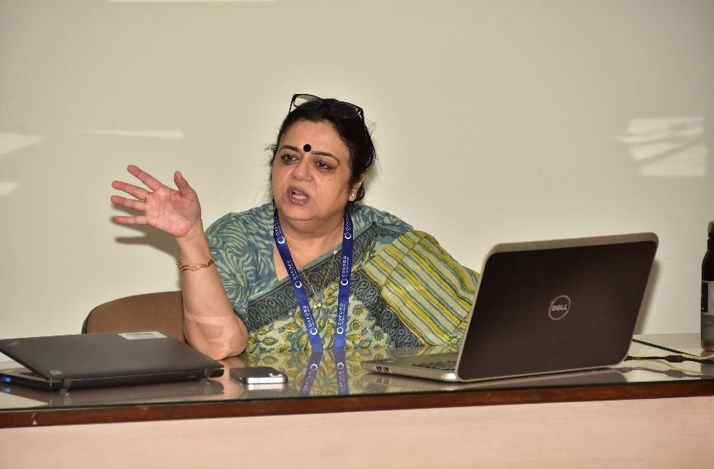
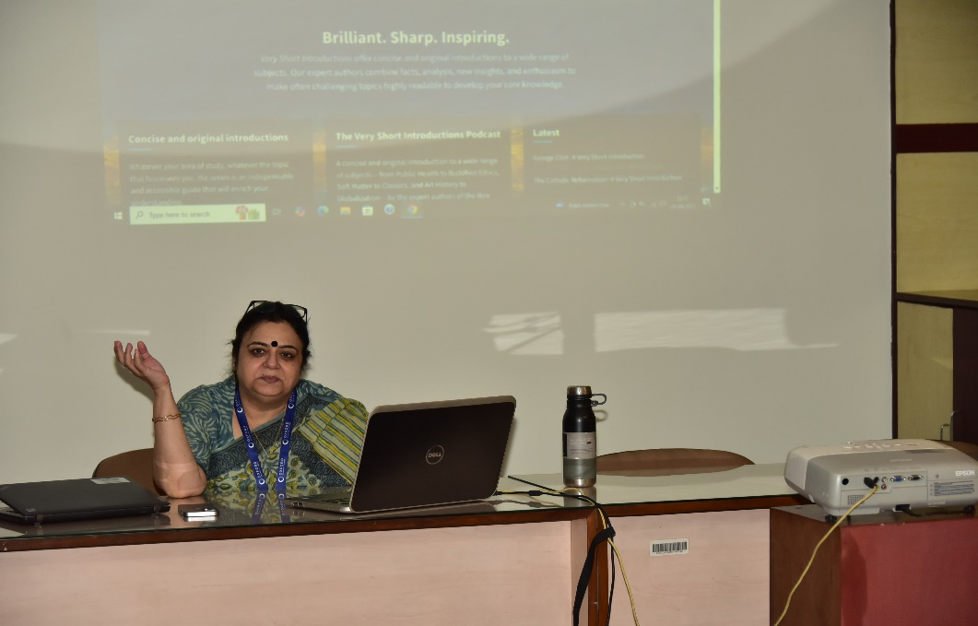

Indian Statistical Institute,Kolkata
“Oxford University Press” User Orientation Programme on April 29, 2025
LIBRARY EVENTS
1

