Slide 1
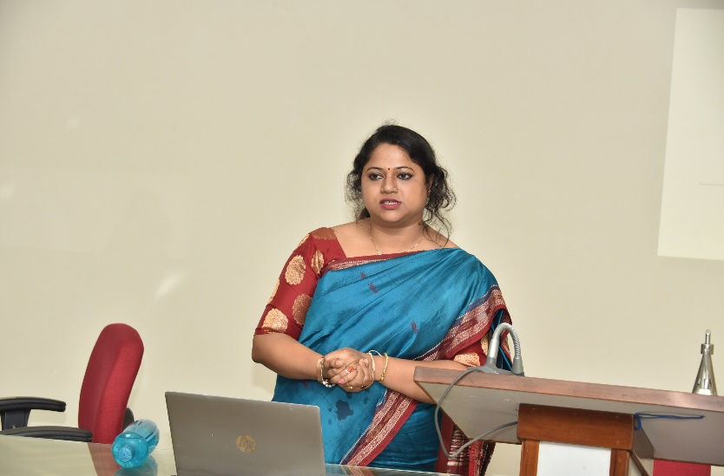
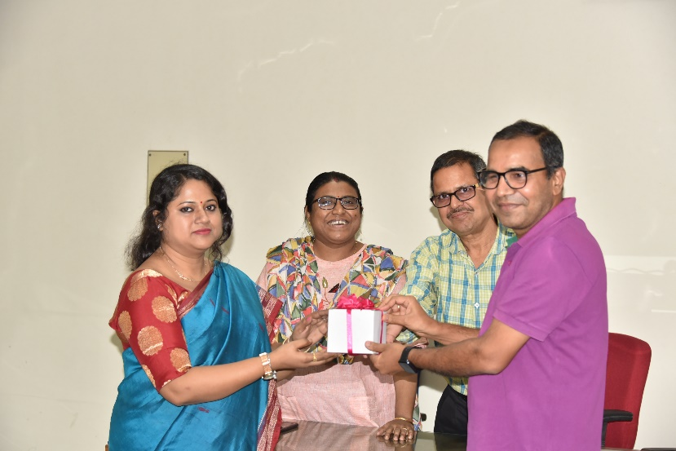
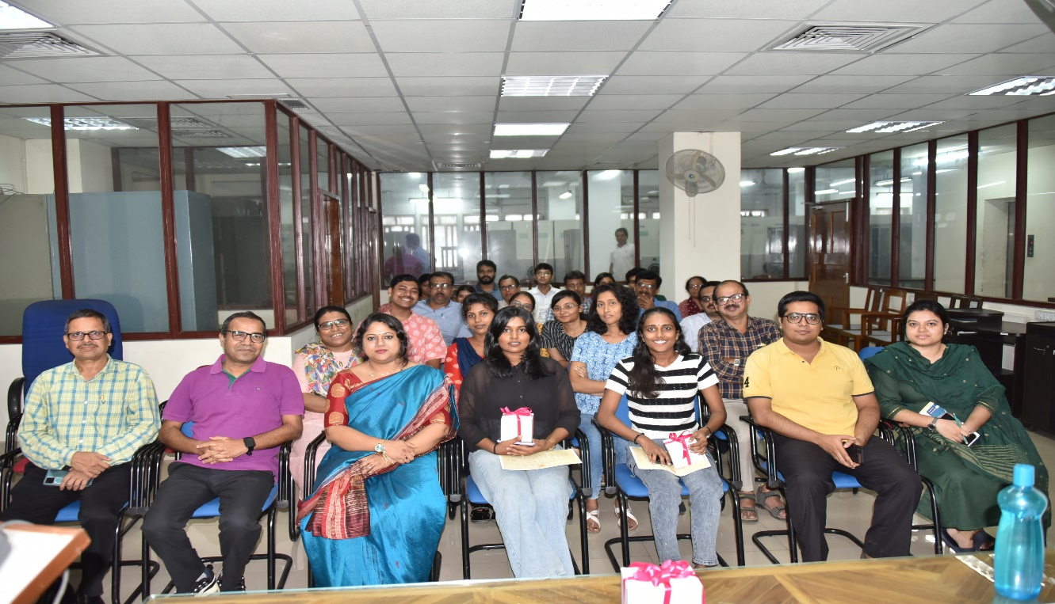

Indian Statistical Institute,Kolkata
Special Lecture on “Open Education Resources in Open Learning Environment”
July 03, 2024
LIBRARY EVENTS
1

