Slide 1
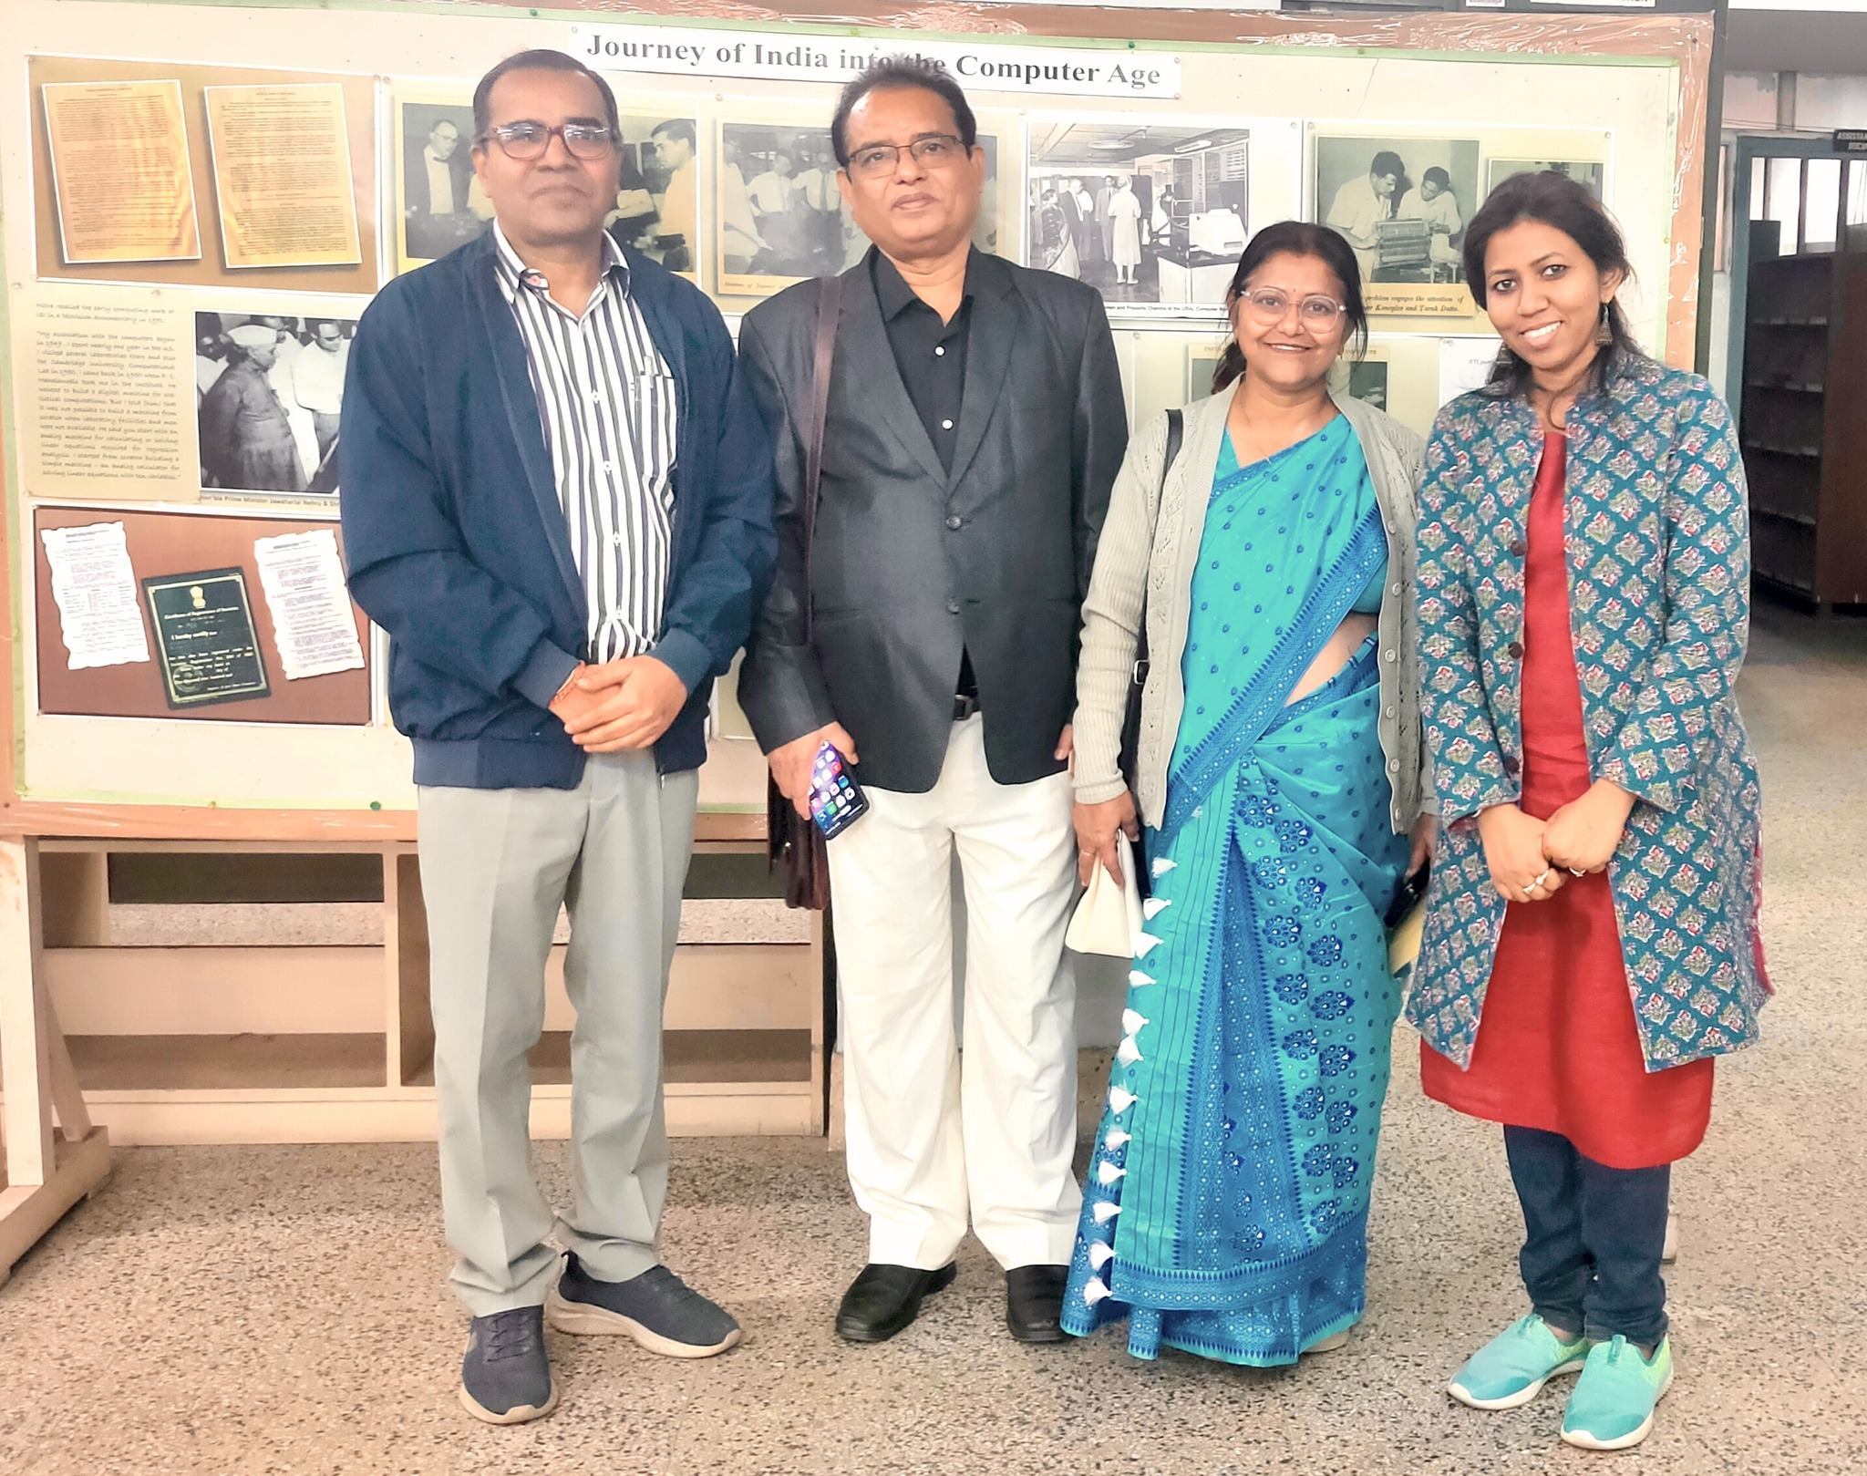
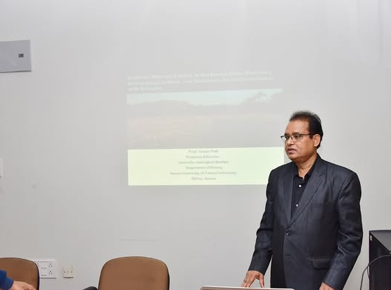
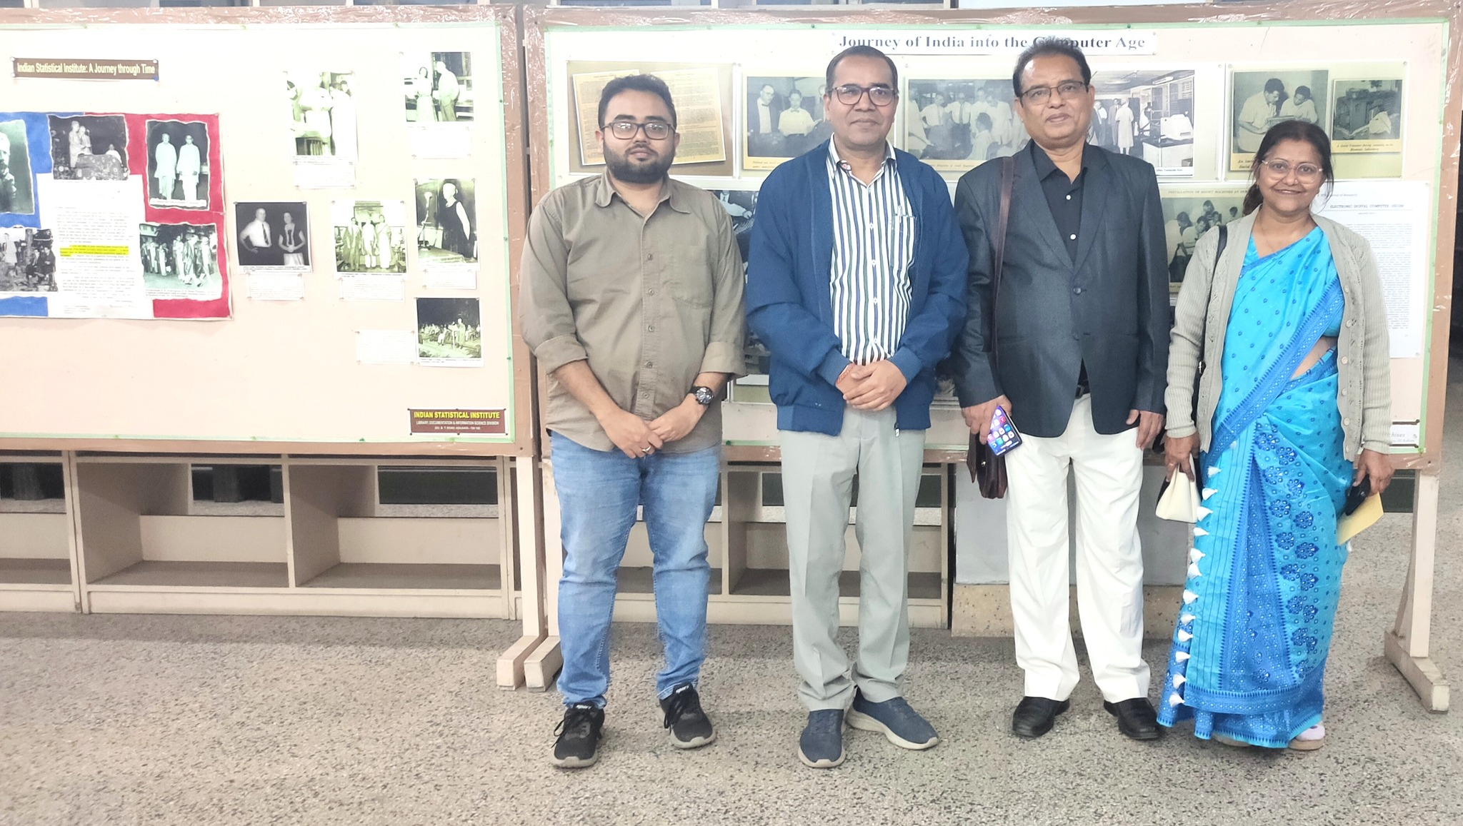
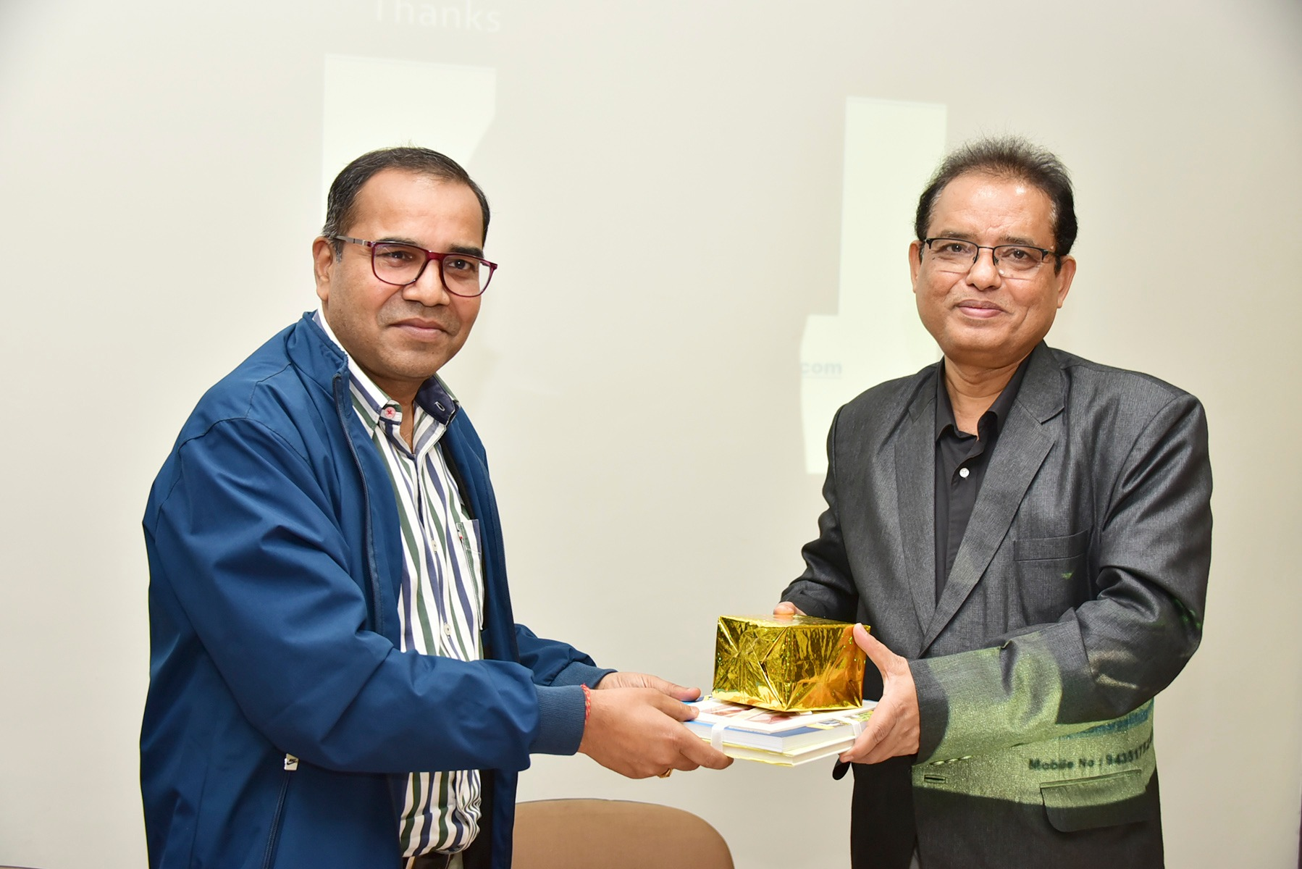

Indian Statistical Institute,Kolkata
“Buddhist Material Culture in Northeast India: Archaeological Sites, Museums, and Southeast Asian Connections with Nalanda” : A Special Lecture on February 09, 2026
LIBRARY EVENTS
1

