Slide 1
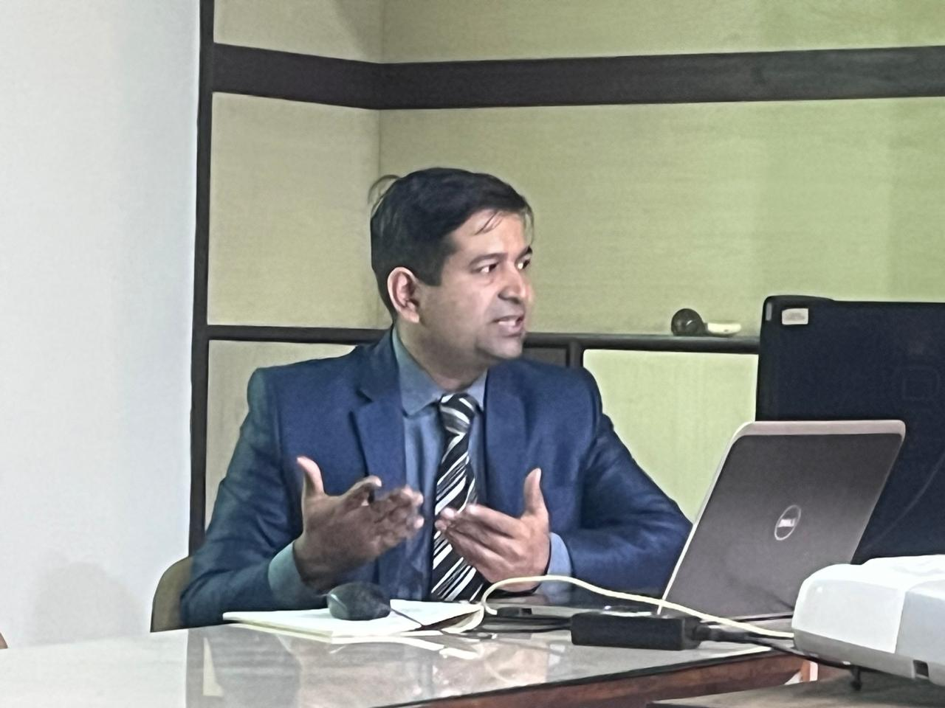
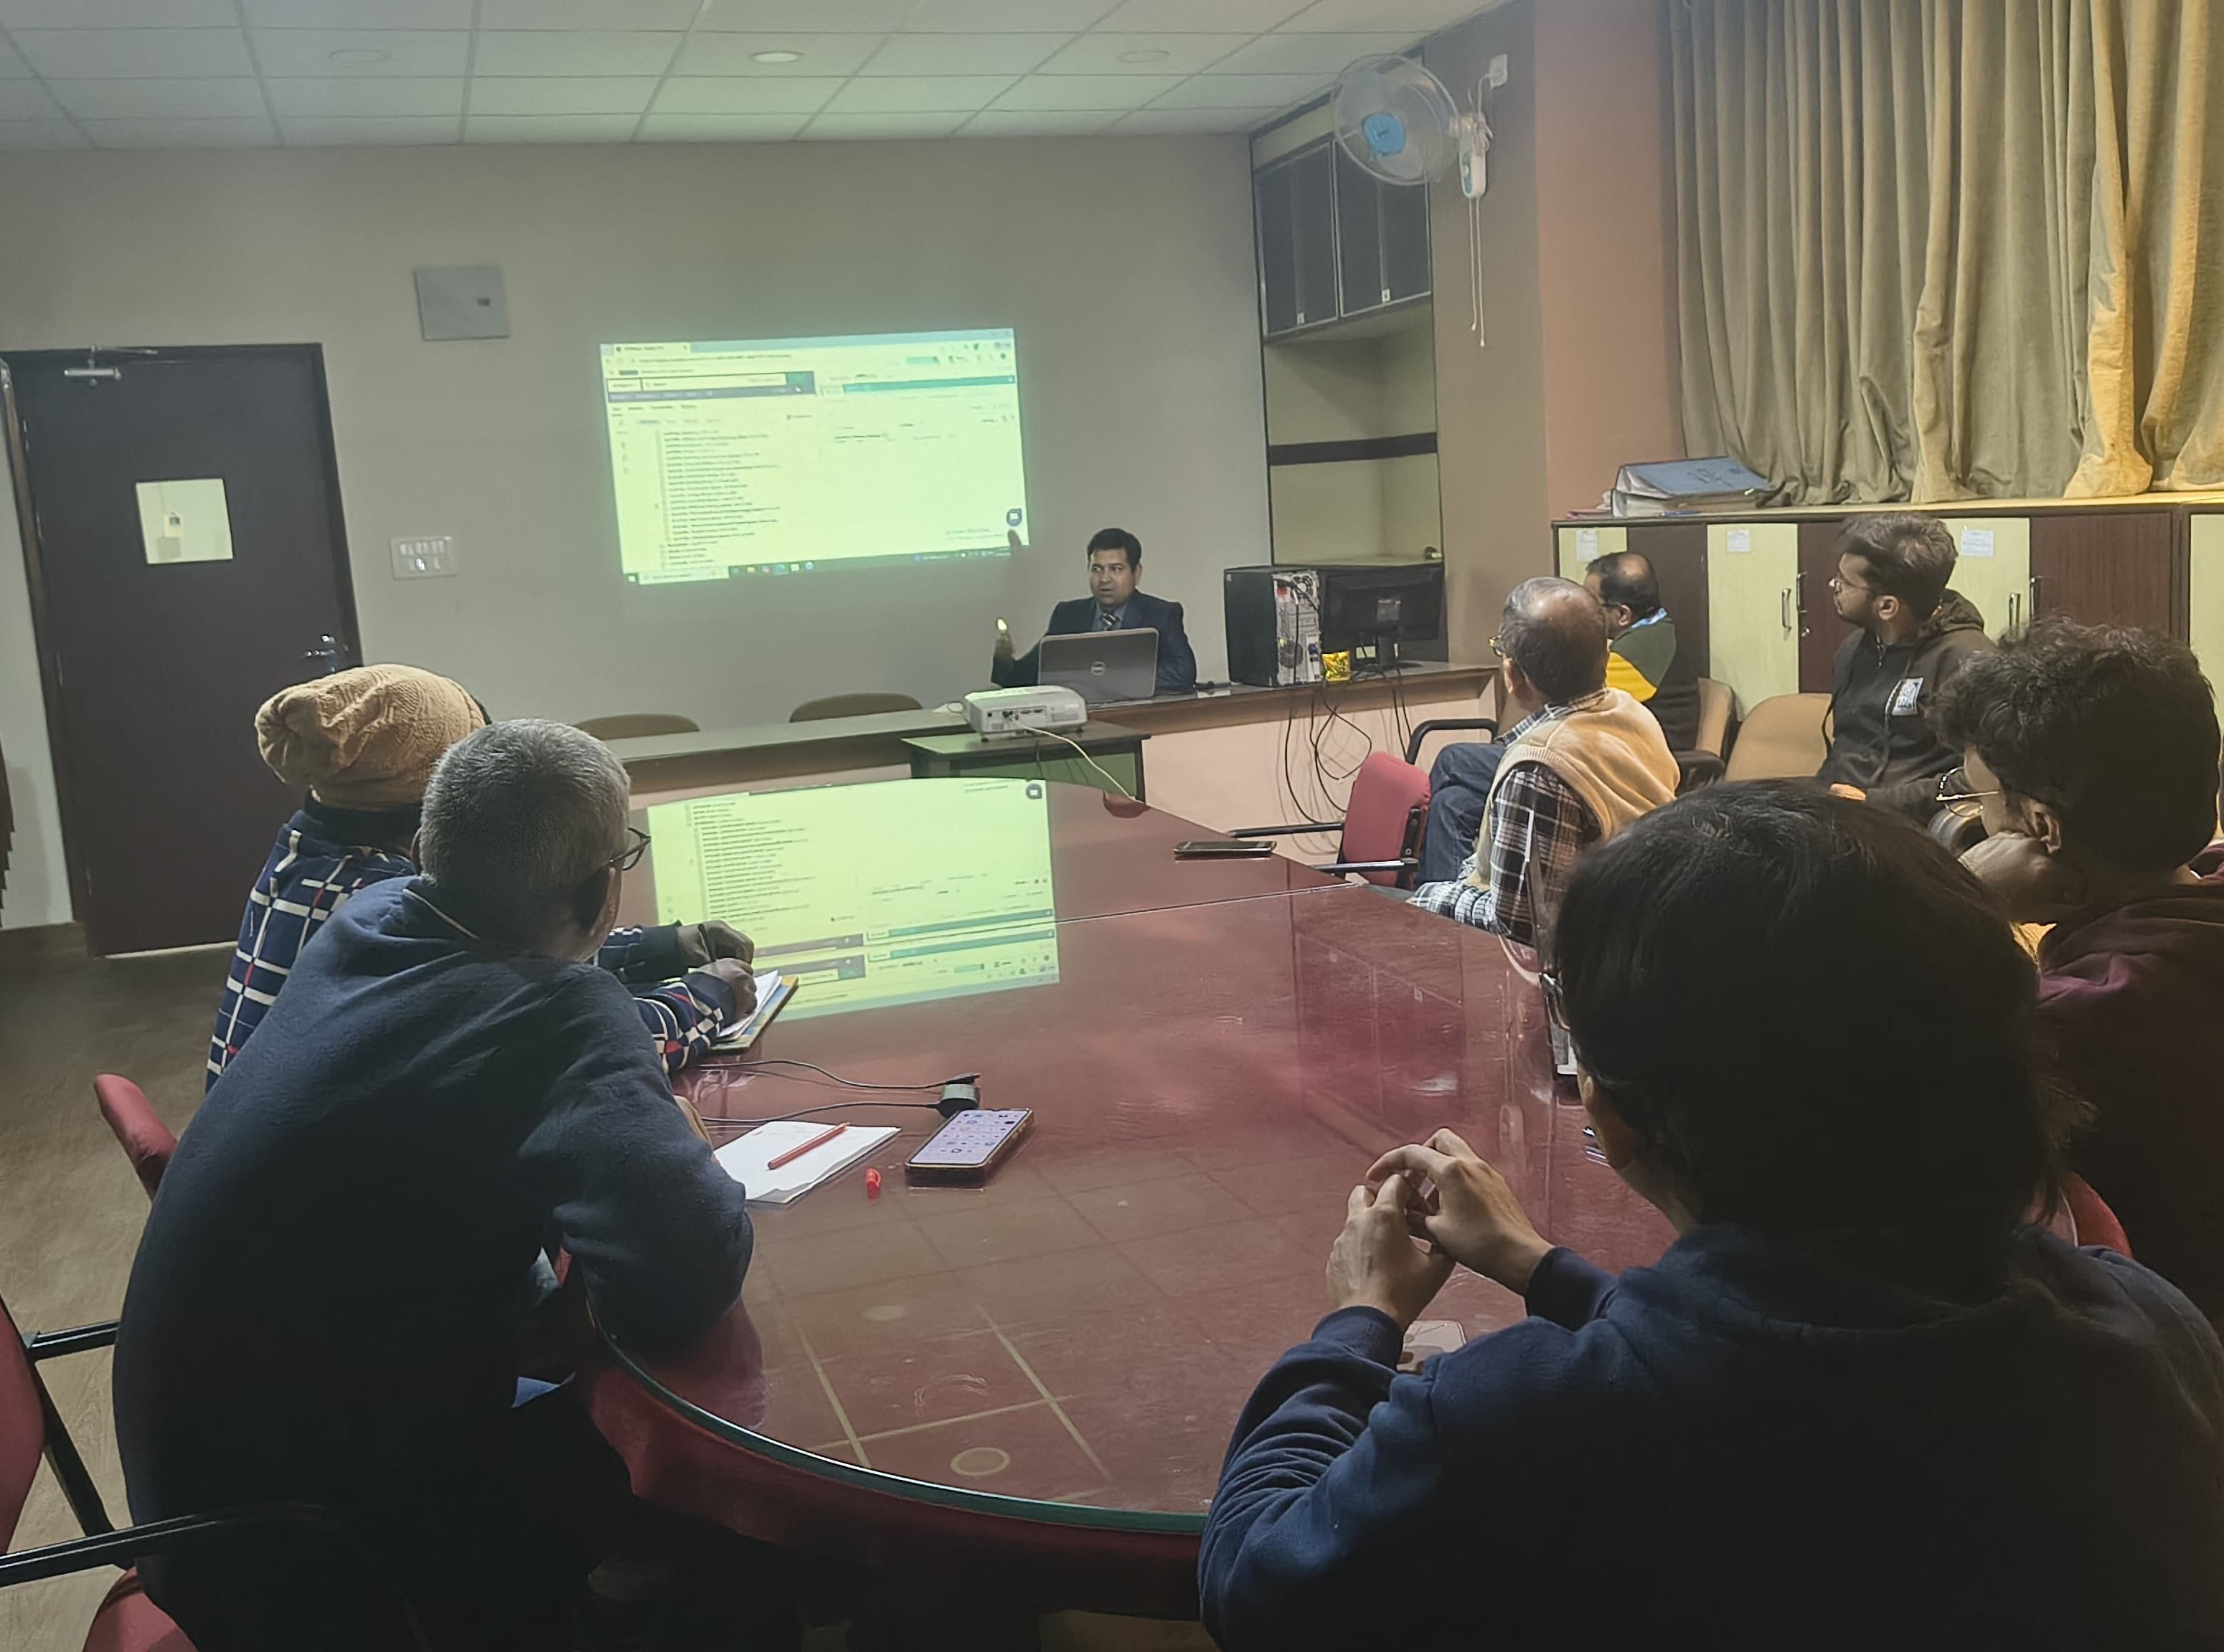
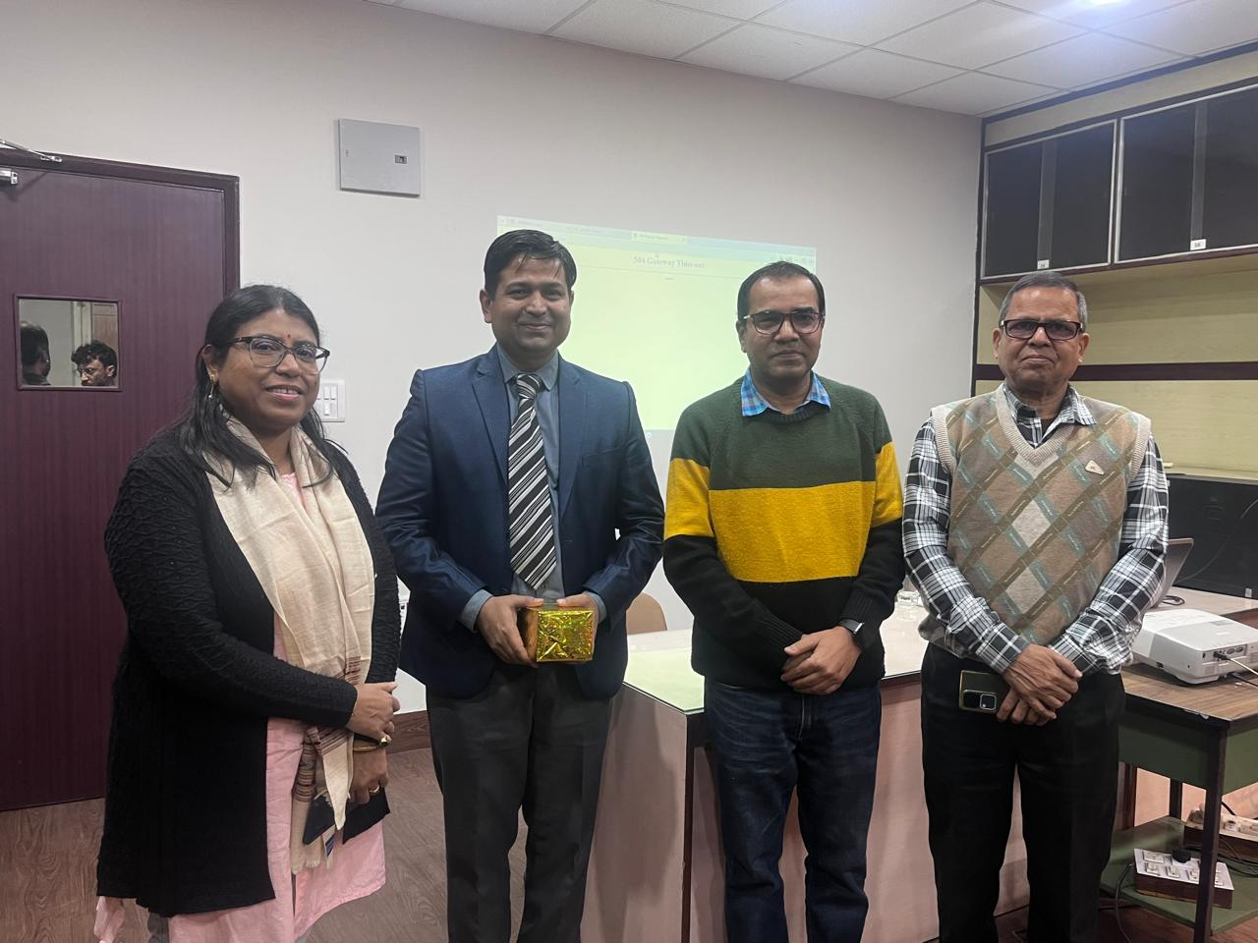
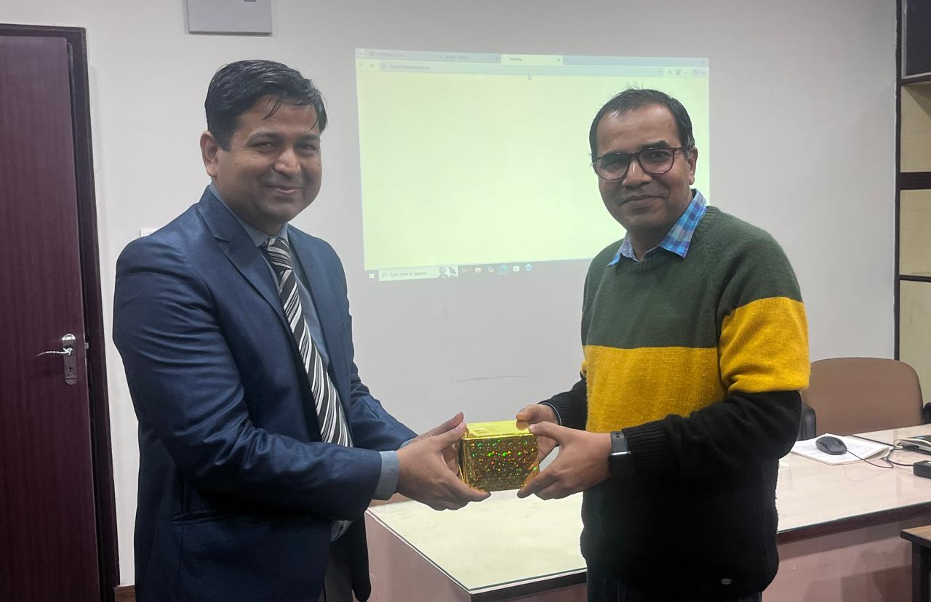

Indian Statistical Institute,Kolkata
“Changing Global Trade and Geopolitical Scenario tracking with help of CEIC Database”
Special Lecture on January 19, 2026
LIBRARY EVENTS
1

