Slide 1
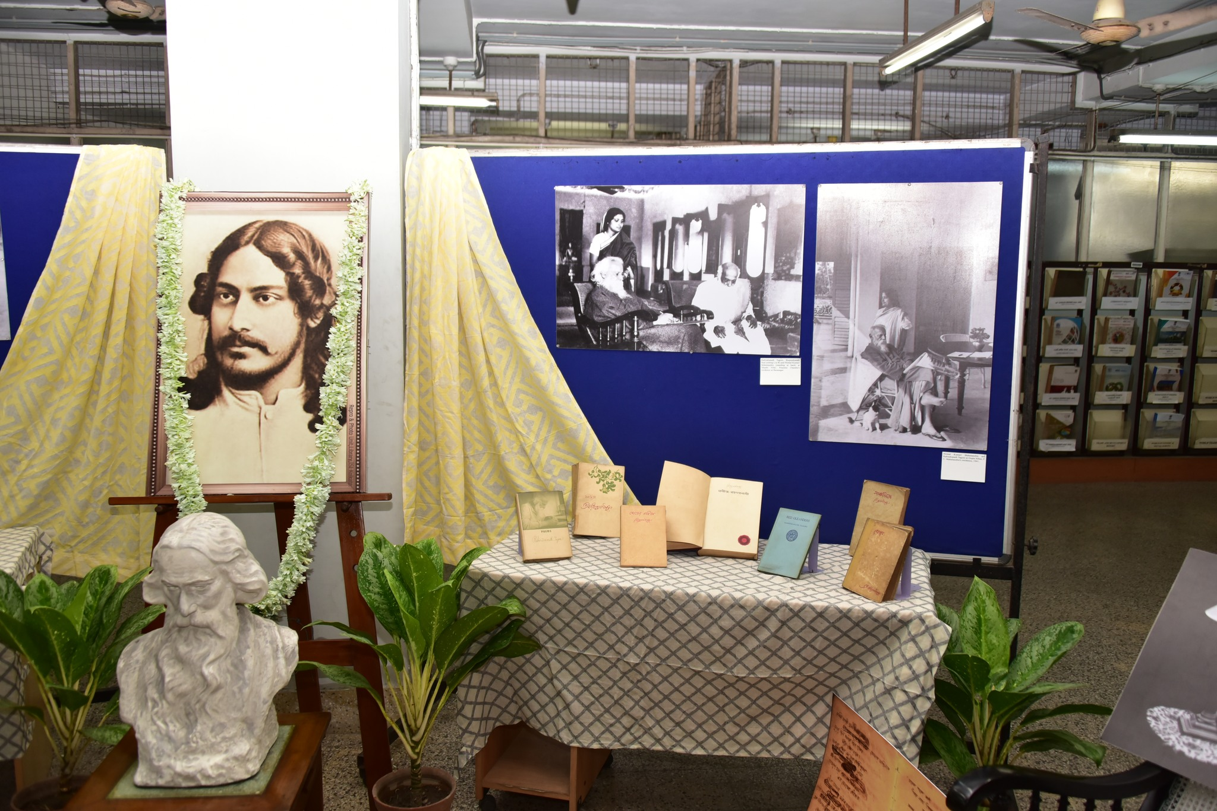
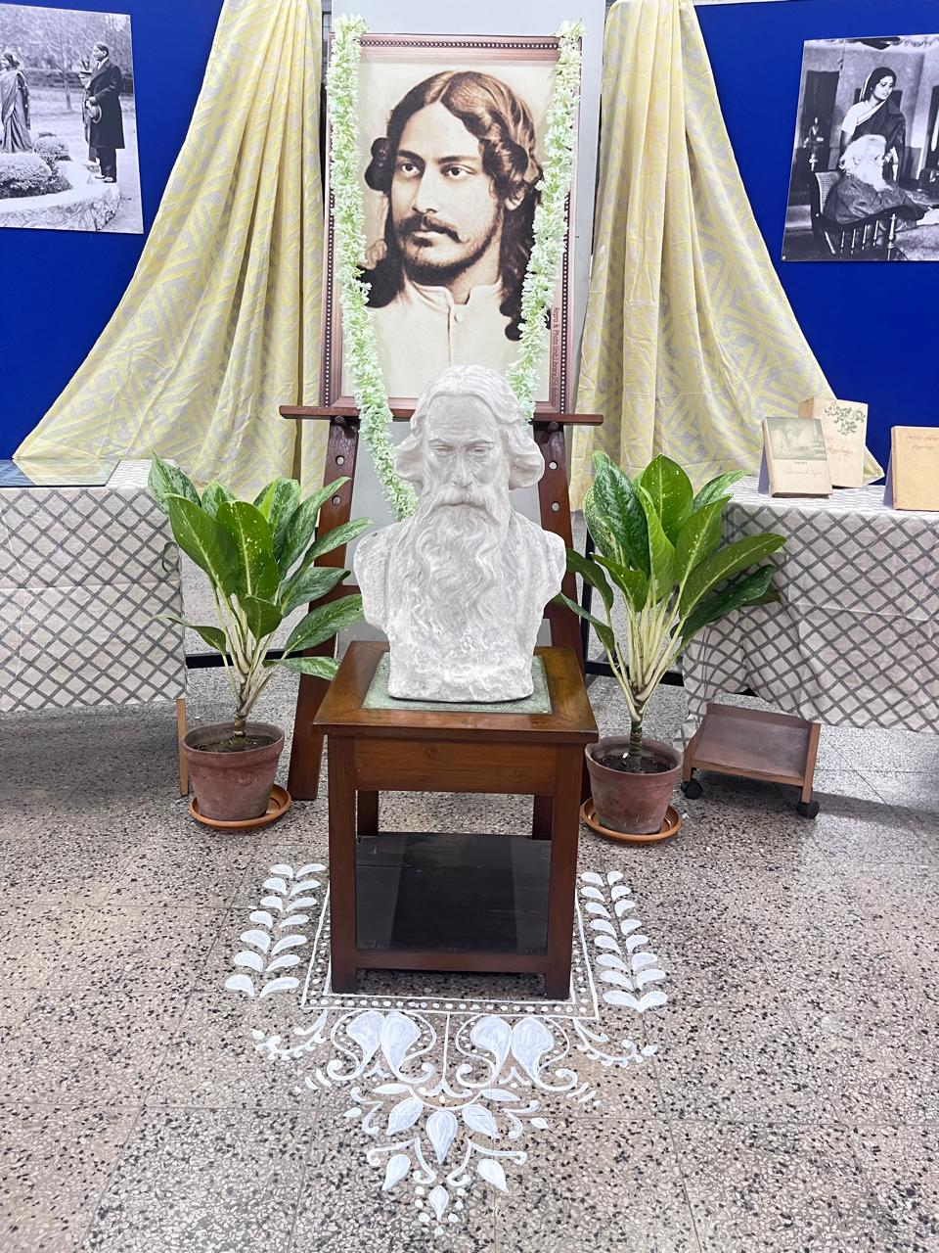
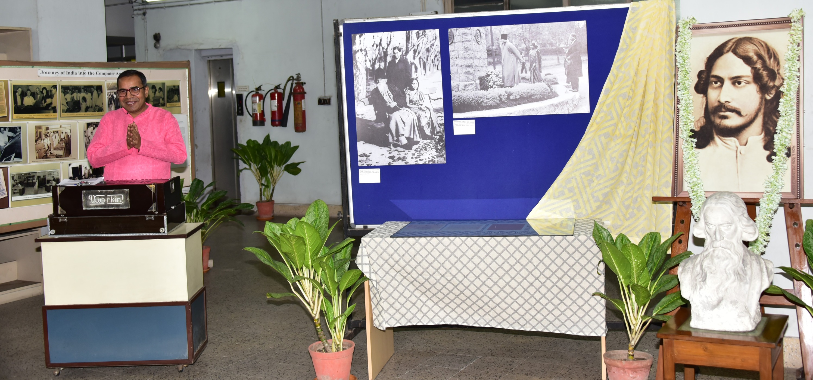
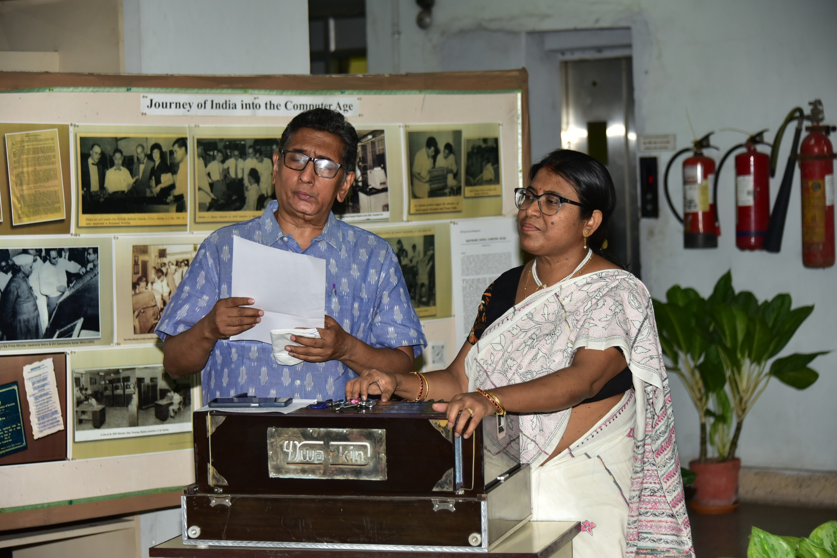
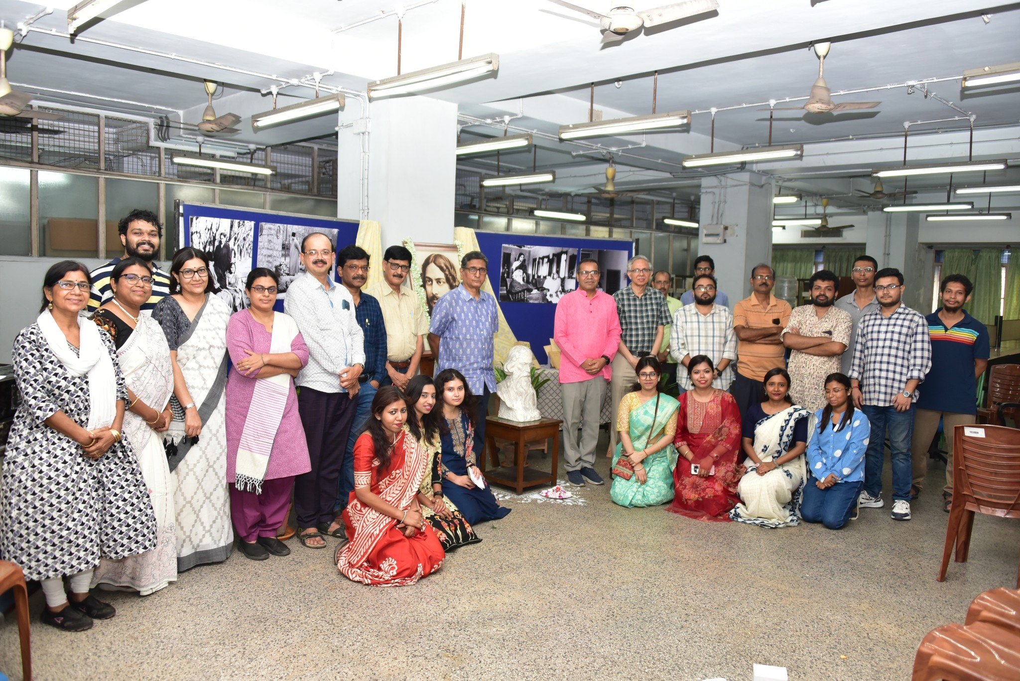
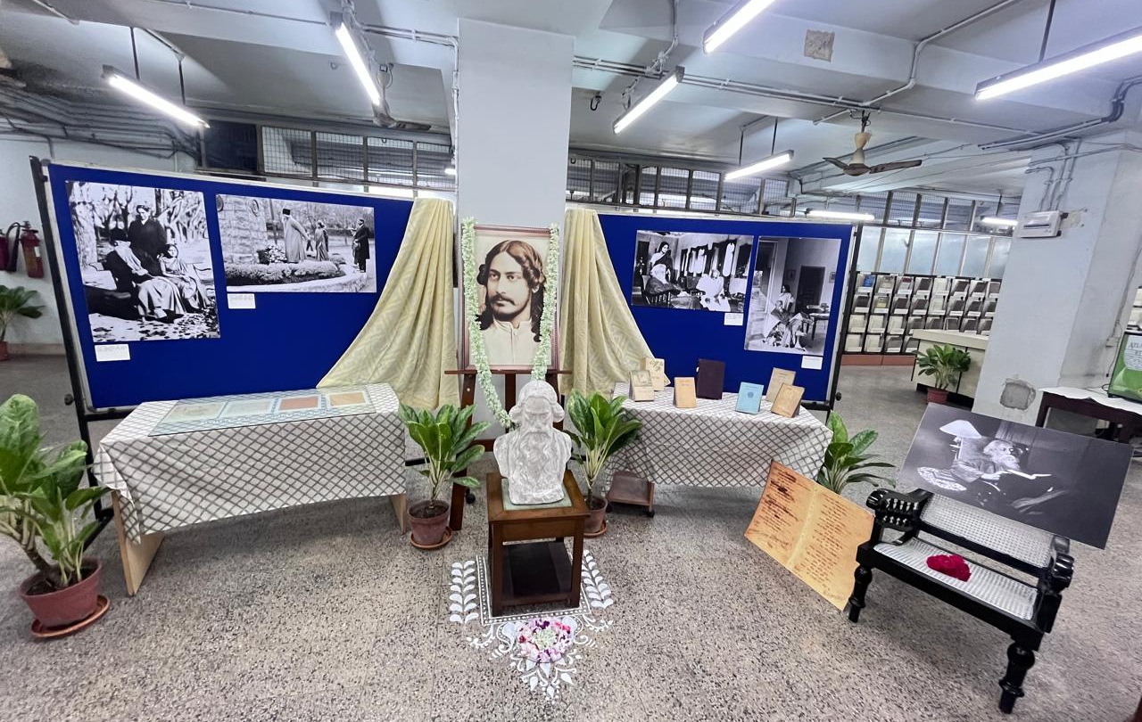

Indian Statistical Institute,Kolkata
Rabindra Jayanti Celebration on May 8, 2026
LIBRARY EVENTS
1

Slide 2
Indian Statistical Institute,Kolkata
Rbindra Jayanti Celebration on May 8, 2026
LIBRARY EVENTS
1

