Slide 1
Text Document Clustering
C. A. Murthy
Machine Intelligence Unit
Indian Statistical Institute
Text Mining Workshop 2014
Notes:
1

Slide 2
What is clustering?
Clustering provides the natural groupings in the dataset.
    Documents within a cluster should be similar.
    Documents from different clusters should be dissimilar.
The commonest form of unsupervised learning
    Unsupervised learning = learning from raw data, as opposed to supervised data where a classification of examples is given
A common and important task that finds many applications
in Information Retrieval, Natural Language Processing, Data
Mining etc.

Slide 3
Example of Clustering
.
.
.
.
.
.
.
.
.
.
.
.
.
.
.
.
.
.
.
.
.
.
.
.
.
.
.
.
.
.
.
.

Slide 4
What is a Good Clustering
A good clustering will produce high quality clusters in which:
  The intra-cluster similarity is high
  The inter-cluster similarity is low
  The quality depends on the data representation and the similarity
  measure used

Slide 5
Text Clustering
Clustering in the context of text documents:
organizing documents into groups, so that different groups correspond to different categories.
Text clustering is better known as Document Clustering
Example: Fruit
Apple Multinational Company
Newspaper (Hongkong)

Slide 6
Basic Idea
Task
  Evolve measures of similarity to cluster a set of documents
  The intra cluster similarity must be larger than the inter cluster similarity
Similarity
  Represent documents by TF- IDF scheme (the conventional one)
  Cosine of angle between document vectors
Issues
  Large number of dimensions (i.e., terms)
  Data Matrix is Sparse
  Noisy data (Preprocessing needed, e.g. stopword removal, feature selection)
Notes:
6

Slide 7
Document Vectors
  Documents are represented as bags of words
  Represented as vectors
    There will be a vector corresponding to each document
    Each unique term is the component of a document vector
    Data matrix is sparse as most of the terms do not exist in
    every document.

Slide 8
Document Representation
Boolean (term present /absent)
tf : term frequency – No. of times a term occurs in document.
  The more times a term t occurs in document d the more likely it is that t is relevant to the document.
df : document frequency – No. of documents in which the spec ific term occurs.
  The more a term t occurs throughout all documents, the more poorly t discriminates between documents
Notes:
8

Slide 9
Document Representation cont.
Weight of a Vector Component (TF-IDF scheme):
Notes:
9

Slide 10
Example
Number of terms = 6, Number of documents = 7
Word | Doc1 ( tf₁ ) | Doc2( tf₂ ) | Doc2( tf₃ ) | Doc4 ( tf₄ ) | Doc5 ( tf₅ ) | Doc6 ( tf₆ ) | Doc7 ( tf₇ ) | df | idf (N/df)
t₁ | 0 | 2 | 0 | 1 | 0 | 5 | 3 | 4 | 4/7
t₂ | 0 | 12 | 5 | 0 | 2 | 0 | 0 | 3 | 3/7
t₃ | 1 | 0 | 2 | 0 | 0 | 6 | 0 | 3 | 3/7
t₄ | 3 | 2 | 0 | 7 | 2 | 0 | 9 | 5 | 5/7
t₅ | 1 | 0 | 2 | 3 | 0 | 1 | 0 | 4 | 4/7
t₆ | 0 | 0 | 0 | 5 | 2 | 0 | 0 | 2 | 2/7
Notes:
10

Slide 11
Document Similarity
Notes:
11

Slide 12
Some Document Clustering Methods
Document
Clustering
Hierarchical
Agglomerative
Partitional
k-means
Bisecting
k-means
Buckshot
Single
Linkage
Complete
Linkage
Group
Average

Slide 13
Partitional Clustering
k-means
Method:
Input: D: {d₁,d₂,…d_{n} }; k: the cluster number
Steps: Select k document vectors as the initial centroids of k
clusters
Repeat
For i = 1,2,….n
Compute similarities between d_{i} and k centroids.
Put d_{i} in the closest cluster
End for
Recompute the centroids of the clusters
Until the centroids don’t change
Output: k clusters of documents
Notes:
13

Slide 14
Example of k-means Clustering
Pick seeds
Reassign clusters
Compute centroids
Reassign clusters
x
x
x
x
Compute centroids
x
Reassign clusters
Converged!

Slide 15
K-means properties
    Linear time complexity
    Works relatively well in low dimensional space
    Initial k centroids affect the quality of clusters
    Centroid vectors may not well summarize the cluster documents
Assumes clusters are spherical in vector space

Slide 16
Hierarchical Clustering
Build a tree-based hierarchical taxonomy (dendrogram) from a set of unlabeled examples.
animal
vertebrate
invertebrate
fish reptile amphib mammal worm insect crustacean

Slide 17
Dendrogram
  Clustering obtained by cutting the dendrogram at a desired level: each connected component forms a cluster.

Slide 18
Agglomerative vs. Divisive
Aglommerative (bottom-up) methods start with each example as a cluster and iteratively combines them to form larger and larger clusters.
Divisive (top-down) methods divide one of the existing clusters into two clusters till the desired no. of clusters is obtained.

Slide 19
Hierarchical Agglomerative Clustering (HAC)
Method:
Input : D={d₁,d₂,…d_{n} }
Steps: Calculate similarity matrix Sim[i,j]
Repeat
    Merge the two most similar clusters C₁ and C₂, to form a new cluster C_{0.}
    Compute similarities between C₀ and each of the remaining clusters and update Sim[i,j].
Until there remain(s) a single or specified number of cluster(s)
Output : Dendrogram of clusters
Notes:
19

Slide 20
Impact of Cluster Distance Measure
““ Single-Link” (inter-cluster distance =
distance between closest pair of points)
“Complete-Link”
(inter-cluster distance= distance between farthest pair of points)

Slide 21
Group-average Similarity based
Hierarchical Clustering
Instead of single or complete link, we can consider cluster distance in terms of average distance of all pairs of documents from each cluster
Problem: n*m similarity computations for each pair of clusters of size n and m respectively at each step

Slide 22
Bisecting k-means
Divisive partitional clustering technique
Method:
Input: D : {d₁,d₂,…d_{n} }, k: No. of clusters
Steps: Initialize the list of clusters to contain the cluster of all
points
Repeat
Select the largest cluster from the list of clusters
Bisect the selected cluster using basic k-means (k = 2)
Add these two clusters in the list of clusters
Until the list of clusters contain k clusters
Output: k clusters of documents
Notes:
22

Slide 23
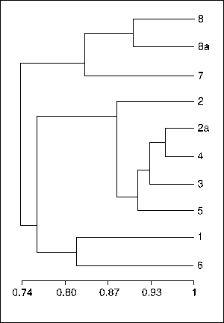
Buckshot Clustering
Hybrid Method
Cut where
You have k
clusters
Combines HAC and k-Means clustering.
Method:
Randomly take a sample of documents of size √kn
Run group-average HAC on this sample to produce k
clusters, which takes only O(kn) time.
Use the results of HAC as initial seeds for k-means.
Overall algorithm is O(kn) and tries to avoid the problem of bad seed selection.
Initial √kn documents may not represent all the
categories e.g., where the categories are diverse in size

Slide 24
Issues related to Cosine Similarity
  It has become famous as it is length invariant
  It measures the content similarity of the documents as the
  number of shared terms.
  No bound on how many shared terms can identify the
  similarity
  Cosine similarity may not represent the following
  phenomenon
  Let a, b, c be three documents. If a is related to b and c, then b is somehow related to c.

Slide 25
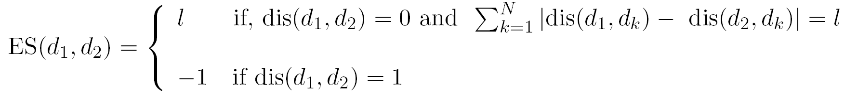
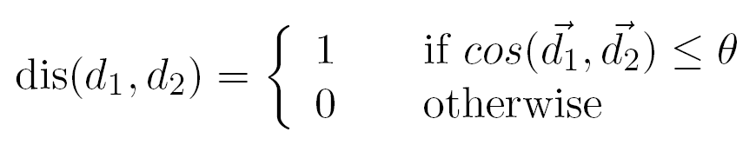
Extensive Similarity
A new similarity measure is introduced to overcome the restrictions of cosine similarity
Extensive Similarity (ES) between documents d₁ and d₂ :
where dis(d₁,d₂) is the distance between d₁ and d₂
where
Notes:
25

Slide 26
Illustration:
Assume θ = 0.2
Sim (d_{i}, d_{j}) : i, j = 1,2,3,4 dis (d_{i}, d_{j}) matrix : i, j = 1,2,3,4
 | d₁ | d₂ | d₃ | d₄
d₁ | 1 | 0.05 | 0.39 | 0.47
d₂ | 0.05 | 1 | 0.16 | 0.50
d₃ | 0.39 | 0.16 | 1 | 0.43
d₄ | 0.47 | 0.50 | 0.43 | 1
 | d₁ | d₂ | d₃ | d₄
d₁ | 0 | 1 | 0 | 0
d₂ | 1 | 0 | 1 | 0
d₃ | 0 | 1 | 0 | 0
d₄ | 0 | 0 | 0 | 0
ES (d_{i},d_{j}) : i, j = 1,2,3,4
 | d₁ | d₂ | d₃ | d₄
d₁ | 0 | -1 | 0 | 1
d₂ | -1 | 0 | -1 | 2
d₃ | 0 | -1 | 0 | 1
d₄ | 1 | 2 | -1 | 0

Slide 27
Effect of ‘θ’ on Extensive Similarity
If then the documents d₁ and d₂ are
dissimilar
If and θ is very high, say 0.65. Then
d_{1,} d₂ are very likely to have similar distances with the other documents.

Slide 28

Properties of Extensive Similarity
Consider d₁ and d₂ be a pair of documents.
ES is symmetric i.e., ES (d_{1,} d₂) = ES (d_{2,} d₁)
If d₁= d₂ then ES (d_{1,} d₂) = 0.
ES (d_{1,} d₂) = 0 => dis(d_{1,} d₂) =0 and
But dis(d_{1,} d₂) = 0 ≠> d₁=d₂ . Hence ES is not a metric
Triangular inequality is satisfied for non negative ES values
for any d₁ and d₂. However the only such value is -1.

Slide 29
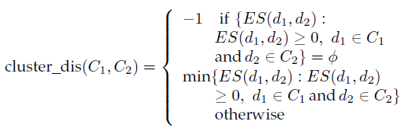
CUES: Clustering Using Extensive Similarity
(A new Hierarchical Approach)
Distance between Clusters:
It is derived using extensive similarity
The distance between the nearest two documents becomes the cluster distance
Negative cluster distance indicates no similarity between clusters

Slide 30
CUES: Clustering Using Extensive Similarity cont.
Algorithm:
Input : 1) Each document is taken as a cluster
2) A similarity matrix whose each entry is the cluster distance between two singleton clusters.
Steps:
1) Find those two clusters with minimum cluster distance.
Merge them if the cluster distance between them is non-
negative.
2) Continue till no more merges can take place.
Output: Set of document clusters

Slide 31
CUES: Illustration
dis (d_{i},d_{j}) matrix ES (d_{i},d_{j}) matrix
 | d₁ | d₂ | d₃ | d₄ | d₅ | d₆
d₁ | 0 | 0 | 1 | 1 | 1 | 0
d₂ | 0 | 0 | 0 | 1 | 1 | 1
d₃ | 1 | 0 | 0 | 1 | 1 | 1
d₄ | 1 | 1 | 1 | 0 | 0 | 1
d₅ | 1 | 1 | 1 | 0 | 0 | 1
d₆ | 1 | 1 | 1 | 1 | 1 | 0
 | d₁ | d₂ | d₃ | d₄ | d₅ | d₆
d₁ | × | 2 | -1 | -1 | -1 | 1
d₂ | 2 | × | 1 | -1 | -1 | -1
d₃ | -1 | 1 | × | -1 | -1 | -1
d₄ | -1 | -1 | -1 | × | 0 | -1
d₅ | -1 | -1 | -1 | 0 | × | -1
d₆ | 1 | -1 | -1 | -1 | -1 | ×
Cluster set = {{d₁},{d₂},{d₃},{d₄},{d₅},{d₆}}

Slide 32
CUES: Illustration
ES (d_{i},d_{j}) matrix
 | d₁ | d₂ | d₃ | d₄ | d₅ | d₆
d₁ | × | 2 | -1 | -1 | -1 | 1
d₂ | 2 | × | 1 | -1 | -1 | -1
d₃ | -1 | 1 | × | -1 | -1 | -1
d₄ | -1 | -1 | -1 | × | 0 | -1
d₅ | -1 | -1 | -1 | 0 | × | -1
d₆ | 1 | -1 | -1 | -1 | -1 | ×
Cluster set = {{d₁},{d₂},{d₃},{d₄,d₅},{d₆}}

Slide 33
CUES: Illustration
ES (d_{i},d_{j}) matrix
 | d₁ | d₂ | d₃ | d₄ | d₆
d₁ | × | 2 | -1 | -1 | 1
d₂ | 2 | × | 1 | -1 | -1
d₃ | -1 | 1 | × | -1 | -1
d₄ | -1 | -1 | -1 | × | -1
d₆ | 1 | -1 | -1 | -1 | ×
Cluster set = {{d₁},{d₂},{d₃},{d₄,d₅},{d₆}}

Slide 34
CUES: Illustration
ES (d_{i},d_{j}) matrix
 | d₁ | d₂ | d₃ | d₄ | d₆
d₁ | × | 2 | -1 | -1 | 1
d₂ | 2 | × | 1 | -1 | -1
d₃ | -1 | 1 | × | -1 | -1
d₄ | -1 | -1 | -1 | × | -1
d₆ | 1 | -1 | -1 | -1 | ×
Cluster set = {{d₁},{d₂,d₃},{d₄,d₅},{d₆}}
34

Slide 35
CUES: Illustration
ES (d_{i},d_{j}) matrix
 | d₁ | d₂ | d₄ | d₆
d₁ | × | 2 | -1 | 1
d₂ | 2 | × | -1 | -1
d₄ | -1 | -1 | × | -1
d₆ | 1 | -1 | -1 | ×
Cluster set = {{d₁},{d₂,d₃},{d₄,d₅},{d₆}}

Slide 36
CUES: Illustration
ES (d_{i},d_{j}) matrix
 | d₁ | d₂ | d₄ | d₆
d₁ | × | 2 | -1 | 1
d₂ | 2 | × | -1 | -1
d₄ | -1 | -1 | × | -1
d₆ | 1 | -1 | -1 | ×
Cluster set = {{d₁,d₆},{d₂,d₃},{d₄,d₅}}

Slide 37
CUES: Illustration
ES (d_{i},d_{j}) matrix
 | d₁ | d₂ | d₄
d₁ | × | 2 | -1
d₂ | 2 | × | -1
d₄ | -1 | -1 | ×
Cluster set = {{d₁,d₆},{d₂,d₃},{d₄,d₅}}

Slide 38
CUES: Illustration
ES (d_{i},d_{j}) matrix
 | d₁ | d₂ | d₄
d₁ | × | 2 | -1
d₂ | 2 | × | -1
d₄ | -1 | -1 | ×
Cluster set = {{d₁,d₆,d₂,d₃},{d₄,d₅}}

Slide 39
CUES: Illustration
ES (d_{i},d_{j}) matrix
 | d₁ | d₄
d₁ | × | -1
d₄ | -1 | ×
Cluster set = {{d₁,d₆,d₂,d₃},{d₄,d₅}}

Slide 40
Salient Features
  The number of clusters is determined automatically
  It can identify two dissimilar clusters and never merge them
  The range of similarity values of the documents of each cluster
  is known
  No external stopping criterion is needed
  Chaining effect is not present
  A histogram thresholding based method is proposed to fix the
  value of the parameter θ

Slide 41

Validity of Document Clusters
“The validation of clustering structures is the most difficult and frustrating part of cluster analysis.
Without a strong effort in this direction, cluster analysis will remain a black art accessible only to those true believers who have experience and great courage.”
Algorithms for Clustering Data, Jain and Dubes
Notes:
41

Slide 42
Evaluation Methodologies
How to evaluate clustering?
  Internal:
    Tightness and separation of clusters (e.g. k-means objective)
    Fit of probabilistic model to data
  External:
    Compare to known class labels on benchmark data
Improving search to converge faster and avoid local minima.
Overlapping clustering.

Slide 43
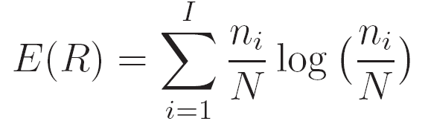
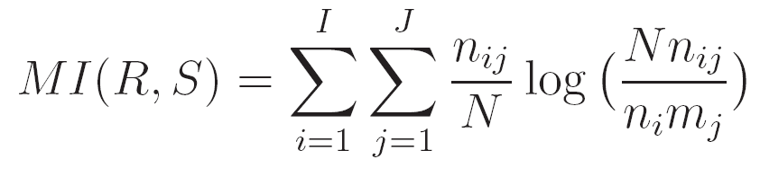
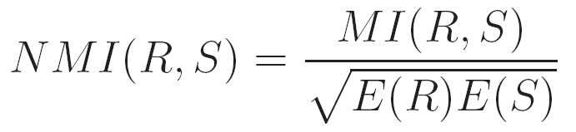
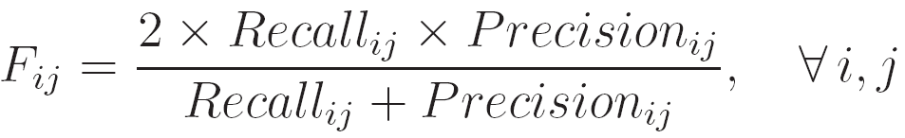

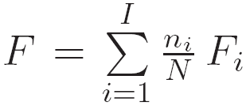
Evaluation Methodologies cont.
I = Number of actual classes, R = Set of classes
J = Number of clusters obtained , S = Set of clusters
N= Number of documents in the corpus
n_{i} = number of documents belong to class I, m_{j} = number of documents belong to cluster j
n_{i,j} =number of documents belong to both class I and cluster j
Normalized Mutual Information
F-measure
Let cluster j be the retrieval result of class i then the f-measure for class i is as follow :
The F-measure for all the cluster :

Slide 44
Text Datasets
(freely available)
20-newsgroups data is collection of news articles collected from 20 different
sources. There are about 19,000 documents in the original corpus. We have
developed a data set 20ns by randomly selecting 100 documents from each
category.
Reuters-21578 is a collection of documents that appeared on Reuters
newswire in 1987. The data sets rcv1, rcv2, rcv3 and rcv4 is the Modapte
version of the Reuters-21578 corpus, each containing 30 categories
Some other well known text data sets* are developed in the lab of Prof.
Karypis of University of Minnesota, USA, which is better known as Karypis
Lab (http://glaros.dtc.umn.edu/gkhome/index.php).
  fbis, hitech, la, tr are collected from TREC (Text REtrieval Conference, http://trec.nist.gov)
  oh10, oh15 are taken from OHSUMED, a collection containing the title, abstract etc. of the papers from medical database MEDLINE.
  wap is collected from the WebACE project
  _______________________________________________________________
  * http://www-users.cs.umn.edu/~han/data/tmdata.tar.gz

Slide 45
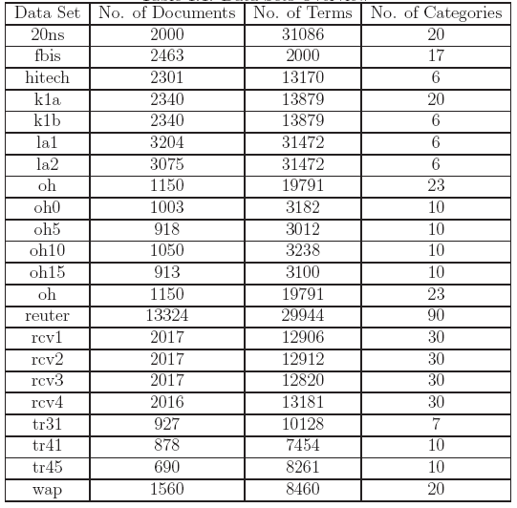
Overview of Text Datasets
Notes:
45

Slide 46
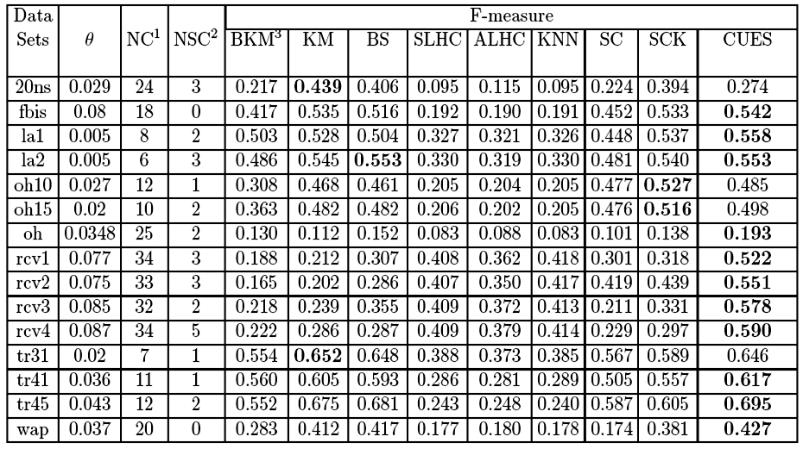
Experimental Evaluation
0.43
0.542
0.558
0.553
0.553
0.52
0.51
0.193
0.522
0.551
0.578
0.590
0.65
0.617
0.695
0.427
NC : Number of clusters; NSC : No. of singleton clusters; BKM: Bisecting k-means, KM: k-means
SLHC: Single-link hierarchical clustering; ALHC: Average-link hierarchical clustering; KNN : k nearest
neighbor clustering; SC: Spectral clustering; SCK: Spectral clustering with kernel;
Notes:
46

Slide 47
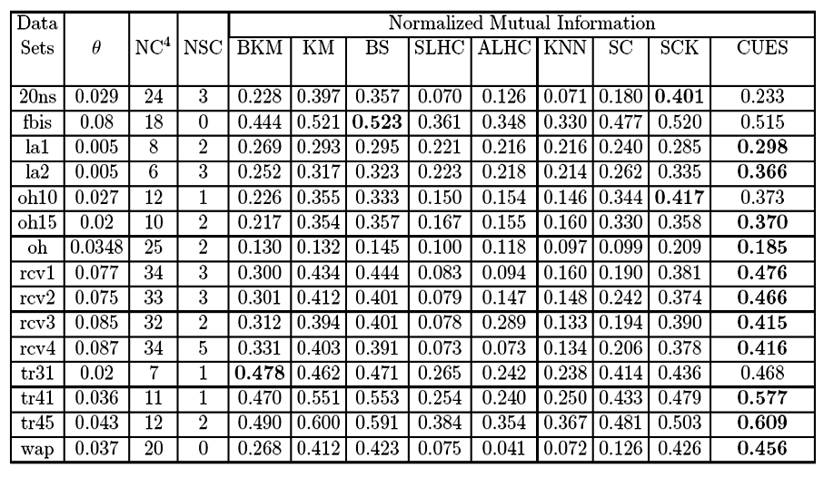
Experimental Evaluation cont.
0.40
0.52
0.298
0.366
0.41
0.370
0.185
0.476
0.466
0.415
0.416
0.47
0.577
0.609
0.456
Notes:
47

Slide 48
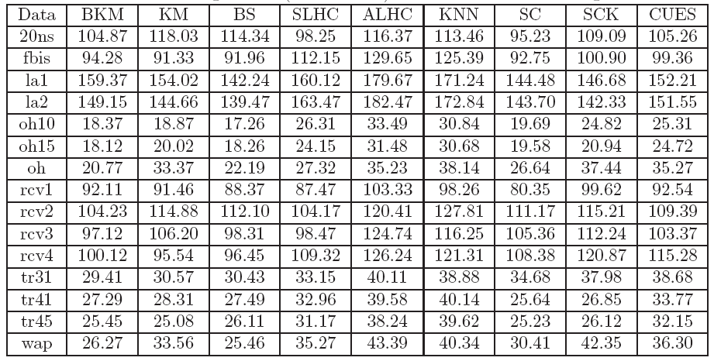
Computational Time

Slide 49
Discussions
Methods are heuristic in nature. Theory needs to be developed.
Usual clustering algorithms are not always applicable since the no. of dimensions is large and the data is sparse.
Many other clustering methods like spectral clustering, non negative matrix factorization are also available.
Bi clustering methods are also present in the literature.
Dimensionality reduction techniques will help in better clustering.
The literature on dimensionality reduction techniques is mostly limited to feature ranking.
Cosine similarity measure !!!

Slide 50

R. C. Dubes and A. K. Jain. Algorithms for Clustering Data. Prentice Hall, 1988.
R. Duda and P. Hart. Pattern Classification and Scene Analysis. J. Wiley and Sons, 1973.
P. Berkhin. Survey of clustering data mining techniques. Grouping Multidimensional
Data, pages 25–71, 2006.
M. Steinbach, G. Karypis, and V. Kumar. A comparison of document clustering
techniques. In Text Mining Workshop, KDD 2000.
D. R. Cutting, D. R. Karger, J. O. Pedersen, and J.W. Tukey. Scatter/gather: A
cluster-based approach to browsing large document collections. In International
Conference on Research and Development in Information Retrieval, SIGIR’93,
pages 126–135, 1993.
T. Basu and C.A. Murthy. Cues: A new hierarchical approach for document clustering.
Journal of Pattern Recognition Research, 8(1):66–84, 2013.
A. Strehl and J. Ghosh. Cluster ensembles - a knowledge reuse framework for
combining multiple partitions. The Journal of Machine Learning Research, 3:583–617,
2003.

Slide 51
Thank You !

