Slide 1

Real-time Dehazing of Videos Using Color Uniformity Principle
Prof. Sumana Gupta
Dr Himanshu Kumar
IIT Kanpur
February 27, 2019
Prof. Sumana Gupta
February 27, 2019
1 / 34

Slide 2
Introduction
Introduction
The visual range of a scene is considerably reduced in the presence of haze or fog.
Scattered light from particles and water droplets appears as haze/fog.
Nayar¹ Hazing/fogging process is modeled as in following Equation (1) based on scattering of light.
I(x) = Jt + (1 − t )A
t(x)=exp(-βd(x))
Here, I is the observed hazy image, t is transmittance, A is atmospheric scattering parameter and J is scene radiance.
(1)
¹ Shree K Nayar and Srinivasa G Narasimhan. “Vision in bad weather”. In: Computer Vision, 1999. The Proceedings of the Seventh IEEE International Conference on. Vol. 2. IEEE. 1999, pp. 820–827.
Prof. Sumana Gupta
February 27, 2019
2 / 34

Slide 3
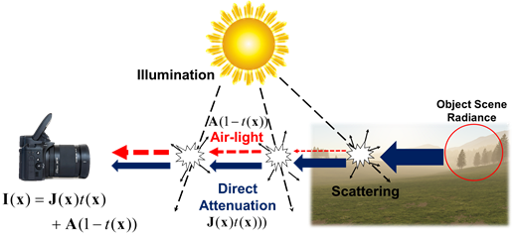
Dehazing Model
Introduction
Figure: Dehazing model.
Prof. Sumana Gupta
February 27, 2019
3 / 34

Slide 4
Introduction...........cont...........
Introduction
We estimate t and A to recover the scene radiance.
State of the art methods such as Dark Channel Prior², Sulami’s method³ are used to estimate A.
Dark Channel Prior states that minimum intensity present in any patch among all color planes is close to 0 for any natural image.
Sulami uses color lines of the patches to obtain the A.
While, for t estimation, methods such as haze-line , color line, dark channel etc exist.
Usually, these methods works well in low haze conditions and are highly sensitive to estimated A.
State of the art methods have large processing time requirement hence are not suitable for real-time applications.
² Kaiming He, Jian Sun, and Xiaoou Tang. “Single image haze removal using dark channel prior”. In: IEEE transactions on pattern analysis and machine intelligence 33.12 (2011), pp. 2341–2353.
³ Matan Sulami et al. “Automatic Recovery of the Atmospheric Light in Hazy Images”.
I
4 / 34

Slide 5
Dark Channel Prior (DCP)
Introduction
The dark channel prior⁴ states that in the haze-free patches, at least one color channel has some pixels whose intensity values are very low and even close to zero.
The dark channel is defined as the minimum of all pixel colors in a local patch:
D (x ) = min
(min (I^{c} (y )))
(2)
y ∈Ωr (x ) c∈{r,g,b}
where I^{c} is a RGB color channel of I and Ω_{r} (x ) is a local patch centered at x with the size of r × r .
⁴ He, Sun, and Tang, “Single image haze removal using dark channel prior”.
Prof. Sumana Gupta
February 27, 2019
5 / 34

Slide 6
Dark.............cont
Introduction
The dark channel is used to determine the amount of haze in the image by estimating the medium transmission t (x ) and atmospheric scattering parameter A.
Then, the radiance J is recovered using estimated transmission t (x ) and atmospheric scattering parameter A.
However, the dark channel prior is applicable only for outdoor images. Also, the dark channel prior does not hold true for reflecting surfaces.
Prof. Sumana Gupta
February 27, 2019
6 / 34

Slide 7
Color Attenuation Prior (CAP)
Introduction
Color Attenuation Prior (CAP)⁵ states that the brightness and the saturation of pixels in a hazy image vary sharply with haze concentration.
The depth information is recovered by creating a linear model for modeling the scene depth of the hazy image under this prior.
d (x ) ∝ c (x ) ∝ v (x ) − s (x ),
(3)
The parameters of the model are learnt with a supervised learning method.
⁵ Qingsong Zhu, Jiaming Mai, and Ling Shao. “Single Image Dehazing Using Color Attenuation Prior.”. In: BMVC. Citeseer. 2014.
Prof. Sumana Gupta
February 27, 2019
7 / 34

Slide 8
CAP..............cont
Introduction
We estimate the transmission and restore the scene radiance using the atmospheric scattering model with the depth map of the hazy image.
I(x ) = A,
^{d (x ) ≥ d}thresold .
(4)
The following linear depth model is used for this purpose.
d (x ) = θ₀ + θ₁v (x ) + θ₂s (x ) + ε(x ), (5)
learning resulted in the following parameters θ₀ = 0.121779, θ₁ = 0.959710 and θ₂ = −0.780245 and ε ∼ N(0, σ = 0.041337).
The proposed model may not be true in general.
Hence, dehazing may result in erroneous recovery of radiance.
Prof. Sumana Gupta
February 27, 2019
8 / 34

Slide 9
Multi-Scale Convolutional Neural Networks(MSCNN)
Introduction
The method⁶ uses multi-scale convolutional neural networks for dehazing by learning the mapping between hazy images and their corresponding transmission maps.
The proposed algorithm consists of a coarse-scale net which predicts a holistic transmission map based on the entire image and a fine-scale net which refines results locally.
To train the multi-scale deep network, method used dataset comprised of hazy images and corresponding transmission maps obtained using NYU Depth dataset.
However, performance of the method is sensitive to choice of training set used. The method is usually suitable for synthetic hazy images.
⁶ Wenqi Ren et al. “Single image dehazing via multi-scale convolutional neural networks”. In: European conference on computer vision. Springer. 2016, pp. 154–169.
Prof. Sumana Gupta
February 27, 2019
9 / 34

Slide 10
Dehazenet
Introduction
Dehazenet⁷ is a trainable end-to-end system which adopts convolutional neural network-based deep architecture for transmission map estimation.
The atmospheric scattering parameter is recovered using dark channel prior.
The haze-free image is recovered using atmospheric scattering model.
However, performance of the method is depends upon choice of training set and usually suitable in presence of thin haze conditions.
⁷ Bolun Cai et al. “Dehazenet: An end-to-end system for single image haze removal”.
In: IEEE Transactions on Image Processing 25.11 (2016), pp. 5187–5198.
Prof. Sumana Gupta

Slide 11
All-in-One Dehazing Network (AOD-Net)
Introduction
All-in-One Dehazing Network⁸ uses dehazing model built with a convolutional neural network.
It is designed based on a re-formulated atmospheric scattering model.
Instead of estimating the transmission matrix and the atmospheric light separately, AOD-Net directly generates the clean image through a light-weight CNN.
However, performance is dependent upon the training set.
⁸ Boyi Li et al. “Aod-net: All-in-one dehazing network”. In: Proceedings of the IEEE International Conference on Computer Vision. Vol. 1. 4. 2017, p. 7.
Prof. Sumana Gupta

Slide 12
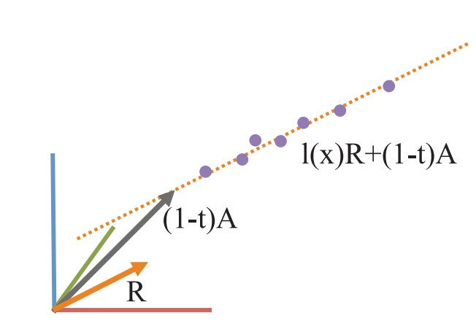
Colorline
Introduction
This method⁹ relies on a generic regularity in natural images where pixels of small image patches typically exhibit a 1D distribution in RGB color space, known as color-lines.
The radiance J is expressed as radiance magnitude l (x ) and relative intensity of each color channel of the reflected light R¯,
J (x ) = l (x )R¯ , x ∈ Ω
(6)
I(x) = t l (x )R¯ + (1 − t )A = l (x )R + (1 − t )A,
x ∈ Ω (7)
⁹ Raanan Fattal. “Dehazing using color-lines”. In: ACM Transactions on Graphics
Prof. Sumana Gupta
(TOG) 34.1 (2014), p. 13.

Slide 13
Colorline
Introduction
Formation model of the color-lines is used for recovering the scene transmission based on the offset of these lines.
Atmospheric scattering parameter is estimated using dark channel prior.
The scene radiance is recovered using estimated transmission map and atmospheric scattering parameter.
Performance of the method depends on accuracy of atmospheric scattering parameter. The method works well under thin haze conditions.
Prof. Sumana Gupta

Slide 14
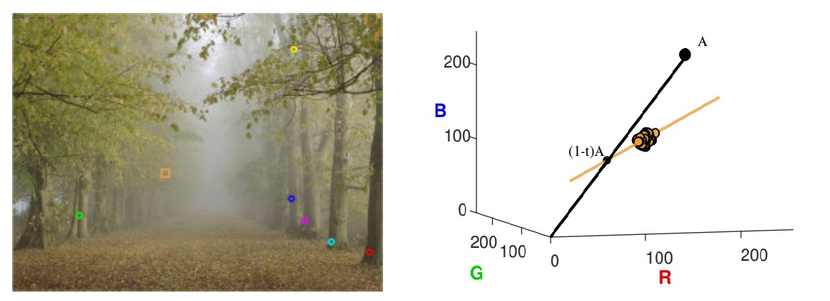
Colorline Example
Introduction
Figure: Example of Color-line; Pixels of orange patch form color-line in RGB plane.
Prof. Sumana Gupta

Slide 15
Haze-line
Introduction
The method¹⁰ relies on the assumption that colors of a haze-free image are well approximated by a few hundred distinct colors, that form tight clusters in RGB space.
The key observation is that pixels in a given cluster are often non-local, i.e., they are spread over the entire image plane and are located at different distances from the camera.
In the presence of haze these varying distances translate to different transmission coefficients. Therefore, each color cluster in the clear image becomes a line in RGB space, that is termed as haze-line.
Using these haze-lines, method recovers the transmission map.
The method performs well under thin haze condition and performance depends upon accuracy of atmospheric scattering parameter.
¹⁰ Dana Berman and Shai Avidan. “Non-local image dehazing”. In: Proceedings of the IEEE conference on computer vision and pattern recognition. 2016, pp. 1674–1682.
Prof. Sumana Gupta

Slide 16
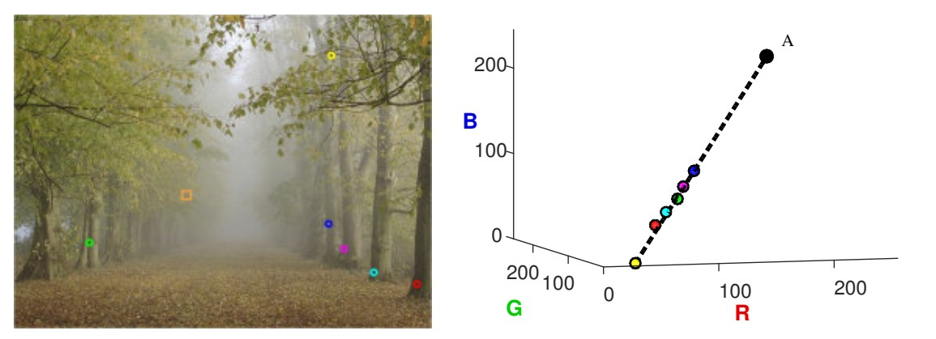
Haze-line Example
Introduction
Figure: Example of Haze-line; pixels in circle form Haze-line in RGB plane.
Prof. Sumana Gupta

Slide 17
Color Uniformity Principle
Proposed System
Non-uniformity of an object’s texture results in variation of color.
Objects at very large distances such as sky depicts a property of low color variation.
Color uniformity of large regions arise due to the presence of high defocus value and large space quantization.
Higher color uniformity denotes higher depth hence higher degree of haze/fog.
Transmittance map is estimated by measuring the uniformity of color in a local window.
Prof. Sumana Gupta

Slide 18
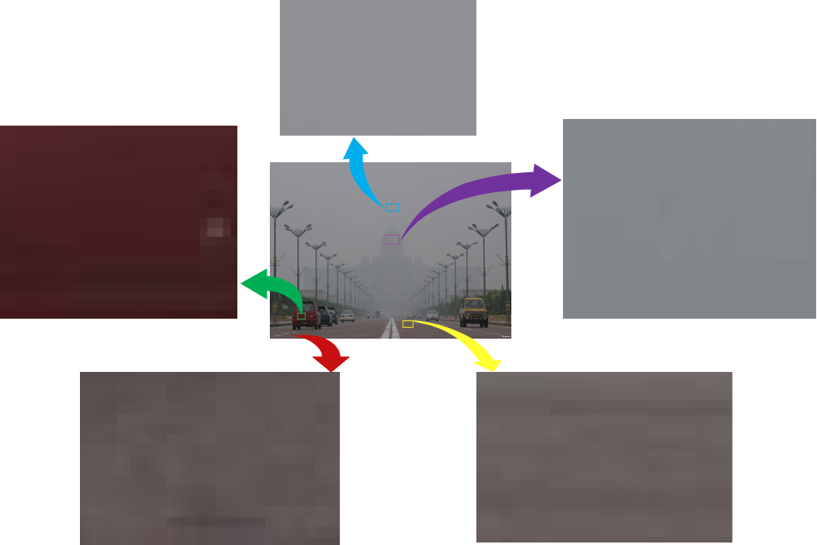
CUP Example
Proposed System
Figure: Example of Color Uniformity Principle
Prof. Sumana Gupta

Slide 19
CUP Metric in Thick Haze and Thin Haze
Proposed System
0.5
thick haze regions thin haze regions
0.45
0.4
0.35
0.3
0.25
0.2
0.15
0.1
0.05
probability
0
0
0.01
0.02
0.03 0.04 0.05
color uniformity metric
0.06
0.07
0.08
Figure: Comparison of probability density function of mean color uniformity in two regions viz thick haze and thin haze.
Prof. Sumana Gupta

Slide 20
Proposed System
Probability density function of mean color uniformity metric for thick haze regions is concentrated towards origin.
While, pdf of mean color uniformity metric for thin haze has wider spread i.e. color uniformity metric has much higher value compared to thick haze case.
Thus, the two regions can be distinguished using CUP and hence CUP can be used for dehazing.
Prof. Sumana Gupta

Slide 21





Visibility Enhancement Flow Diagram
Proposed System
Transmission Map Estimation
Image
Enhanced Image
Adaptive Histogram
Equalization
Figure: Visibility Enhancement Flow Diagram
Prof. Sumana Gupta

Slide 22
Figure: Test image and corresponding Transmission map, Red colour denotes highest and Blue colour denotes least transmittance value

Slide 23
Transmittance Map Estimation
Proposed System
We estimate the transmittance map using CUP.
Color uniformity for each pixel is estimated in a window of 11 × 11.
Color uniformity metric of a pixel is measured as the variance of the chosen window for given pixel.
The computational time is speeded-up by vectorizing the calculation of color uniformity metric as given below.
Var (x ) = E ((x − E (x ))²) ⇒ Var (x ) = ((I-I*H).^2)*H (8)
Here, H is a average filter of size 11 × 11.
Prof. Sumana Gupta

Slide 24
Atmospheric Scattering Parameter Estimation
Proposed System
Atmospheric scattering parameter A plays an important role in dehazing process.
We estimate A from estimated transmittance map using Equation (9) for the haze saturated regions (t is approximately 0).
t ≈ 0 ⇒ I ≈ A
(9)
We create a mask corresponding to lowest transmittance regions and take median pixel value of mask region as an estimate of A
RMSE is used as accuracy measure of estimated A
Prof. Sumana Gupta

Slide 25
Where
represent the ground truth and estimated values respectively
The ground truth values of A are directly calculated from saturated regions of the corresponding image

Slide 26
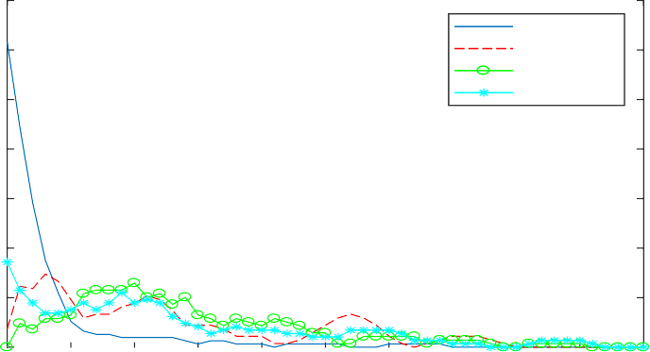
Proposed System
0.35
Proposed Sulami Berman Bahat
0.3
0.25
Probability
0.2
0.15
0.1
0.05
0
0 0.05
0.1
0.15
0.2
0.25
RMSE
0.3
0.35
0.4
0.45
0.5
Figure: PDF of RMSE in estimation of A on database¹¹
¹¹ Saumik Bhattacharya, Sumana Gupta, and KS Venkatesh. “Dehazing of color image using stochastic enhancement”. In: Image Processing (ICIP), 2016 IEEE International Conference on. IEEE. 2016, pp. 2251–2255.
Prof. Sumana Gupta

Slide 27
Image Enhancement
Proposed System
Finally, Radiance J is estimated from estimated A and t using scattering model of Haze given in Equation (1).
Visibility range of dehazed image is further increased using Contrast Limited Adaptive Histogram Equalization (CLAHE).
Prof. Sumana Gupta

Slide 28
Figure: Intermediate Dehazing Results for ‘Tiananmen-square’ Red color denotes highest and Blue color denotes least transmittance value
We observe that CLAHE increases contrast and visual range of dehazed output

Slide 29
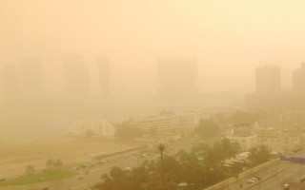
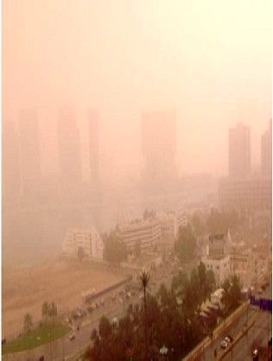
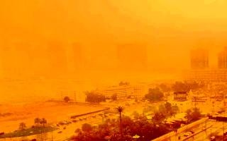
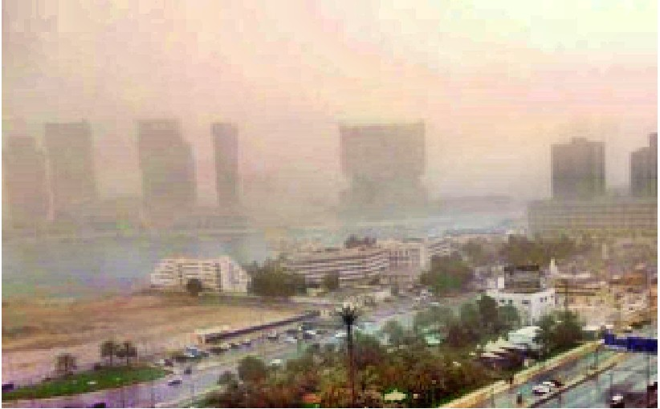
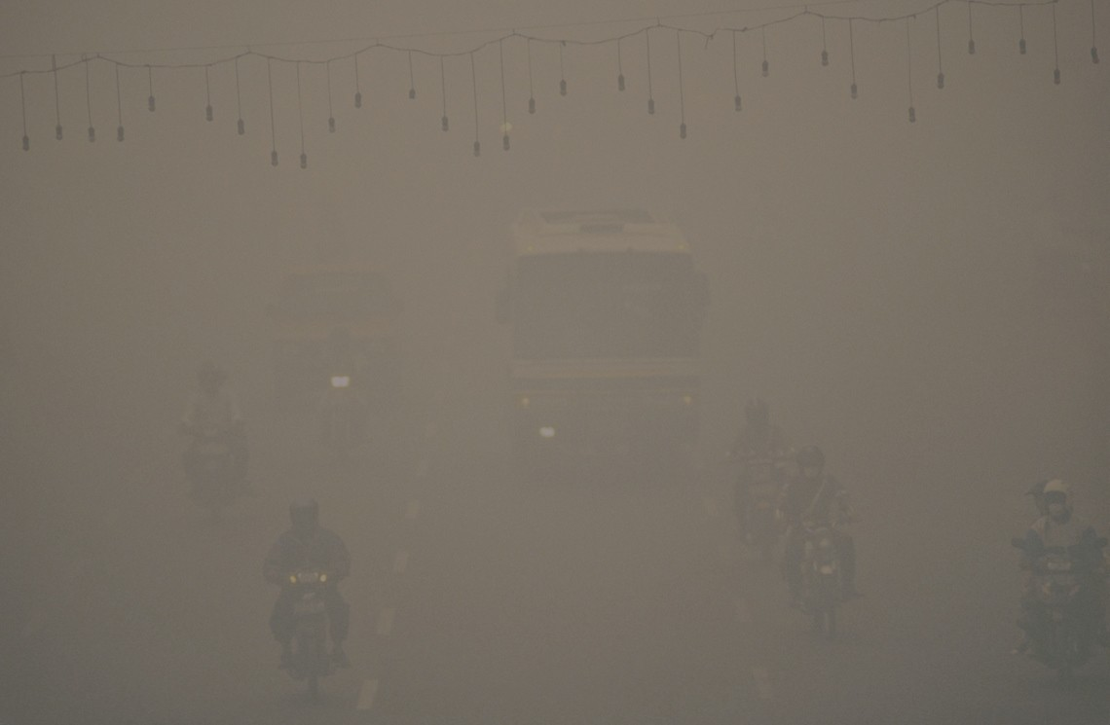
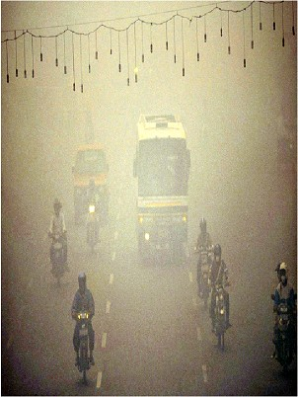
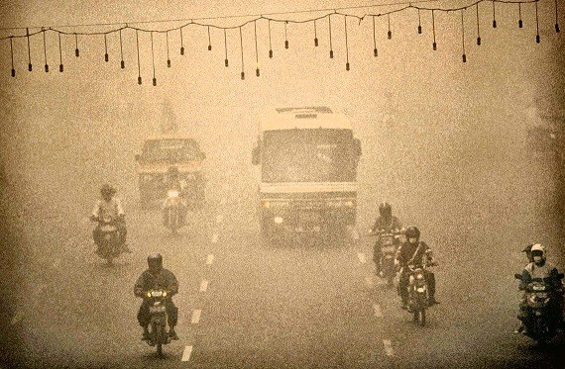
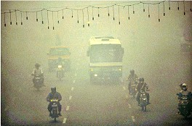
Visibility Enhancement Comparison
Results
(a) (b) (c) (d)
Figure: Comparison of Various Image Enhancement Methods; Column (a) contains test images, Columns (b), (c), and (d) show enhanced results for Berman, Bhattacharya, and Proposed method respectively.
Prof. Sumana Gupta

Slide 30
Figure: Comparison of various Dehazing methods:Column (a) contains test images from
database[8],Column (b),(c),(d),(e),(f),(g),(h) &(i) show dehazing results for Berman’s,
CLAHE, Bhattacharya, MSCNN,AOD-Net,Dehazenet,CAP and Proposed methods respectively

Slide 31
Visibility Enhancement: Processing Time
Results
Table: Processing Time (in sec)
Size (px) | Bhatta -charya¹² | Berman | Dehaz -enet | MSCNN | CAP | AOD -Net | Proposed
640x480 | 48 | 4.8 | 4.47 | 3.88 | 1.81 | 1.08 | 0.30
320x240 | 12 | 2.1 | 2.11 | 1.04 | 0.80 | 0.38 | 0.16
Visibility Enhancement Algorithm produces comparable quality enhanced image in real-time
¹² Bhattacharya, Gupta, and Venkatesh, “Dehazing of color image using stochastic enhancement”.
Prof. Sumana Gupta

Slide 32
Quantitative Comparison
Results
Prof. Sumana Gupta

Slide 33
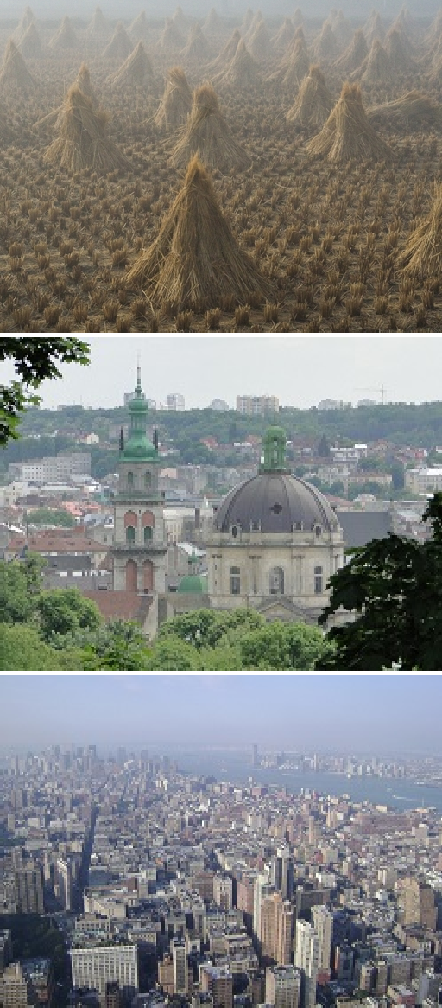
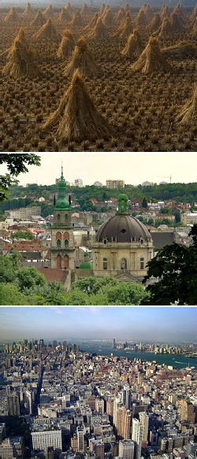
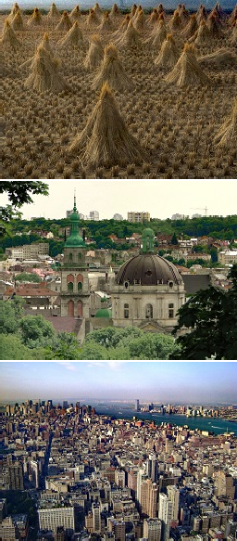
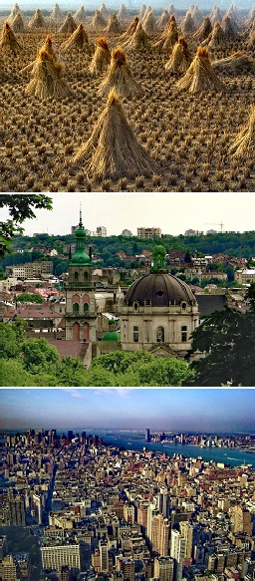
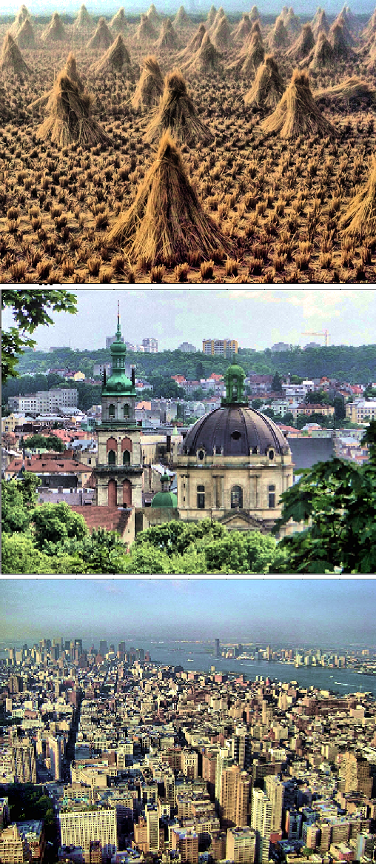
Results
(a)
(b)
(c)
(d)
(e)
Figure: Dehazed output for standard test images; Column (a) contains standard test images, Columns (b), (c), (d) and (e) show dehazed outputs using DCP, Colorline, Hazeline and Proposed method respectively
Prof. Sumana Gupta

Slide 34
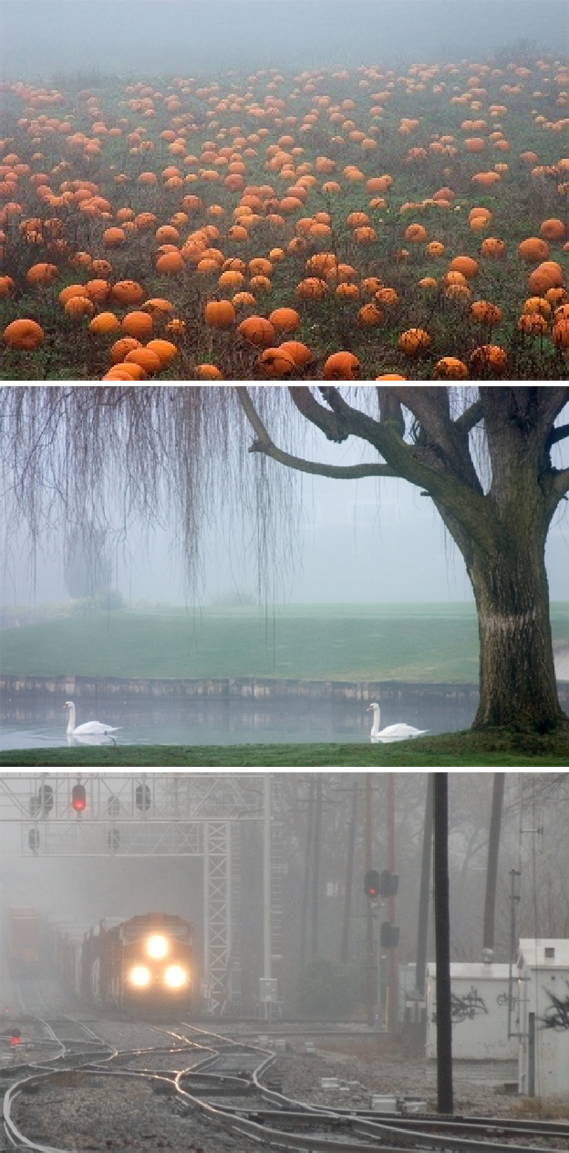
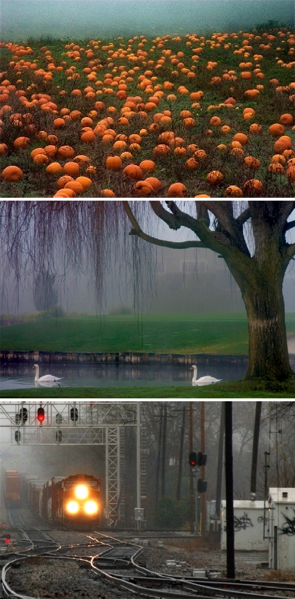
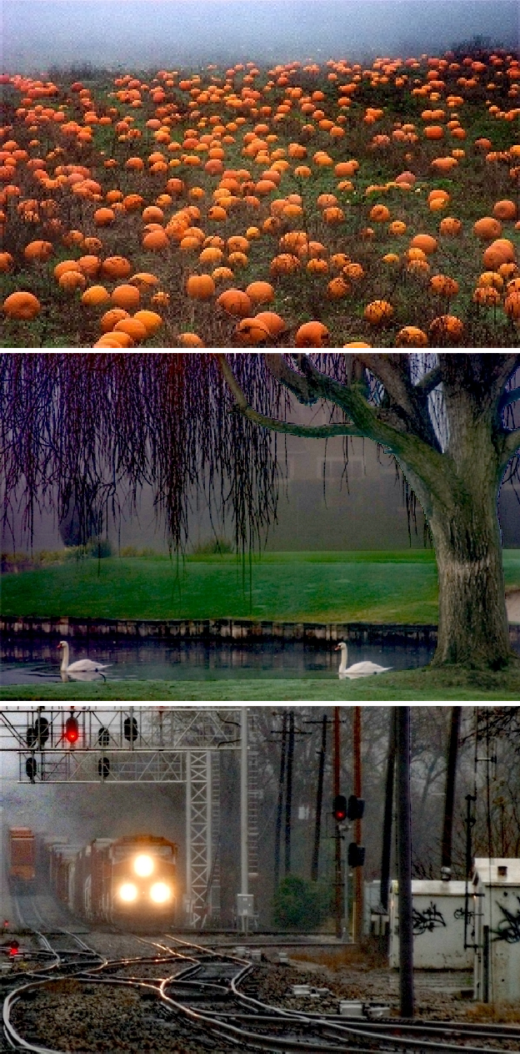
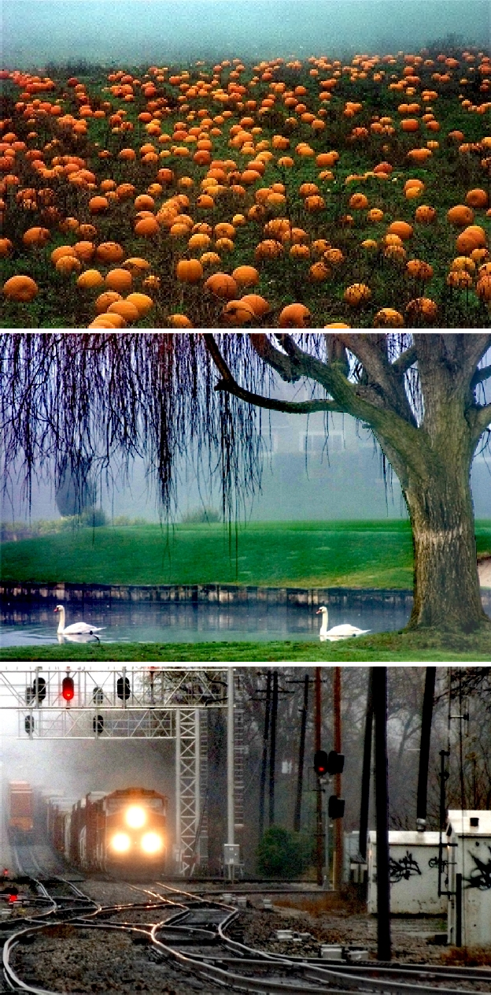
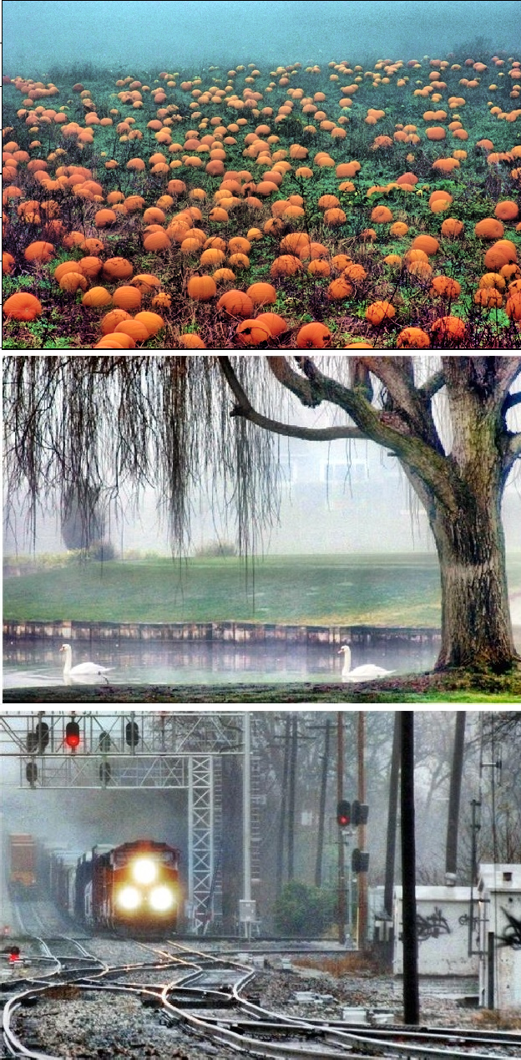
Results
(a)
(b)
(c)
(d)
(e)
Figure: Dehazed output for standard test images; Column (a) contains standard test images, Columns (b), (c), (d) and (e) show dehazed outputs using DCP, Colorline , Hazeline and Proposed method respectively
Prof. Sumana Gupta

Slide 35
For a quantitative comparison of the dehazed outputs, we used the metrics entropy E and Qe defined as ratio of visible edges after and before dehazing.
Results
Table: Quantitative Quality Comparison
Image | DCP |  | Colorline |  | Hazeline |  | Proposed
 | Qe | E | Qe | E | Qe | E | Qe | E
cones | 1.13 | 6.9 | 1.18 | 7.0 | 1.14 | 7.6 | 1.10 | 7.8
lviv | 1.16 | 7.3 | 1.21 | 7.4 | 1.27 | 7.3 | 1.40 | 7.8
ny17 | 1.05 | 7.8 | 1.09 | 7.9 | 1.12 | 7.8 | 1.08 | 7.8
pkin | 1.20 | 7.2 | 1.27 | 7.5 | 1.24 | 7.6 | 1.27 | 7.6
swan | 0.97 | 7.1 | 1.89 | 6.8 | 1.66 | 7.6 | 1.73 | 7.9
train | 1.20 | 7.2 | 1.56 | 7.2 | 1.47 | 7.5 | 1.54 | 7.6
Prof. Sumana Gupta

Slide 36
Table: Performance metric comparison on RESIDE dataset¹³
Results
 | DCP | CAP | Haze -line | Dehaze -Net | MSCNN | AOD -Net | Propo -sed
PSNR | 18.54 | 23.95 | 19.52 | 26.84 | 21.73 | 24.08 | 20.21
SSIM | 0.7100 | 0.869 | 0.732 | 0.826 | 0.831 | 0.872 | 0.792
BLIINDS-II | 89.12 | 85.93 | 86.32 | 83.60 | 86.72 | 87.43 | 90.41
¹³ Boyi Li et al. “Benchmarking single-image dehazing and beyond”. In: IEEE Transactions on Image Processing 28.1 (2019), pp. 492–505.
Prof. Sumana Gupta

Slide 37
Effect of accuracy of A
Figure: Effect of Accuracy of A on Berman’s Method : Estimated by Sulami and Proposed Method; Column (a) contains test images,Columns (b) and (c) show transmission map using A estimated from Sulami and proposed method respectively and Columns (d) and (e) respectively contain corresponding dehazing results; In transmission map, Red color denotes highest and Blue color denotes least transmittance value

Slide 38
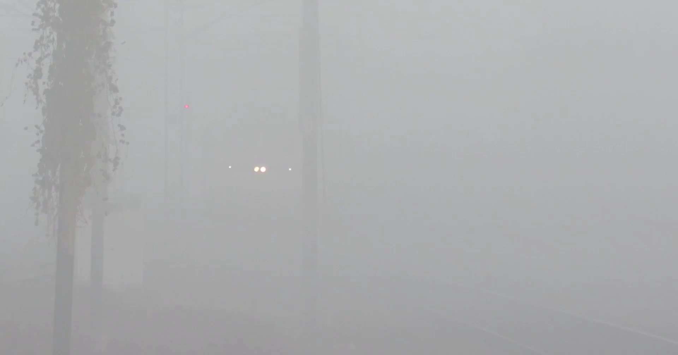
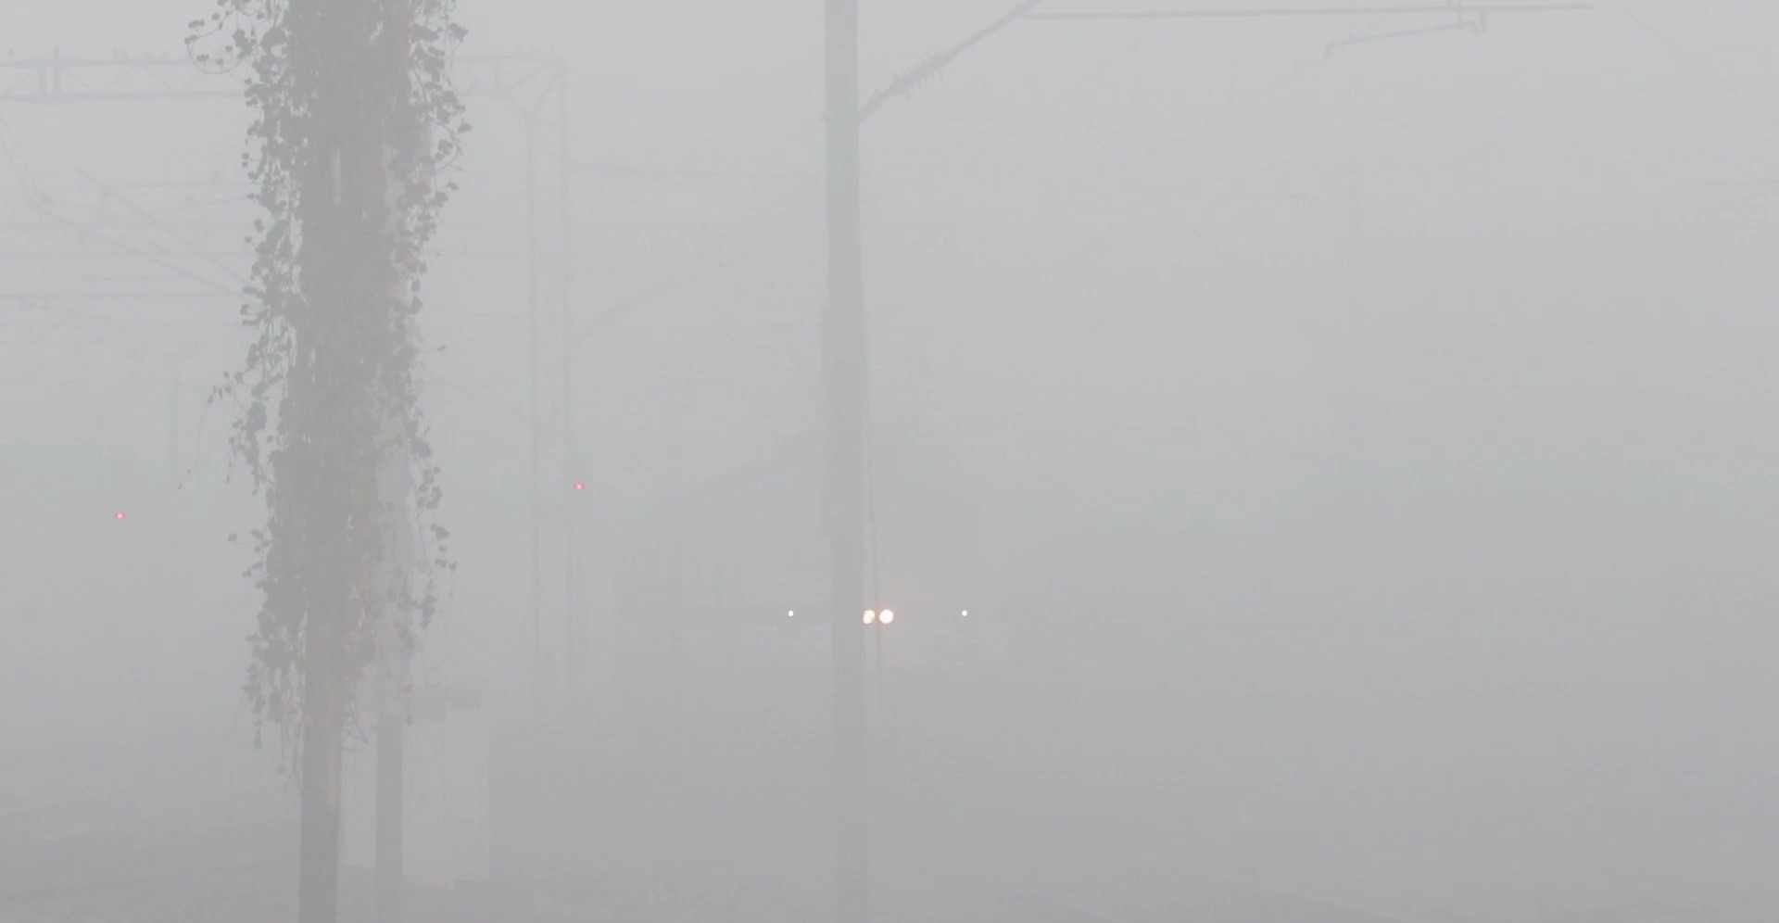
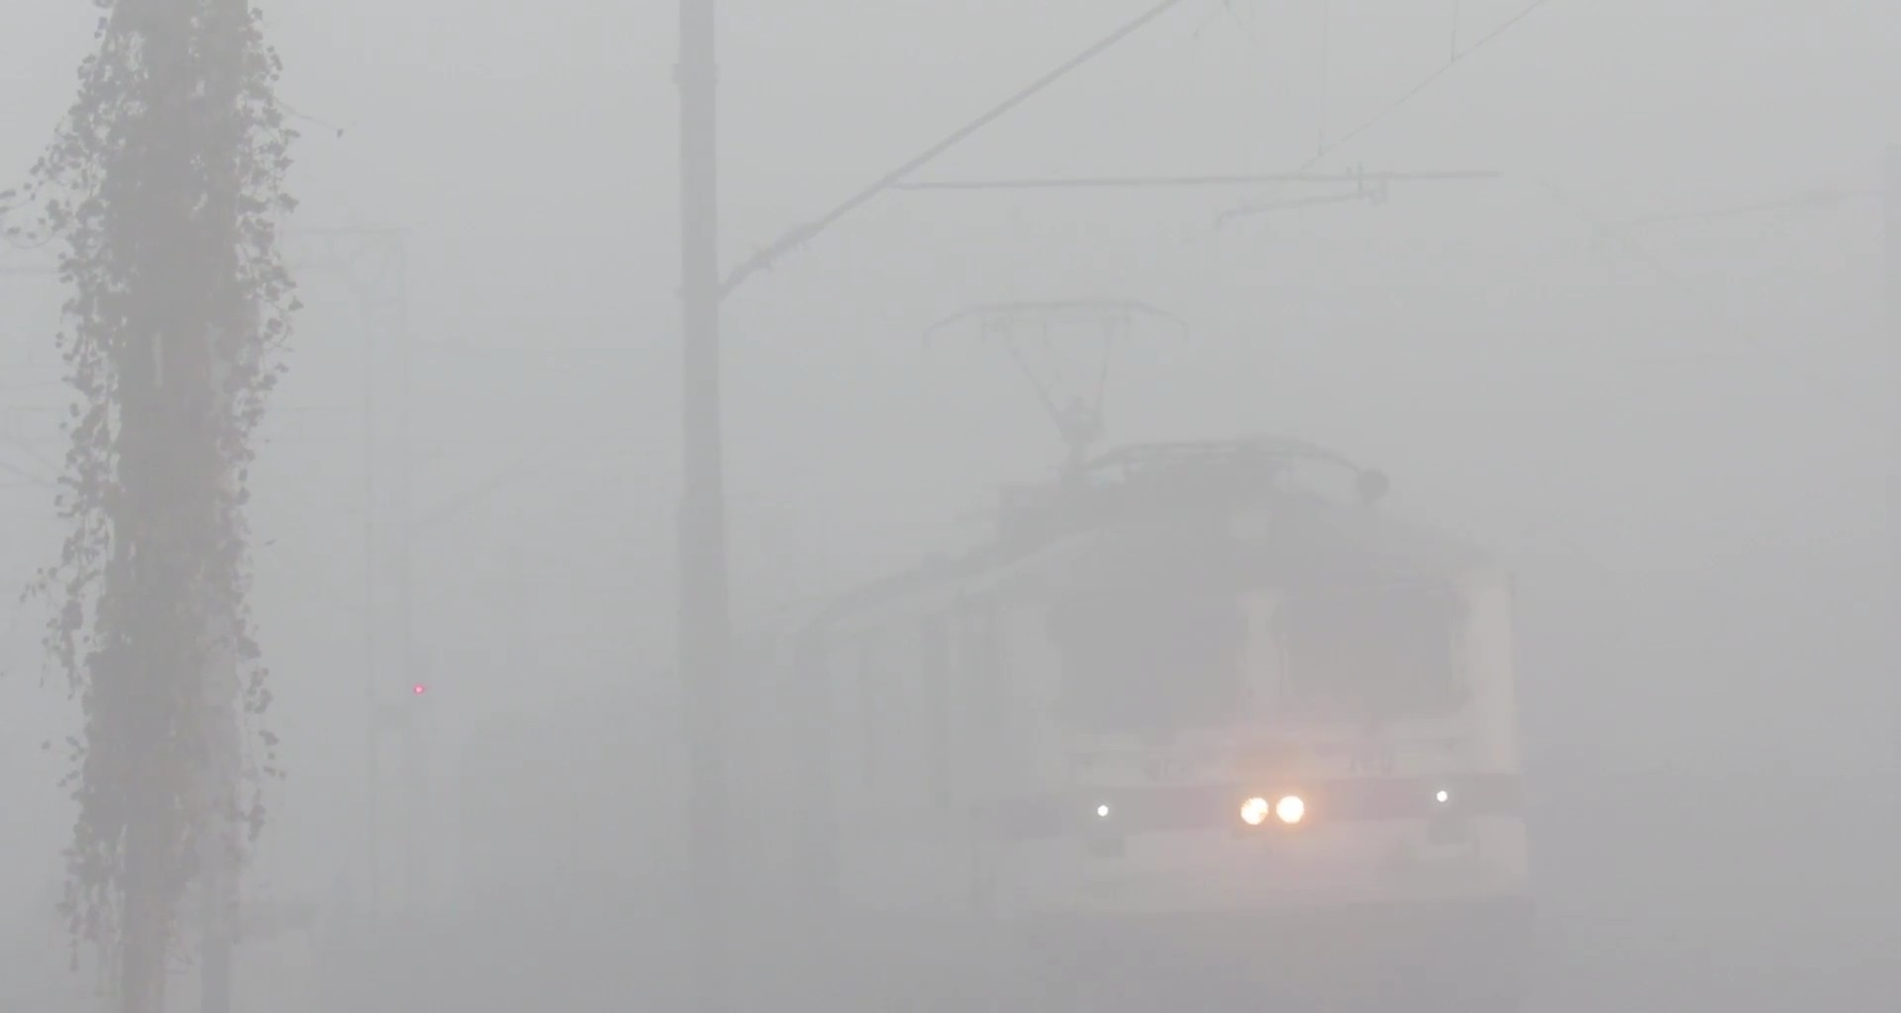
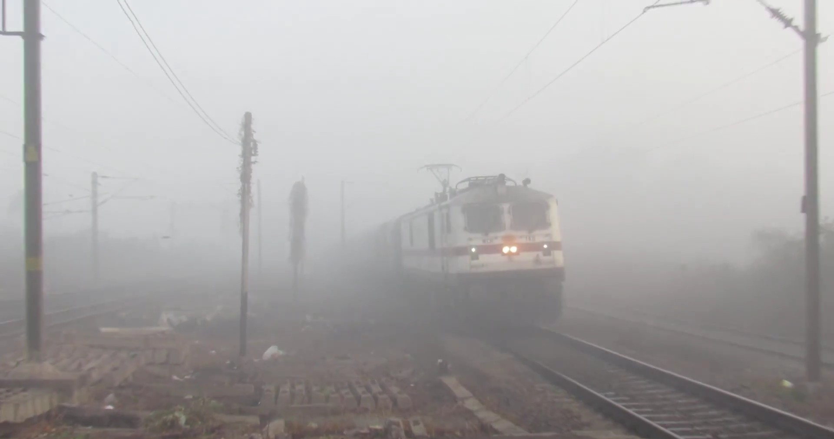
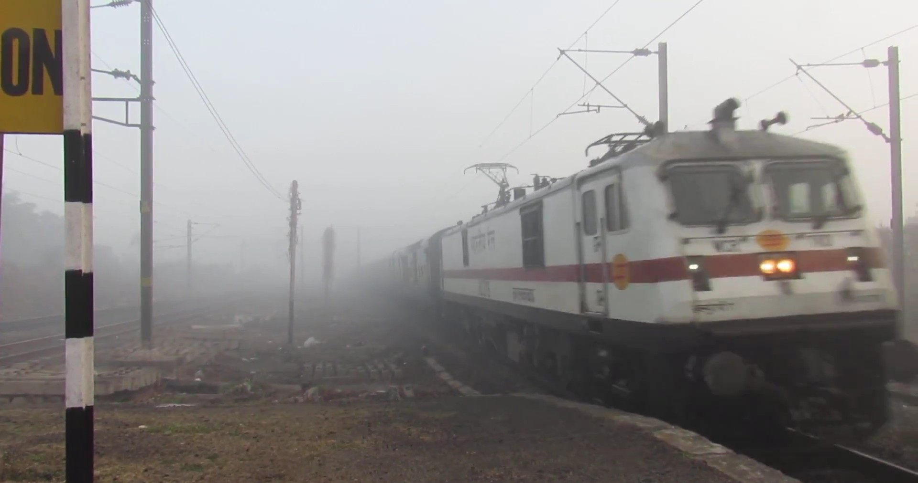
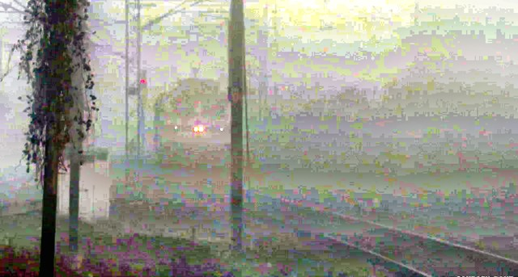
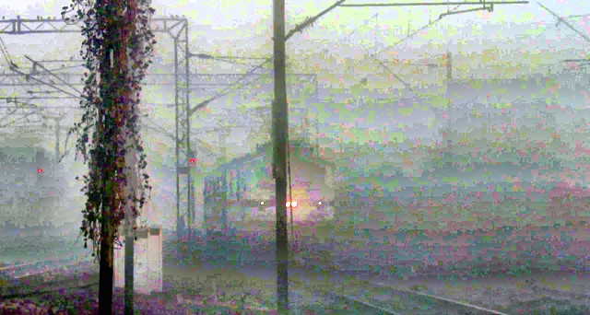
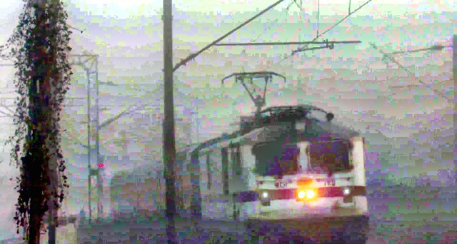
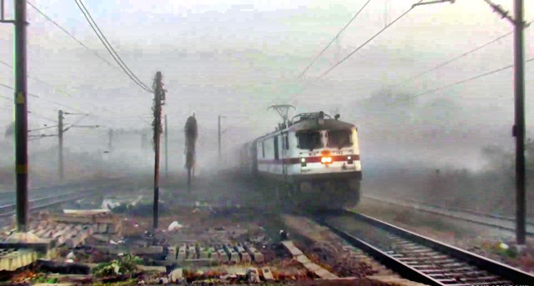
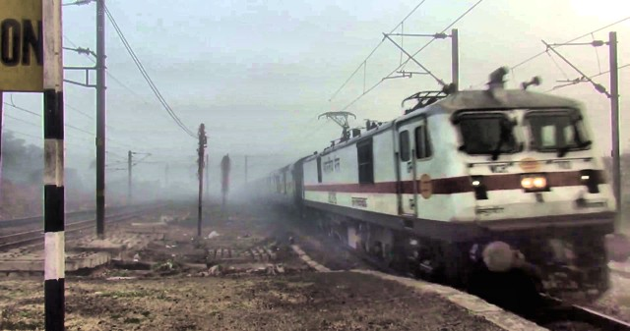
Results: Image Sequence
Results
Frame 1
Frame 135 Frame 320 Frame 459
Figure: Example Image Sequence
Frame 524
Prof. Sumana Gupta

Slide 39
Figure: Dehazing of Image Sequence 2,First row contains test images from Image sequence 2,Second row
contains dehazed output of proposed method,Third,fourth,fifth,sixth & seventh rows contain corresponding dehazed
outputs obtained using Berman,AOD,MSCNN,CAP & Dehaze net resp

Slide 40
Conclusion
Conclusion
We propose Color Uniformity Principle to estimate the transmittance map.
Proposed method results in more accurate A estimation.
Proposed dehazing method requires low processing time and is suitable for real time implementation.
Proposed method is also applicable in presence of motion blur i.e. video sequence.
Prof. Sumana Gupta

Slide 41
Thank You!
Conclusion
Prof. Sumana Gupta

