Slide 1
Machine Learning: A Bird’s Eye View
By
Swagatam Das
E-mail: swagatam.das@isical.ac.in
Electronics and Communication Sciences Unit,
Indian Statistical Institute, Kolkata – 700 108, India.

Slide 2
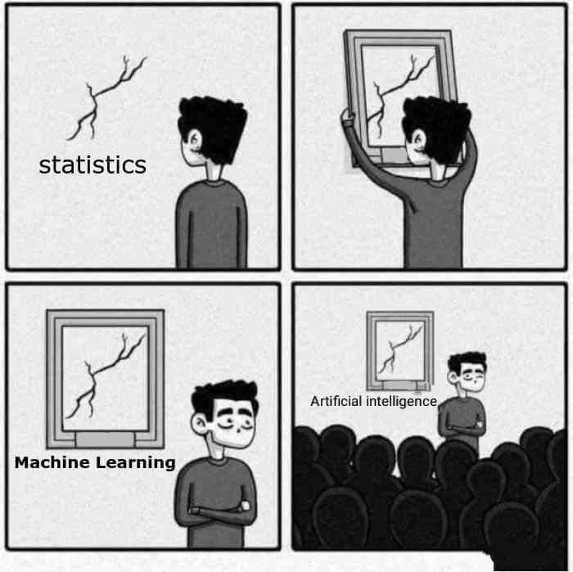
We start a little light….
“When you’re fundraising, it’s AI. When you’re hiring, it’s ML. When you’re implementing, it’s logistic regression.”
(from Twitter)
But is that all?

Slide 3
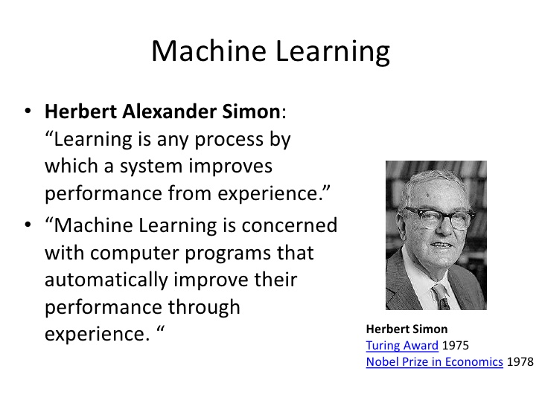

Slide 4
Why “Learn”?
Machine learning is programming computers to optimize a performance criterion using example data which can act like past experience.
There is no need to “learn” to calculate payroll
Learning is used when:
  Human expertise does not exist (navigating on Mars),
  Humans are unable to explain their expertise (speech recognition)
  Solution changes in time (routing on a computer network)
  Solution needs to be adapted to particular cases (user biometrics)

Slide 5
What We Talk About When We Talk About“Learning”
Learning general models from a data of particular examples
Data is cheap and abundant (data warehouses, data marts); knowledge is expensive and scarce.
Example in retail: Customer transactions to consumer behavior:
  People who bought “Da Vinci Code” also bought “The Five People You Meet in Heaven” (www.amazon.com)
Build a model that is a good and useful approximation to the data.

Slide 6
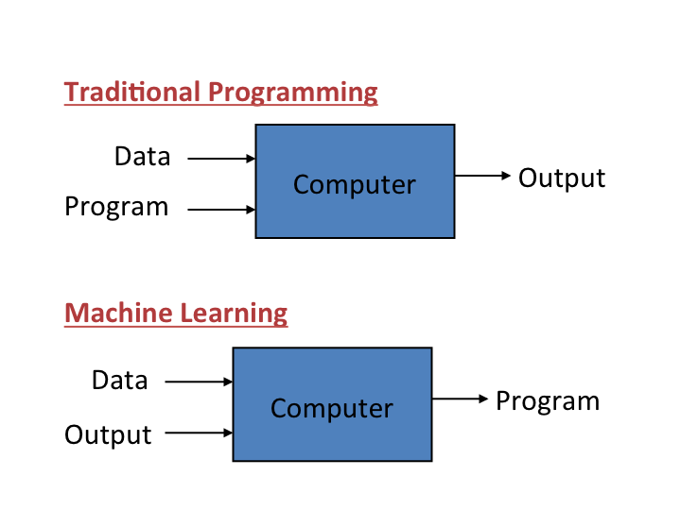
What is Machine Learning?
Machine learning is a field of computer science that uses statistical techniques to give computer systems the ability to "learn" (i.e., progressively improve performance on a specific task) with data, without being explicitly programmed.
The name machine learning was coined in 1959 by Arthur Samuel. - Wikipedia

Slide 7
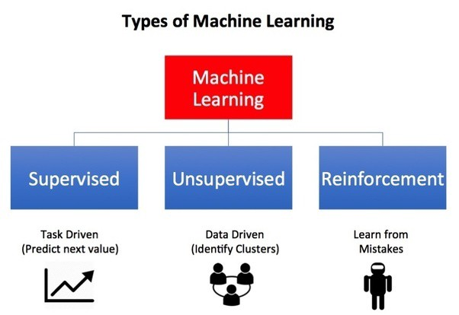
https://towardsdatascience.com/what-are-the-types-of-machine-learning-e2b9e5d1756f

Slide 8
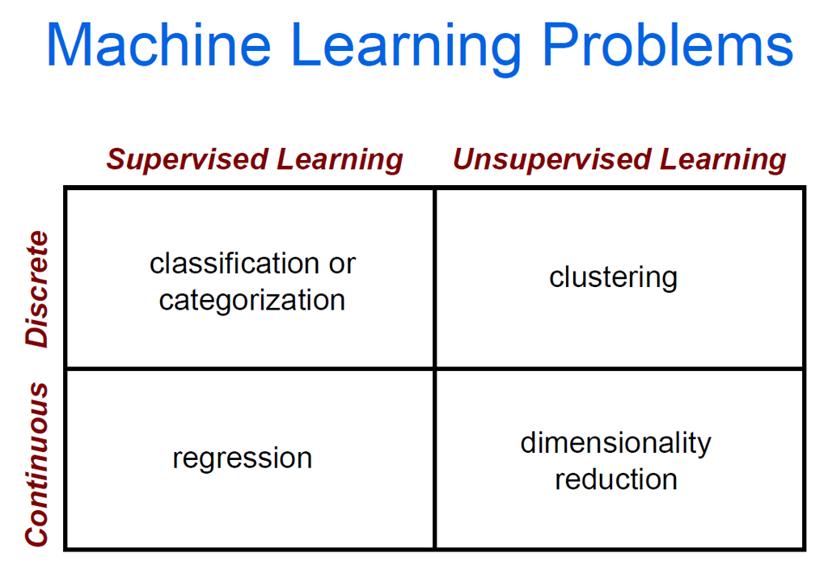
Conventionally….

Slide 9
The data and the goal
Data: A set of data records (also called examples, instances or cases) described by
  k attributes/variables/features: A₁, A₂, … A_{k}.
  a class: Each example is labelled with a pre-defined class.
Goal: To learn a classification model f from the data that can be used to predict the classes of new (future, or test) cases/instances.
Notes:
Induction is different from deduction and DBMS does not not support induction;
The result of induction is higher-level information or knowledge: general statements about data
There are many approaches. Refer to the lecture notes for CS3244 available at the Co-Op.
We focus on three approaches here, other examples:
Other approaches
Instance-based learning
other neural networks
Concept learning (Version space, Focus, Aq11, …)
Genetic algorithms
Reinforcement learning

Slide 10
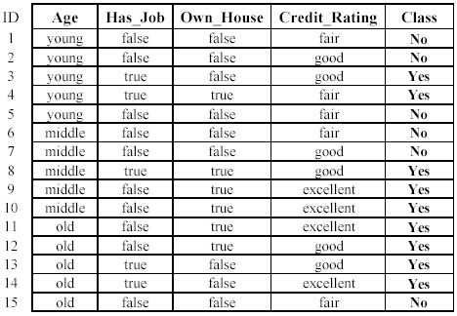
An example: data (loan application)
Approved or not

Slide 11
An example: the learning task
Learn a classification model from the data
Use the model to classify future loan applications into
  Yes (approved) and
  No (not approved)
What is the class for following case/instance?

Slide 12



The machine learning framework
Apply a prediction function to a feature representation of the image to get the desired output:
f( ) = “apple”
f( ) = “tomato”
f( ) = “cow”
Slide credit: L. Lazebnik

Slide 13
The machine learning framework
y = f(x)
Training: given a training set of labeled examples {(x₁,y₁), …, (x_{N},y_{N})}, estimate the prediction function f by minimizing the prediction error on the training set
Testing: apply f to a never before seen test example x and output the predicted value y = f(x)
output
prediction function
Image feature
Slide credit: L. Lazebnik

Slide 14
Linear Classifiers: The Simple Models!
α
x
f
y^{est}
f(x,w,b) = sign(w x + b)
denotes +1
denotes -1
w x + b>0
w x + b=0
How would you classify this data?
w x + b<0

Slide 15
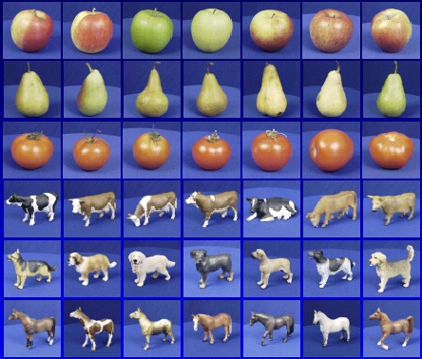

Steps
Slide credit: D. Hoiem and L. Lazebnik
Training
Training Labels
Training Images
Image Features
Training
Learned model
Testing
Image Features
Learned model
Prediction
Test Image

Slide 16
Is ML really so hard?
Slide courtesy: Dr. Mingxuan Sun, LSU

Slide 20
But still classification is not that easy….especially nowadays…

Slide 23
Perhaps a lot of it depends on proper feature
representations: Feature Engineering!

Slide 24
So many classifiers over the years….
k-nearest neighbor
SVM
Decision Trees
Neural networks
Naïve Bayes
Bayesian network
Logistic regression
Randomized Forests
The Deep Learning Systems
And so on…..
And then comes the No Free Lunch Theorem of
ML……..

Slide 25
Generative vs. Discriminative Classifiers
Generative Models
Represent both the data and the labels
Often, makes use of conditional independence and priors
Examples
  Naïve Bayes classifier
  Bayesian network
  GANs
Models of data may apply to future prediction problems
Discriminative Models
Learn to directly predict the labels from the data
Often, assume a simple boundary (e.g., linear)
Examples
  Logistic regression
  SVM
  Boosted decision trees
Often easier to predict a label from the data than to model the data
Slide credit: D. Hoiem
Notes:
Generative classifiers try to model the data. Discriminative classifiers try to predict the label.

Slide 26
A very brief look into a
few traditional classifiers

Slide 27
The k-Nearest Neighbor Classifier
The k-Nearest Neighbor (kNN) classifier (Fix and Hodges 1958, Cover and Hart 1967) labels a test point y, by that class which has the majority number of representatives among the training set neighbors of y.
?
Reference:
E. Fix and J.L. Hodges, Discriminatory analysis-nonparametric discrimination: consistency properties, Technical Report, California Univ Berkeley (1951)
T. M. Cover and P. E. Hart, “Nearest neighbour pattern classification,” IEEE Transactions on Information Theory, vol. 13, no. 1, pp. 21–27, 1967.

Slide 28
Example: k=6 (6NN)
Government
Science
Arts
A new point
Pr(Govt| )= 5/6

Slide 29
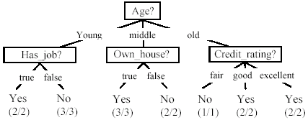
The Decision Tree Classifier
Decision nodes and leaf nodes (classes)

Slide 30
The Loan Data Reproduced…
Decision Tree Classifiers….
Approved or not

Slide 31
Use the decision tree
No

Slide 32
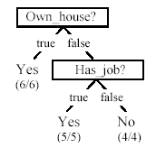
Is the decision tree unique?
No. Here is a simpler tree.
We want smaller tree and accurate tree.
  Easy to understand and perform better.
Finding the best tree is NP-hard.
All current tree building algorithms are heuristic algorithms

Slide 33
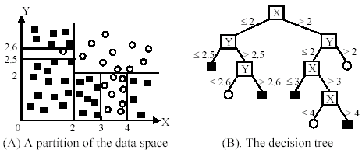
An example in a continuous space

Slide 34
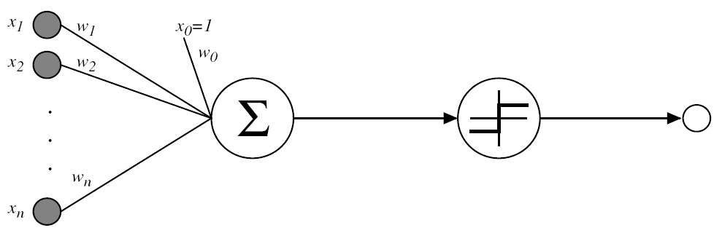
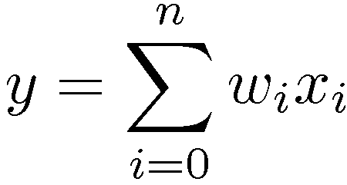
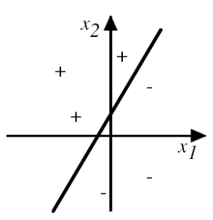

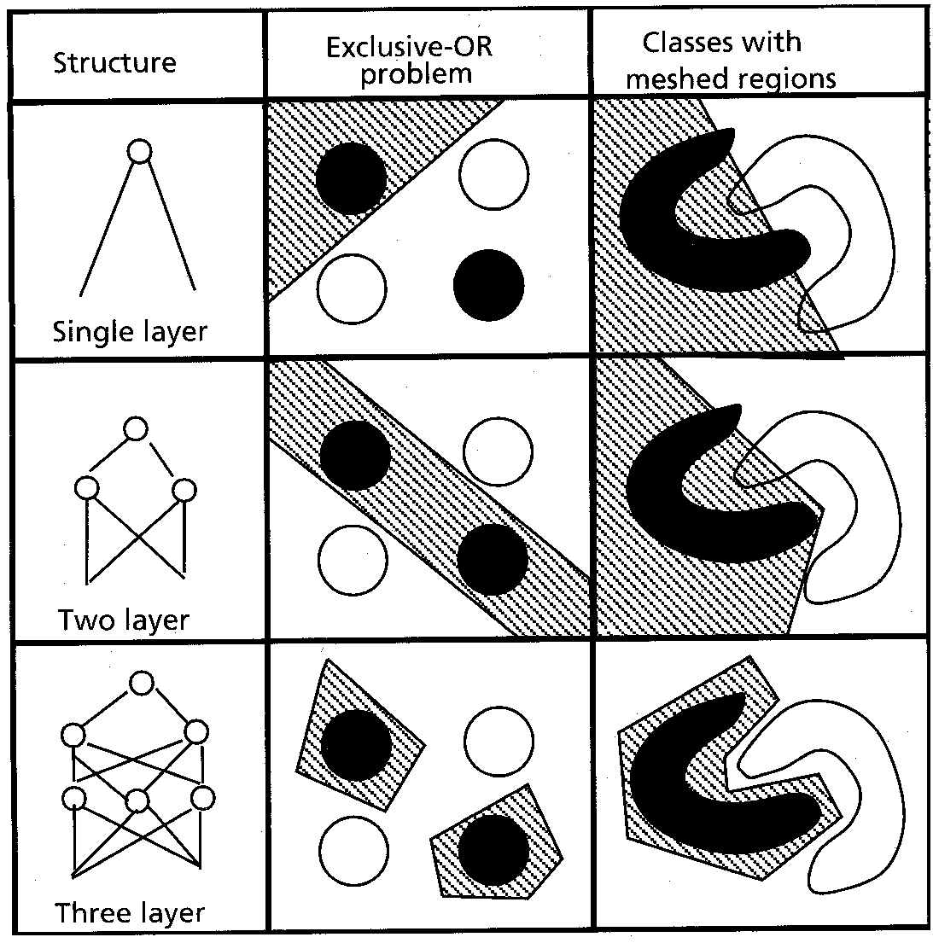

Artificial Neural Network (ANN)
Perceptron : A computational unit with binary threshold
Abilities
  Linear separable decision surface
  Represent boolean functions (AND, OR, NO)
  Network (Multilayer) of perceptrons
  ➔ Various network architectures and capabilities
Weighted Sum
Activation Function
(Jain, 1996)
Jong Youl Choi, 2018

Slide 35
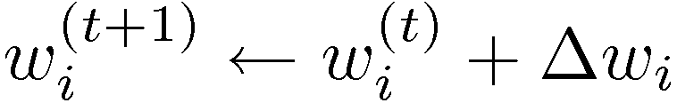

Artificial Neural Network (ANN)
Learning weights – random initialization and updating
Error-correction training rules
  Difference between training data and output: E(t,o)
  Gradient descent (Batch learning)
    With E being the total loss,
  Stochastic approach (On-line learning)
    Update gradient for each result
Various error functions
  Adding weight regularization term (∑ w_{i}²) to avoid overfitting
  Adding momentum (Δw_{i}^{(n-1)}) to expedite convergence

Slide 36


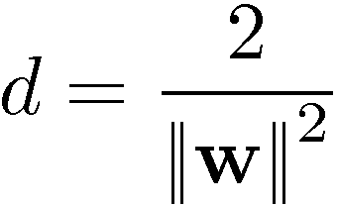



Support Vector Machine
Q: How to draw the optimal linear separating hyperplane?
  ➔ A: Maximizing margin
Margin maximization
  The distance between H₊₁ and H₋₁:
  Thus, ||w|| should be minimized
Margin

Slide 37

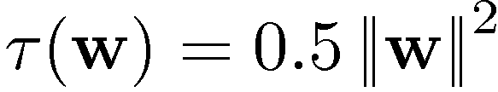
Support Vector Machine
Constraint optimization problem
  Given training set {x_{i}, y_{i}} (y_{i} ϵ {+1, -1}):
  Minimize :
Lagrangian equation with saddle points
  Minimized w.r.t the primal variable w and b:
  Maximized w.r.t the dual variables α_{i} (all α_{i} ¸ 0)
  x_{i} with α_{i} > 0 (not α_{i} = 0) is called support vector (SV)

Slide 38
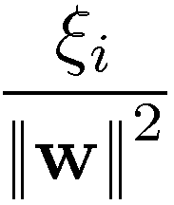

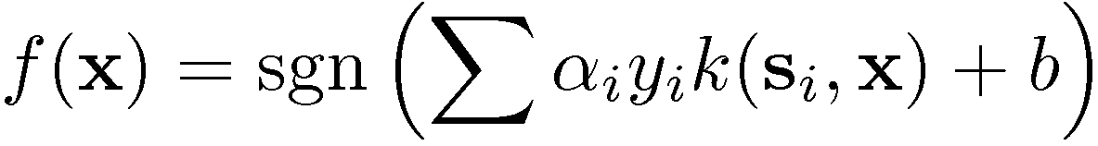
Support Vector Machine
Soft Margin (Non-separable case)
  Slack variables ξ_{i} < C
  Optimization with additional constraint
Non-linear SVM
  Map non-linear input to feature space
  Kernel function k(x,y) = <Φ(x), Φ(y)>
  Kernel classifier with support vectors s_{i}
Input Space
Feature Space

Slide 39

Generalization
Training set (labels known)
Test set (labels unknown)
How well does a learned model generalize from the data it was trained on to a new test set?
Slide credit: L. Lazebnik

Slide 40
Generalization
Components of generalization error
  Bias: how much the average model over all training sets differ from the true model?
    Error due to inaccurate assumptions/simplifications made by the model
  Variance: how much models estimated from different training sets differ from each other
Underfitting: model is too “simple” to represent all the relevant class characteristics
  High bias and low variance
  High training error and high test error
Overfitting: model is too “complex” and fits irrelevant characteristics (noise) in the data
  Low bias and high variance
  Low training error and high test error
Slide credit: L. Lazebnik

Slide 41
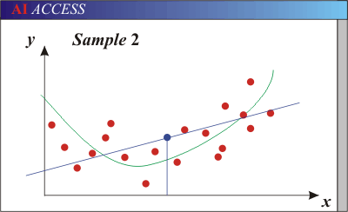
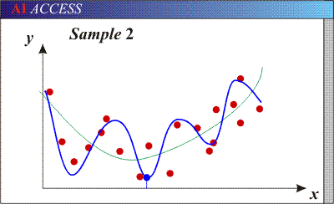
Bias-Variance Trade-off
Models with too few parameters are inaccurate because of a large bias (not enough flexibility).
Models with too many parameters are inaccurate because of a large variance (too much sensitivity to the sample).
Slide credit: D. Hoiem
Notes:
http://www.aiaccess.net/English/Glossaries/GlosMod/e_gm_bias_variance.htm

Slide 42
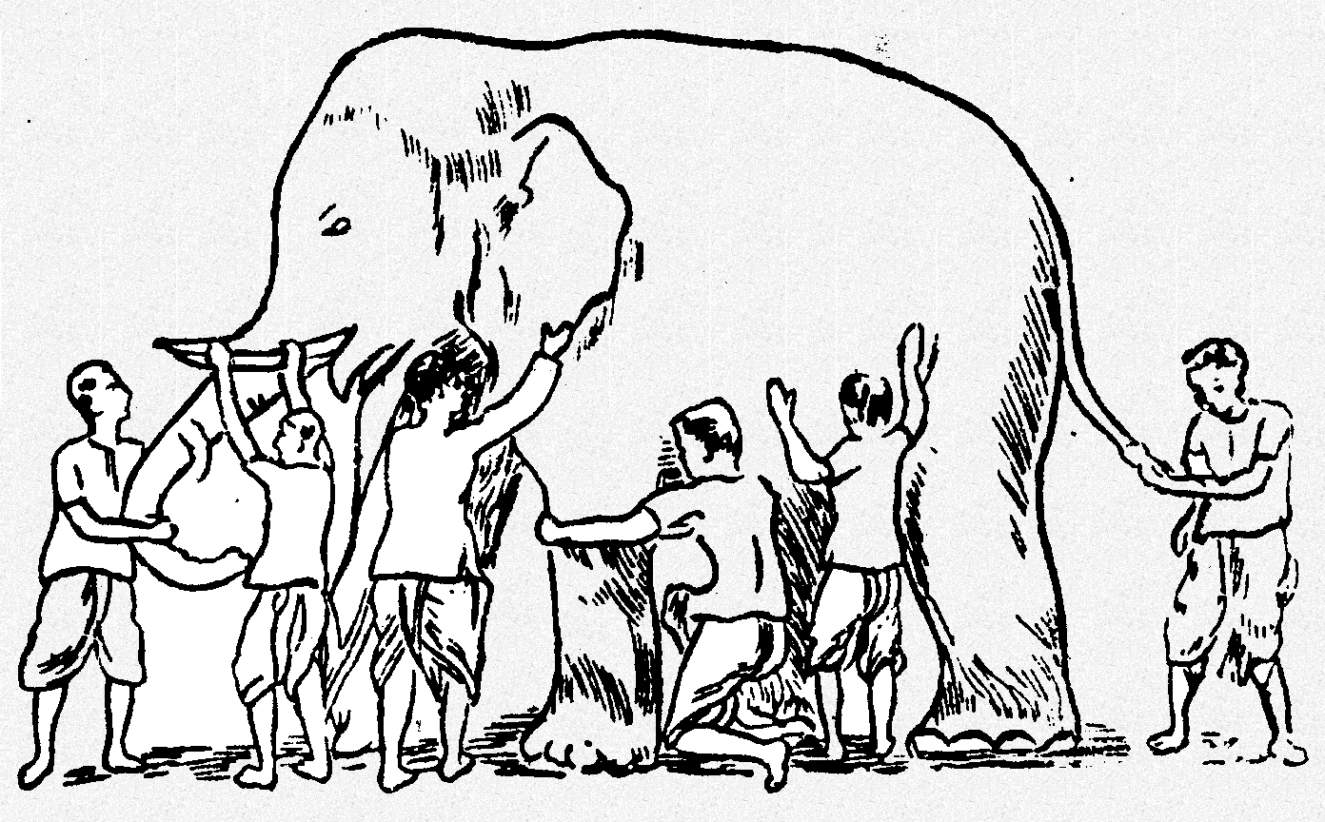
Towards Ensemble Classifiers…
Some unknown distribution
Model 1
Model 6
Model 3
Model 5
Model 2
Model 4
Ensemble gives the global picture!

Slide 43
Ensemble of Classifiers—Learn to Combine
training
test
classifier 1
Ensemble model
labeled
data
unlabeled
data
classifier 2
……
classifier k
final
predictions
learn the combination from labeled data
Algorithms: boosting, stacked generalization, rule ensemble, Bayesian model averaging……

Slide 44
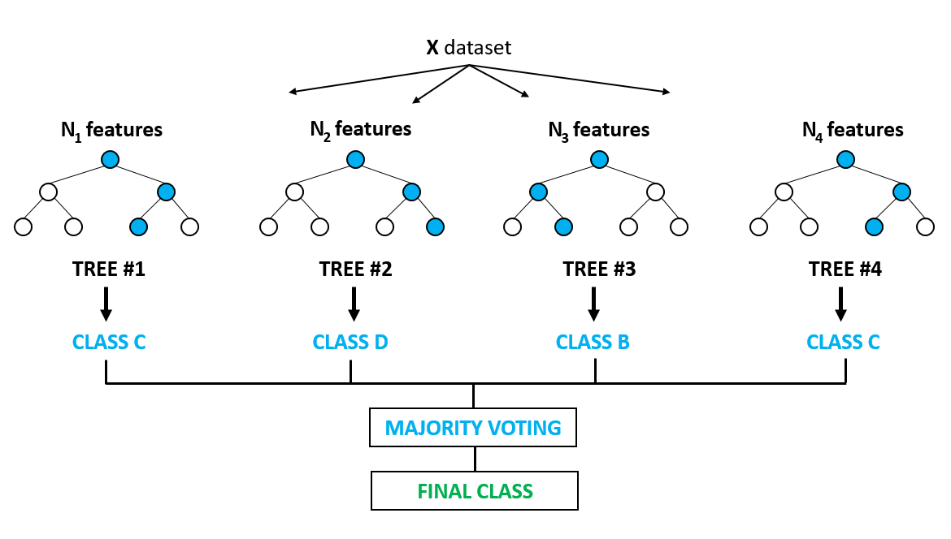
For example, the Random Forest Classifiers…
Breiman, L. Random Forests. Machine Learning 45, pp. 5–32, 2001.

Slide 46
Regression
For classification the output(s) is nominal
In regression the output is continuous
  Function Approximation
Many models could be used – Simplest is linear regression
  Fit data with the best hyper-plane which "goes through" the points
y
dependent
variable
(output)
x – independent variable (input)
Notes:
Show generalization

Slide 47
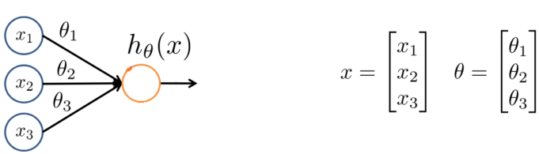
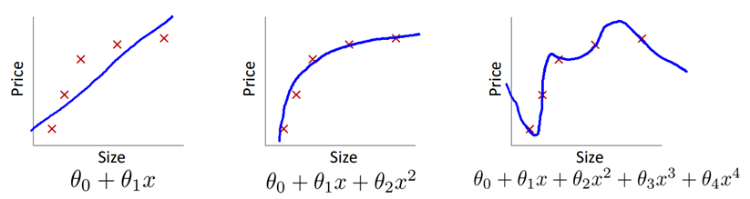
Regression: Over/under fitting
- In overfitting, if we have too many features, the learned hypothesis may fit the training set very well, but fail to generalize to new examples (predict prices on new examples).
Source: ”Machine learning ” course, Andrew Ng

Slide 48
Logistic Regression
This is also regression but with targets Y=(0,1). i.e. it is classification!
We will fit a regression function on P(Y=1|X)
linear regression
logistic regression

Slide 49
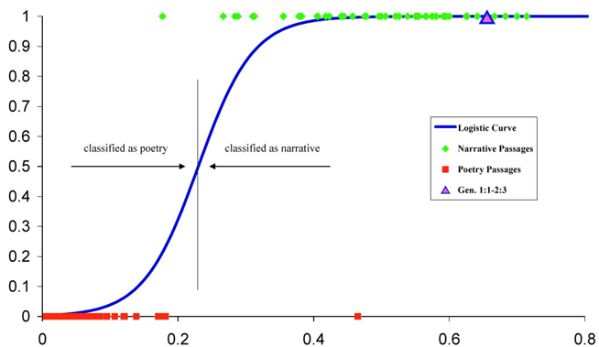
Sigmoid function f(x)
data-points with Y=1
data-points with Y=0

Slide 51
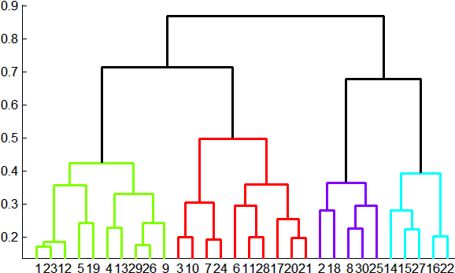
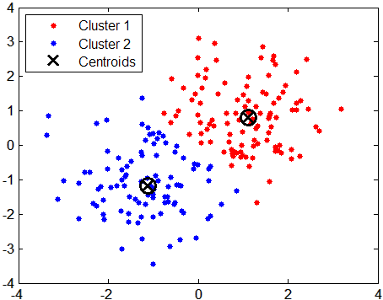
Clustering Analysis
Definition
  Grouping unlabeled data into clusters, for the purpose of inference of hidden structures or information
Dissimilarity measurement
  Distance : Euclidean(L₂), Manhattan(L₁), …
  Angle : Inner product, …
  Non-metric : Rank, Intensity, …
Types of Clustering
  Hierarchical
    Agglomerative or divisive
  Partitioning
    K-means, VQ, MDS, …
(Matlab helppage)

Slide 52
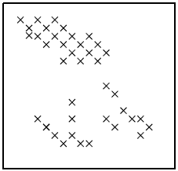
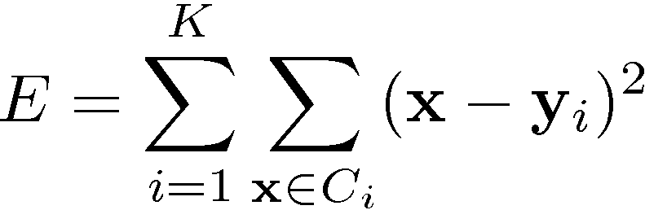
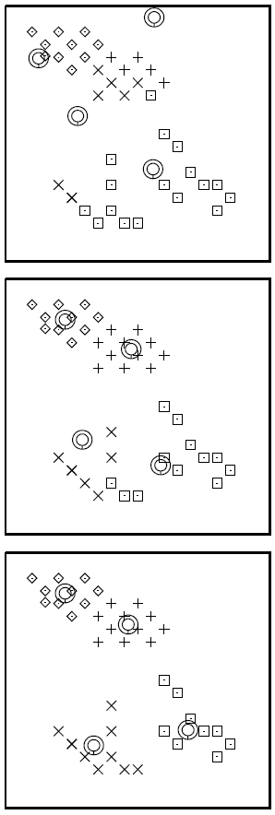
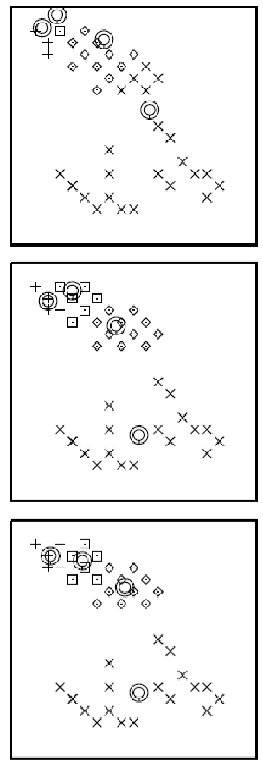
K-Means
Find K partitions with the total intra-cluster variance minimized
Iterative method
  Initialization : Randomized y_{i}
  Assignment of x (y_{i} fixed)
  Update of y_{i} (x fixed)
Problem?
➔ Trap in local minima
(MacKay, 2003)

Slide 54
Dimension Reduction
Definition
  Process to transform high-dimensional data into low-dimensional ones for improving accuracy, understanding, or removing noises.
Curse of dimensionality
  Complexity grows exponentially
  in volume by adding extra
  dimensions
Types
  Feature selection : Choose representatives (e.g., filter,…)
  Feature extraction : Map to lower dim. (e.g., PCA, MDS, … )

Slide 55
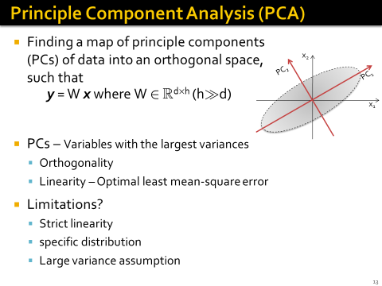
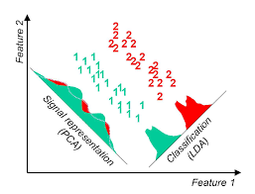
However, it is different from the supervised LDA

Slide 56
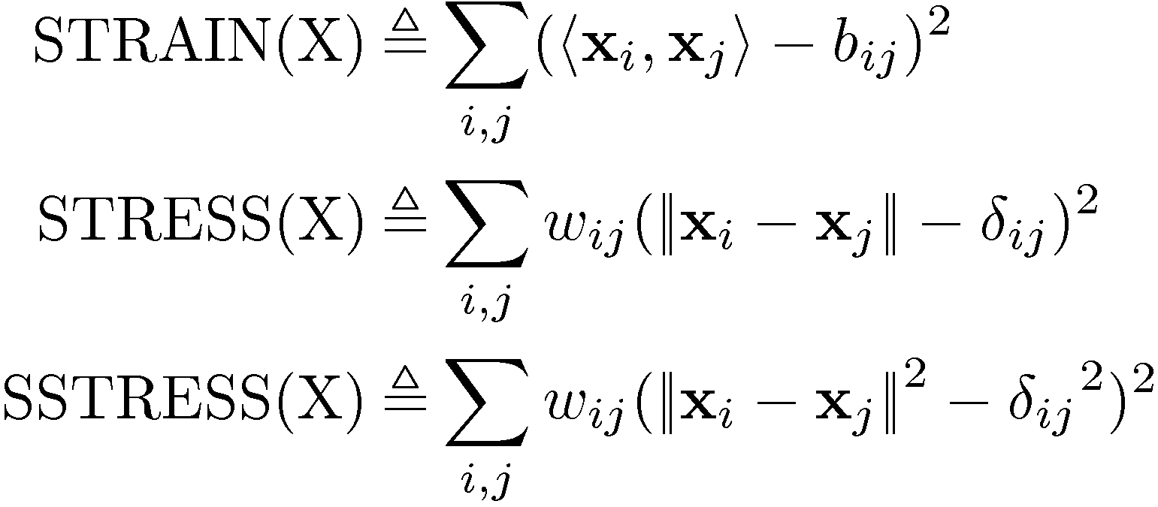
Multi-Dimensional Scaling (MDS)
Dimension reduction preserving distance proximities observed in original data set
Loss functions
  Inner product
  Distance
  Squared distance
Classical MDS: minimizing STRAIN, given Δ
  From Δ, find inner product matrix B (Double centering)
  From B, recover the coordinates X’ (i.e., B=X’X’^{T} )

Slide 57
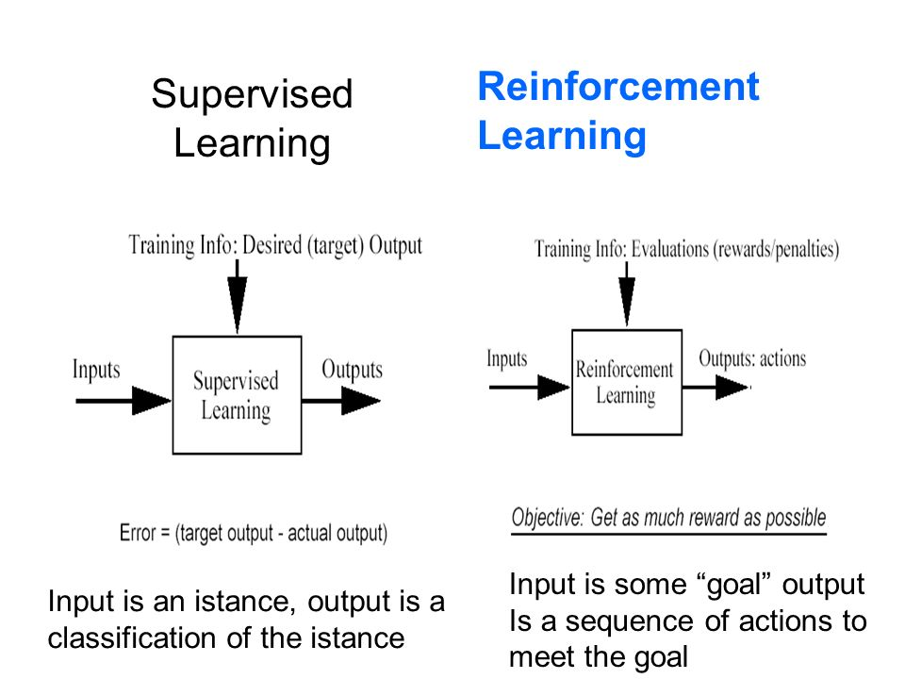
A third type of Learning: RL

Slide 58
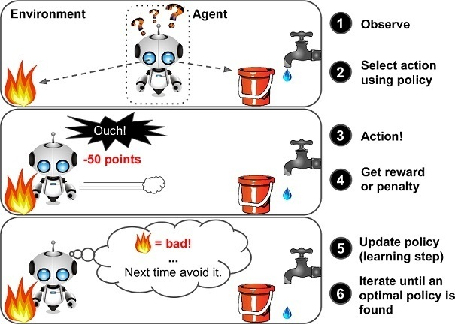
The fundamental idea of RL

Slide 59
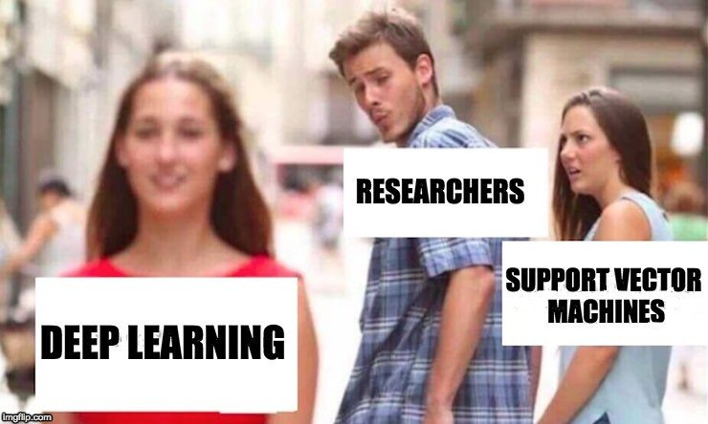
Machine Learning : Some Recent Advances

Slide 60
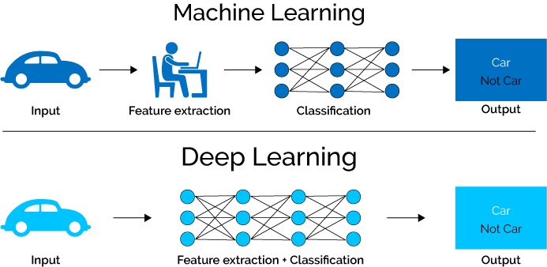
What is Deep Learning (DL) ?
A machine learning subfield is the learning of representations in data.
Deep learning algorithms attempt to learn (multiple levels of) representation by using a hierarchy of multiple layers.
If you provide the system tons of information, it begins to understand it and respond in useful ways.
https://www.xenonstack.com/blog/static/public/uploads/media/machine-learning-vs-deep-learning.png

Slide 62
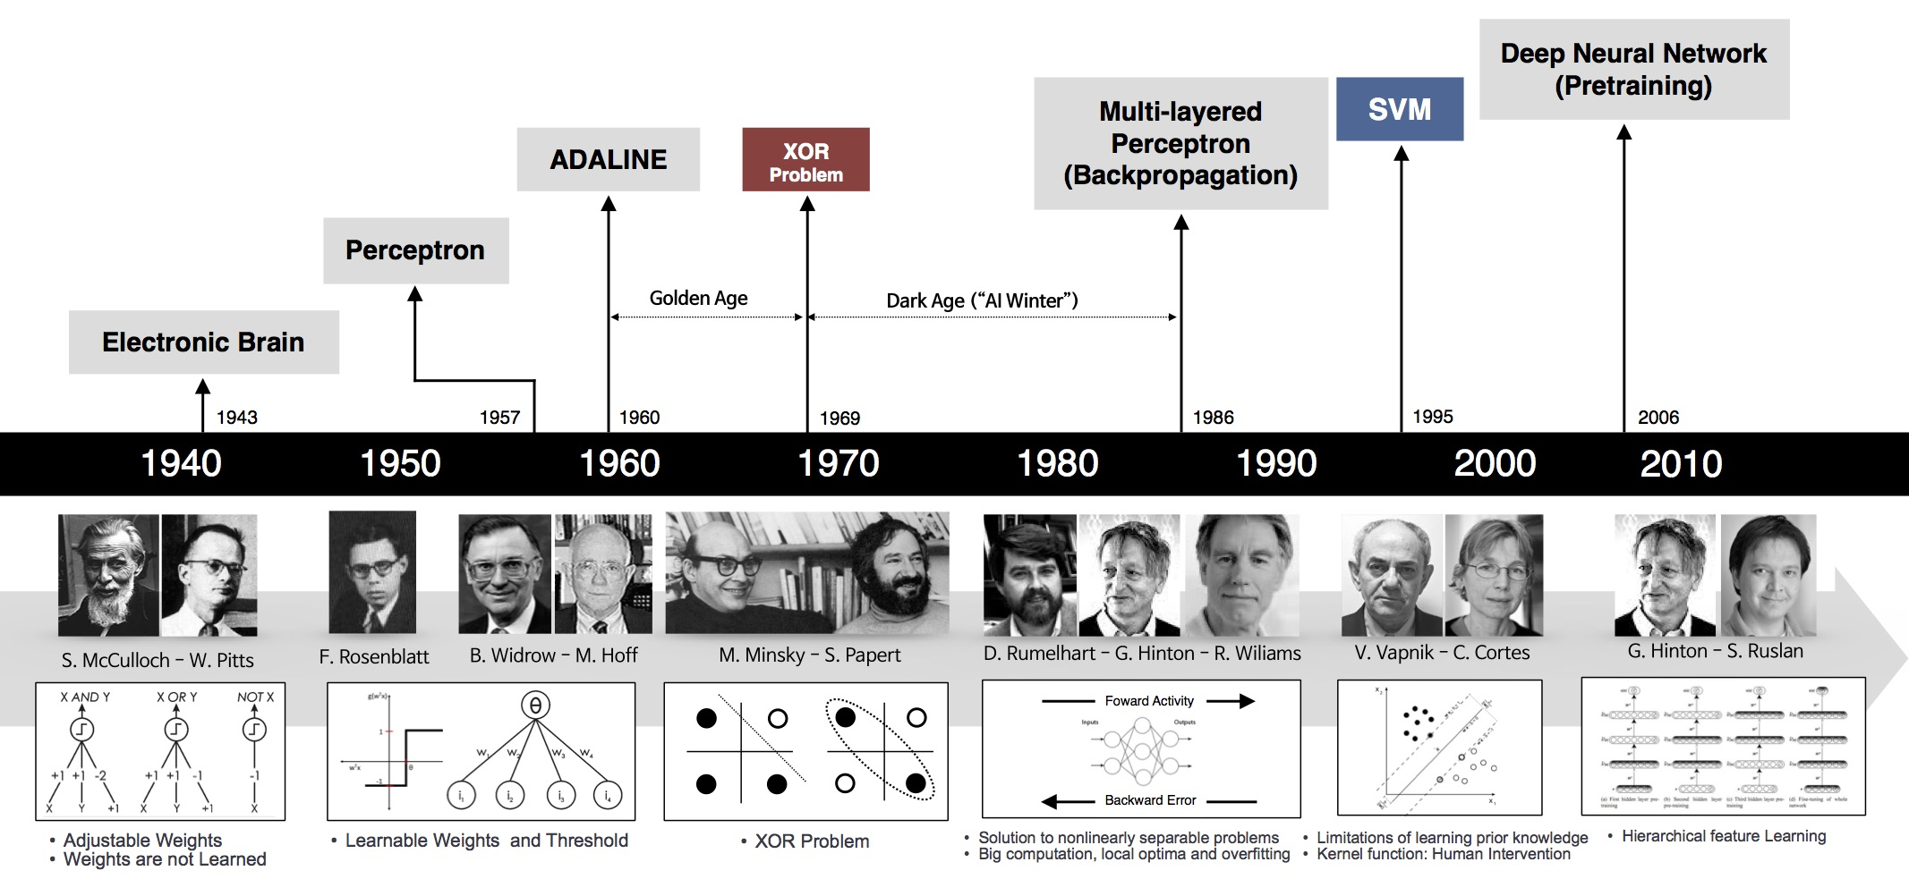
Developments in Neural Learning Systems
https://www.slideshare.net/barbarafusinska/networks-are-like-onions-practical-deep-learning-with-tensorflow

Slide 63
Two deep inference
models
Predictive
Generative
Predict the category/class of
an object by learning a model
Generate a new object that closely
matches to those in a limited training
set by closely approximating the
underlying (but unknown) probability
distribution of the set of objects.
Example: CNN
Example: GAN

Slide 64
The 2012 Breakthrough in Predictive Learning….
A Krizhevsky, I Sutskever, and GE Hinton, “Imagenet classification with deep convolutional neural networks”, Advances in neural information processing systems (NIPS 2012), 1097-1105
Has 32,000+ citations by now!!
Reduced the error rate on imagenet under LSVRC to 16%
Later evolved into Alexnet.

Slide 65
Deep Learning: Acknowledging Some Resources used here…
“Neural Networks and Deep Learning”
  written by Michael Nielsen
  http://neuralnetworksanddeeplearning.com/
“Deep Learning”
  Written by Ian J. Goodfellow, Yoshua Bengio, and Aaron Courville
  http://www.iro.umontreal.ca/~bengioy/dlbook/
  Deep Learning Tutorial. Hung-yi Lee, NTU.
  Brandon Rohrer on LinkedIn
  Roger Grosse, CycleGAN

Slide 66
Deep Learning
What people already knew in 1980s
Notes:
Three questions:
Model
Cost
Train

Slide 67
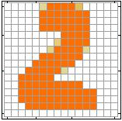
Example Application
Handwriting Digit Recognition
Machine
“2”
Notes:
“Hello world” for deep learning
Data: http://yann.lecun.com/exdb/mnist/

Slide 68
Handwriting Digit Recognition
Input
Output
y₁
is 1
0.1
y₂
is 2
0.7
The image is “2”
……
……
……
y₁₀
0.2
is 0
16 x 16 = 256
Ink → 1
No ink → 0
Each dimension represents the confidence of a digit.
Notes:
The same for even more complex tasks.

Slide 69
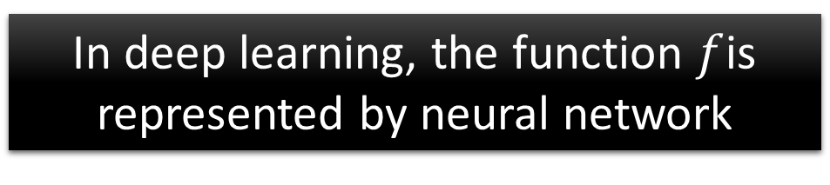

Example Application
Handwriting Digit Recognition
y₁
Machine
y₂
“2”
……
……
y₁₀
$$f:R^{256}→R^{10}$$
In deep learning, the function $f$is represented by neural network

Slide 70

Element of Neural Network
Neuron
$$f:R^{K}→R$$
…
Activation function
weights
bias
Notes:
sigmoid

Slide 71
Neural Network
neuron
Input
Layer 1
Layer 2
Layer L
Output
……
y₁
……
y₂
……
……
……
……
……
……
y_{M}
Input Layer
Output Layer
Hidden Layers
Deep means many hidden layers
Notes:
Fully Connected Feedforward Network
You can always connect the neurons in your own way.
“+” is ignored
Each dimension corresponds to a digit (10 dimension is needed)

Slide 72



Neural Network
……
y₁
W¹
W²
W^{L}
……
y₂
b¹
b²
b^{L}
……
……
……
……
……
x
a¹
a²
y
……
y_{M}
W¹
x
b¹
+
$$σ\left( \right)$$
a¹
b²
W²
+
$$σ\left( \right)$$
W^{L}
b^{L}
a^{L-1}
+
$$σ\left( \right)$$
Notes:
Draw it?

Slide 73


Neural Network
……
y₁
W¹
W²
W^{L}
……
y₂
b¹
b²
b^{L}
……
……
……
……
……
x
a¹
a²
y
……
y_{M}
y
x
Using parallel computing techniques to speed up matrix operation
$$=f\left( \right)$$
W^{L}
…
W²
W¹
x
b¹
b²
…
b^{L}
+
+
+
$$σ\left( \right)$$
$$=σ\left( \right)$$
$$σ\left( \right)$$
Notes:
Draw it?

Slide 74


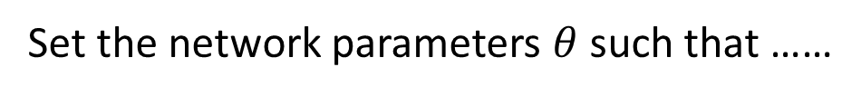
How to set network parameters
$$θ=\left\{W^{1},b^{1},W^{2},b^{2},⋯W^{L},b^{L}\right\}$$
……
y₁
is 1
0.1
……
y₂
0.7
is 2
Softmax
……
……
……
……
y₁₀
is 0
0.2
16 x 16 = 256
Ink → 1
No ink → 0
Set the network parameters $θ$ such that ……
Input:
How to let the neural network achieve this
y₁ has the maximum value
Input:
y₂ has the maximum value

Slide 75








Training Data
Preparing training data: images and their labels
“5”
“0”
“4”
“1”
“9”
“2”
“1”
“3”
Using the training data to find the network parameters.

Slide 76

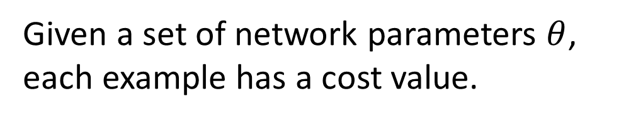
Cost
Given a set of network parameters $θ$, each example has a cost value.
“1”
……
y₁
0.2
1
……
y₂
0
0.3
……
……
……
Cost
……
……
……
y₁₀
$$L(θ)$$
0
0.5
target
Cost can be Euclidean distance or cross entropy of the network output and target
Notes:
With softmax, the summation of all the ouputs would be one.
Can be considered as probability if you want ……

Slide 77
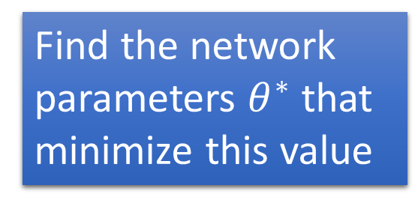


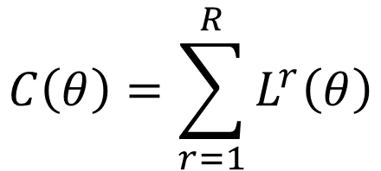






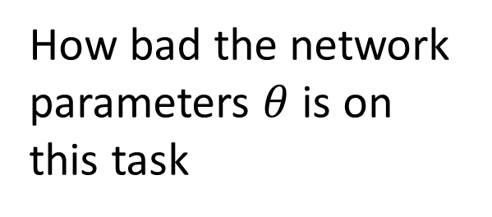
Total Cost
For all training data …
Total Cost:
NN
$$C\left(θ\right)=\sum_{r=1}^{R}{L^{r}\left(θ\right)}$$
x¹
y¹
$${\hat{y}}^{1}$$
$$L^{1}\left(θ\right)$$
x²
NN
y²
$${\hat{y}}^{2}$$
How bad the network parameters $θ$ is on this task
$$L^{2}\left(θ\right)$$
x³
NN
y³
$${\hat{y}}^{3}$$
$$L^{3}\left(θ\right)$$
……
……
……
……
Find the network parameters $θ^{∗}$ that minimize this value
x^{R}
NN
y^{R}
$${\hat{y}}^{R}$$
$$L^{R}\left(θ\right)$$
Notes:
Randomly picked one
Two approaches update the parameters towards the same direction, but stochastic is faster!
Better!

Slide 78
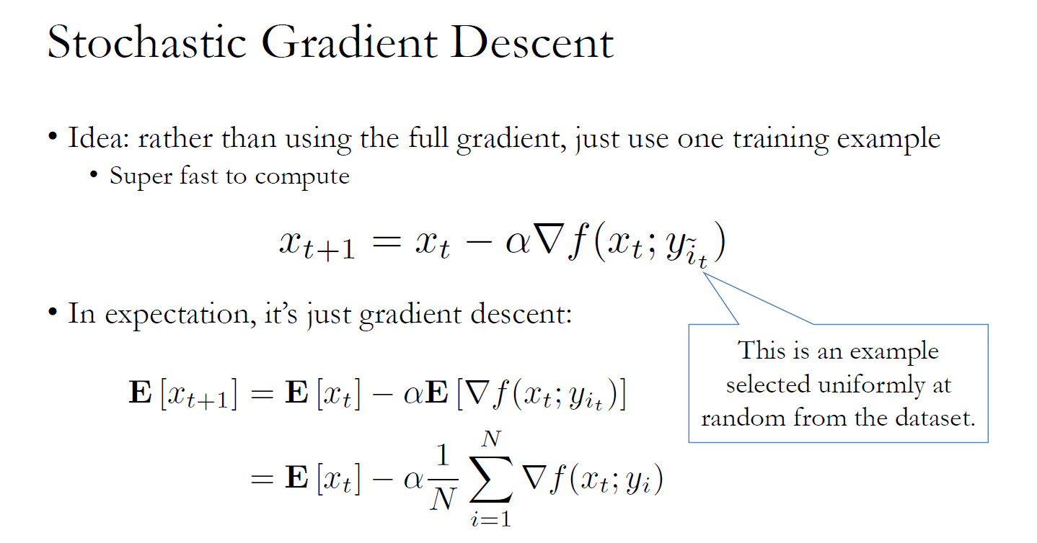
(SGD)
- A special case of mini-batch gradient descent with batch size 1
Herbert Robbins and Sutton Monro, A Stochastic Approximation Method,The Annals of Mathematical Statistics, Vol. 22, No. 3. (Sep., 1951), pp. 400-407.

Slide 79
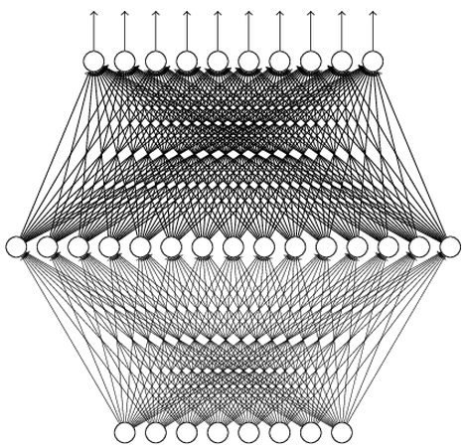
Universality Theorem
Any continuous function f
Can be realized by a network with one hidden layer
(given enough hidden neurons)
Reference for the reason: http://neuralnetworksanddeeplearning.com/chap4.html
Why “Deep” neural network not “Fat” neural network?

Slide 80
Fat + Short v.s. Thin + Tall
The same number of parameters
Which one is better?
……
……
……
Shallow
Deep

Slide 81
Why Deep?
Deep → Modularization
Classifier 1
Girls with
long hair
Long hair women
Long hair women
Long hair women
Long hair women
Classifier 2
Boys with
long hair
Cheiko
Image
weak
Little examples
Classifier 3
Girls with
short hair
Short hair woman
Short hair woman
Short hair woman
Short hair woman
Classifier 4
Boys with short hair
Short hair male
Short hair male
Short hair male
Short hair male
Notes:
Programming -> all in main -> so long and bad
-> function -> shorter

Slide 82
Why Deep?
Each basic classifier can have sufficient training examples.
Deep → Modularization
Long hair woman
Chieko
Long hair woman
Boy or Girl?
Short hair woman
Long hair woman
Short hair woman
Long hair woman
Short hair woman
v.s.
Short hair male
Short hair woman
Short hair male
Image
Short hair male
Short hair male
Basic
Classifier
Long hair woman
Short hair woman
Long or short?
Long hair woman
Short hair woman
Long hair woman
Short hair woman
Long hair woman
Short hair woman
v.s.
Short hair male
Chieko
Short hair male
Classifiers for the attributes
Short hair male
Short hair male

Slide 83
Why Deep?
can be trained by little data
Deep → Modularization
Classifier 1
Girls with
long hair
Boy or Girl?
Classifier 2
Boys with
long hair
Image
Basic
Classifier
fine
Little data
Classifier 3
Girls with
short hair
Long or short?
Classifier 4
Boys with short hair
Sharing by the following classifiers as module

Slide 84
Why Deep?
→ Less training data?
Deep → Modularization
……
The modularization is automatically learned from data.
……
……
……
……
……
……
The most basic classifiers
Use 1st layer as module to build classifiers
Use 2nd layer as module ……
Notes:
Need less data!!!!!

Slide 85
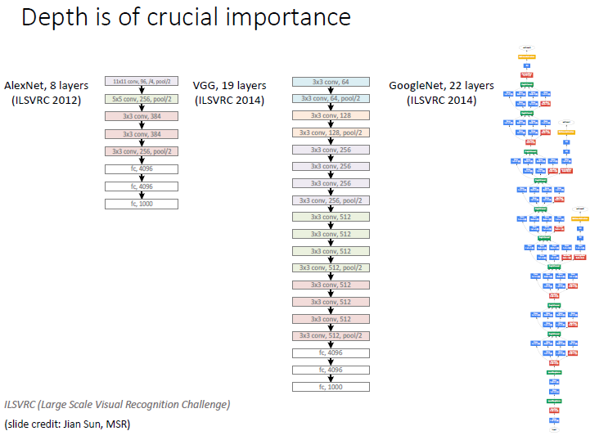
Theory is picking up only recently:
J. Andén and S. Mallat, “Deep scattering spectrum,” IEEE Trans. Signal Process., vol. 62, no. 16, pp. 4114–4128, Aug. 2014.
T. Wiatowski and H. Bölcskei, "A Mathematical Theory of Deep Convolutional Neural Networks for Feature Extraction," in IEEE Transactions on Information Theory, vol. 64, no. 3, pp. 1845-1866, March 2018.

Slide 86

Generative Adversarial Network (GAN)
The 2014 breakthrough:
Goodfellow, Ian; Pouget-Abadie, Jean; Mirza, Mehdi; Xu, Bing; Warde-Farley, David; Ozair, Sherjil; Courville, Aaron; Bengio, Yoshua. "Generative Adversarial Networks". arXiv:1406.2661, NIPS 2014
6000+ citations till date!
"the most interesting idea in the last 10 years in machine learning."
- Yann LeCun, director of AI research at Facebook
GANs were used to create the 2018 painting Edmond de Belamy which sold for $432,500

Slide 93
J. Zhu et al. Unpaired image-to-image translation using cycle-consistent adversarial networks. In International Conference on Computer Vision (ICCV), 2017

Slide 94
Sparse Methods for Machine Learning
F. Bach, NIPS 2010 Tutorial

Slide 96
The Sparse k-means Clustering…
Weighted between cluster sun of the
squares for feature j
Objective Function:
The sparse penalty
Witten, D. M. and Tibshirani, R. (2010) A framework for feature selection in clustering. J. Am. Statist. Ass., 105, 713–726.

Slide 97


Semi-supervised Learning
…Because labeled data is so costly!!!
Semi-supervised Classification…
Semi-supervised Clustering…
Wagstaff K.L. (2011) Constrained Clustering. In: Sammut C., Webb G.I. (eds) Encyclopedia of Machine Learning. Springer, Boston, MA

Slide 98
Ever Tough Challenge to ML: Data Irregularities
Data Irregularities
Distribution based
Class Imbalance
Class Skew
Feature based
Missing Features
Small Disjuncts
Absent Features
Das et al., "Handling data irregularities in classification: foundations, trends, and future challenges", Pattern Recognition, Elsevier, 2018.

Slide 99
Imbalance in the Deep Learning Era
Wang et al., NIPS 2017

Slide 100
Many other facets of machine learning are
gaining momentum….
Few Shot Learning
(ICLR 2019 Open Review: https://openreview.net/forum?id=HkxLXnAcFQ)
Extreme Class Classification Problems
(NIPS 2017 Workshop: http://manikvarma.org/events/XC17/index.html)
Privacy preserving learning
(NeurIPS 2018 Workshop on PPML:https://ppml-workshop.github.io/ppml/)
Multi-label learning
(A nice survey in IEEE TKDE: https://ieeexplore.ieee.org/stamp/stamp.jsp?arnumber=6471714)
Meta-learning and learning to learn
(see Sebastian Thrun’s homepage: http://robots.stanford.edu/papers/thrun.book3.html)

Slide 101

However, with back-propagation and other methods,
are we really any closer to how the brain functions?
“The future depends on some graduate student who is deeply suspicious of everything I have said.”
Geoffrey E. Hinton, widely revered as the “godfather of deep learning”
So, keep on doubting!

Slide 102

…and that’s it!
Thank You

