Slide 1
High Dimensional Search
Min-Hashing
Locality Sensitive Hashing
Debapriyo Majumdar
Data Mining – Fall 2014
Indian Statistical Institute Kolkata
September 8 and 11, 2014

Slide 2
High Support Rules vs Correlation of Rare Items
Recall: association rule mining
  Items, trasactions
  Itemsets: items that occur together
  Consider itemsets (items that occur together) with minimum support
  Form association rules
Very sparse high dimensional data
  Several interesting itemsets have negligible support
  If support threshold is very low, many itemsets are frequent → high memory requirement
  Correlation: rare pair of items, but high correlation
  One item occurs → High chance that the other may occur

Slide 3
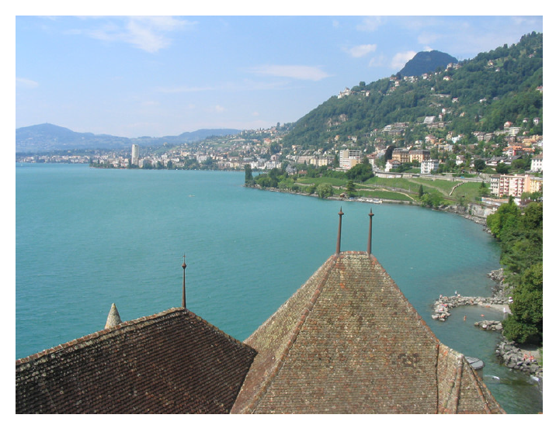

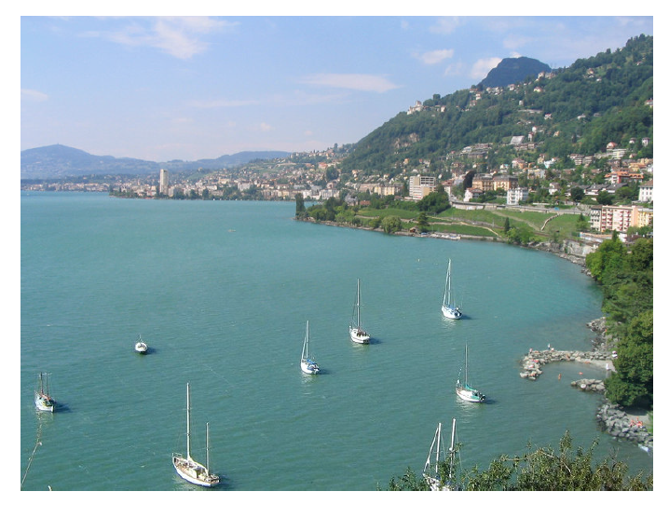
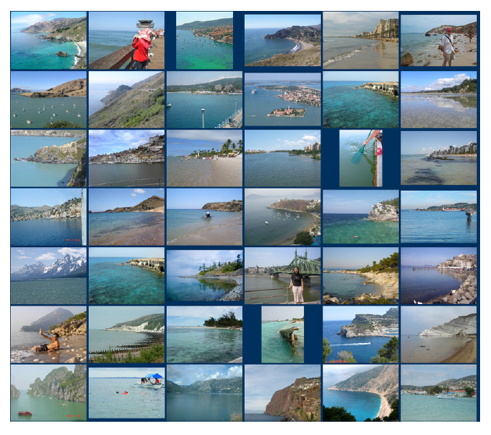
Scene Completion: Hyes and Efros (2007)
Source of this slide’s material: http://www.eecs.berkeley.edu/~efros
Search for similar images among many images
Remove this part and set as input
Find k most similar images
Reconstruct the missing part of the image

Slide 4
Use Cases of Finding Nearest Neighbors
Product recommendation
  Products bought by same or similar customers
Online advertising
  Customers who visited similar webpages
Web search
  Documents with similar terms (e.g. the query terms)
Graphics
  Scene completion

Slide 5
Use Cases of Finding Nearest Neighbors
Product recommendation
Online advertising
Web search
Graphics

Slide 6
Use Cases of Finding Nearest Neighbors
Product recommendation
  Millions of products, millions of customers
Online advertising
  Billions of websites, Billions of customer actions, log data
Web search
  Billions of documents, millions of terms
Graphics
  Huge number of image features
All are high dimensional spaces

Slide 7
The High Dimension Story
As dimension increases
The average distance between points increases
Less number of neighbors in the same radius
1-D
2-D

Slide 8
Data Sparseness
Product recommendation
  Most customers do not buy most products
Online advertising
  Most uses do not visit most pages
Web search
  Most terms are not present in most documents
Graphics
  Most images do not contain most features
But a lot of data are available nowadays

Slide 9
Distance
Distance (metric) is a function defining distance between elements of a set X
A distance measure d : X × X → R (real numbers) is a function such that
  For all x, y ∈ X, d(x,y) ≥ 0
  For all x, y ∈ X, d(x,y) = 0 if and only if x = y (reflexive)
  For all x, y ∈ X, d(x,y) = d(y,x) (symmetric)
  For all x, y, z ∈ X, d(x,z) + d(z,y) ≥ d(x,y) (triangle inequality)

Slide 10
Distance measures
Euclidean distance (L₂ norm)
  Manhattan distance (L₁ norm)
  Similarly, L∞ norm
Cosine distance
  Angle between vectors to x and y drawn from the origin
Edit distance between string of characters
  (Minimum) number of edit operations (insert, delete) to obtain one string to another
Hamming distance
  Number of positions in which two bit vectors differ

Slide 11
Problem: Find Similar Documents
Given a text document, find other documents which are very similar
  Very similar set of words, or
  Several sequences of words overlapping
Applications
  Clustering (grouping) search results, news articles
  Web spam detection
Broder et al. (WWW 2007)

Slide 12
Shingles
Syntactic Clustering of the Web: Andrei Z. Broder, Steven C. Glassman, Mark S. Manasse, Geoffrey Zweig
A document
  A sequence of words, a canonical sequence of tokens (ignoring formatting, html tags, case)
  Every document D is a set of subsequences or tokens S(D,w)
Shingle: a contiguous subsequence contained in D
For a document D, define its w-shingling S(D, w) as the set of all unique shingles of size w contained in D
  Example: the 4-shingling of (a,car,is,a,car,is,a,car) is the set
{ (a,car,is,a), (car,is,a,car), (is,a,car,is) }

Slide 13
Resemblance
Fix a large enough w, the size of the shingles
Resemblance of documents A and B
Jaccard similarity between two sets
Resemblance distance is a metric
Containment of document A in document B
Notes:
Large enough w, otherwise too many shingles will be common across many documents

Slide 14
Brute Force Method
We have: N documents, similarity / distance metric
Finding similar documents in brute force method is expensive
  Finding similar documents for one given document: O(N)
  Finding pairwise similarities for all pairs: O(N²)

Slide 15
Locally Sensitive Hashing (LSH): Intuition
Two points are close to each other in a high dimensional space → They remain close to each other after a “projection” (map)
If two points are not close to each other in a high dimensional space, they may come close after the mapping
However, it is quite likely that two points that are far apart in the high dimensional space will preserve some distance after the mapping also
2-D
1-D

Slide 16
LSH for Similar Document Search
Documents are represented as set of shingles
  Documents D₁ and D₂ are points at a (very) high dimensional space
  Documents as vectors, the set of all documents as a matrix
  Each row corresponds to a shingle,
  Each column corresponds to a document
  The matrix is very sparse
Need a hash function h, such that
  If d(D₁, D₂) is high, then dist(h(D₁), h(D₂)) is high, with high probability
  If d(D₁, D₂) is low, then dist(h(D₁), h(D₂)) is low, with high probability
Then, we can apply h on all documents, put them into hash buckets
Compare only documents in the same bucket
Some appropriate distance function, not the same as d

Slide 17
Min-Hashing
Defining the hash function h as:
  Choose a random permutation σ of m = number of shingles
  Permute all rows by σ
  Then, for a document D, h(D) = index of the first row in which D has 1
 | D1 | D2 | D3 | D4 | D5
S1 | 0 | 1 | 1 | 1 | 0
S2 | 0 | 0 | 0 | 0 | 1
S3 | 1 | 0 | 0 | 0 | 0
S4 | 0 | 0 | 1 | 0 | 0
S5 | 0 | 0 | 0 | 1 | 0
S6 | 0 | 1 | 1 | 0 | 0
S7 | 1 | 0 | 0 | 0 | 0
S8 | 1 | 0 | 0 | 0 | 1
S9 | 0 | 1 | 1 | 0 | 0
S10 | 0 | 0 | 1 | 0 | 0
σ
3
1
7
10
6
2
5
9
8
4
 | D1 | D2 | D3 | D4 | D5
S2 | 0 | 0 | 0 | 0 | 1
S6 | 0 | 1 | 1 | 0 | 0
S1 | 0 | 1 | 1 | 1 | 0
S10 | 0 | 0 | 1 | 0 | 0
S7 | 1 | 0 | 0 | 0 | 0
S5 | 0 | 0 | 0 | 1 | 0
S3 | 1 | 0 | 0 | 0 | 0
S9 | 0 | 1 | 1 | 0 | 0
S8 | 1 | 0 | 0 | 0 | 1
S4 | 0 | 0 | 1 | 0 | 0
h(D)
D1 | D2 | D3 | D4 | D5
5 | 2 | 2 | 3 | 1

Slide 18
Property of Min-hash
How does Min-Hashing help us?
Do we retain some important information after hashing high dimensional vectors to one dimension?
Property of MinHash
The probability that D₁ and D₂ are hashed to the same value is same as the resemblance of D₁ and D₂
In other words,
P[h(D₁) = h(D₂)] = r(D₁, D₂)

Slide 19
Proof
There are four types of rows
Let n_{x} be the number of rows of type x ∈{11, 01, 10, 00}
Note:
 | D1 | D2
Type 11 | 1 | 1
Type 10 | 1 | 0
Type 01 | 0 | 1
Type 00 | 0 | 0
Now, let σ be a random permutation. Consider σ(D₁)
Let j = h(D₁) be the index of the first 1 in σ(D₁)
Let x_{j} be the type of the j-th row
Observe: h(D₁) = h(D₂) = j if and only if x_{j} = 11
Also, x_{j} ≠ 00
So,

Slide 20
Using one min-hash function
High similarity documents go to same bucket with high probability
Task: Given D₁, find similar documents with at least 75% similarity
Apply min-hash:
  Documents which are 75% similar to D₁ fall in the same bucket with D₁ with 75% probability
  Those documents do not fall in the same bucket with about 25% probability
  Missing similar documents and false positives

Slide 21
Min-hash Signature
Hundreds, but still less than the number of dimensions
Create a signature for a document D using many independent min-hash functions
Compute similarity of columns by the similarity in their signatures
Signature matrix
 |  | D1 | D2 | D3 | D4 | D5
SIG(1) | h₁ | 5 | 2 | 2 | 3 | 1
SIG(2) | h₂ | 3 | 1 | 1 | 5 | 2
SIG(3) | h₃ | 1 | 4 | 4 | 1 | 3
 | … | … | … | … | … | …
SIG(n) | h_{n} | … | … | … | … | …
Example (considering only 3 signatures):
Sim_{SIG}(D₂,D₃) = 1
Sim_{SIG}(D₁,D₄) = 1/3
Observe:
E[Sim_{SIG}(D_{i},D_{j})] = r(D_{i},D_{j}) for any 0 < i, j < N (#documents)

Slide 22
Computational Challenge
Computing signature matrix of a large matrix is expensive
  Accessing random permutation of billions of rows is also time consuming
Solution:
  Pick a hash function h : {1, …, m} → {1, …, m}
  Some pairs of integers will be hashed to the same value, some values (buckets) will remain empty
  Example: m = 10, h : k → (k + 1) mod 10
  Almost equivalent to a permutation

Slide 23
Computing a Signature Matrix
Pick n hash functions on the rows (not permutations): h₁, h₂,…, h_{n}
Let SIG(i,j) = the (i,j)-th entry of the signature matrix (i-th hash function, j-th document)
  For each row r BEGIN
    Compute h₁(r), h₂(r),…, h_{n}(r)
    For each column j BEGIN
      If the j-th column has 1 in row r
        For each i = 1, 2, … , n BEGIN
          set SIG(i,j) = min{SIG(i,j), h_{i}(r)}
        END
      END IF
    END
  END

Slide 24
Example

Slide 25
Locality Sensitive Hashing
Suppose there is a hashing scheme such that
  Each time hashing: similar documents are likely to fall into same bucket, dissimilar documents are less likely to fall into same bucket
Main idea
  Hash several times: Dissimilar documents are very unlikely to fall into the same bucket several times
  Two documents fall into the same bucket several times → They are likely to be similar
  Candidate pair: a pair of documents which has to the same bucket at least some number of times

Slide 26
Locality Sensitive Hashing
Banding of hash functions: b bands, r rows each
For each band, hash portion of each column to some bucket (k buckets)
Two columns agree on at least one band → the corresponding pair of documents is a candidate pair
Band 1 | ……
Band 2 |  |  |  |  |  | ……
 | ……
Band b | ……
r rows
These two columns agree on this band → They are a candidate pair

Slide 27
Locality Sensitive Hashing
A band (portion) of two columns hashing to same bucket
High probability that those bands of those columns are identical
Signature of two documents matching significantly
Candidate pairs
Band 1 | ……
Band 2 |  |  |  |  |  | ……
 | ……
Band b | ……
r rows
These two columns agree on this band → They are a candidate pair

Slide 28
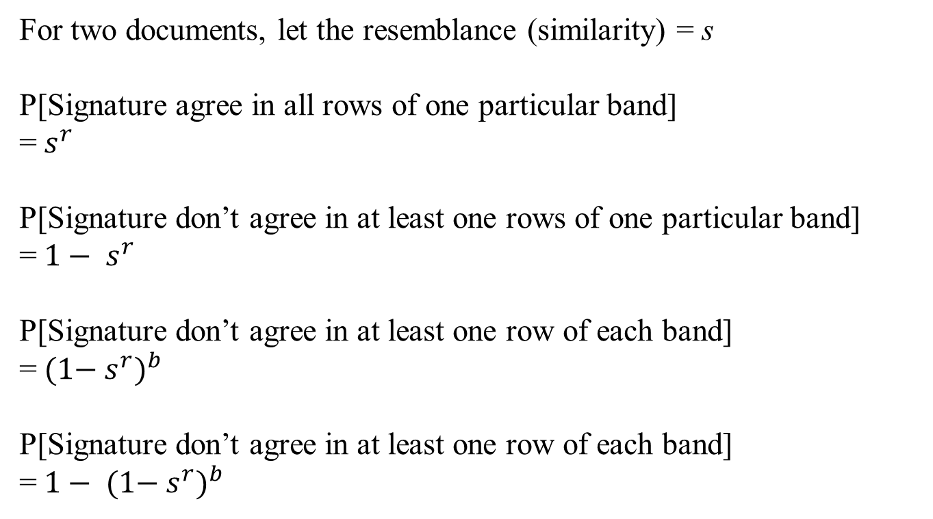
Analysis of LSH
Signature: n (hash functions)× N, b bands, r rows per band
For two documents, let the resemblance (similarity) = s
P[Signature agree in all rows of one particular band]
=${ s}^{r}$
P[Signature don’t agree in at least one rows of one particular band]
=${ 1− s}^{r}$
P[Signature don’t agree in at least one row of each band]
=$({1−{ s}^{r})}^{b}$
P[Signature don’t agree in at least one row of each band]
=$1− ({1−{ s}^{r})}^{b}$

Slide 29
What we want
1
1
Similarity > t → Surely same bucket
Prob (Candidate pair)
Prob (Candidate pair)
One Min-hashing: probability same bucket ~ doc similarity
Similarity < t → Surely not same bucket
0
0
0
Original document similarity
1
0
Original document similarity
1
Tune r and b to get the desired step function

Slide 30
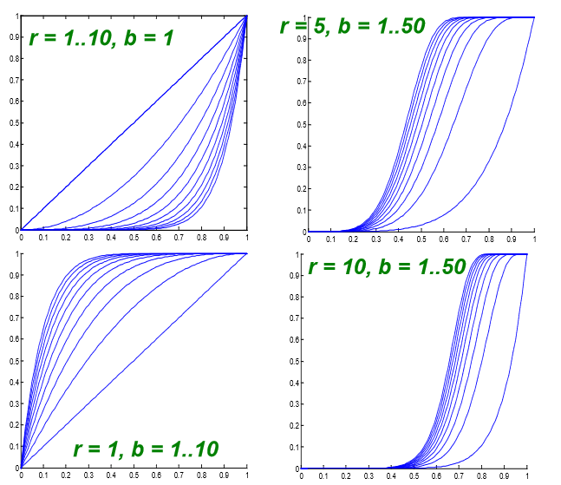
Tuning b and r
Credit for the plots: Jure Leskovec, Stanford University
By tuning b and r we can get a desired step function
Prob (Candidate pair)
Prob (Candidate pair)
Resemblance (similarity) of documents

Slide 31
Generalization: LSH Family of Functions
Conditions for the family of functions
  Declares closer pairs as candidate pairs with higher probability than a pair that are not close to each other
  Statistically independent: product rule for independent events can be used
  Efficient in identifying candidate pairs much faster than exhaustive pairwise computation
  Efficient in combining for avoiding false positives and false negatives

Slide 32
General Definition
Let d₁ < d₂ be two distances (say between two pairs of points)
A family F of functions is said to be (d₁, d₂, p₁, p₂)-sensitive, if for every f ∈ F, and for some 0 ≤ p₁, p₂ ≤ 1 we have:
  If d(x,y) ≤ d₁ then P[f(x) = f(y)] ≥ p₁
  If d(x,y) ≥ d₂ then P[f(x) = f(y)] ≤ p₂
If two points are close enough, then probability that they are mapped to the same value is high enough
p₁
If two points are far enough, then probability that they are mapped to the same value is small enough
p₂
Prob (Candidate pair)
d₁
d₂
distance

Slide 33

The Min-Hash Function
Class exercise:
The family of min-hash functions is (d₁, d₂, 1 $−$d₁, 1 $−$d₂)-sensitive for any d₁ and d₂ such that 0 ≤ d₁ ≤ d₂ ≤ 1

Slide 34
General Definition
Let d₁ < d₂ be two distances (say between two pairs of points)
A family F of functions is said to be (d₁, d₂, p₁, p₂)-sensitive, if for every f ∈ F, and for some 0 ≤ p₁, p₂ ≤ 1 we have:
  If d(x,y) ≤ d₁ then P[f(x) = f(y)] ≥ p₁
  If d(x,y) ≥ d₂ then P[f(x) = f(y)] ≤ p₂
If two points are close enough, then probability that they are mapped to the same value is high enough
  Like to make p₁ and p₂ far apart
p₁
If two points are far enough, then probability that they are mapped to the same value is small enough
p₂
Prob (Candidate pair)
Cannot say anything about some d if 0 ≤ d₁ ≤ d ≤ d₂ ≤ 1
d₁
d₂
distance
Given

Slide 35
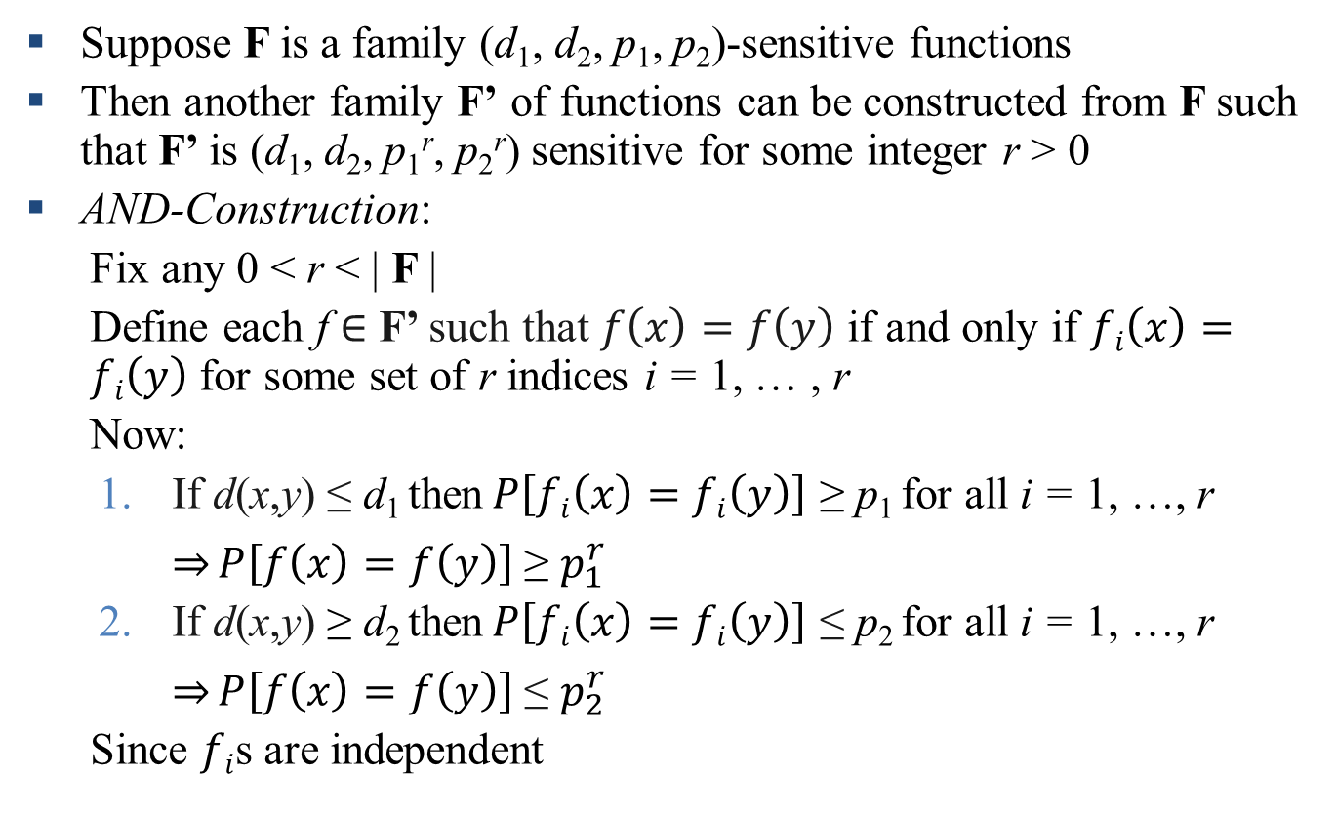
Amplifying an LSH Family
Suppose F is a family (d₁, d₂, p₁, p₂)-sensitive functions
Then another family F’ of functions can be constructed from F such that F’ is (d₁, d₂, p₁^{r}, p₂^{r}) sensitive for some integer r > 0
AND-Construction:
  Fix any 0 < r < | F |
  Define each f ∈ F’ such that $f\left(x\right)=f\left(y\right)$ if and only if $fi\left(x\right)=fi\left(y\right)$ for some set of r indices i = 1, … , r
  Now:
  If d(x,y) ≤ d₁ then$P\left[fi\left(x\right)=fi\left(y\right)\right]$ ≥ p₁ for all i = 1, …, r $\underset{⇒}{}P\left[f\left(x\right)=f\left(y\right)\right]$ ≥ $p_{1}^{r}$
  If d(x,y) ≥ d₂ then$P\left[fi\left(x\right)=fi\left(y\right)\right]$ ≤ p₂ for all i = 1, …, r $\underset{⇒}{}P\left[f\left(x\right)=f\left(y\right)\right]$ ≤ $p_{2}^{r}$
  Since $fi$s are independent

Slide 36
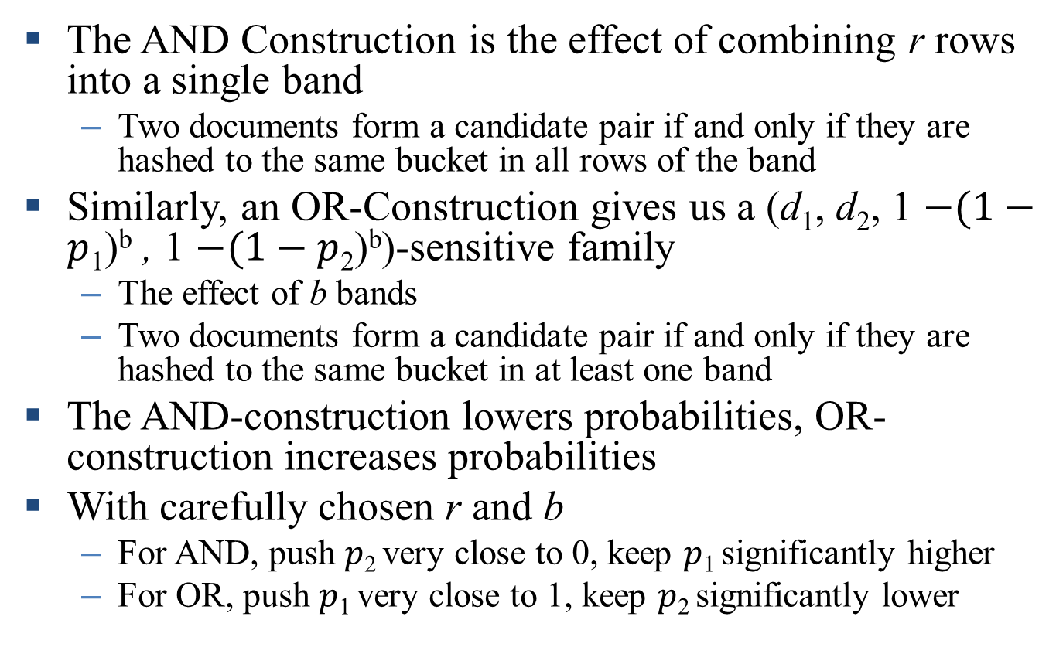
Amplifying
The AND Construction is the effect of combining r rows into a single band
  Two documents form a candidate pair if and only if they are hashed to the same bucket in all rows of the band
Similarly, an OR-Construction gives us a (d₁, d₂, 1 $−(1−p$₁)^{b} , 1 $−(1−p$₂)^{b})-sensitive family
  The effect of b bands
  Two documents form a candidate pair if and only if they are hashed to the same bucket in at least one band
The AND-construction lowers probabilities, OR-construction increases probabilities
With carefully chosen r and b
  For AND, push $p$₂ very close to 0, keep $p$₁ significantly higher
  For OR, push $p$₁ very close to 1, keep $p$₂ significantly lower

Slide 37
References and Acknowledgements
The book “Mining of Massive Datasets” by Leskovec, Rajaraman and Ullman
Slides by Leskovec, Rajaraman and Ullman from the courses taught in the Stanford University

