Slide 1
Linear Discriminant Analysis
Debapriyo Majumdar
Data Mining – Fall 2014
Indian Statistical Institute Kolkata
August 28, 2014

Slide 2
The owning house data
Can we separate the points with a line?
Equivalently, project the points onto another line so that the projection of the points in the two classes are separated

Slide 3
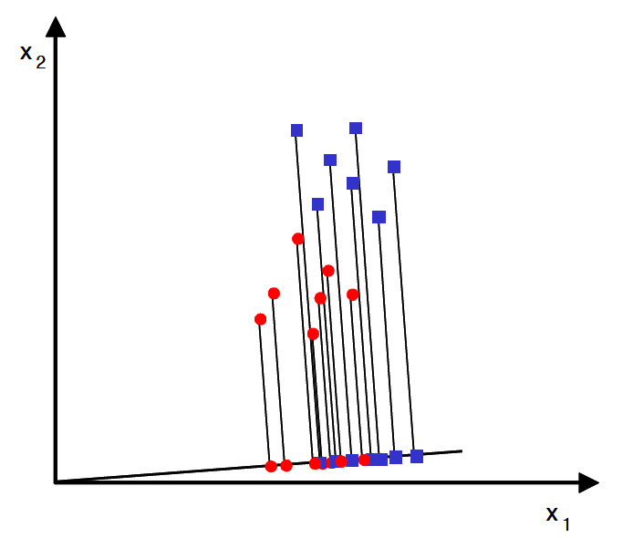
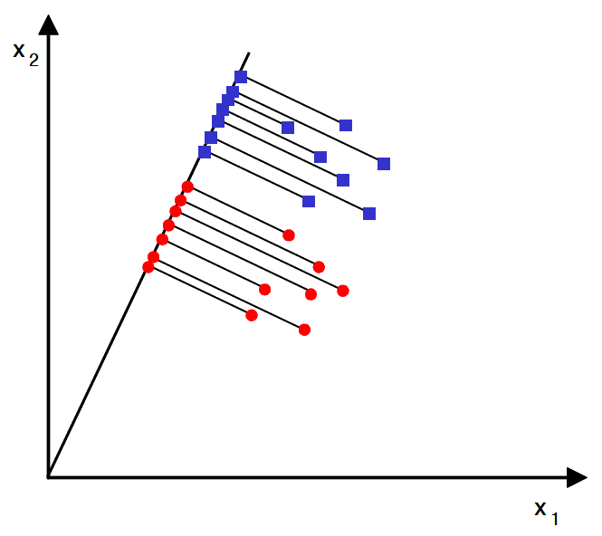
Linear Discriminant Analysis (LDA)
Not same as Latent Dirichlet Allocation (also LDA)
Reduce dimensionality, preserve as much class discriminatory information as possible
A projection with non-ideal separation
A projection with ideal separation
The figures are from Ricardo Gutierrez-Osuna’s slides

Slide 4
Projection onto a line – basics
1×2 vector
norm=1
represents
the x axis
2×2 matrix
two data points
(0.5,0.7) and (1.1,0.8)
Projection onto the x axis
Distances from the origin
Projection onto the y axis
Distances from the origin

Slide 5
Projection onto a line – basics
1×2 vector, norm=1
the x=y line
Projection onto the x=y line
Distances from the origin
distance of projection of x onto the line along w from origin = w^{T}x
w^{T}x :
a scalar
x : any point
w : some unit vector

Slide 6
Projection vector for LDA
Define a measure of separation (discrimination)
Mean vectors μ₁ and μ₂ for the two classes c₁ and c₂, with N₁ and N₂ points:
The mean vector projected onto the a unit vector w:

Slide 7
Towards maximizing separation
One approach: find a line such that the distance between projected means is maximized
Objective function J(w)
Example: if w is the unit vector along x or y axis
μ₁
Better separation
μ₂
Better separation of means

Slide 8
How much are the points scattered?
Scatter: within each class, variance of the projected points
Within-class scatter of the projected samples:
μ₁
μ₂

Slide 9
Fisher’s discriminant
Maximize difference between the projected means, normalized by within-class scatter
μ₁
Separation of means and the points as well
μ₂

Slide 10
Formulation of the objective function
Measure of scatter in the feature space (x)
The within-class scatter matrix is: S_{W} = S₁ + S₂
The scatter of projections, in terms of S_{W}
Hence:

Slide 11
Formulation of the objective function
Similarly, the difference in terms of μ_{i}’s in the feature space
Between class scatter matrix
Fisher’s objective function in terms of S_{B} and S_{W}

Slide 12
Maximizing the objective function
Take derivative and solve for it being zero
Dividing by same denominator
The generalized eigenvalue problem

Slide 13
Limitations of LDA
LDA is a parametric method
  Assumes Gaussian (normal) distribution of data
  What if the data is very much non-Gaussian?
μ₂
μ₁
μ₁=μ₂
LDA depends on mean for the discriminatory information
  What if it is mainly in the variance?
μ₁=μ₂

