Slide 1
Logistic Regression
Debapriyo Majumdar
Data Mining – Fall 2014
Indian Statistical Institute Kolkata
September 1, 2014

Slide 2
Recall: Linear Regression
Power (bhp)
Engine displacement (cc)
Assume: the relation is linear
Then for a given x (=1800), predict the value of y
Both the dependent and the independent variables are continuous

Slide 3
Scenario: Heart disease – vs – Age
Training set
Yes
Age (numarical): independent variable
Heart disease (Yes/No): dependent variable with two classes
Task: Given a new person’s age, predict if (s)he has heart disease
Heart disease (Y)
No
Age (X)
The task: calculate P(Y = Yes | X)

Slide 4
Scenario: Heart disease – vs – Age
Training set
Yes
Age (numarical): independent variable
Heart disease (Yes/No): dependent variable with two classes
Task: Given a new person’s age, predict if (s)he has heart disease
Heart disease (Y)
No
Age (X)
Calculate P(Y = Yes | X) for different ranges of X
A curve that estimates the probability P(Y = Yes | X)

Slide 5
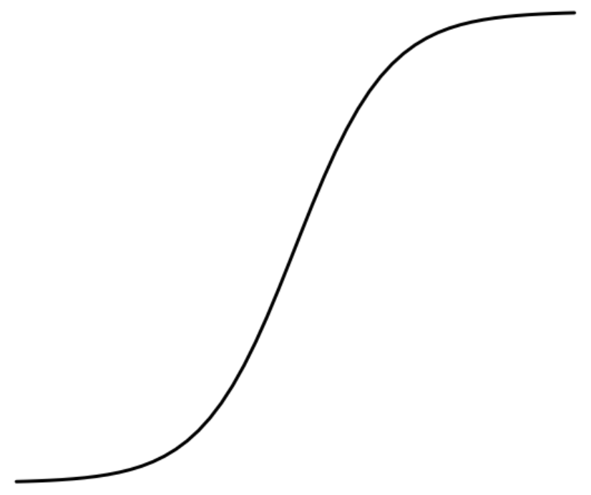
The Logistic function
Logistic function on t : takes values between 0 and 1
If t is a linear function of x
L(t)
Logistic function becomes:
t
The logistic curve
Probability of the dependent variable Y taking one value against another

Slide 6
The Likelihood function
Let, a discrete random variable X has a probability distribution p(x; θ), that depends on a parameter θ
In case of Bernoulli’s distribution
Intuitively, likelihood is “how likely” is an outcome being estimated correctly by the parameter θ
  For x = 1, p(x;θ) = θ
  For x = 0, p(x;θ) = 1−θ
Given a set of data points x₁, x₂ ,…, x_{n}, the likelihood function is defined as:

Slide 7
About the Likelihood function
The actual value does not have any meaning, only the relative likelihood matters, as we want to estimate the parameter θ
Constant factors do not matter
Likelihood is not a probability density function
The sum (or integral) does not add up to 1
In practice it is often easier to work with the log-likelihood
Provides same relative comparison
The expression becomes a sum

Slide 8
Example
Experiment: a coin toss, not known to be unbiased
Random variable X takes values 1 if head and 0 if tail
Data: 100 outcomes, 75 heads, 25 tails
Relative likelihood: if θ₁ > θ₂, L(θ₁) > L(θ₂)

Slide 9
Maximum likelihood estimate
Maximum likelihood estimation: Estimating the set of values for the parameters (for example, θ) which maximizes the likelihood function
Estimate:
One method: Newton’s method
  Start with some value of θ and iteratively improve
  Converge when improvement is negligible
May not always converge

Slide 10
Taylor’s theorem
If f is a
  Real-valued function
  k times differentiable at a point a, for an integer k > 0
  Then f has a polynomial approximation at a
In other words, there exists a function h_{k}, such that
and
Polynomial approximation (k-th order Taylor’s polynomial)

Slide 11
Newton’s method
Finding the global maximum w* of a function f of one variable Assumptions:
  The function f is smooth
  The derivative of f at w* is 0, second derivative is negative
Start with a value w = w₀
Near the maximum, approximate the function using a second order Taylor polynomial
Using the gradient descent approach iteratively estimate the maximum of f

Slide 12
Newton’s method
Take derivative w.r.t. w, and set it to zero at a point w₁
Iteratively:
Converges very fast, if at all
Use the optim function in R

Slide 13
Logistic Regression: Estimating β₀ and β₁
Logistic function
Log-likelihood function
  Say we have n data points x₁, x₂ ,…, x_{n}
  Outcomes y₁, y₂ ,…, y_{n}, each either 0 or 1
  Each y_{i} = 1 with probabilities p and 0 with probability 1 − p

Slide 14
Visualization
Fit some plot with parameters β₀ and β₁
Yes
0.25
Heart disease (Y)
0.75
0.5
No
Age (X)

Slide 15
Visualization
Fit some plot with parameters β₀ and β₁
Iteratively adjust curve and the probabilities of some point being classified as one class vs another
Yes
0.25
Heart disease (Y)
0.75
0.5
No
Age (X)
For a single independent variable x the separation is a point x = a

Slide 16
Two independent variables
Separation is a line where the probability becomes 0.5
0.5
0.75
0.25

Slide 17
Classification
Wrapping up classification

Slide 18
Binary and Multi-class classification
Binary classification:
  Target class has two values
  Example: Heart disease Yes / No
Multi-class classification
  Target class can take more than two values
  Example: text classification into several labels (topics)
Many classifiers are simple to use for binary classification tasks
How to apply them for multi-class problems?

Slide 19
Compound and Monolithic classifiers
Compound models
  By combining binary submodels
  1-vs-all: for each class c, determine if an observation belongs to c or some other class
  1-vs-last
Monolithic models (a single classifier)
  Examples: decision trees, k-NN

