Slide 1
PageRank
Debapriyo Majumdar
Data Mining – Fall 2014
Indian Statistical Institute Kolkata
October 27, 2014

Slide 2

Search in the traditional way
Assumption: If term T is has a good “score” in document D, then D is about T
amir khan
pk
movie
movie
amir khan
Query:
amir khan movie
amir khan salman khan
buy this! pay here ☺
movie amir khan pk shahrukh khan sachin tendulkar pk pk pk
Devil: wants to sell illegal stuff
Term spam

Slide 3
PageRank
Motivation
  Users of the web are largely reasonable people
  They put (more) links to useful pages
PageRank
  Named after Larry Page (co-founder of Google Inc.)
  Patented by Stanford University, later bought by Google
Approach
  Importance (PageRank) of a webpage is influenced by the number and quality of links into the page
  Search results ranked by term matching as well as PageRank
  Intuition – Random web surfer model: a random surfer follows links and surfs the web. More likely to end up at more important pages
Advantage: term spam cannot ensure in-links into those pages
Many variations of PageRank

Slide 4
The random surfer model
A tiny web
Web graph, links are directed edges
  Assume equal weights in this example
  If a surfer starts at A, with probability 1/3 each, may go to B, C, or D
  If a surfer starts at B, with probability 1/2 each may go to A or D
  Can define a transition matrix
Markov process:
  Future state solely based on present
A
B
C
D
Example courtesy: book by Leskovec, Rajaraman and Ullman
M_{ij} = P[i → j in next step | presently in i]
A
B
C
D

Slide 5
The random surfer model
A tiny web
Random surfer: initially at any position, with equal probability 1/n
Distribution (column) vector v = (1/n, … , 1/n)
Probability distribution for her location after one step?
Distribution vector: Mv
How about two steps?
A
B
C
D
Initially at A (1/4), A → A : not possible
Initially at B (1/4), B → A (1/2), overall prob =1/8
Initially at C (1/4), C → A (1), overall prob = ¼
Initially at D (1/4), no route to A in one step
Example courtesy: book by Leskovec, Rajaraman and Ullman

Slide 6
Perron – Frobenius theorem
The probability distribution converges to a limiting distribution (when Mv = v) if
  The graph is strongly connected (possible to get from any node to any other node)
  No dead ends (each node has some outgoing edge)
The limiting v is an eigenvector of M with eigenvalue 1
Note: M is (left) stochastic (each column sum is 1)
  Hence 1 is the largest eigenvalue
  Then v is the principal eigenvector of M
Method for computing the limiting distribution (PageRank!)
  Initialize v = (1/n, … , 1/n)
  while (Mv − v > ε) {
  v = Mv
  }

Slide 7
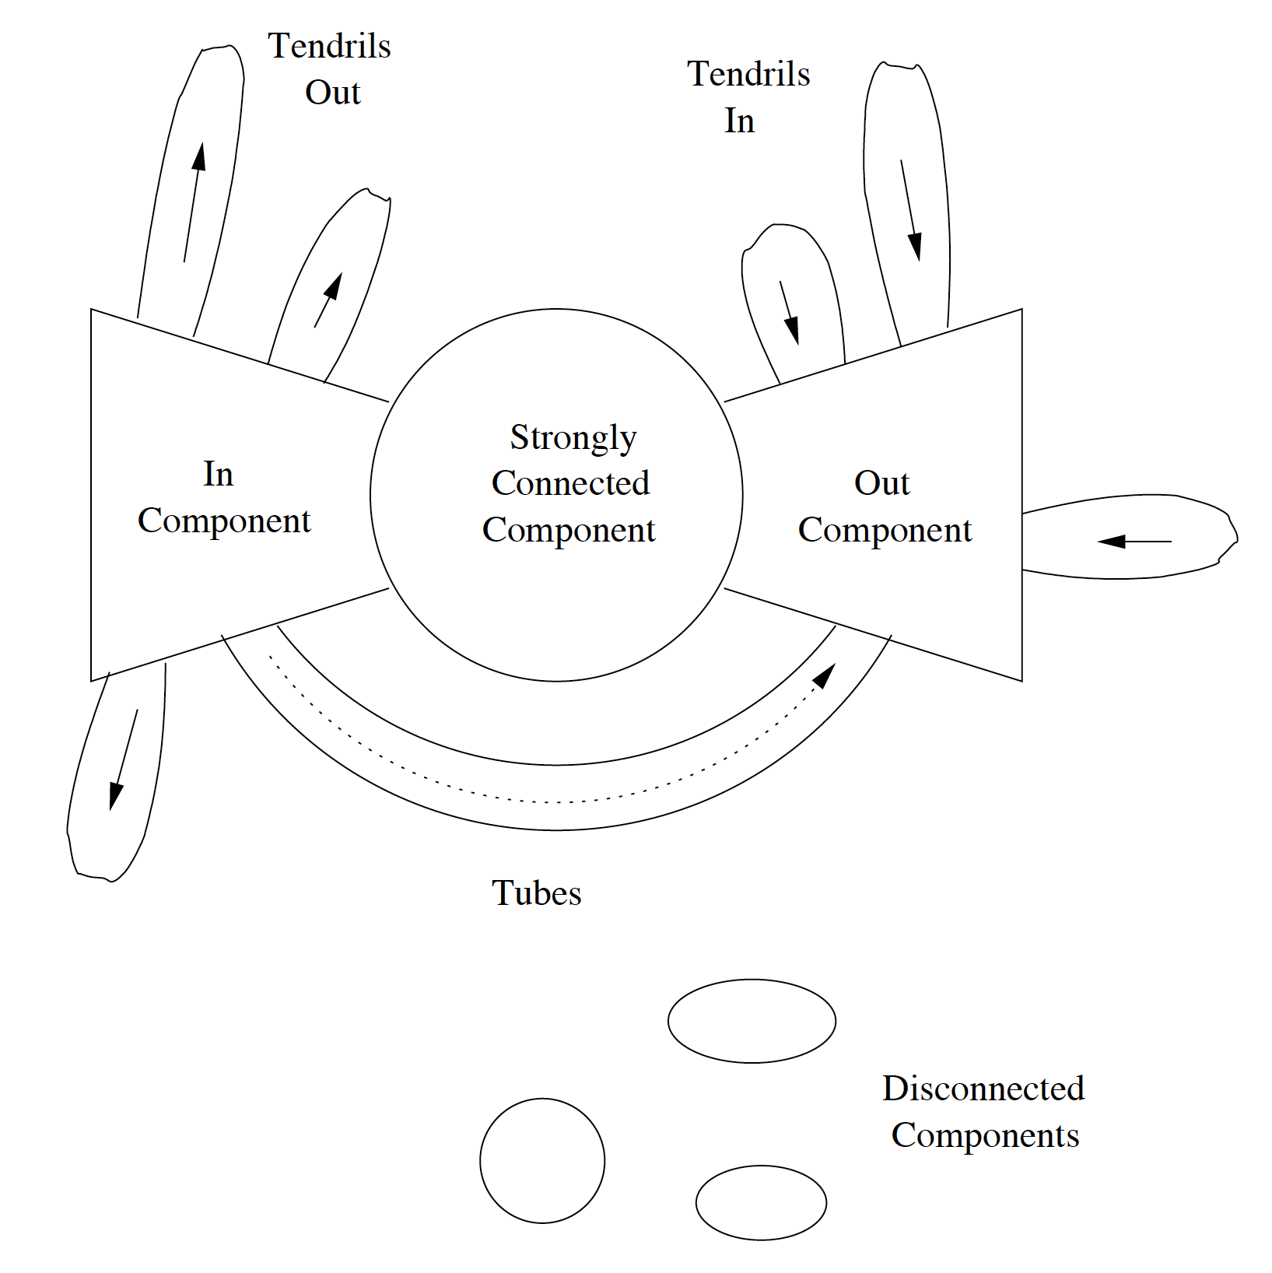
Structure of the web
The web is not strongly connected ☹
An early study of the web showed
  One large strongly connected component
  Several other components
Requires modification to PageRank approach
Two main problems
  Dead ends: a page with no outlink
  Spider traps: group of pages, outlinks only within themselves
Picture courtesy: book by Leskovec, Rajaraman and Ullman

Slide 8
Dead ends
A tiny web
Let’s make C a dead end
M is not stochastic anymore, rather substochastic
  The 3rd column sum = 0 (not 1)
Now the iteration v := Mv takes all probabilities to zero
A
B
C
D
Example courtesy: book by Leskovec, Rajaraman and Ullman

Slide 9
Spider traps
A tiny web
Let C be a one node spider trap
Now the iteration v := Mv takes all probabilities to zero except the spider trap
The spider trap gets all the PageRank
A
B
C
D
Example courtesy: book by Leskovec, Rajaraman and Ullman

Slide 10
Taxation
Approach to handle dead-ends and spider traps
Taxation
  The surfer may leave the web with some probability
  A new surfer may start at any node with some probability
Idealized PageRank: iterate v_{k} = Mv_{k-1}
PageRank with taxation
  where β is a constant, usually between 0.8 and 0.9
  e = (1, …, 1)
with probability β continue to an outlink
with probability (1-β) teleport (leave and join at another node)

Slide 11
Link spam
Google took care of the term spam, but …
The devil still wants to sell illegal stuff
A target page
A spam farm
Links to/from own “supporting” pages
Most of the web
(Inaccessible to the spammer)
Accessible pages (blogs, sites where spammer can leave comments)
Pages controlled by the spammer (own pages)

Slide 12
Analysis of a spam farm
Setting
  Total #of pages in the web = n
  Target page T, with m supporting pages
  Let x be the PageRank contributed by accessible pages (sum of all PageRank of accessible pages times β)
  How much y = PageRank of the target page can be?
PageRank of every supporting page
Contribution from the target page with PageRank y
Share of PageRank among all pages in the web

Slide 13
Analysis of a spam farm (continued)
Three sources contribute to PageRank
  Contribution from accessible pages = x
  Contribution from supporting pages =
  The n-th share of the fraction (1−β)/n [negligible]
So, we have
If β = 0.85, then
y = 3.6 × x + 0.46 × m/n
Solving for y, we get
External contribution up by 3.6 times, plus 46% of the fraction of the PageRank from the web

Slide 14
TrustRank and Spam Mass
A set S of trustworthy pages where the spammers cannot place links
  Wikipedia (after moderation), university pages, …
Compute TrustRank
The random surfers are introduced only at trusted pages
Spam mass = PageRank – TrustRank
High spam mass ➔ likely to be spam

Slide 15
References
Mining of Massive Datasets: Leskovec, Rajaraman and Ullman

