Slide 1
Support Vector Machine
Debapriyo Majumdar
Data Mining – Fall 2014
Indian Statistical Institute Kolkata
November 3, 2014

Slide 2
Recall: A Linear Classifier
A Line (generally hyperplane) that separates the two classes of points
Choose a “good” line
Optimize some objective function
LDA: objective function depending on mean and scatter
Depends on all the points
There can be many such lines, many parameters to optimize

Slide 3
Recall: A Linear Classifier
What do we really want?
Primarily – least number of misclassifications
Consider a separation line
When will we worry about misclassification?
Answer: when the test point is near the margin
So – why consider scatter, mean etc (those depend on all points), rather just concentrate on the “border”

Slide 4
Support Vector Machine: intuition
support vectors
support vectors
Recall: A projection line w for the points lets us define a separation line L
How? [not mean and scatter]
Identify support vectors, the training data points that act as “support”
Separation line L between support vectors
w
L₂
L₁
L
Maximize the margin: the distance between lines L₁ and L₂ (hyperplanes) defined by the support vectors

Slide 5
Basics
Distance of L from origin
w

Slide 6
Support Vector Machine: formulation
Scale w and b such that we have the lines are defined by these equations
Then we have:
The margin (separation of the two classes)
w
Consider the classes as another dimension y_{i}=-1, +1

Slide 7
Langrangian for Optimization
An optimization problem
  minimize f(x)
  subject to g(x) = 0
The Langrangian:
  L(x,λ) = f(x) – λg(x)
  where
In general (many constrains, with indices i)

Slide 8
The SVM Quadratic Optimization
The Langrangian of the SVM optimization:
The Dual Problem
The input vectors appear only in the form of dot products

Slide 9
Case: not linearly separable
Data may not be linearly separable
Map the data into a higher dimensional space
Data can become separable (by a hyperplane) in the higher dimensional space
Kernel trick
Possible only for certain functions when have a kernel function K such that

Slide 10
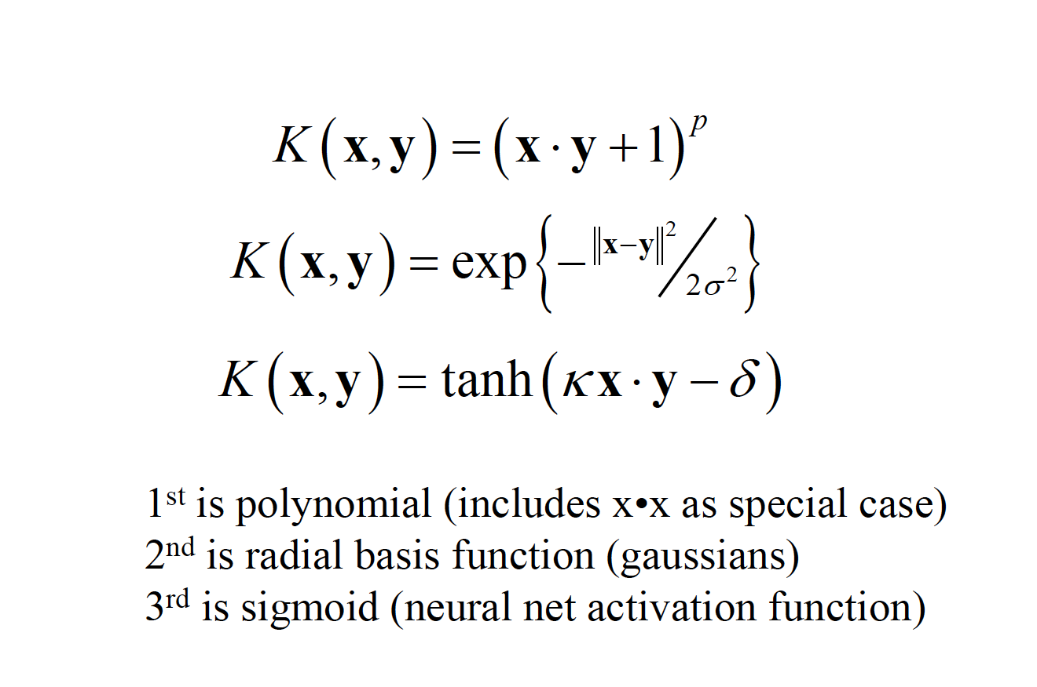
Non – linear SVM kernels

