Slide 1
MapReduce and Hadoop
Debapriyo Majumdar
Data Mining – Fall 2014
Indian Statistical Institute Kolkata
November 10, 2014

Slide 2
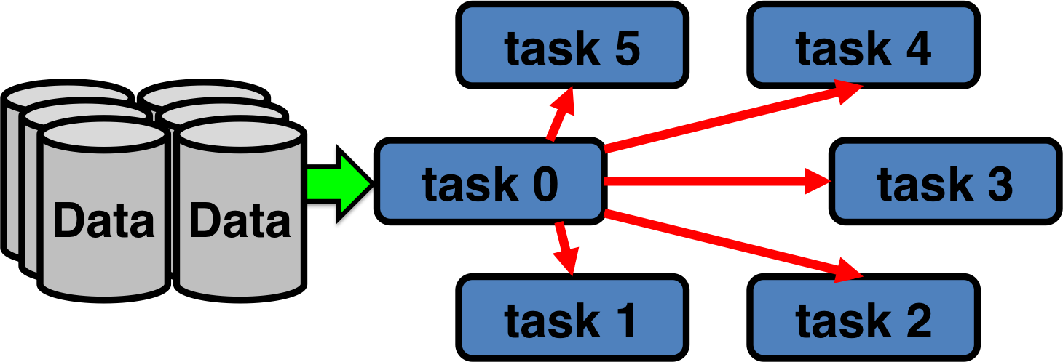
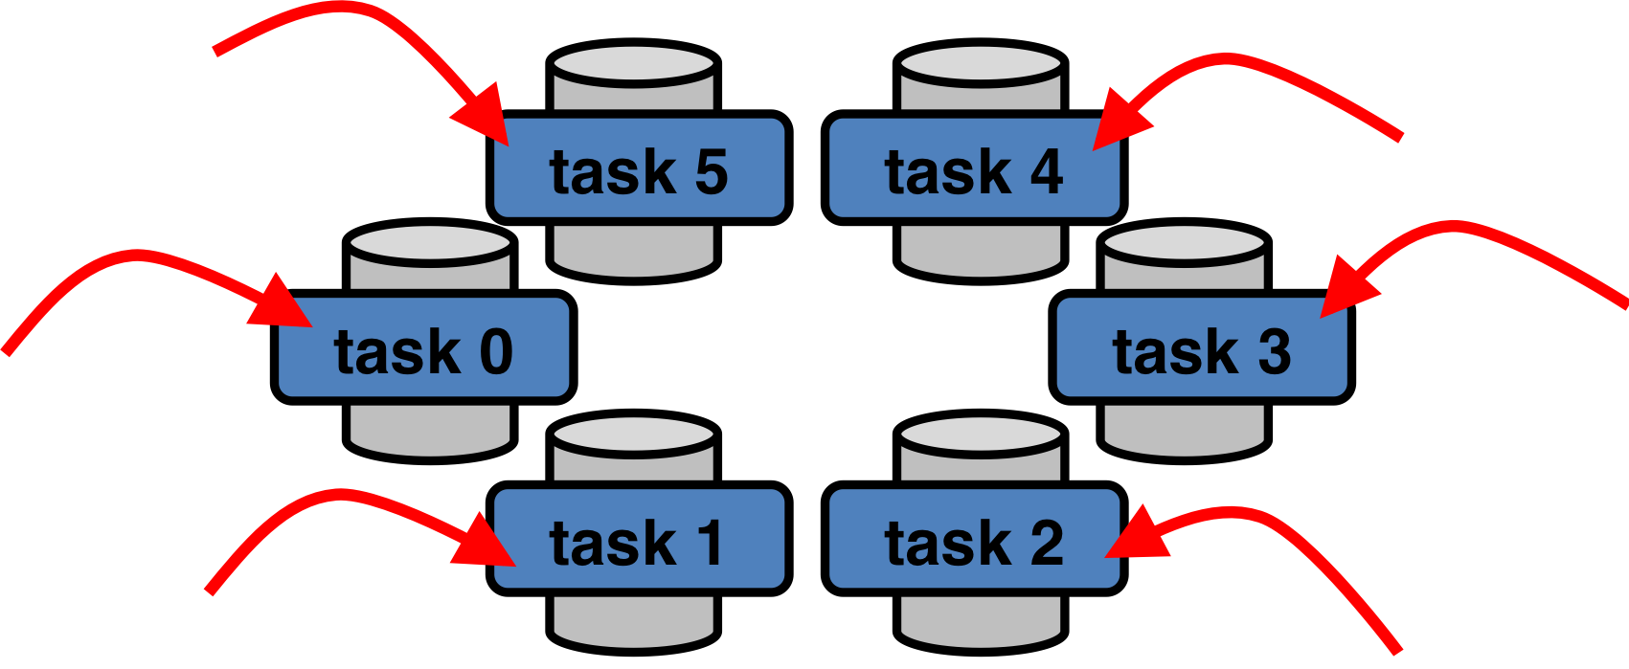
Let’s keep the intro short
Modern data mining: process immense amount of data quickly
Exploit parallelism
Traditional parallelism
Bring data to compute
MapReduce
Bring compute to data
Pictures courtesy: Glenn K. Lockwood, glennklockwood.com

Slide 3
The MapReduce paradigm
Split
Map
Shuffle and sort
Reduce
Final
Final
output
original
Input
Input chunks
<Key,Value> pairs
<Key,Value> pairs grouped by keys
Output chunks
May not need to combine
May be already split in filesystem
The user needs to write the map() and the reduce()
Notes:
1. Some number of Map tasks each are given one or more chunks from a
distributed file system. These Map tasks turn the chunk into a sequence
of key-value pairs. The way key-value pairs are produced from the input
data is determined by the code written by the user for the Map function.
2. The key-value pairs from each Map task are collected by a master con-
troller and sorted by key. The keys are divided among all the Reduce
tasks, so all key-value pairs with the same key wind up at the same Reduce
task.
3. The Reduce tasks work on one key at a time, and combine all the values
associated with that key in some way. The manner of combination
of values is determined by the code written by the user for the Reduce
function.

Slide 4
An example: word frequency counting
Split
Map
Shuffle and sort
Reduce
Final
the pairs (w,1) for the same words are grouped together
output: (w,n) for each w
collection of documnts
subcollections of documnts
map: for each word w, output pairs (w,1)
reduce: count the number (n) of pairs for each w, make it (w,n)
Final
output
original
Input
Input chunks
<Key,Value> pairs
<Key,Value> pairs grouped by keys
Output chunks
Problem: Given a collection of documents, count the number of times each word occurs in the collection
map: for each word w, emit pairs (w,1)
reduce: count the number (n) of pairs for each w, make it (w,n)
Notes:
1. Some number of Map tasks each are given one or more chunks from a
distributed file system. These Map tasks turn the chunk into a sequence
of key-value pairs. The way key-value pairs are produced from the input
data is determined by the code written by the user for the Map function.
2. The key-value pairs from each Map task are collected by a master con-
troller and sorted by key. The keys are divided among all the Reduce
tasks, so all key-value pairs with the same key wind up at the same Reduce
task.
3. The Reduce tasks work on one key at a time, and combine all the values
associated with that key in some way. The manner of combination
of values is determined by the code written by the user for the Reduce
function.

Slide 5
An example: word frequency counting
Split
Map
Shuffle and sort
Reduce
Final
(apple,1)
(apple,1)
(apple,2)
apple orange peach
(apple,1)
(orange,1)
(peach,1)
(orange,1)
(orange,1)
(orange,1)
(orange,3)
apple orange peach
orange plum
orange apple guava
cherry fig
peach fig peach
orange plum
(orange,1)
(plum,1)
(apple,2)
(orange,3)
(guava,1)
(plum,2)
(cherry,2)
(fig,2)
(peach,3)
(guava,1)
(guava,1)
orange apple guava
(orange,1)
(apple,1)
(guava,1)
(plum,1)
(plum,1)
(plum,2)
cherry fig
(cherry,1)
(fig,1)
(cherry,1)
(cherry,1)
(cherry,2)
peach fig peach
(peach,1)
(fig,1)
(peach,1)
(fig,1)
(fig,1)
(fig,2)
Final
output
original
Input
Input chunks
<Key,Value> pairs
(peach,1)
(peach,1)
(peach,1)
(peach,3)
<Key,Value> pairs grouped by keys
Output chunks
Problem: Given a collection of documents, count the number of times each word occurs in the collection
map: for each word w, output pairs (w,1)
reduce: count the number (n) of pairs for each w, make it (w,n)
Notes:
1. Some number of Map tasks each are given one or more chunks from a
distributed file system. These Map tasks turn the chunk into a sequence
of key-value pairs. The way key-value pairs are produced from the input
data is determined by the code written by the user for the Map function.
2. The key-value pairs from each Map task are collected by a master con-
troller and sorted by key. The keys are divided among all the Reduce
tasks, so all key-value pairs with the same key wind up at the same Reduce
task.
3. The Reduce tasks work on one key at a time, and combine all the values
associated with that key in some way. The manner of combination
of values is determined by the code written by the user for the Reduce
function.

Slide 6
Hadoop
Apache Hadoop
An open source MapReduce framework

Slide 7
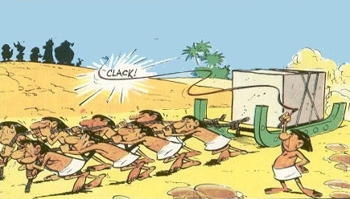
Hadoop
Two main components
  Hadoop Distributed File System (HDFS): to store data
  MapReduce engine: to process data
Master – slave architecture using commodity servers
The HDFS
  Master: Namenode
  Slave: Datanode
MapReduce
  Master: JobTracker
  Slave: TaskTracker

Slide 8
HDFS: Blocks
Datanode 1
Block 1
Block 2
Block 1
Block 2
Block 3
Big File
Datanode 2
Block 3
Block 4
Block 1
Block 3
Block 4
Datanode 3
Block 5
Block 6
Block 2
Block 6
Block 5
Datanode 4
Runs on top of existing filesystem
Blocks are 64MB (128MB recommended)
Single file can be > any single disk
POSIX based permissions
Fault tolerant
Block 4
Block 6
Block 5

Slide 9
HDFS: Namenode and Datanode
Namenode
  Only one per Hadoop Cluster
  Manages the filesystem namespace
  The filesystem tree
  An edit log
  For each block block i, the datanode(s) in which block i is saved
  All the blocks residing in each datanode
Secondary Namenode
  Backup namenode
Datanodes
  Many per Hadoop cluster
  Controls block operations
  Physically puts the block in the nodes
  Do the physical replication

Slide 10
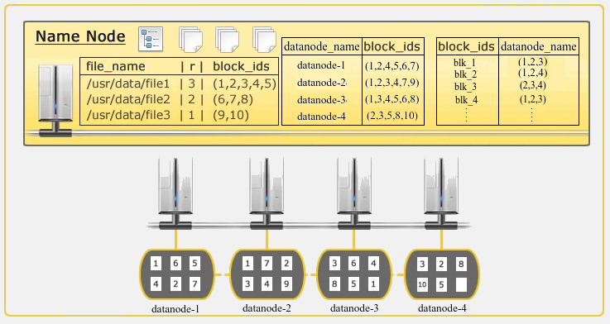
HDFS: an example

Slide 11
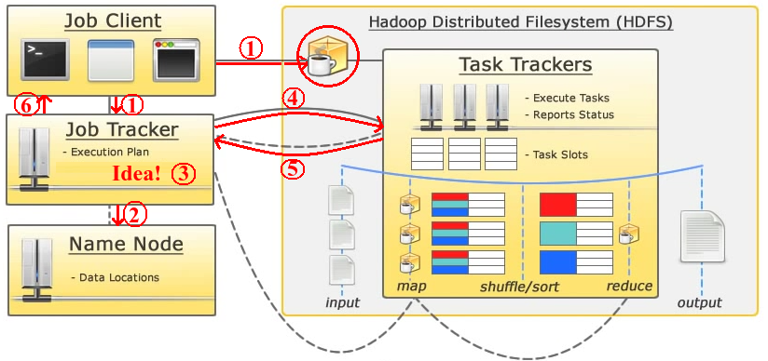
MapReduce: JobTracker and TaskTracker
JobClient submits job to JobTracker; Binary copied into HDFS
JobTracker talks to Namenode
JobTracker creates execution plan
JobTracker submits work to TaskTrackers
TaskTrackers report progress via heartbeat
JobTracker updates status

Slide 12
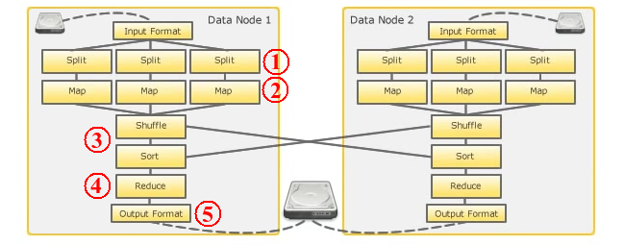
Map, Shuffle and Reduce: internal steps
Splits data up to send it to the mapper
Transforms splits into key/value pairs
(Key-Value) with same key sent to the same reducer
Aggregates key/value pairs based on user-defined code
Determines how the result are saved

Slide 13
Fault Tolerance
If the master fails
  MapReduce would fail, have to restart the entire job
A map worker node fails
  Master detects (periodic ping would timeout)
  All the map tasks for this node have to be restarted
    Even if the map tasks were done, the output were at the node
A reduce worker fails
  Master sets the status of its currently executing reduce tasks to idle
  Reschedule these tasks on another reduce worker

Slide 14
using MapReduce
Some algorithms using MapReduce

Slide 15
Matrix – Vector Multiplication
Multiply M = (m_{ij}) (an n × n matrix) and v = (v_{i}) (an n-vector)
If n = 1000, no need of MapReduce!
n
M
v
n
Case 1: Large n, M does not fit into main memory, but v does
Since v fits into main memory, v is available to every map task
Map: for each matrix element m_{ij}, emit key value pair (i, m_{ij}v_{j})
Shuffle and sort: groups all m_{ij}v_{j} values together for the same i
Reduce: sum m_{ij}v_{j} for all j for the same i

Slide 16
Matrix – Vector Multiplication
Multiply M = (m_{ij}) (an n × n matrix) and v = (v_{i}) (an n-vector)
If n = 1000, no need of MapReduce!
This much will fit into main memory
This whole chunk does not fit in main memory anymore
Case 2: Very large n, even v does not fit into main memory
For every map, many accesses to disk (for parts of v) required!
Solution:
  How much of v will fit in?
  Partition v and rows of M so that each partition of v fits into memory
  Take dot product of one partition of v and the corresponding partition of M
  Map and reduce same as before

Slide 17
Relational Algebra
Relation R(A₁, A₃, …, A_{n}) is a relation with attributes A_{i}
Schema: set of attributes
Selection on condition C: apply C on each tuple in R, output only those which satisfy C
Projection on a subset S of attributes: output the components for the attributes in S
Union, Intersection, Join…
Attr₁ | Attr₂ | Attr₃ | Attr₄
xyz | abc | 1 | true
abc | xyz | 1 | true
xyz | def | 1 | false
bcd | def | 2 | true
Links between URLs
URL1 | URL2
url1 | url2
url2 | url1
url3 | url5
url1 | url3

Slide 18
Selection using MapReduce
Trivial
Map: For each tuple t in R, test if t satisfies C. If so, produce the key-value pair (t, t).
Reduce: The identity function. It simply passes each key-value pair to the output.
Links between URLs
URL1 | URL2
url1 | url2
url2 | url1
url3 | url5
url1 | url3

Slide 19
Union using MapReduce
Union of two relations R and S
Suppose R and S have the same schema
Map tasks are generated from chunks of both R and S
Map: For each tuple t, produce the key-value pair (t, t)
Reduce: Only need to remove duplicates
  For all key t, there would be either one or two values
  Output (t, t) in either case
Links between URLs
URL1 | URL2
url1 | url2
url2 | url1
url3 | url5
url1 | url3

Slide 20
Natural join using MapReduce
Join R(A,B) with S(B,C) on attribute B
Map:
  For each tuple t = (a,b) of R, emit key value pair (b,(R,a))
  For each tuple t = (b,c) of S, emit key value pair (b,(S,c))
Reduce:
  Each key b would be associated with a list of values that are of the form (R,a) or (S,c)
  Construct all pairs consisting of one with first component R and the other with first component S , say (R,a ) and (S,c ). The output from this key and value list is a sequence of key-value pairs
  The key is irrelevant. Each value is one of the triples (a, b, c ) such that (R,a ) and (S,c) are on the input list of values
R
A | B
x | a
y | b
z | c
w | d
S
B | C
a | 1
c | 3
d | 4
g | 7

Slide 21
Grouping and Aggregation using MapReduce
Group and aggregate on a relation R(A,B) using aggregation function γ(B), group by A
Map:
  For each tuple t = (a,b) of R, emit key value pair (a,b)
Reduce:
  For all group {(a,b₁), …, (a,b_{m})} represented by a key a, apply γ to obtain b_{a} = b₁ + … + b_{m}
  Output (a,b_{a})
R
A | B
x | 2
y | 1
z | 4
z | 1
x | 5
select A, sum(B) from R group by A;
A | SUM(B)
x | 7
y | 1
z | 5

Slide 22
Matrix multiplication using MapReduce
n
l
l
A
(m × n)
B
(n × l)
C
(m × l)
m
n
=
m
Think of a matrix as a relation with three attributes
For example matrix A is represented by the relation A(I, J, V)
  For every non-zero entry (i, j, a_{ij}), the row number is the value of I, column number is the value of J, the entry is the value in V
  Also advantage: usually most large matrices would be sparse, the relation would have less number of entries
The product is ~ a natural join followed by a grouping with aggregation

Slide 23
Matrix multiplication using MapReduce
n
l
l
A
(m × n)
(i, j, a_{ij})
B
(n × l)
(j, k, b_{jk})
C
(m × l)
m
n
=
m
Natural join of (I,J,V) and (J,K,W) → tuples (i, j, k, a_{ij}, b_{jk})
Map:
  For every (i, j, a_{ij}), emit key value pair (j, (A, i, a_{ij}))
  For every (j, k, b_{jk}), emit key value pair (j, (B, k, b_{jk}))
Reduce:
  for each key j
    for each value (A, i, a_{ij}) and (B, k, b_{jk})
      produce a key value pair ((i,k),(a_{ij}b_{jk}))

Slide 24
Matrix multiplication using MapReduce
n
l
l
A
(m × n)
(i, j, a_{ij})
B
(n × l)
(j, k, b_{jk})
C
(m × l)
m
n
=
m
      First MapReduce process has produced key value pairs ((i,k),(a_{ij}b_{jk}))
Another MapReduce process to group and aggregate
      Map: identity, just emit the key value pair ((i,k),(a_{ij}b_{jk}))
Reduce:
  for each key (i,k)
    produce the sum of the all the values for the key:

Slide 25
Matrix multiplication using MapReduce: Method 2
n
l
l
A
(m × n)
(i, j, a_{ij})
B
(n × l)
(j, k, b_{jk})
C
(m × l)
m
n
=
m
A method with one MapReduce step
Map:
  For every (i, j, a_{ij}), emit for all k = 1,…, l, the key value ((i,k), (A, j, a_{ij}))
  For every (j, k, b_{jk}), emit for all i = 1,…, m, the key value ((i,k), (B, j, b_{jk}))
Reduce:
  for each key (i,k)
    sort values (A, j, a_{ij}) and (B, j, b_{jk}) by j to group them by j
    for each j multiply a_{ij} and b_{jk}
    sum the products for the key (i,k) to produce
May not fit in main memory. Expensive external sort!

Slide 26
References and acknowledgements
Mining of Massive Datasets, by Leskovec, Rajaraman and Ullman, Chapter 2
Slides by Dwaipayan Roy

