Slide 1
Question Answering
Debapriyo Majumdar
Information Retrieval – Spring 2015
Indian Statistical Institute Kolkata
Adapted from slides by Dan Jurafsky (Stanford) and Tao Yang (UCSB)

Slide 2
Question Answering
One of the oldest NLP tasks (punched card systems in 1961)
Simmons, Klein, McConlogue. 1964. Indexing and Dependency Logic for Answering English Questions. American Documentation 15:30, 196-204

Slide 3
Question Answering: IBM’s Watson
Won Jeopardy on February 16, 2011!
WILLIAM WILKINSON’S
“AN ACCOUNT OF THE PRINCIPALITIES OF
WALLACHIA AND MOLDOVIA”
INSPIRED THIS AUTHOR’S
MOST FAMOUS NOVEL
Bram Stoker

Slide 4
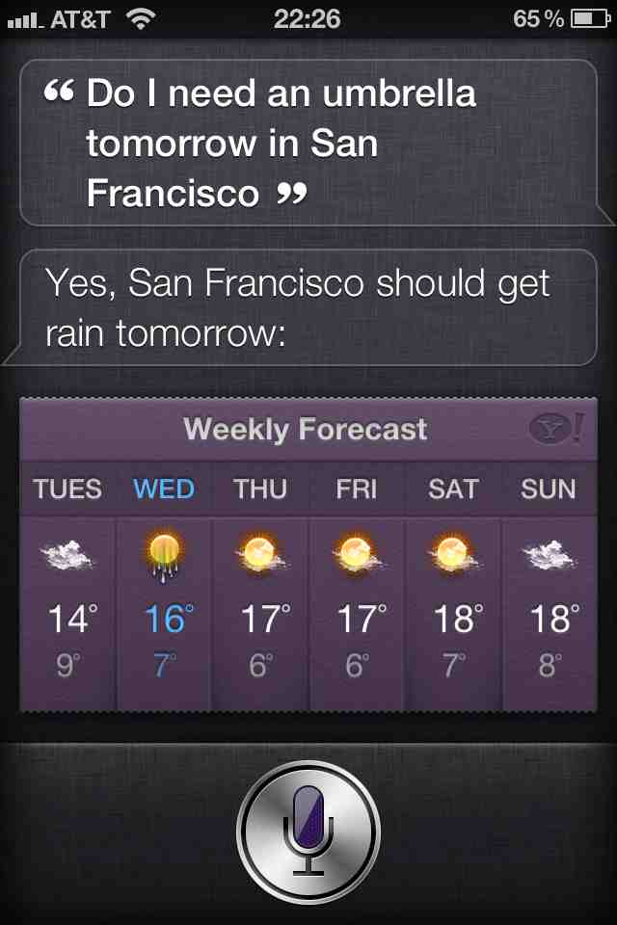
Apple’s Siri
A seemingly “limited” set of few possible questions
Answers based on contextual parameters

Slide 5
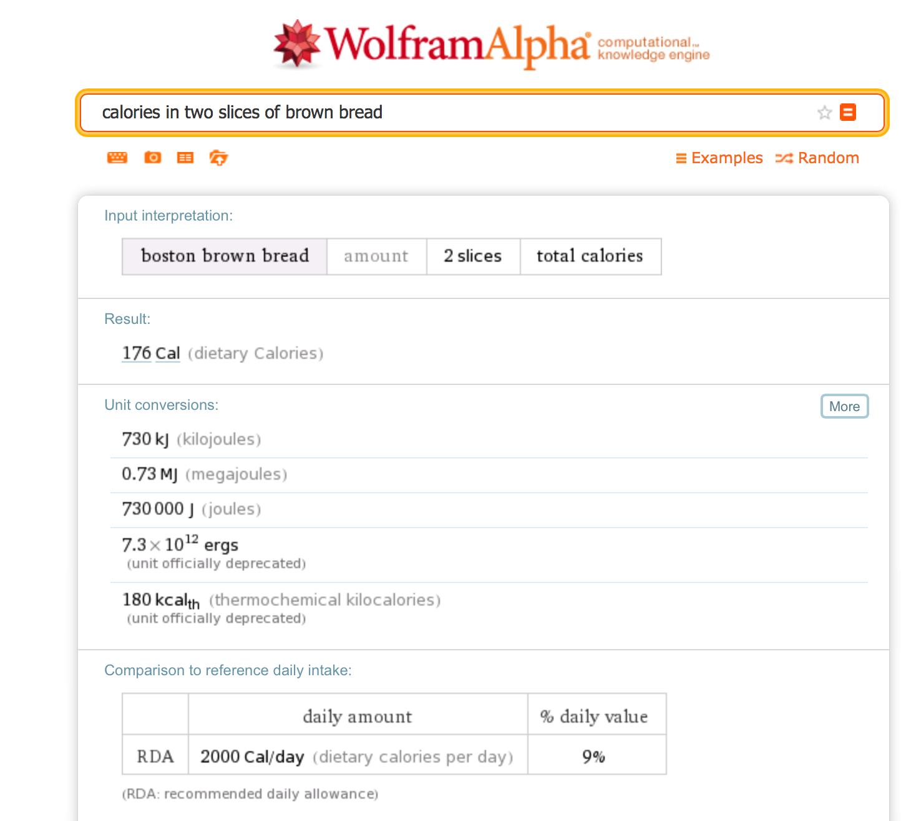
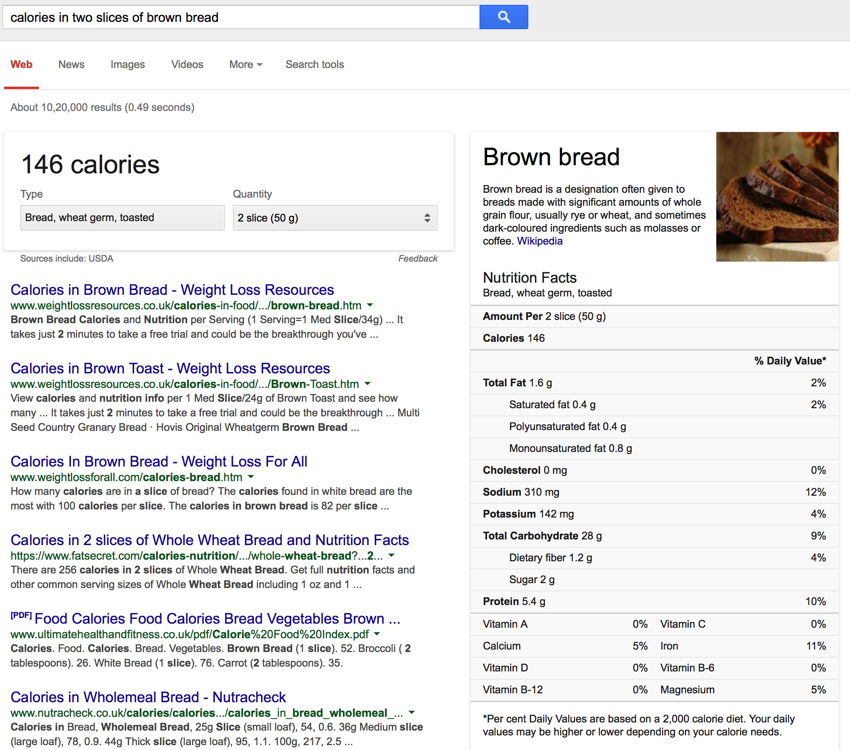
Wolfram Alpha, Google

Slide 6
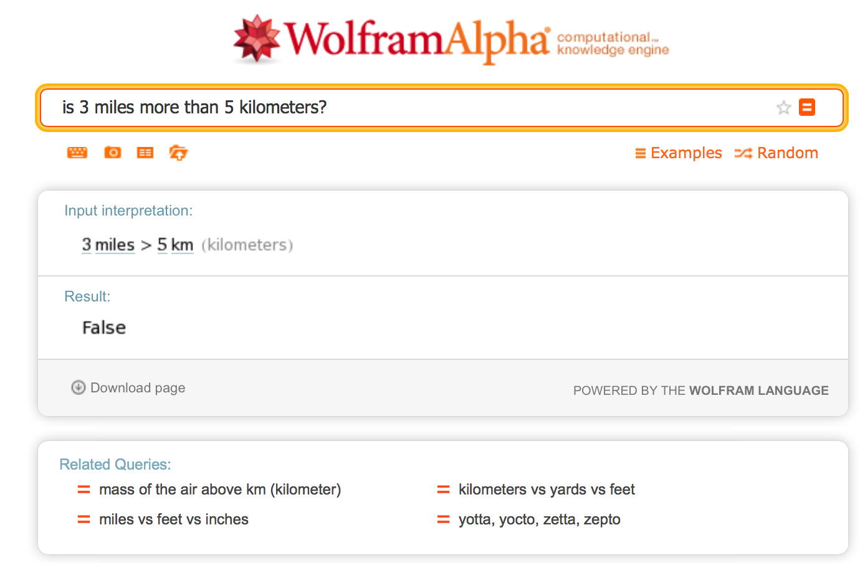
Wolfram Alpha
But in this case, Google returns a standard list of document links

Slide 7
Types of Questions in Modern Systems
Factoid questions
  Answers are short
  The question can be rephrased as “fill in the blanks” question
  Examples:
  Who directed the movie Titanic?
  How many calories are there in two slices of apple pie?
  Where is Louvre museum located?
Complex (narrative) questions:
  What precautionary measures should we take to be safe from swine flu?
  What do scholars think about Jefferson’s position on dealing with pirates?

Slide 8
Paradigms for QA
IR-based approaches
  TREC QA Track (AskMSR, ISI, …)
  IBM Watson
  Google
Knowledge-based and Hybrid approaches
  IBM Watson
  Apple Siri
  Wolfram Alpha
  True Knowledge Evi

Slide 9
AskMSR
A Basic IR Based Approach

Slide 10
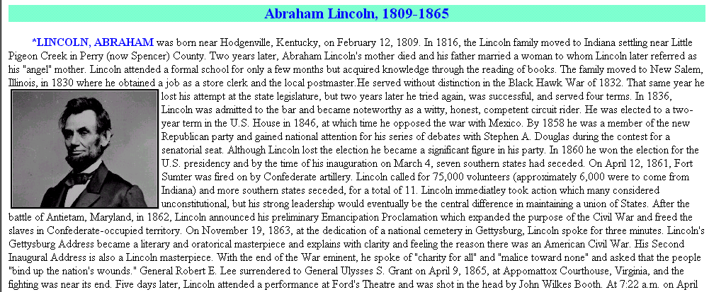
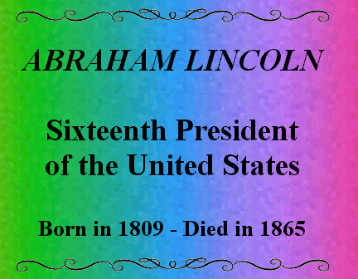
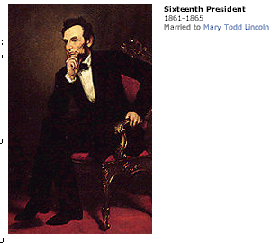
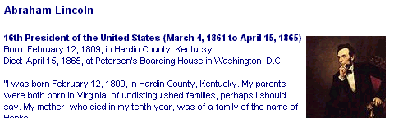
AskMSR: Shallow approach
In what year did Abraham Lincoln die?
Ignore hard documents and find easy ones

Slide 11
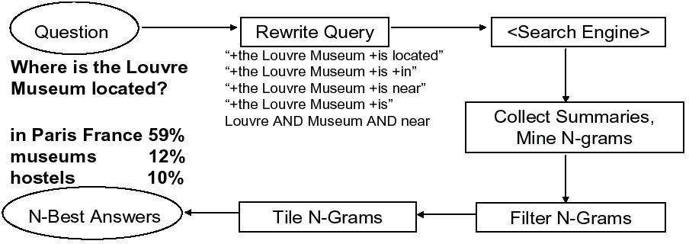
AskMSR: Details
1
2
3
5
4

Slide 12
Step 1: Rewrite queries
Intuition: The user’s question is often syntactically quite close to sentences that contain the answer
  Q: Where is the Louvre Museum located?
  Hope: there would be a sentence of the form:
    The Louvre Museum is located in Paris.
  Q: Who created the character of Scrooge?
  Hope: there would be a sentence of the form:
    Charles Dickens created the character of Scrooge.

Slide 13
Query rewriting
Classify question into categories
  Who is/was/are/were…?
  When is/did/will/are/were …?
  Where is/are/were …?
  …
a. Category-specific transformation rules
eg “For Where questions, move ‘is’ to all possible locations”
“Where is the Louvre Museum located”
→ “is the Louvre Museum located”
→ “the is Louvre Museum located”
→ “the Louvre is Museum located”
→ “the Louvre Museum is located”
→ “the Louvre Museum located is”
b. Expected answer “Datatype” (eg, Date, Person, Location, …)
When was the French Revolution? → DATE
Hand-crafted classification/rewrite/datatype rules
(Could they be automatically learned?)
Some of these are nonsense,
but who
cares? It’s
only a few
more queries
to Google.

Slide 14
Step 2: Query search engine
Send all rewrites to a (Web) search engine
Retrieve top N answers (may be 100)
For speed, rely just on search engine’s “snippets”, not the full text of the actual document

Slide 15
Step 3: Mining N-Grams
Enumerate all N-grams (N=1,2,3 say) in all retrieved snippets
  Use hash table and other fancy footwork to make this efficient
Weight of an n-gram: occurrence count, each weighted by “reliability” (weight) of rewrite that fetched the document
Example: “Who created the character of Scrooge?”
  Dickens - 117
  Christmas Carol - 78
  Charles Dickens - 75
  Disney - 72
  Carl Banks - 54
  A Christmas - 41
  Christmas Carol - 45
  Uncle - 31

Slide 16
Step 4: Filtering N-Grams
Each question type is associated with one or more “data-type filters” = regular expression
When…
Where…
What …
Who …
Boost score of n-grams that do match regexp
Lower score of n-grams that don’t match regexp
Date
Location
Person

Slide 17
Step 5: Tiling the Answers
Scores
20
15
10
merged, discard
old n-grams
Charles Dickens
Dickens
Mr Charles
Score 45
Mr Charles Dickens
N-Grams
tile highest-scoring n-gram
N-Grams
Repeat, until no more overlap

Slide 18
Results
Standard TREC contest test-bed:
~1M documents; 900 questions
Technique doesn’t do too well (though would have placed in top 9 of ~30 participants!)
  MRR = 0.262 (ie, right answered ranked about #4-#5)
Using the Web as a whole, not just TREC’s 1M documents… MRR = 0.42 (ie, on average, right answer is ranked about #2-#3)
  Why? Because it relies on the enormity of the Web!

Slide 19
IR and Knowledge Based QA
Modern QA

Slide 20
IR-based Factoid QA

Slide 21
IR-based Factoid QA
QUESTION PROCESSING
  Detect question type, answer type, focus, relations
  Formulate queries to send to a search engine
PASSAGE RETRIEVAL
  Retrieve ranked documents
  Break into suitable passages and rerank
ANSWER PROCESSING
  Extract candidate answers
  Rank candidates
    using evidence from the text and external sources

Slide 22
Knowledge-based approaches (Siri)
Build a semantic representation of the query
  Times, dates, locations, entities, numeric quantities
Map from this semantics to query structured data or resources
  Geospatial databases
  Ontologies (Wikipedia infoboxes, dbPedia, WordNet, Yago)
  Restaurant review sources and reservation services
  Scientific databases

Slide 23
Hybrid approaches (IBM Watson)
Build a shallow semantic representation of the query
Generate answer candidates using IR methods
  Augmented with ontologies and semi-structured data
Score each candidate using richer knowledge sources
  Geospatial databases
  Temporal reasoning
  Taxonomical classification

Slide 24
IR-based Factoid QA

Slide 25
Question processing: Extraction from the question
Answer Type Detection
  Decide the named entity type (person, place) of the answer
Query Formulation
  Choose query keywords for the IR system
Question Type classification
  Is this a definition question, a math question, a list question?
Focus Detection
  Find the question words that are replaced by the answer
Relation Extraction
  Find relations between entities in the question

Slide 26
Answer Type Detection: Named Entities
Who founded Virgin Airlines?
  PERSON
What Canadian city has the largest population?
  CITY.
Answer type taxonomy
6 coarse classes
  ABBEVIATION, ENTITY, DESCRIPTION, HUMAN, LOCATION, NUMERIC
50 finer classes
  LOCATION: city, country, mountain…
  HUMAN: group, individual, title, description
  ENTITY: animal, body, color, currency…

Slide 27
Part of Li & Roth’s Answer Type Taxonomy

Slide 28
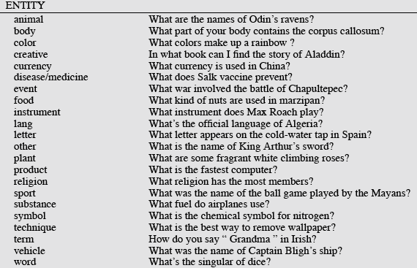
Answer Types

Slide 29
More Answer Types

Slide 30
Answer types in Jeopardy
2500 answer types in 20,000 Jeopardy question sample
The most frequent 200 answer types cover < 50% of data
The 40 most frequent Jeopardy answer types
he, country, city, man, film, state, she, author, group, here, company, president, capital, star, novel, character, woman, river, island, king, song, part, series, sport, singer, actor, play, team, show, actress, animal, presidential, composer, musical, nation, book, title, leader, game
Ferrucci et al. 2010. Building Watson: An Overview of the DeepQA Project. AI Magazine. Fall 2010. 59-79.

Slide 31
Answer Type Detection
Hand-written rules
Machine Learning
Hybrids

Slide 32
Answer Type Detection: Rules
Regular expression-based rules can get some cases:
  Who {is|was|are|were} PERSON
  PERSON (YEAR – YEAR)
Other rules use the question headword:
  (the headword of the first noun phrase after the wh-word)
  Which city in China has the largest number of foreign financial companies?
  What is the state flower of California?

Slide 33
Answer Type Detection: ML
Treat the problem as machine learning classification
  Define a taxonomy of question types
  Annotate training data for each question type
  Train classifiers for each question class using a rich set of features.
    features include those hand-written rules!
Features
  Question words and phrases
  Part-of-speech tags
  Parse features (headwords)
  Named Entities
  Semantically related words

Slide 34
Query formulation: keyword selection
1. Select all non-stop words in quotations
2. Select all NNP words in recognized named entities
3. Select all complex nominals with their adjectival modifiers
4. Select all other complex nominals
5. Select all nouns with their adjectival modifiers
6. Select all other nouns
7. Select all verbs
8. Select all adverbs
9. Select the QFW word (skipped in all previous steps)
10. Select all other words
Dan Moldovan, Sanda Harabagiu, Marius Paca, Rada Mihalcea, Richard Goodrum, Roxana Girju and Vasile Rus. 1999. Proceedings of TREC-8.

Slide 35
IR-based Factoid QA

Slide 36
Passage Retrieval
Intuition: the answer to a question is usually not the full document. Either a passage, or a part of it.
Step 1: IR engine retrieves documents using query terms
Step 2: Segment the documents into shorter units
  Paragraphs, …
Step 3: Passage ranking
  Use answer type to help re-rank passages

Slide 37
Features for Passage Ranking
Number of Named Entities of the right type in passage
Number of query words in passage
Number of question N-grams also in passage
Proximity of query keywords to each other in passage
Longest sequence of question words
Rank of the document containing passage

Slide 38
IR-based Factoid QA

Slide 39
Answer Extraction
Run an answer-type named-entity tagger on the passages
  Each answer type requires a named-entity tagger that detects it
  If answer type is CITY, tagger has to tag CITY
    Can be full NER, simple regular expressions, or hybrid
Return the string with the right type:
  Who is the prime minister of India (PERSON)
  Manmohan Singh, Prime Minister of India, had told left leaders that the deal would not be renegotiated.
  How tall is Mt. Everest? (LENGTH)
  The official height of Mount Everest is 29035 feet

Slide 40
Ranking Candidate Answers
But what if there are multiple candidate answers!
Q: Who was Queen Victoria’s second son?
Answer Type: Person
Passage:
The Marie biscuit is named after Marie Alexandrovna, the daughter of Czar Alexander II of Russia and wife of Alfred, the second son of Queen Victoria and Prince Albert

Slide 41
Ranking Candidate Answers
But what if there are multiple candidate answers!
Q: Who was Queen Victoria’s second son?
Answer Type: Person
Passage:
The Marie biscuit is named after Marie Alexandrovna, the daughter of Czar Alexander II of Russia and wife of Alfred, the second son of Queen Victoria and Prince Albert

Slide 42
Ranking candidate answers
Use Machine learning
Features for ranking candidate answers:
  Answer type match: Candidate contains a phrase with the correct answer type
  Pattern match: Regular expression pattern matches the candidate.
  Question keywords: # of question keywords in the candidate.
  Keyword distance: Distance in words between the candidate and query keywords
  Novelty factor: A word in the candidate is not in the query.
  Apposition features: The candidate is an appositive to question terms
  Punctuation location: The candidate is immediately followed by a comma, period, quotation marks, semicolon, or exclamation mark.
  Sequences of question terms: The length of the longest sequence of question terms that occurs in the candidate answer.

Slide 43
Common Evaluation Metrics
Accuracy (does answer match gold-labeled answer?)
Mean Reciprocal Rank
  For each query return a ranked list of M candidate answers.
  Query score is 1/Rank of the first correct answer
    If first answer is correct: 1
    else if second answer is correct: ½
    else if third answer is correct: ⅓, etc.
    Score is 0 if none of the M answers are correct
  Take the mean over all N queries

Slide 44
Question Answering
Using Knowledge in QA

Slide 45
Relation Extraction
Answers: Databases of Relations
  born-in(“Emma Goldman”, “June 27 1869”)
  author-of(“Cao Xue Qin”, “Dream of the Red Chamber”)
  Draw from Wikipedia infoboxes, DBpedia, FreeBase, etc.
Questions: Extracting Relations in Questions
  Whose granddaughter starred in E.T.?
(acted-in ?x “E.T.”)
  (granddaughter-of ?x ?y)

Slide 46
Temporal Reasoning
Relation databases
  (and obituaries, biographical dictionaries, etc.)
IBM Watson
  ”In 1594 he took a job as a tax collector in Andalusia”
  Candidates:
    Thoreau is a bad answer (born in 1817)
    Cervantes is possible (was alive in 1594)

Slide 47
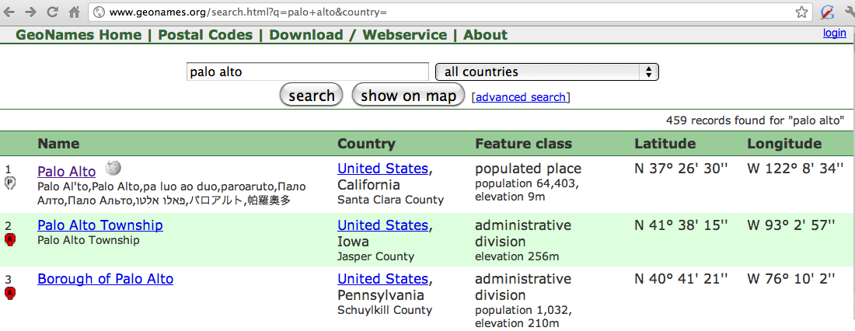
Geospatial knowledge
Beijing is a good answer for ”Asian city”
California is ”southwest of Montana”
geonames.org:

Slide 48
Context and conversation (Siri)
Coreference helps resolve ambiguities
  U: “Book a table at Il Fornaio at 7:00 with my mom”
  U: “Also send her an email reminder”
Clarification questions:
  U: “Chicago pizza”
  S: “Did you mean pizza restaurants in Chicago or Chicago-style pizza?”

