Slide 1
Query Suggestions
Debapriyo Majumdar
Information Retrieval – Spring 2015
Indian Statistical Institute Kolkata

Slide 2



Search engines
A search engine tries to bridge this gap
User needs some information
Assumption: the required information is present somewhere
How:
User expresses the information need – in the form of a query
Engine returns – list of documents, or by some better means

Slide 3
Search queries
Navigational queries
We know the answer (which document we want), just using a search engine to navigate
  tendulkar date of birth → Wikipedia / Bio page
  serendipity meaning → dictionary page
  air india → simply the URL: www.airindia.in
  In a people database, typing the name → the record of the person we are looking for
Straightforward to formulate such queries
Query suggestion is primarily for saving time and typing
Simple informational queries
100 USD in INR → Currency conversion requested
kolkata weather → weather information requested
Complex informational queries
We do not know the answers
Hence, we may not express the question perfectly

Slide 4
Why query suggestion?
A search engine tries to bridge this gap
User needs some information
Assumption: the required information is present somewhere
We may not know what information is available, or in what form the it is present, or we cannot express it well
If you know what exactly you want, it’s easier to get it
User: information need → a query in words (language)
Engine processes the documents

Slide 5

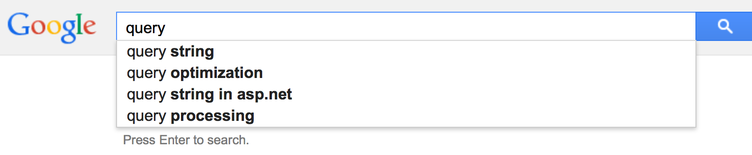
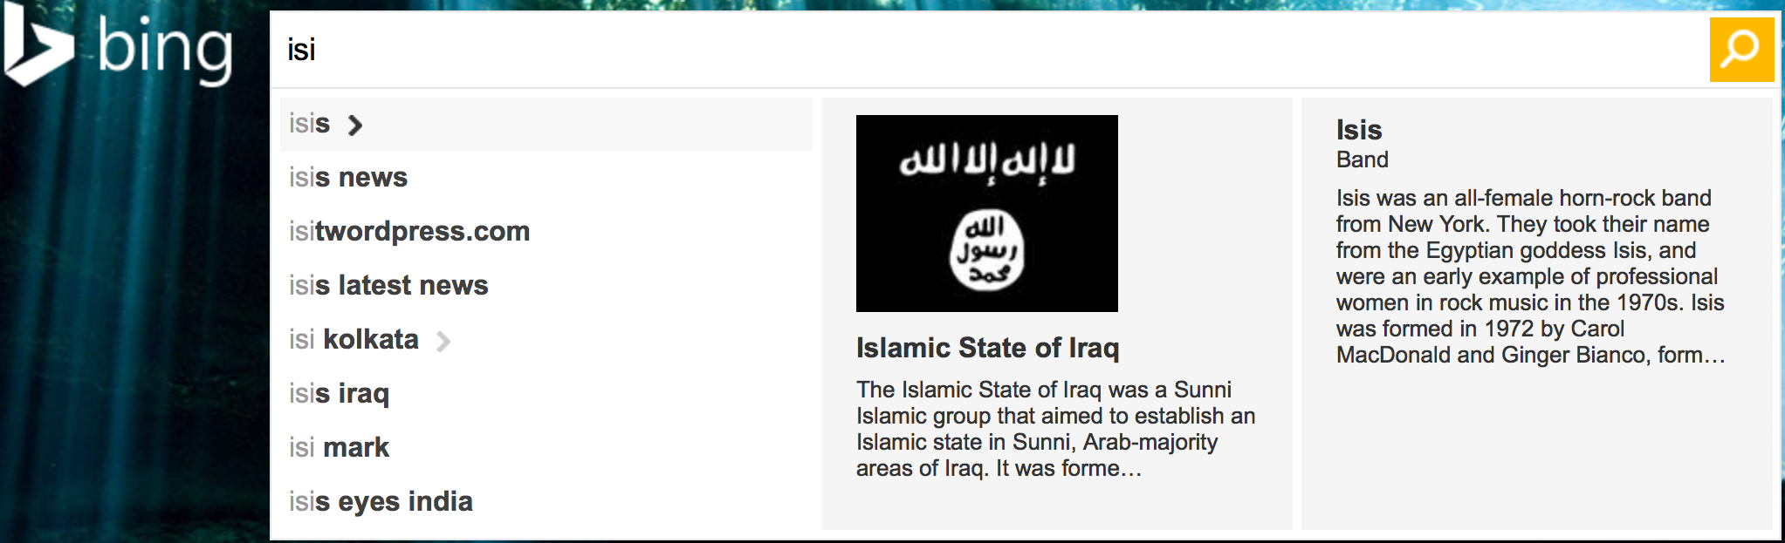
Interactive query suggestion

Slide 6
Why query suggestion?
Query logs have the wisdom of crowd
A search engine tries to bridge this gap
User needs some information
Assumption: the required information is present somewhere
We may not know what information is available, or in what form the it is present, or we cannot express it well
If you know what exactly you want, it’s easier to get it
User: information need → a query in words (language)
Engine processes the documents

Slide 7
Query suggestion methods using query logs
Can leverage wisdom of crowd
High quality, queries are well formed
Methods
  Query similarity
    Baeza-Yats et. al., 2004; Barouni-Ebarhimi and Ghorbani, 2007
  Click-through data
    Sao et. al., 2008; Mao et. al., 2008; Song and wei He, 2010
  Query-URL bipartile graph, hitting time
    Me et. al., 2008; Ma et. al., 2010
  Session information
    Lee et. al., 2009; Cucerzan and White, 2010; Jones et. al., 2006

Slide 8
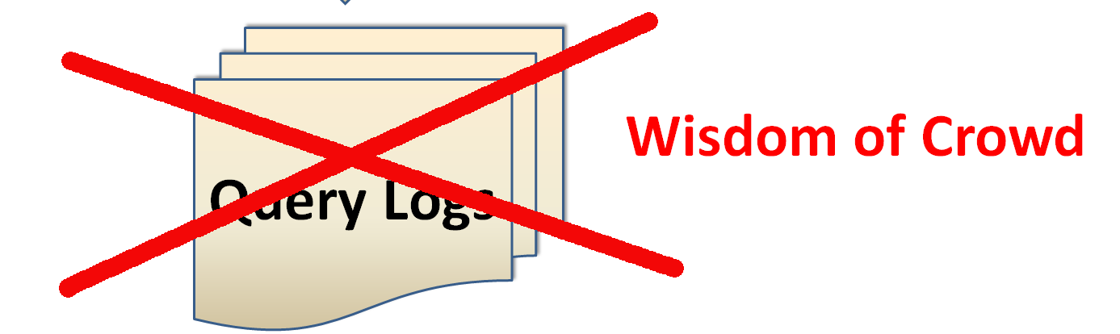
Query suggestion without using query logs
Custom search engines in the enterprise world
Small scale search, not so much of log, e.g. paper search (Google scholar still does not have a query suggestion)
Site search (search within ISI website)
Desktop search – only one user
Legally restricted environment – if you cannot expose other users’ queries even anonymously
Method: have to suggest collection of words that are likely to form meaningful queries matching the partial query typed by the user so far

Slide 9
Query suggestion using query similarity
Baeza-Yates et al, 2004

Slide 10
Outline
Preprocessing (offline)
Represent queries as term weighted vectors
Cluster queries using similarity between queries
Rank queries in each cluster
Query time (online)
Given the user’s query q
Find cluster C in which q should belong
Suggest top k queries in cluster C
  Based on their rank and similarity with q

Slide 11
Query term weight model
popularity of clicking URL u after querying with q
Weight of i-th term in q
term frequency of i-th term in document with URL u
maximum term frequency of any term from q in document with URL u
For all URLs that have been clicked after querying with query q
Query similarity is computed using cosine similarity
Cluster queries using this similarity

Slide 12
Query support and ranking
What is a good query?
  Several users are submitting the same query
  For some queries, more returned documents are clicked by some user
  For some other queries, less returned documents are clicked
  If no result is ever clicked → Not a good query at all
  Query goodness ~ fraction of returned documents clicked by some user
  A global score → rank within cluster
Final ranking at query time
Rank using a combination of query support and similarity with the given query

Slide 13
Query suggestion using session information
Boldi et al, CIKM 2008; Also other papers

Slide 14
Suggestion to aid reformulation
Assumptions
User is happy when the information need is fulfilled
User keeps reformulating the query until satisfied
Within – session reformulation probability of q’ from q
Number of occurrences of q’ appearing followed by q
Probability of q’ appearing after q in a session
Number of occurrences of the query q

Slide 15
Query graph / transition matrix of queries
Draw a graph with queries as nodes
Weight of the edge q → q’ is by the within session reformulation probability
Concept similar to PageRank
  Random walk, with some probability teleport to any query
  What is the probability that the user would eventually type q’?
Compute the stationary probability distribution of each query

Slide 16
Query suggestion for a query q
Random walk relative to q
With probability p follow path (random walk)
With probability 1 – p teleport to q (no other node)
Query suggestion
Offline: store top-k ranked queries for each q
Online: given q, return the top ranked queries as suggestions

Slide 17
Query suggestion using hitting time
Mei, Zhou & Church (Microsoft research), WSDM 2008
Using slides by the authors

Slide 18

Random Walk and Hitting Time
P = 0.3
0.3
k
A
i
0.7
P = 0.7
j
Hitting Time
T^{A}: the first time that the random walk is at a vertex in A
Mean Hitting Time
h_{i}^{A}: expectation of T^{A} given that the walk starts from vertex i

Slide 19
Computing Hitting Time
h_{i}^{A} = 0.7 h_{j}^{A} + 0.3 h_{k}^{A} + 1
T^{A}: the first time that the random walk is at a vertex in A
0.7
h = 0
k
A
i
h_{i}^{A}: expectation of T^{A} given that the walk starting from vertex i
0.7
j
Apparently, h_{i}^{A} = 0 for those
Iterative Computation

Slide 20
Bipartite Graph and Hitting Time
Bipartite Graph:
  Edges between V₁ and V₂
  No edge inside V₁ or V₂
  Edges are weighted
Example: V₁ = {queries}; V₂ = {URLs}
5
5
A
A
4
4
V₁
V₁
0.4
0.4
V₂
V₂
0.7
0.7
7
7
1
1
i
i
j
j
Expected proximity of query i to the query A : hitting time of i → A, h_{i}^{A}
w(i, j) = 3
Convert to a directed graph, even collapse one group

Slide 21
Generate Query Suggestion
Construct a (kNN) subgraph from the query log data (of a predefined number of queries/urls)
Compute transition probabilities p(i → j)
Compute hitting time h_{i}^{A}
Rank candidate queries using h_{i}^{A}
Query
Url
300
T
www.aa.com
aa
15
www.theaa.com/travelwatch/
planner_main.jsp
mexiana
american airline
en.wikipedia.org/wiki/Mexicana

Slide 22
Intuition
Why it works?
  A url is close to a query if freq(q, url) dominates the number of clicks on this url (most people use q to access url)
  A query is close to the target query if it is close to many urls that are close to the target query

Slide 23
Summary
Query suggestion using query logs

Slide 24
Summary
A current field of research
Primary approaches using query logs
Query – query similarity
  Word based
  Query – URL association based
  Session information: a query following another
Personalization / Context awareness is very important
  Several works, not covered in this class though

Slide 25
References
A.Anagnostopoulos,L.Becchetti,C.Castillo,andA.Gionis.Anoptimizationframeworkfor query recommendation. In Proc. of WSDM 2010, pages 161–170, 2010.
R. Baeza-Yates, C. Hurtado, and M. Mendoza. Query recommendation using query logs in search engines. In Current Trends in Database Technology-EDBT 2004 Workshops, pages 588–596, 2004.
P. Boldi, F. Bonchi, C. Castillo, D. Donato, A. Gionis, and S. Vigna. The query-flow graph: model and applications. In Proc. of CIKM 2008, pages 609–618, 2008.
P. Boldi, F. Bonchi, C. Castillo, and S. Vigna. From Dango to Japanese Cakes: Query Refor- mulation Models and Patterns. In Proc. of WI 2009, pages 183–190, 2009.
H. Cao, D. Jiang, J. Pei, Q. He, Z. Liao, E. Chen, and H. Li. Context-aware query suggestion by mining click-through and session data. In Proc. of KDD 2008, pages 875–883, 2008.
Q. He, D. Jiang, Z. Liao, S. Hoi, K. Chang, E. Lim, and H. Li. Web query recommendation via sequential query prediction. In Proc. of ICDE 2009, pages 1443–1454, 2009.
H. Ma, H. Yang, I. King, and M. Lyu. Learning latent semantic relations from clickthrough data for query suggestion. In Proc. of CIKM 2008, pages 709–718, 2008.
Q. Mei, D. Zhou, and K. Church. Query suggestion using hitting time. In Proc. of CIKM 2008, pages 469–478, 2008.
Y. Song and L. He. Optimal rare query suggestion with implicit user feedback. In Proc. of WWW 2010, pages 901–910, 2010.

