Slide 1
Term Weighting and
Ranking Models
Debapriyo Majumdar
Information Retrieval – Spring 2015
Indian Statistical Institute Kolkata

Slide 2
Parametric and zone indexes
Sec. 6.1
Thus far, a doc has been a sequence of terms
In fact documents have multiple parts, some with special semantics:
  Author
  Title
  Date of publication
  Language
  Format
  etc.
These constitute the metadata about a document

Slide 3
Fields
Sec. 6.1
We sometimes wish to search by these metadata
  E.g., find docs authored by William Shakespeare in the year 1601, containing alas poor Yorick
Year = 1601 is an example of a field
Also, author last name = shakespeare, etc.
Field or parametric index: postings for each field value
  Sometimes build range trees (e.g., for dates)
Field query typically treated as conjunction
  (doc must be authored by shakespeare)

Slide 4
Zone
Sec. 6.1
A zone is a region of the doc that can contain an arbitrary amount of text, e.g.,
  Title
  Abstract
  References …
Build inverted indexes on zones as well to permit querying
E.g., “find docs with merchant in the title zone and matching the query gentle rain”

Slide 5
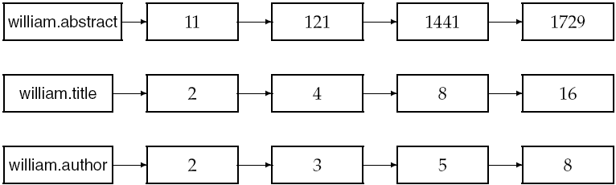
Example zone indexes
Sec. 6.1
Encode zones in dictionary vs. postings.

Slide 6
Basics of Ranking
Boolean retrieval models simply return documents satisfying the Boolean condition(s)
  Among those, are all documents equally “good”?
  No
Consider the case of a single term query
Not all documents containing the term are equally associated with that term
From Boolean model to term weighting
  Weight of a term in a document is 1 or 0 in Boolean model
  Use more granular term weighting
Weight of a term in a document: represent how much the term is important in the document and vice versa

Slide 7
Term weighting – TF.iDF
How important is a term t in a document d
Intuition 1: More times a term is present in a document, more important it is
  Term frequency (TF)
Intuition 2: If a term is present in many documents, it is less important particularly to any one of them
  Document frequency (DF)
Combining the two: TF.iDF (term frequency × inverse document frequency)
  Many variants exist for both TF and DF

Slide 8
Term frequency (TF)
  Variants of TF(t, d)
  Simplest term frequency: Number of times t occurs in d: freq(t, d)
    If a term a is present 10 times, b is present 2 times, is a 5 times more important than b in that document?
  Logarithmically scaled frequency: 1 + log(freq(t, d))
    Still, long documents on same topic would have the more frequency for the same terms
  Augmented frequency: avoid bias towards longer documents
Half the score for just being present
Rest is a function of frequency
    for all t in d; 0 otherwise

Slide 9
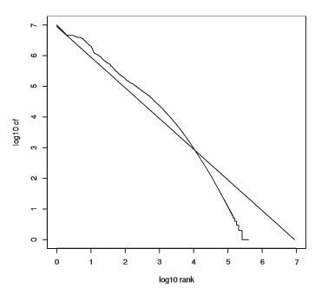
(Inverse) document frequency (iDF)
Inverse document frequency of t : iDF(t)
    where N = total number of documents
    DF(t) = number of documents in which t occurs
Distribution of terms
Zipf’s law: Let T = {t₁, … , t_{m}} be the terms, sorted by decreasing order of the number of documents in which they occur. Then:
For some constant c
Zipf’s law fitting for Reuter’s RCV1 collection

Slide 10
Vector space model
 | d₁ | d₂ | d₃ | d₄ | d₅ |  | q
diwali | 0.5 | 0 | 0 | 0 | 0
india | 0.2 | 0.2 | 0 | 0.2 | 0.1 |  | 1
flying | 0 | 0.4 | 0 | 0 | 0
population | 0 | 0 | 0 | 0.5 | 0
autumn | 0 | 0 | 1 | 0 | 0
statistical | 0 | 0.3 | 0 | 0 | 0.2 |  | 1
Each term represents a dimension
Documents are vectors in the term-space
Term-document matrix: a very sparse matrix
Entries are scores of the terms in the documents (Boolean → Count → Weight)
Query is also a vector in the term-space
Vector similarity: inverse of “distance”
Euclidean distance?

Slide 11
Problem with Euclidean distance
Term 2
Problem
Topic-wise d₃ is closer to d₁ than d₂ is
Euclidean distance wise d₂ is closer to d₁
Dot product solves this problem
d₂
d₁
d₃
Term 1

Slide 12
Vector space model
 | d₁ | d₂ | d₃ | d₄ | d₅ |  | q
diwali | 0.5 | 0 | 0 | 0 | 0
india | 0.2 | 0.2 | 0 | 0.2 | 0.1 |  | 1
flying | 0 | 0.4 | 0 | 0 | 0
population | 0 | 0 | 0 | 0.5 | 0
autumn | 0 | 0 | 1 | 0 | 0
statistical | 0 | 0.3 | 0 | 0 | 0.2 |  | 1
Each term represents a dimension
Documents are vectors in the term-space
Term-document matrix: a very sparse matrix
Entries are scores of the terms in the documents (Boolean → Count → Weight)
Query is also a vector in the term-space
Vector similarity: dot product

Slide 13
Problem with dot product
Problem
Topic-wise d₂ is closer to d₁ than d₃ is
Dot product of d₃ and d₁ is greater because of the length of d₃
Consider angle
  Cosine of the angle between two vectors
  Same direction: 1 (similar)
  Orthogonal: 0 (unrelated)
  Opposite direction: ˗1 (opposite)
Term 2
d₂
d₃
d₁
Term 1

Slide 14
Vector space model
 | d₁ | d₂ | d₃ | d₄ | d₅ |  | q
diwali | 0.5 | 0 | 0 | 0 | 0
india | 0.2 | 0 | 0 | 0.2 | 0.4 |  | 1
flying | 0 | 0.4 | 0 | 0 | 0
population | 0 | 0 | 0 | 0.5 | 0
autumn | 0 | 0 | 1 | 0 | 0
statistical | 0 | 0.3 | 0 | 0 | 0.6 |  | 1
Each term represents a dimension
Documents are vectors in the term-space
Term-document matrix: a very sparse matrix
Entries are scores of the terms in the documents (Boolean → Count → Weight)
Query is also a vector in the term-space
Vector similarity: cosine of the angle between the vectors

Slide 15
Query processing
How to compute cosine similarity and find top-k?
Similar to merge union or intersection using inverted index
  The aggregation function changes to compute cosine
  We are interested only in ranking, no need of normalizing with query length
  If the query words are unweighted, this becomes very similar to merge union
Need to find top-k results after computing the union list with cosine scores

Slide 16
Partial sort using heap for selecting top k
Sec. 7.1
Usual sort takes n log n (may be n = 1 million)
Partial sort
Binary tree in which each node’s value > the values of children
Takes 2n operations to construct, then each of top k read off in 2 log n steps.
For n =1 million, k = 100, this is about 10% of the cost of sorting
1
.9
.3
.3
.8
.1
.1

Slide 17
Length normalization and query – document similarity
Term – document scores
TF.iDF or similar scoring. May already apply some normalization to eliminate bias on long documents
Document length normalization
Ranking by cosine similarity is equivalent to further normalizing the term – document scores by document length. Query length normalization is redundant.
Similarity measure and aggregation
Cosine similarity Sum the scores with union Sum the scores with intersection Other possible approaches

Slide 18
Top-k algorithms
If there are millions of documents in the lists
  Can the ranking be done without accessing the lists fully?
Exact top-k algorithms (used more in databases)
  Family of threshold algorithms (Ronald Fagin et al)
  Threshold algorithm (TA)
  No random access algorithm (NRA) [we will discuss, as an example]
  Combined algorithm (CA)
  Other follow up works

Slide 19
NRA (No Random Access) Algorithm
Fagin’s NRA Algorithm:
List 1
List 2
List 3
doc 25 0.6 | doc 17 0.6 | doc 83 0.9
doc 78 0.5 | doc 38 0.6 | doc 17 0.7
doc 83 0.4 | doc 14 0.6 | doc 61 0.3
doc 17 0.3 | doc 5 0.6 | doc 81 0.2
doc 21 0.2 | doc 83 0.5 | doc 65 0.1
doc 91 0.1 | doc 21 0.3 | doc 10 0.1
 | doc 44 0.1
lists sorted by score
read one doc from every list

Slide 20
NRA (No Random Access) Algorithm
Fagin’s NRA Algorithm: round 1
0.6 + 0.6 + 0.9 = 2.1
current score
best-score
List 1
List 2
List 3
Candidates
doc 25 0.6 | doc 17 0.6 | doc 83 0.9
doc 78 0.5 | doc 38 0.6 | doc 17 0.7
doc 83 0.4 | doc 14 0.6 | doc 61 0.3
doc 17 0.3 | doc 5 0.6 | doc 81 0.2
doc 21 0.2 | doc 83 0.5 | doc 65 0.1
doc 91 0.1 | doc 21 0.3 | doc 10 0.1
 | doc 44 0.1
doc 83 [0.9, 2.1]
doc 17 [0.6, 2.1]
doc 25 [0.6, 2.1]
min top-2 score: 0.6
maximum score for unseen docs: 2.1
lists sorted by score
min-top-2 < best-score of candidates
read one doc from every list

Slide 21
NRA (No Random Access) Algorithm
Fagin’s NRA Algorithm: round 2
0.5 + 0.6 + 0.7 = 1.8
List 1
List 2
List 3
Candidates
doc 25 0.6 | doc 17 0.6 | doc 83 0.9
doc 78 0.5 | doc 38 0.6 | doc 17 0.7
doc 83 0.4 | doc 14 0.6 | doc 61 0.3
doc 17 0.3 | doc 5 0.6 | doc 81 0.2
doc 21 0.2 | doc 83 0.5 | doc 65 0.1
doc 91 0.1 | doc 21 0.3 | doc 10 0.1
 | doc 44 0.1
doc 17 [1.3, 1.8]
doc 83 [0.9, 2.0]
doc 25 [0.6, 1.9]
doc 38 [0.6, 1.8]
doc 78 [0.5, 1.8]
min top-2 score: 0.9
maximum score for unseen docs: 1.8
lists sorted by score
min-top-2 < best-score of candidates
read one doc from every list

Slide 22
NRA (No Random Access) Algorithm
Fagin’s NRA Algorithm: round 3
0.4 + 0.6 + 0.3 = 1.3
List 1
List 2
List 3
Candidates
doc 25 0.6 | doc 17 0.6 | doc 83 0.9
doc 78 0.5 | doc 38 0.6 | doc 17 0.7
doc 83 0.4 | doc 14 0.6 | doc 61 0.3
doc 17 0.3 | doc 5 0.6 | doc 81 0.2
doc 21 0.2 | doc 83 0.5 | doc 65 0.1
doc 91 0.1 | doc 21 0.3 | doc 10 0.1
 | doc 44 0.1
doc 83 [1.3, 1.9]
doc 17 [1.3, 1.7]
doc 25 [0.6, 1.5]
doc 78 [0.5, 1.4]
min top-2 score: 1.3
maximum score for unseen docs: 1.3
lists sorted by score
min-top-2 < best-score of candidates
no more new docs can get into top-2
but, extra candidates left in queue
read one doc from every list

Slide 23
NRA (No Random Access) Algorithm
Fagin’s NRA Algorithm: round 4
0.3 + 0.6 + 0.2 = 1.1
List 1
List 2
List 3
Candidates
doc 25 0.6 | doc 17 0.6 | doc 83 0.9
doc 78 0.5 | doc 38 0.6 | doc 17 0.7
doc 83 0.4 | doc 14 0.6 | doc 61 0.3
doc 17 0.3 | doc 5 0.6 | doc 81 0.2
doc 21 0.2 | doc 83 0.5 | doc 65 0.1
doc 91 0.1 | doc 21 0.3 | doc 10 0.1
 | doc 44 0.1
doc 17 1.6
doc 83 [1.3, 1.9]
doc 25 [0.6, 1.4]
min top-2 score: 1.3
maximum score for unseen docs: 1.1
lists sorted by score
min-top-2 < best-score of candidates
no more new docs can get into top-2
but, extra candidates left in queue
read one doc from every list

Slide 24
NRA (No Random Access) Algorithm
Fagin’s NRA Algorithm: round 5
0.2 + 0.5 + 0.1 = 0.8
List 1
List 2
List 3
Candidates
doc 25 0.6 | doc 17 0.6 | doc 83 0.9
doc 78 0.5 | doc 38 0.6 | doc 17 0.7
doc 83 0.4 | doc 14 0.6 | doc 61 0.3
doc 17 0.3 | doc 5 0.6 | doc 81 0.2
doc 21 0.2 | doc 83 0.5 | doc 65 0.1
doc 91 0.1 | doc 21 0.3 | doc 10 0.1
 | doc 44 0.1
doc 83 1.8
doc 17 1.6
min top-2 score: 1.6
maximum score for unseen docs: 0.8
lists sorted by score
no extra candidate in queue
Done!
More approaches:
Periodically also perform random accesses on documents to reduce uncertainty (CA)
Sophisticated scheduling on lists
Crude approximation: NRA may take a lot of time to stop. Just stop after a while with approximate top-k – who cares if the results are perfect according to the scores?
read one doc from every list

Slide 25
Inexact top-k retrieval
Does the exact top-k matter?
  How much are we sure that the 101st ranked document is less important than the 100th ranked?
  All the scores are simplified models for what information may be associated with the documents
Suffices to retrieve k documents with
  Many of them from the exact top-k
  The others having score close to the top-k

Slide 26
Champion lists
Sec. 7.1.3
Precompute for each dictionary term t, the r docs of highest score in t’s posting list
  Ideally k < r << n (n = size of the posting list)
  Champion list for t (or fancy list or top docs for t)
Note: r has to be chosen at index build time
  Thus, it’s possible that r < k
At query time, only compute scores for docs in the champion list of some query term
  Pick the K top-scoring docs from amongst these

Slide 27
Static quality scores
Sec. 7.1.4
We want top-ranking documents to be both relevant and authoritative
Relevance is being modeled by cosine scores
Authority is typically a query-independent property of a document
Examples of authority signals
  Wikipedia among websites
  Articles in certain newspapers
  A paper with many citations
  (Pagerank)

Slide 28
Modeling authority
Sec. 7.1.4
Assign to each document a query-independent quality score in [0,1] to each document d
  Denote this by g(d)
Consider a simple total score combining cosine relevance and authority
Net-score(q,d) = g(d) + cosine(q,d)
  Can use some other linear combination
  Indeed, any function of the two “signals” of user happiness – more later
Now we seek the top k docs by net score

Slide 29
Top k by net score – fast methods
Sec. 7.1.4
First idea: Order all postings by g(d)
Key: this is a common ordering for all postings
Thus, can concurrently traverse query terms’ postings for
  Postings intersection
  Cosine score computation
Under g(d)-ordering, top-scoring docs likely to appear early in postings traversal
In time-bound applications (say, we have to return whatever search results we can in 50 ms), this allows us to stop postings traversal early
  Short of computing scores for all docs in postings

Slide 30
Champion lists in g(d)-ordering
Sec. 7.1.4
Can combine champion lists with g(d)-ordering
Maintain for each term a champion list of the r docs with highest g(d) + tf-idf_{td}
Seek top-k results from only the docs in these champion lists

Slide 31
High and low lists
Sec. 7.1.4
For each term, we maintain two postings lists called high and low
  Think of high as the champion list
When traversing postings on a query, only traverse high lists first
  If we get more than k docs, select the top k and stop
  Else proceed to get docs from the low lists
Can be used even for simple cosine scores, without global quality g(d)
A means for segmenting index into two tiers

Slide 32
Impact-ordered postings
Sec. 7.1.5
We only want to compute scores for docs d for which wf_{t,d}, for query term t, is high enough
Sort each postings list by wf_{t,d}
Now: not all postings in a common order!
How do we compute scores in order to pick top k?
  Two ideas follow

Slide 33
1. Early termination
Sec. 7.1.5
When traversing t’s postings, stop early after either
  a fixed number of r docs
  wf_{t,d} drops below some threshold
Take the union of the resulting sets of docs
  One from the postings of each query term
Compute only the scores for docs in this union

Slide 34
2. iDF-ordered terms
Sec. 7.1.5
When considering the postings of query terms
Look at them in order of decreasing idf
  High idf terms likely to contribute most to score
As we update score contribution from each query term
  Stop if doc scores relatively unchanged
Can apply to cosine or some other net scores

Slide 35
Cluster pruning
Sec. 7.1.6
Preprocessing
Pick √N documents at random: call these leaders
For every other document, pre-compute nearest leader
  Documents attached to a leader: its followers;
  Likely: each leader has ~ √N followers.
Query processing
Process a query as follows:
  Given query Q, find its nearest leader L.
  Seek k nearest docs from among L’s followers.

Slide 36
Cluster pruning
Sec. 7.1.6
Query
Leader
Follower

Slide 37
Cluster pruning
Sec. 7.1.6
Why random sampling?
  Fast
  Leaders reflect data distribution
Variants:
Have each follower attached to b1=3 (say) nearest leaders.
From query, find b2=4 (say) nearest leaders and their followers.
Can recurse on leader/follower construction.

Slide 38
Tiered indexes
Sec. 7.2.1
Break postings up into a hierarchy of lists
  Most important
  …
  Least important
Can be done by g(d) or another measure
Inverted index thus broken up into tiers of decreasing importance
At query time use top tier unless it fails to yield K docs
  If so drop to lower tiers

Slide 39
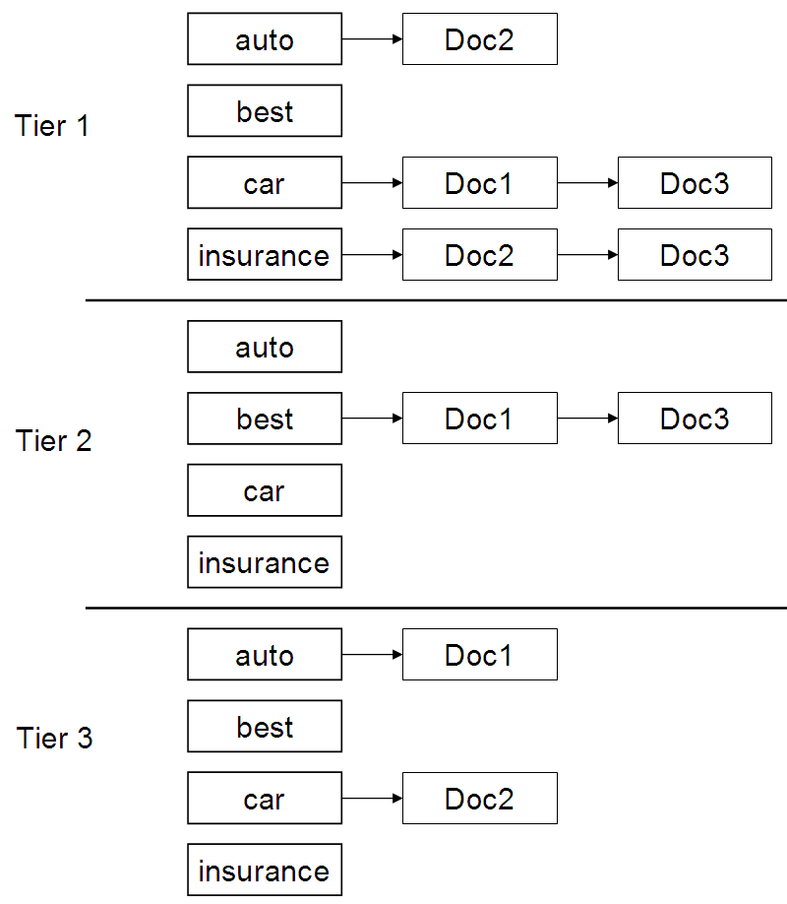
Example tiered index
Sec. 7.2.1

Slide 40
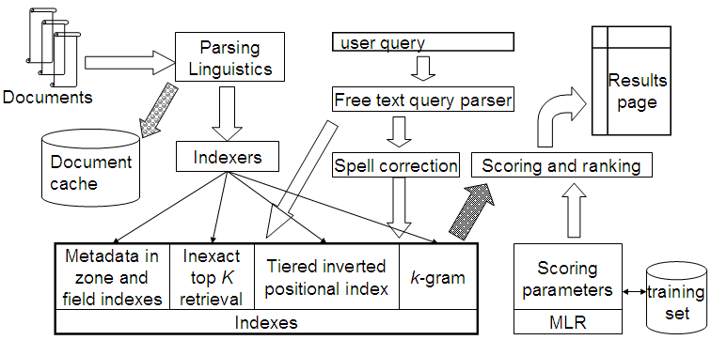
Putting it all together
Sec. 7.2.4

Slide 41
Sources and Acknowledgements
IR Book by Manning, Raghavan and Schuetze: http://nlp.stanford.edu/IR-book/
Several slides are adapted from the slides by Prof. Nayak and Prof. Raghavan for their course in Stanford University

