Slide 1
Recommender Systems
Debapriyo Majumdar
Information Retrieval – Spring 2015
Indian Statistical Institute Kolkata
Credits to Bing Liu (UIC) and Angshul Majumdar (IIITD) for the slides

Slide 2


Recommender systems
Business
How to increase revenue?
How to recommend items customers like?
Customer
Too many options.
How to choose the right one?

Slide 3
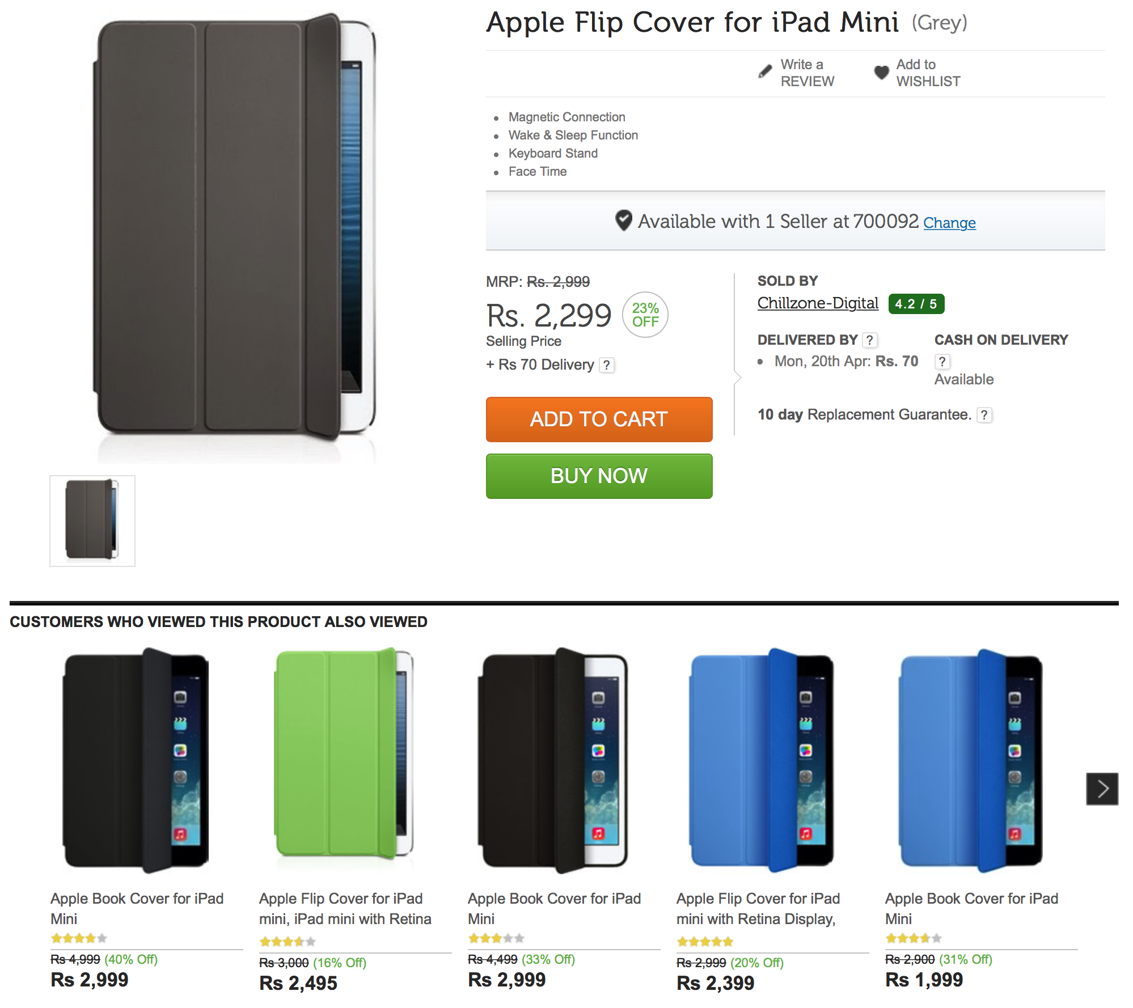
Recommender systems
Customers who viewed / bought this product also bought
Since you are looking at this, you may also look at …

Slide 4
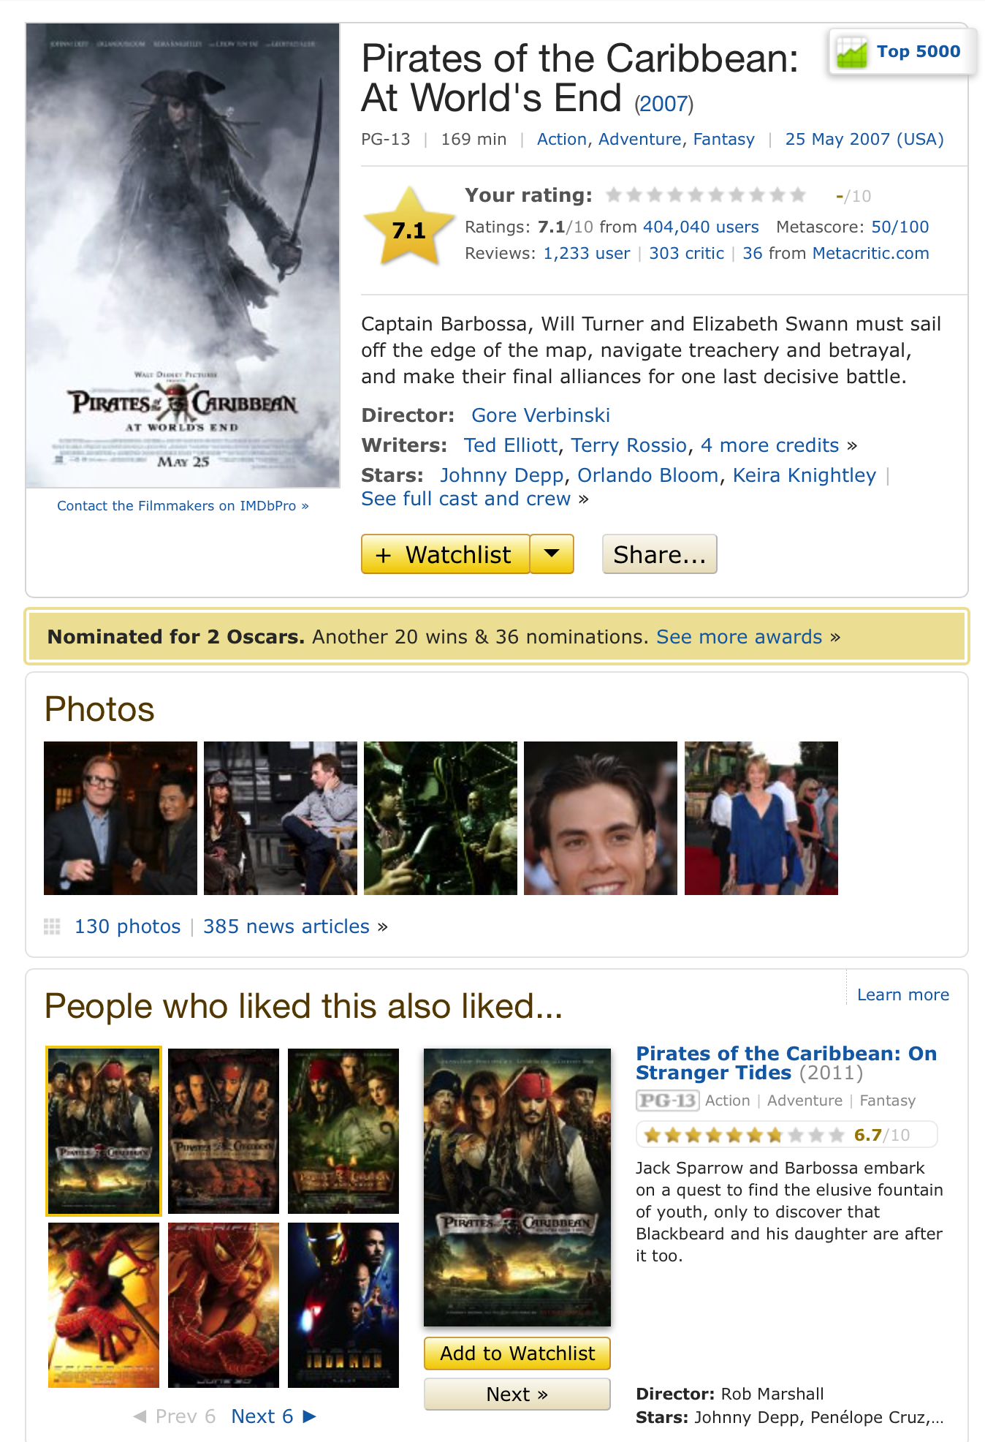
Recommender systems
Viewers who liked this movie also liked the other movies
Since you are looking at this page, you may also like…

Slide 5
The Recommendation Problem
We have a set of users U and a set of items S to be recommended to the users.
Let p be an utility function that measures the usefulness of item s (∈ S) to user u (∈ U), i.e.,
  p : U × S → R, where R is a totally ordered set (e.g., non-negative integers or real numbers in a range)
Objective
  Learn p based on the past data
  Use p to predict the utility value of each item s (∈ S) to each user u (∈ U)

Slide 6
Two main formulations
Rating prediction: predict the rating score that a user is likely to give to an item that (s)he has not seen or used before
  Rating on an unseen movie
  In this case, the utility of item s to user u is the rating given to s by u
Item prediction: predict a ranked list of items that a user is likely to buy or use

Slide 7
Approaches
Content-based recommendations:
The user will be recommended items similar to the ones the user preferred in the past
Collaborative filtering (or collaborative recommendations):
The user will be recommended items that people with similar tastes and preferences liked in the past
Hybrids: Combine collaborative and content-based methods

Slide 8
Content based recommendation
Will user u like item s?
Look at items similar to s; does u like them?
  Similarity based on content
  Example: a movie represented based on features as specific actors, director, genre, subject matter, etc
The user’s interest or preference is also represented by the same set of features (the user profile)
Candidate item s is compared with the user profile of u in the same feature space
Determine if u would like s, or
Top k similar items are recommended

Slide 9
Collaborative filtering
Collaborative filtering (CF): more studied and widely used recommendation approach in practice
  k-nearest neighbor
  association rules based prediction
  matrix factorization
Key characteristic: predicts the utility of items for a user based on the items previously rated by other like-minded users (thus, collaborative)

Slide 10
k nearest neighbor approach
No model building
Utilizes the entire user-item database to generate predictions directly, i.e., there is no model building.
This approach includes both
  User-based methods
  Item-based methods

Slide 11
User based kNN CF
Let the record (or profile) of the target user be u (represented as a vector), and the record of another user be v (v ∈ T).
The similarity between the target user, u, and a neighbor, v, can be calculated using the Pearson’s correlation coefficient:
  where V is the set of k similar users, r_{v,i} is the rating of user v given to item i
Compute the rating prediction of item i for target user u

Slide 12
Problems with user based CF
The problem with the user-based formulation of collaborative filtering is the lack of scalability:
  it requires the real-time comparison of the target user to all user records in order to generate predictions
A variation of this approach that remedies this problem is called item-based CF

Slide 13
Item-based CF
The item-based approach works by comparing items based on their pattern of ratings across users. The similarity of items i and j is computed as follows:
After computing the similarity between items we select a set of k most similar items to the target item and generate a predicted value of user u’s rating
where J is the set of k similar items

Slide 14
Association rule-based CF
Transaction database: users, items
  User → Item: viewed, bought, liked
Find association rules such as
  Bought X, bought Y → Bought Z
  Confidence and support (how strong is this association)
Rank items based on measures such as confidence, subject to some minimum support
Further reading: association rule mining

Slide 15
Matrix factorization based CF
Gained popularity for CF in recent years due to its superior performance both in terms of recommendation quality and scalability.
Part of its success is due to the Netflix Prize contest for movie recommendation
Popularized a Singular Value Decomposition (SVD) based matrix factorization algorithm
  The prize winning method of the Netflix Prize Contest employed an adapted version of SVD

Slide 16
How do we choose a movie?
Possibly, we look at a few factors
  Genre (Action, Thriller, Western, Drama ...)
  Actor
  Director (Tarantino, Nolan, Bergman ...)
There are only a few factors that helps decide our choice (remember: content based)
But we do not know exactly which factors …

Slide 17
Latent Factor Model
Assumes that the factors affecting the choices are hidden / latent.
These factors need not be exactly known.
  The item-j is characterized by m-factors
  The user-a is characterized by his / her affinity towards these factors

Slide 18
Mathematical Formalism
Latent factor model assumes that the rating of a user on an item is just an inner-product of the users’ and items’ latent factors.
How do we use this model for prediction?

Slide 19
A holistic view
The matrix of interactions
Items
Users

Slide 20
A low-rank model
The matrix of ratings can be expressed as:
According to our assumption, the matrix is of low rank (m)

Slide 21
SVD-CF
The problem is to impute missing values in R
Challenge – missing entries.
Therefore ...
  Compute the column average to impute the missing values.
  Compute the row average and subtract from all the elements of the filled matrix – A
  Compute best m-rank approximation of A
  Predict missing value as

