Slide 1
Text Classification using
Support Vector Machine
Debapriyo Majumdar
Information Retrieval – Spring 2015
Indian Statistical Institute Kolkata

Slide 2
A Linear Classifier
A Line (generally hyperplane) that separates the two classes of points
Choose a “good” line
Optimize some objective function
LDA: objective function depending on mean and scatter
Depends on all the points
There can be many such lines, many parameters to optimize

Slide 3
Recall: A Linear Classifier
What do we really want?
Primarily – least number of misclassifications
Consider a separation line
When will we worry about misclassification?
Answer: when the test point is near the margin
So – why consider scatter, mean etc (those depend on all points), rather just concentrate on the “border”

Slide 4
Support Vector Machine: intuition
support vectors
support vectors
Recall: A projection line w for the points lets us define a separation line L
How? [not mean and scatter]
Identify support vectors, the training data points that act as “support”
Separation line L between support vectors
w
L₂
L₁
L
Maximize the margin: the distance between lines L₁ and L₂ (hyperplanes) defined by the support vectors

Slide 5
Basics
Distance of L from origin
w

Slide 6
Support Vector Machine: classification
Denote the two classes as y = +1 and −1
Then for a unlabeled point x, the classification problem is:
w

Slide 7
Support Vector Machine: training
Scale w and b such that we have the lines are defined by these equations
Then we have:
The margin (separation of the two classes)
w
Two classes as y_{i}=−1, +1

Slide 8
Soft margin SVM
(Hard margin) SVM Primal
ξ_{j}
The non-ideal case
Non separable training data
Slack variables ξ_{i} for each training data point
Soft margin SVM
ξ_{i}
Sum: an upper bound on #of misclassifications on training data
δ
w
C is the controlling parameter
Small C → allows large ξ_{i}’s; large C → forces small ξ_{i}’s

Slide 9
Dual SVM
Primal SVM Optimization problem
Dual SVM Optimization problem
Theorem: The solution w*can always be written as a linear combination
of the training vectors x_{i} with 0 ≤ α_{i} ≤ C
Properties:
The factors α_{i} indicate influence of the training examples x_{i}
If ξ_{i} > 0, then α_{i} ≤ C. If α_{i} < C, then ξ_{i} = 0
x_{i} is a support vector if and only if α_{i} > 0
If 0 < α_{i} < C, then y_{i} (w*• x_{i} + b) = 1

Slide 10
Case: not linearly separable
Data may not be linearly separable
Map the data into a higher dimensional space
Data can become separable in the higher dimensional space
Idea: add more features
Learn linear rule in feature space
a | b | c
a | b | c | aa | bb | cc | ab | bc | ac

Slide 11
Dual SVM
Primal SVM Optimization problem
Dual SVM Optimization problem
If w* is a solution to the primal and α* = (α*_{i}) is a solution to the dual, then
Mapping into the features space with Φ
Even higher dimension; p attributes → O(np) attributes with a n degree polynomial Φ
The dual problem depends only on the inner products
What if there was some way to compute Φ(x_{i})•Φ(x_{j})?
Kernel functions: functions such that K(a, b) = Φ(a)•Φ(b)

Slide 12
SVM kernels
Linear: K(a, b) = a • b
Polynomial: K(a, b) = [a • b + 1]^{d}
Radial basis function: K(a, b) = exp(−γ[a − b]²)
Sigmoid: K(a, b) = tanh(γ[a • b] + c)
Example: degree-2 polynomial
Φ(x) = Φ(x₁, x₂) = (x₁², x₂²,√2x₁,√2x₂,√2x₁x₂,1)
K(a, b) = [a • b + 1]²

Slide 13
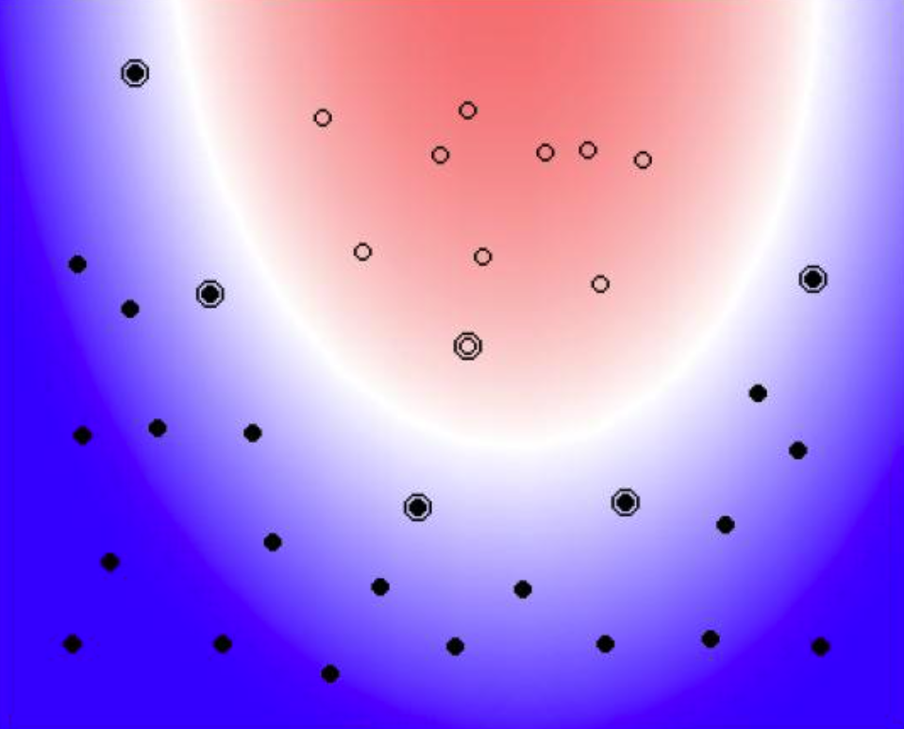
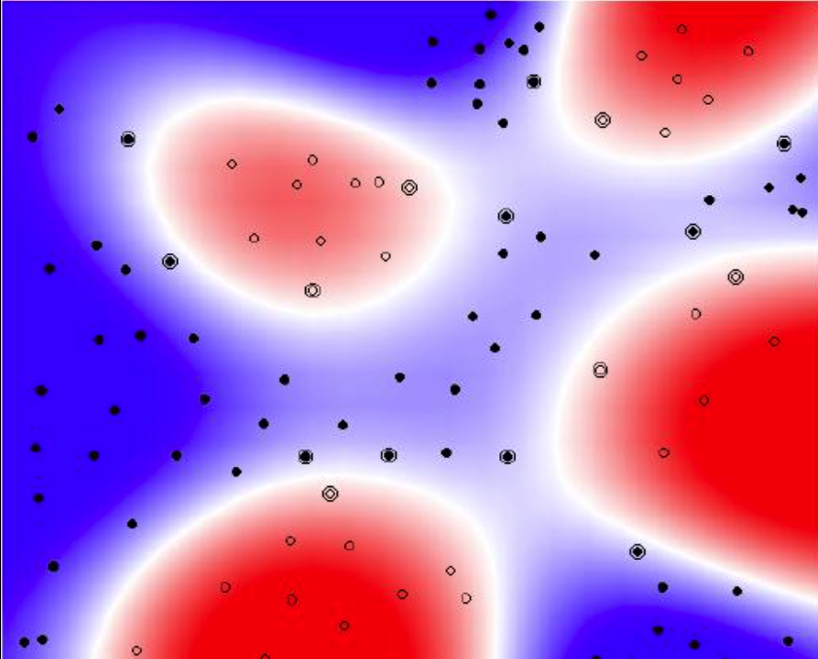
SVM Kernels: Intuition
Degree 2 polynomial
Radial basis function

Slide 14
Acknowledgments
Thorsten Joachims’ lecture notes for some slides

