Slide 1

High Dimensional Expanders (HDXs)
Prahladh Harsha, TIFR

Slide 2
Expander Graphs
Graphs which are very well connected
First studied
  [Barzdin-Kolmogorov ’67]
  [Pinksker ’73]

Slide 3
Expander Graphs
Graphs which are very well connected
Combinatorial Expansion:
  ∀S⊆V, If |S|≤|V|/2 then |N(S)|≥A|S|.

Slide 4
Expander Graphs
Graphs which are very well connected
Spectral Expansion:
  λ := max{λ2,|λn|} ≤ 1−μ < 1
  (eigenvalues of normalized adjacency matrix)

Slide 5
Expander Graphs
Graphs which are very well connected
Random Walk: Walk mixes well
  ∥J/n−A∥≤λ,
  (J = all 1’s matrix and A - normalized adjacency matrix)

Slide 6
Expander Graphs
Graphs which are very well connected
Gold Standard of connectivity:
Complete Graph
Theorem:
There exist explicit constant degree expander graphs

Slide 7
Expander Graphs
Applications:
  Time-space tradeoffs
  Byzantive Agreement
  Derandomization
  Metric Embeddings
  Proof of the PCP Theorem [Dinur ‘05]
  Logspace algorithm for undirected-connectivity [Reingold ‘05]
  Coding Theory
  …..

Slide 8
Expander Graphs
Coding Theory Applications
  Constant rate, linear distance binary codes [Gallager]
  Distance Amplification in codes
  [Alon-Bruck-Naor-Naor-Roth]
  Linear time (unique) decodable codes
  [Sipser-Spielman]
  Linear time list-decodable codes
  [Guruswami-Indyk]

Slide 9
Higher Dimension Analogues
What about expansion in hypergraphs?
  Edge – hyperedges (contain more than 2 vertices)

Slide 10
Higher Dimension Analogues
Several Candidate Definitions
CS perspective:
[Louis, Yoshida, Soma-Yoshida]
  Extend Spectral / Laplacian viewpoint
Math perspective:
[Linial-Meshulam, Gromov, ...]
  topological expanders
  cohomological expanders
  co-boundary expanders
  Link expanders [Dinur-Kaufman ‘18]
  Random walk analogues [Dikstein-Dinur-Filmus-Harsha ‘18]

Slide 11
High Dimensional Expanders (HDXs)
Gold Standard of connectivity in graphs:
Complete Graph
Gold Standard of connectivity in hypergraphs:
k-uniform Complete Graph

Slide 12

Simplicial Complex Viewpoint
X(3)
Triangles
X(2)
Edges
X(1)
Given k-uniform hypergraph X, down close it
Vertices
X(0)
$$φ −empty set$$
Empty Set

Slide 13
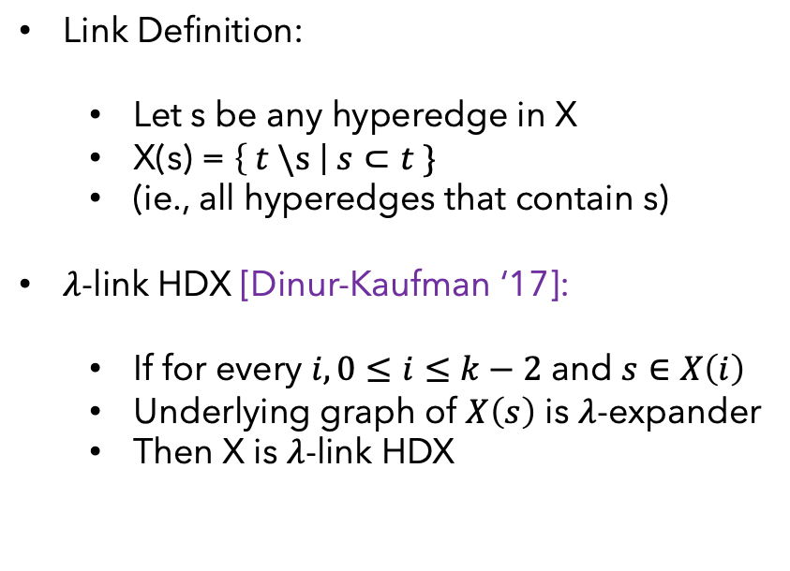
Definition via
Link expansion
X(3)
Triangles
Underlying Graph
X(2)
Link Definition:
  Let s be any hyperedge in X
  X(s) = $\left\{ t \backslash s \right| s⊂t \}$
  (ie., all hyperedges that contain s)
$λ$-link HDX [Dinur-Kaufman ‘17]:
  If for every $i, 0≤i≤k−2$ and $s∈X\left(i\right)$
  Underlying graph of $X\left(s\right)$ is $λ$-expander
  Then X is $λ$-link HDX
Edges
X(1)
Vertices
X(0)
$$φ −empty set$$
Empty Set

Slide 14
Random Walk Definition of HDX
X(3)
Triangles
Consider two types of walk on each layer X(i), 0 < i < k
Up-Down walk
Down-up walk
X(2)
Edges
X(1)
Vertices
X(0)
$$φ −empty set$$
Empty Set

Slide 15
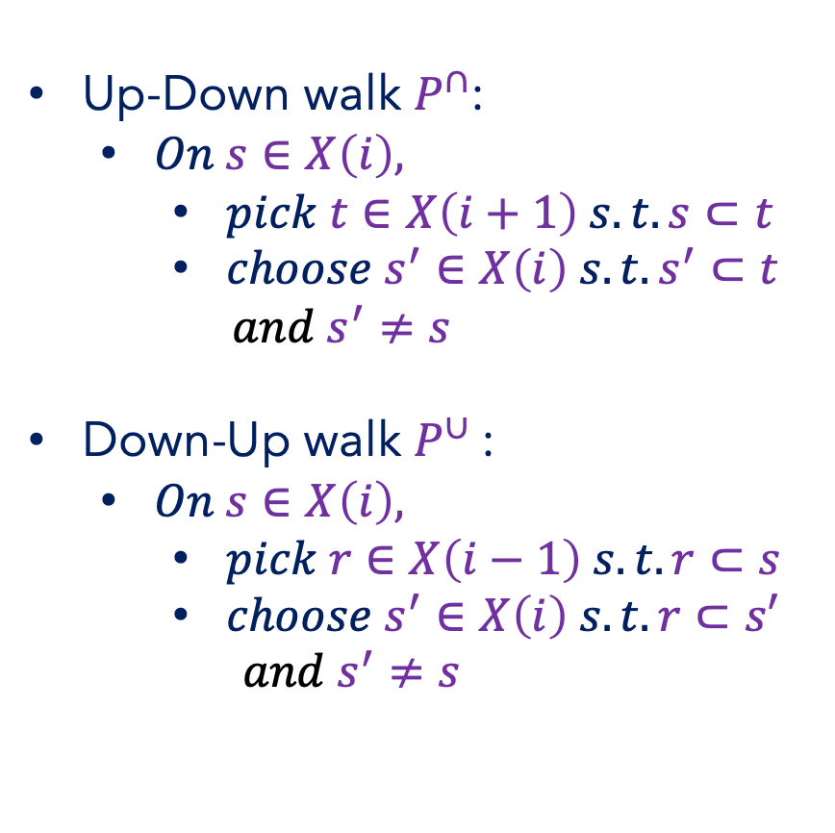
Random Walk Definition of HDX
X(i+1)
Up-Down walk $P^{∩}$:
  $On s∈X\left(i\right),$
    $pick t∈X\left(i+1\right) s.t. s⊂t$
    $choose s^{′}∈X\left(i\right) s.t. s^{′}⊂t$
    ${and s}^{′}≠s$
Down-Up walk $P^{∪}$:
  $On s∈X\left(i\right),$
    $pick r∈X\left(i−1\right) s.t. r⊂s$
    $choose s^{′}∈X\left(i\right) s.t. r⊂s′$
    $${and s}^{′}≠s$$
X(i)
X(i-1)

Slide 16
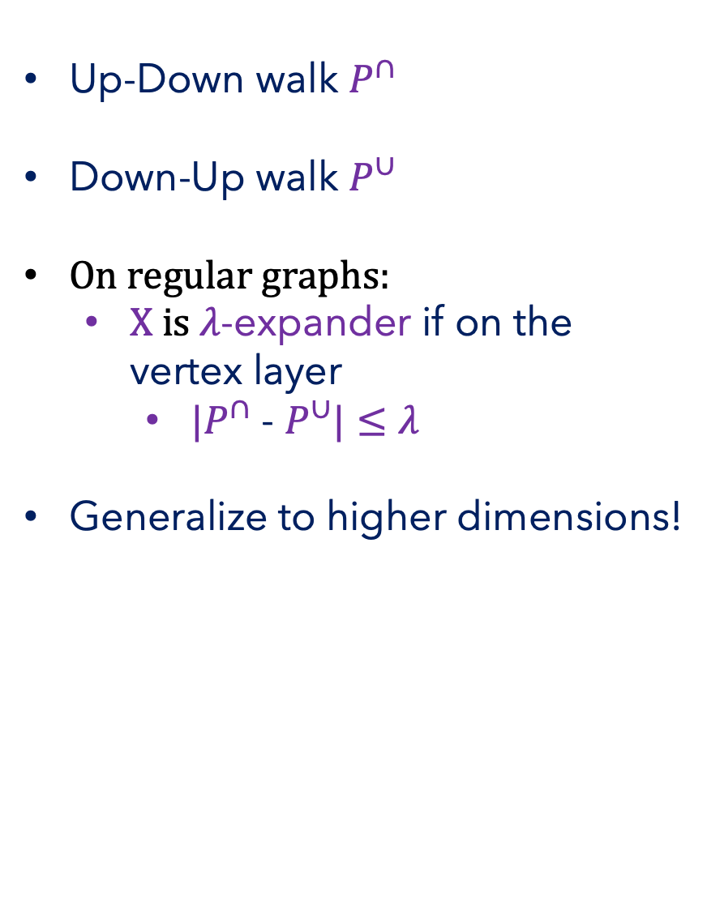
Random Walk Definition of HDX
X(i+1)
Up-Down walk $P^{∩}$
Down-Up walk $P^{∪}$
On regular graphs:
  X is $λ$-expander if on the vertex layer
    $|P^{∩}$ - $P^{∪}|≤λ$
Generalize to higher dimensions!
X(i)
X(i-1)

Slide 17


Random Walk Definition of HDX
X(i+1)
Up-Down walk $P^{∩}$
Down-Up walk $P^{∪}$
X(i)
Clearly, complete k-uniform hypergraph is a 0-HDX
Random Walk Definition of HDX:
  If for each layer i, 0 < i < k
  $|P^{∩}$ - $P^{∪}|≤λ$
  Then X is $λ$-HDX
X(i-1)

Slide 18
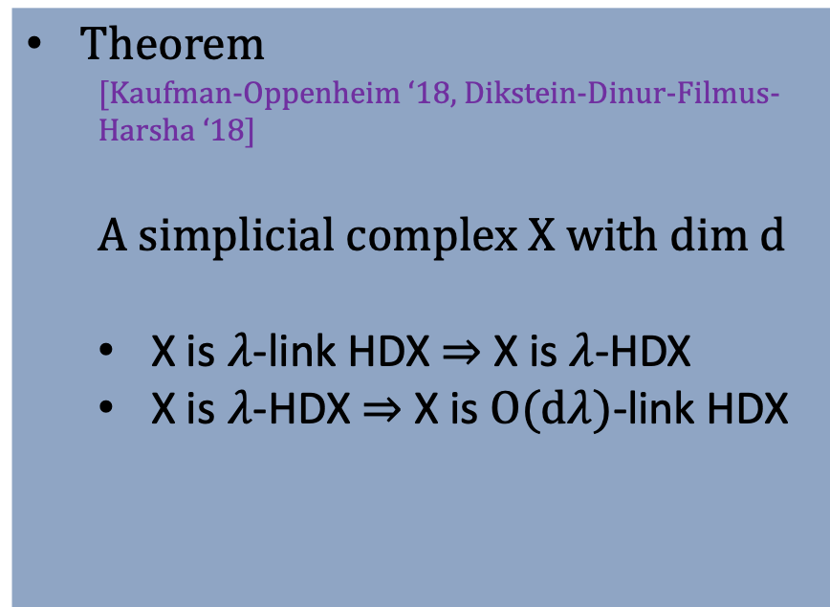
Equivalence of definitions
X(3)
Triangles
X(2)
Theorem
  [Kaufman-Oppenheim ‘18, Dikstein-Dinur-Filmus-Harsha ‘18]
  A simplicial complex X with dim d
  X is $λ$-link HDX $⇒$ X is $λ$-HDX
  X is $λ$-HDX $⇒$ X is $O(dλ)$-link HDX
Edges
X(1)
Vertices
X(0)
$$φ −empty set$$
Empty Set

Slide 19
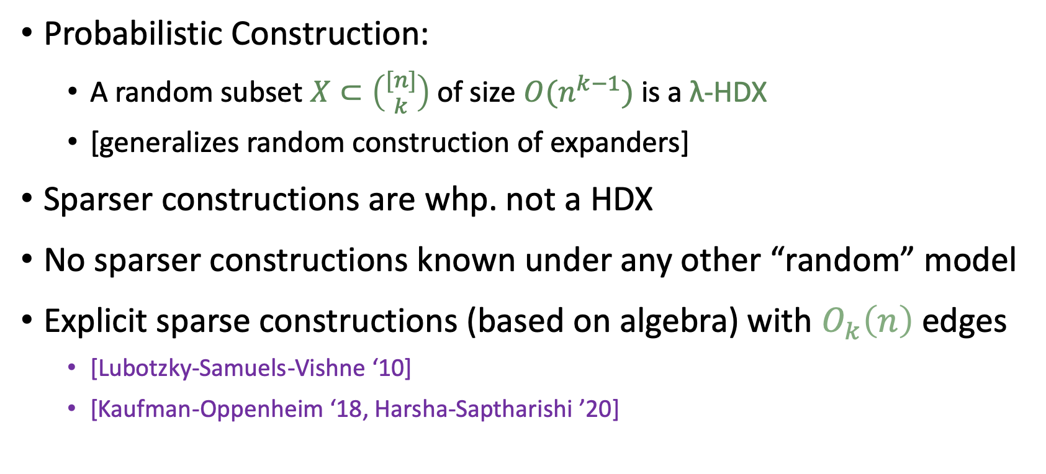
Sparse HDXs
Probabilistic Construction:
  A random subset $X⊂\left({[n] \atop k}\right)$ of size $O(n^{k−1})$ is a λ-HDX
  [generalizes random construction of expanders]
Sparser constructions are whp. not a HDX
No sparser constructions known under any other “random” model
Explicit sparse constructions (based on algebra) with $O_{k}\left(n\right)$ edges
  [Lubotzky-Samuels-Vishne ‘10]
  [Kaufman-Oppenheim ‘18, Harsha-Saptharishi ’20]

Slide 20
HDX Applications to TCS
Local-to-Global Testing
  Property testing, agreement testing [Dinur-Kaufman ‘17]
Coding Theory
  Efficient list-decodable codes [Dinur-Harsha-Kaufman-Livni-RonZewi-TaShma ’19, Alev-Jeranimo-Tulsiani ‘19]
  Locally testable codes [Dikstein-Dinur-Harsha-RonZewi-Kaufman ‘19, Dikstein-Dinur-Harsha-RonZewi ‘20]
Approximate Sampling/Counting
  Sampling/Counting bases of matroid [Anari-Liu-Gharan-Vinzent ‘19, Alev-Lau ‘20]

Slide 21
Application 1:
Sampling bases of Matroid
Example: sample a random Spanning Tree

Slide 22
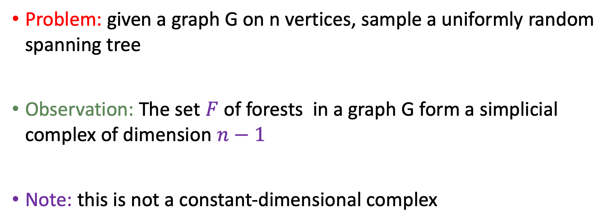
Sampling a random Spanning Tree
Problem: given a graph G on n vertices, sample a uniformly random spanning tree
Observation: The set $F$ of forests in a graph G form a simplicial complex of dimension $n−1$
Note: this is not a constant-dimensional complex

Slide 23
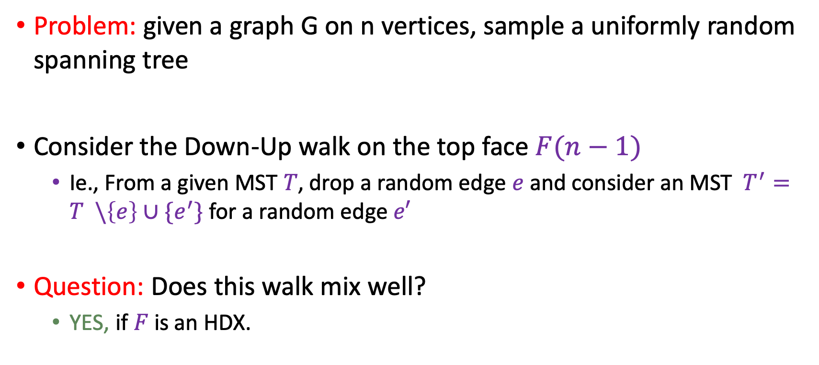
Sampling a random Spanning Tree
Problem: given a graph G on n vertices, sample a uniformly random spanning tree
Consider the Down-Up walk on the top face $F(n−1)$
  Ie., From a given MST $T$, drop a random edge $e$and consider an MST $T^{′}=T \backslash \left\{e\right\}∪\{e^{′}\}$ for a random edge$e′$
Question: Does this walk mix well?
  YES, if $F$ is an HDX.

Slide 24
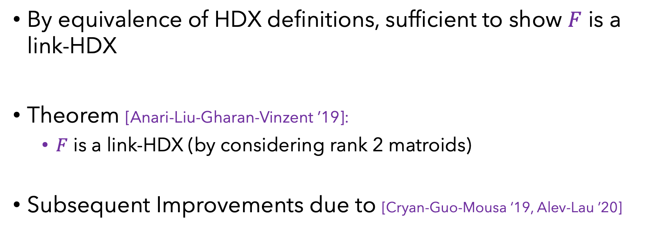
Sampling a random Spanning Tree
By equivalence of HDX definitions, sufficient to show $F$ is a link-HDX
Theorem [Anari-Liu-Gharan-Vinzent ’19]:
  $F$ is a link-HDX (by considering rank 2 matroids)
Subsequent Improvements due to [Cryan-Guo-Mousa ‘19, Alev-Lau ’20]

Slide 25
Application 2:
Local-to-Global Testing

Slide 26


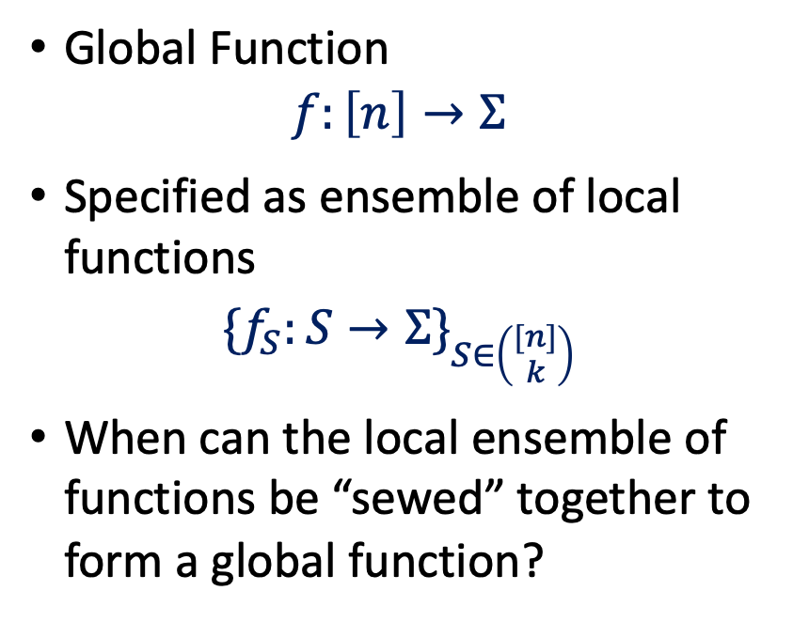



Agreement Testing
$$\{f_{S}:S→Σ\}_{S∈\left({[n] \atop k}\right)}$$
$$\left({[n] \atop k}\right)$$
Global Function
$$f:\left[n\right]→Σ$$
Specified as ensemble of local functions
$$\{f_{S}:S→Σ\}_{S∈\left({[n] \atop k}\right)}$$
When can the local ensemble of functions be “sewed” together to form a global function?
$$\left({[n] \atop t}\right)$$
$$[n]$$
$$f:\left[n\right]→Σ$$

Slide 27





Agreement Testing
$$\{f_{S}:S→Σ\}_{S∈\left({[n] \atop k}\right)}$$
$$\left({[n] \atop k}\right)$$
Global Function
$$f:\left[n\right]→Σ$$
Specified as ensemble of local functions
$$\{f_{S}:S→Σ\}_{S∈\left({[n] \atop k}\right)}$$
$If ∀T∈\left({\left[n\right] \atop t}\right),T⊂S,S^{′}implies$
$$f_{S}|_{T}≡f_{S′}|_{T}$$
$$S$$
$S$’
$$f_{S}|_{T}$$
$$\left({[n] \atop t}\right)$$
$$T$$
What about Approximate Agreement?
$$[n]$$
$$f:\left[n\right]→Σ$$

Slide 28
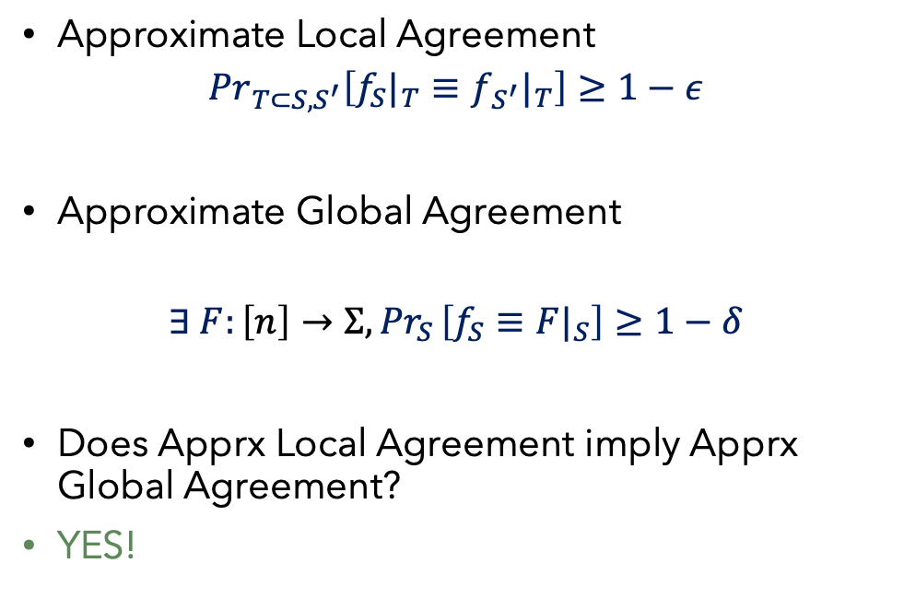
Agreement Testing
$$\{f_{S}:S→Σ\}_{S∈\left({[n] \atop k}\right)}$$
$$\left({[n] \atop k}\right)$$
Approximate Local Agreement
$${Pr}_{T⊂S,S^{′}}\left[f_{S}|_{T}≡f_{S^{′}}|_{T}\right]≥1−ε$$
Approximate Global Agreement
$$∃ F:\left[n\right]→Σ,{Pr}_{S }\left[f_{S}≡{F|}_{S}\right]≥1−δ$$
Does Apprx Local Agreement imply Apprx Global Agreement?
YES!
Theorem : [. . . , DG, IKW, DS, DN, DFH]
If k ≪ n and 0.01 < t/k < 0.99, then
Apprx Local Agreement implies Global Agreement.
In fact, the majority-decoded function is a candidate global F
$$S$$
$S$’
$$\left({[n] \atop t}\right)$$
$$T$$
$$[n]$$
$$f:\left[n\right]→Σ$$

Slide 29
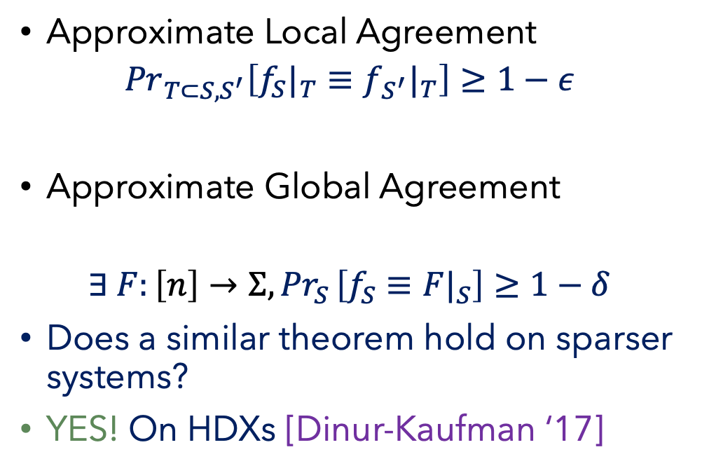
Agreement Testing on Sparser Sets
$$\{f_{S}:S→Σ\}_{S∈\left({[n] \atop k}\right)}$$
$$\left({[n] \atop k}\right)$$
Approximate Local Agreement
$${Pr}_{T⊂S,S^{′}}\left[f_{S}|_{T}≡f_{S^{′}}|_{T}\right]≥1−ε$$
Approximate Global Agreement
$$∃ F:\left[n\right]→Σ,{Pr}_{S }\left[f_{S}≡{F|}_{S}\right]≥1−δ$$
Does a similar theorem hold on sparser systems?
YES! On HDXs [Dinur-Kaufman ‘17]
Theorem : [. . . , DG, IKW, DS, DN, DFH]
If k ≪ n and 0.01 < t/k < 0.99, then
Apprx Local Agreement implies Global Agreement.
In fact, the majority-decoded function is a candidate global F
$$S$$
$S$’
$$\left({[n] \atop t}\right)$$
$$T$$
$$[n]$$
$$f:\left[n\right]→Σ$$

Slide 30
Boolean function Analysis on HDXs

Slide 31
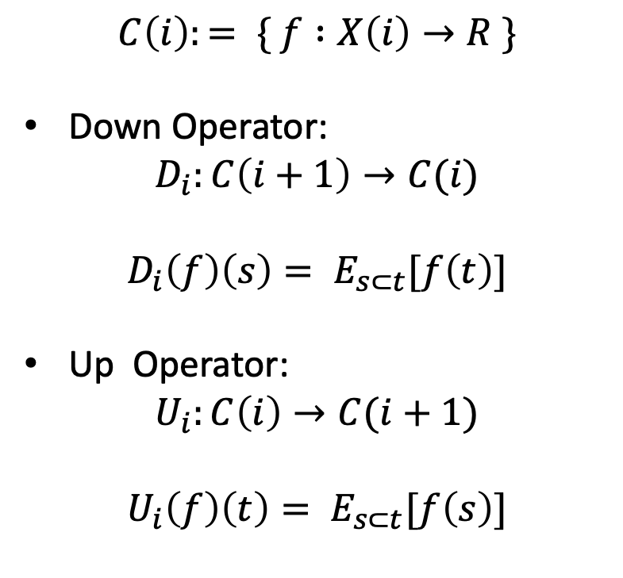
Boolean Function Analysis on HDXs
X(3)
Triangles
$$C\left(i\right):= \{ f :X\left(i\right)→R \}$$
Down Operator:
$$D_{i}:C\left(i+1\right)→C(i)$$
$$D_{i}\left(f\right)\left(s\right)= E_{s⊂t}[f\left(t\right)]$$
Up Operator:
$$U_{i}:C\left(i\right)→C(i+1)$$
$$U_{i}\left(f\right)\left(t\right)= E_{s⊂t}[f\left(s\right)]$$
X(2)
Edges
X(1)
Vertices
X(0)
$$φ −empty set$$
Empty Set

Slide 32
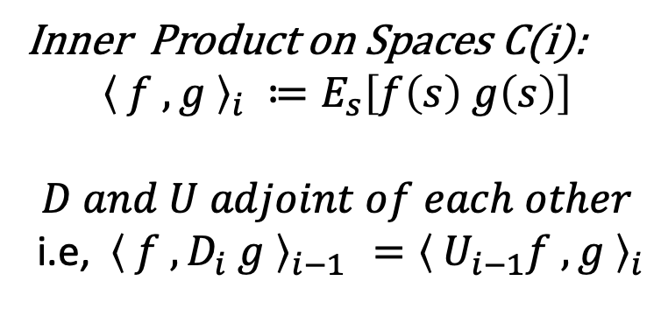
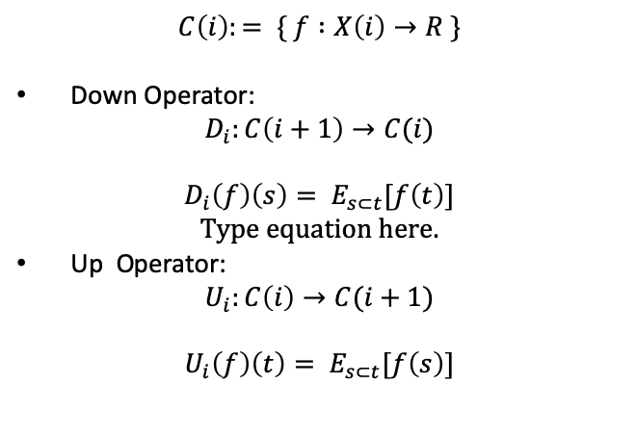
Boolean Function Analysis on HDXs
X(3)
$$C\left(i\right):= \{ f :X\left(i\right)→R \}$$
Down Operator:
$$D_{i}:C\left(i+1\right)→C(i)$$
$$D_{i}\left(f\right)\left(s\right)= E_{s⊂t}[f\left(t\right)]$$
Up Operator:
$$U_{i}:C\left(i\right)→C(i+1)$$
$$U_{i}\left(f\right)\left(t\right)= E_{s⊂t}[f\left(s\right)]$$
Triangles
X(2)
Edges
X(1)
Inner Product on Spaces C(i):
$${\left\langle f , g \right\rangle }_{i} ≔E_{s}\left[f\left(s\right) g\left(s\right)\right]$$
$$D and U adjoint of each other$$
i.e, ${\left\langle f , D_{i} g \right\rangle }_{i−1 }={\left\langle U_{i−1}f , g \right\rangle }_{i}$
Vertices
X(0)
$$φ −empty set$$
Empty Set

Slide 33
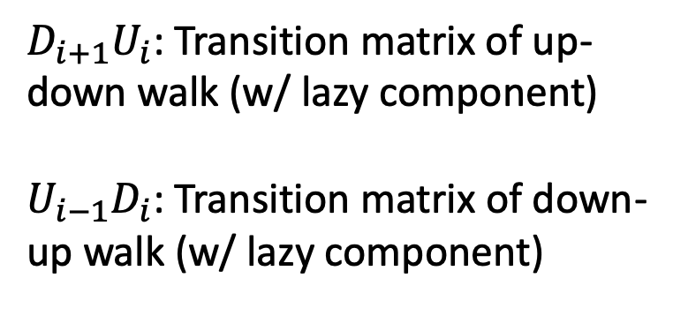
Boolean Function Analysis on HDXs
X(3)
$$C\left(i\right):= \{ f :X\left(i\right)→R \}$$
Down Operator:
$$D_{i}:C\left(i+1\right)→C(i)$$
$$D_{i}\left(f\right)\left(s\right)= E_{s⊂t}[f\left(t\right)]$$
Up Operator:
$$U_{i}:C\left(i\right)→C(i+1)$$
$$U_{i}\left(f\right)\left(t\right)= E_{s⊂t}[f\left(s\right)]$$
Triangles
X(2)
Edges
X(1)
$D_{i+1}U_{i}$: Transition matrix of up-down walk (w/ lazy component)
$U_{i−1}D_{i}$: Transition matrix of down-up walk (w/ lazy component)
Vertices
X(0)
$$φ −empty set$$
Empty Set

Slide 34
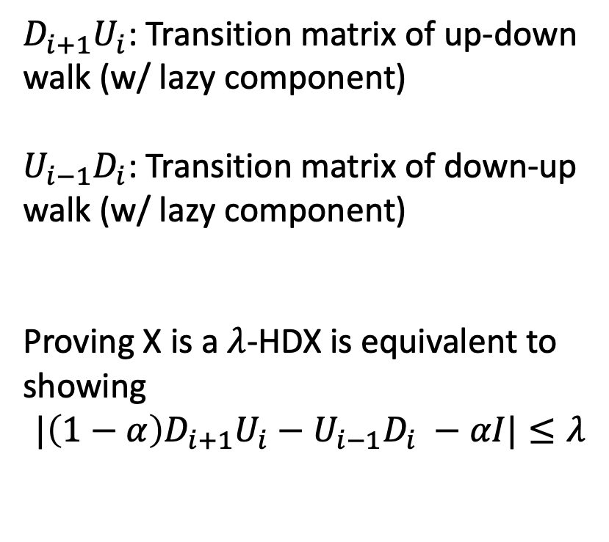
Boolean Function Analysis on HDXs
X(3)
$D_{i+1}U_{i}$: Transition matrix of up-down walk (w/ lazy component)
$U_{i−1}D_{i}$: Transition matrix of down-up walk (w/ lazy component)
Proving X is a $λ$-HDX is equivalent to showing
$$|\left(1−α\right)D_{i+1}U_{i}−U_{i−1}D_{i} −αI|≤λ$$
Triangles
X(2)
Edges
X(1)
Vertices
X(0)
$$φ −empty set$$
Empty Set

Slide 35
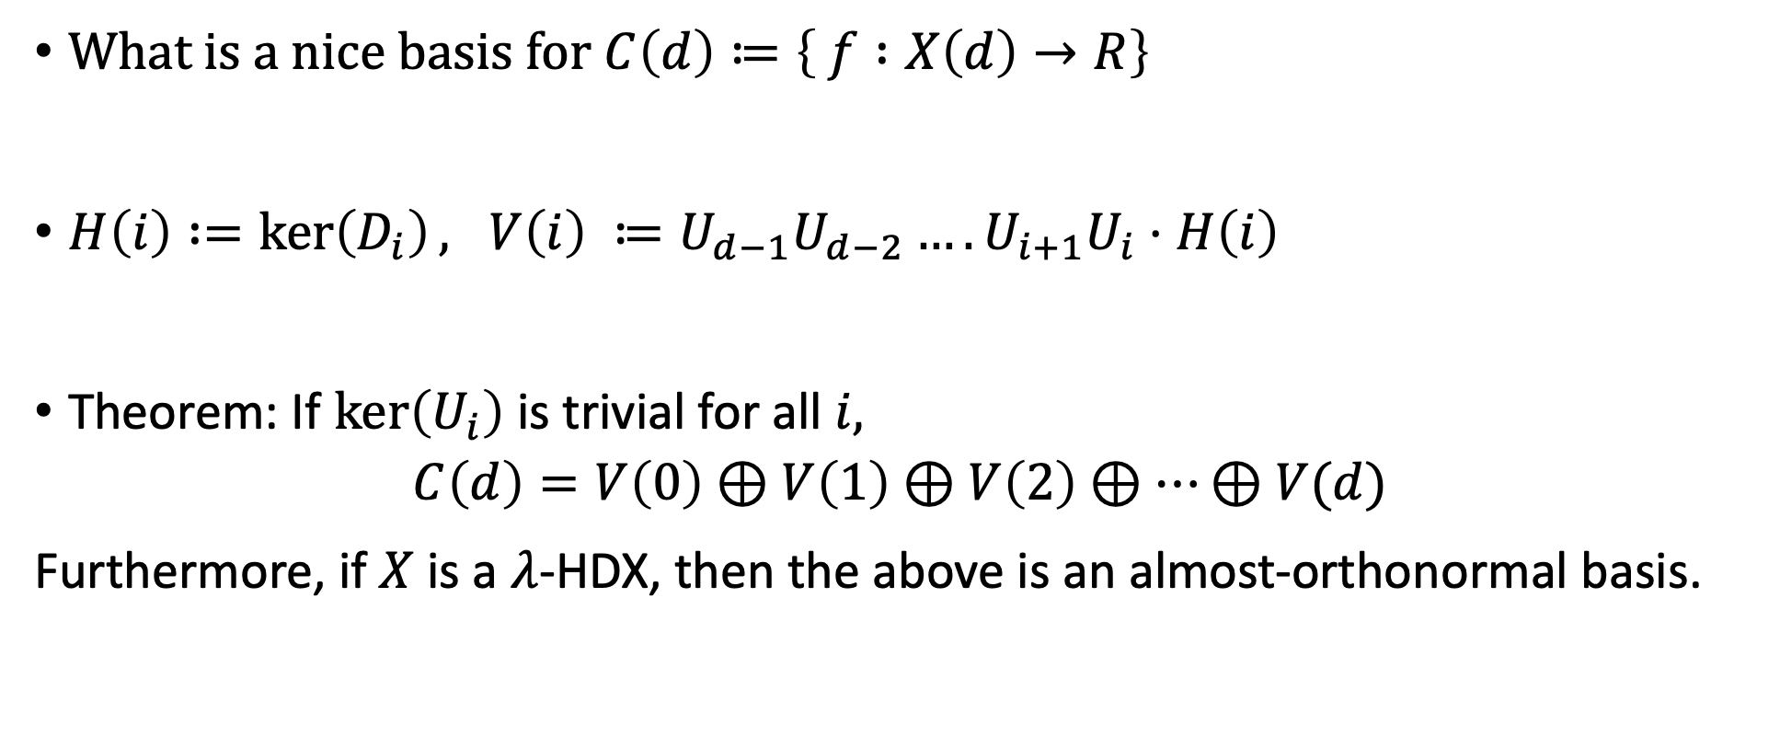
Nice basis of functions
What is a nice basis for $C\left(d\right)≔\left\{ f :X\left(d\right)→R\right\}$
$H\left(i\right) :=\ker\left(D_{i}\right), V\left(i\right) ≔{{U_{d−1}U_{d−2}….U}_{i+1}U}_{i}⋅H\left(i\right)$
Theorem: If $\ker\left(U_{i}\right)$ is trivial for all $i,$
$$C\left(d\right)=V\left(0\right)⊕V\left(1\right)⊕V\left(2\right)⊕⋯⊕V(d)$$
Furthermore, if $X$ is a $λ$-HDX, then the above is an almost-orthonormal basis.

Slide 36
Summarizing …
A new object called high-dimensional expander
  Which generalizes expander graphs to hypergraphs
Applications
  Local-to-Global Testing
  Coding Theory
  Approximate Sampling
  …… ?

Slide 37
High Dimensional Expanders (HDXs)
Thank You

