Slide 1
Exact degree of a symmetric Boolean function
Rajat Mittal
(IIT Kanpur)

Slide 2
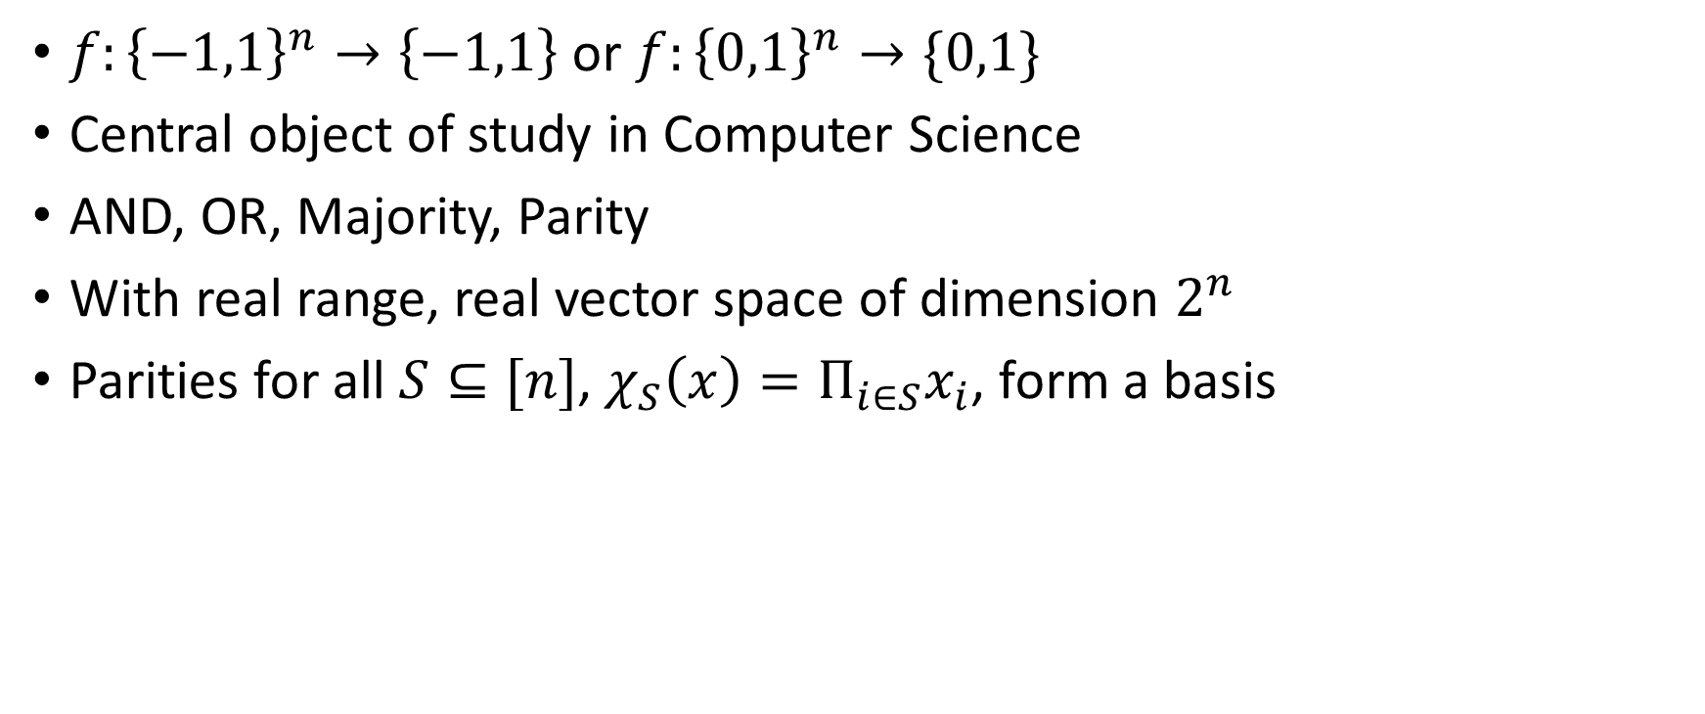
Boolean functions
$f:{\left\{−1,1\right\}}^{n}→\left\{−1,1\right\}$ or $f:{\left\{0,1\right\}}^{n}→\{0,1\}$
Central object of study in Computer Science
AND, OR, Majority, Parity
With real range, real vector space of dimension $2^{n}$
Parities for all $S⊆[n]$, $χ_{S}\left(x\right)=Π_{i∈S}x_{i}$, form a basis

Slide 3
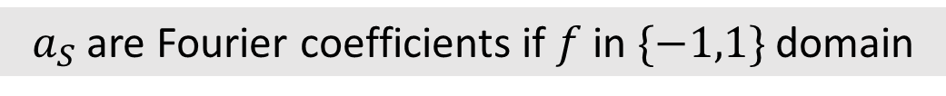

Polynomial representation
Multilinear (degree one in each variable)
Unique
Using interpolation, any $f$ can be written as,
$$f=\sum_{S⊆[n]}{a_{s}}χ_{S}(x)$$
$a_{S}$ are Fourier coefficients if $f$ in $\{−1,1\}$ domain

Slide 4
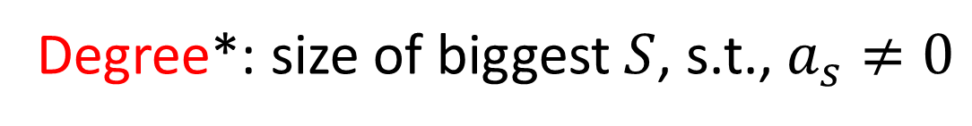
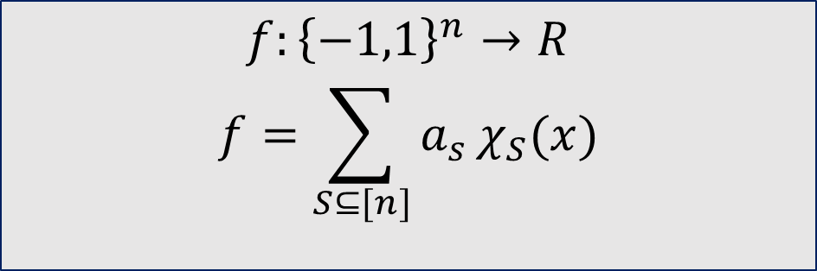
Degree of a representation
$$f:{\left\{−1,1\right\}}^{n}→R$$
$$f=\sum_{S⊆[n]}{a_{s}}χ_{S}(x)$$
Degree*: size of biggest $S$, s.t., $a_{s}≠0$
* Degree remains same even if $f:{\left\{0,1\right\}}^{n}→\{0,1\}$

Slide 5
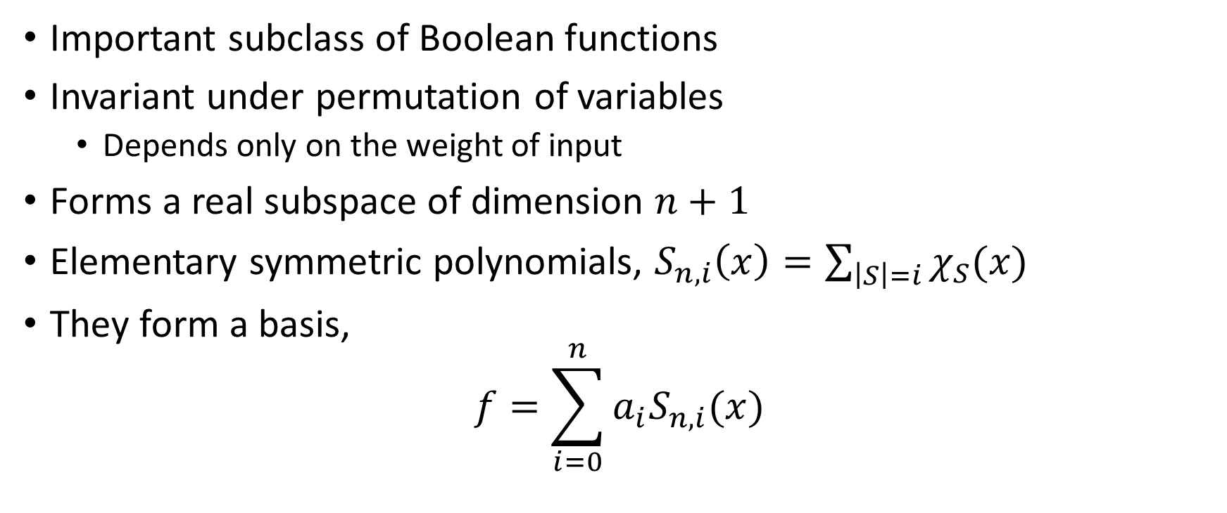

Symmetric function
$$f:{\left\{−1,1\right\}}^{n}→\left\{−1,1\right\}$$
$$f=\sum_{S⊆[n]}{a_{s}}χ_{S}(x)$$
Important subclass of Boolean functions
Invariant under permutation of variables
  Depends only on the weight of input
Forms a real subspace of dimension $n+1$
Elementary symmetric polynomials, $S_{n,i}\left(x\right)=\sum_{\left|S\right|=i}{χ_{S}(x)}$
They form a basis,
$$f=\sum_{i=0}^{n}{a_{i}S_{n,i}(x)}$$

Slide 6
non-constant
What is the minimum possible degree of a Boolean symmetric function?

Slide 7
Same Degree
$$f:{\left\{−1,1\right\}}^{n}→\{−1,1\}$$
𝑓:{−1,1}^𝑛→{−1,1}
$$f:{\left\{0,1\right\}}^{n}→\{0,1\}$$
𝑓:{0,1}^𝑛→{0,1}
F$:{\left[n\right]}_{0}→\{0,1\}$ (univariate)
F:[𝑛]_0→{0,1} (univariate)

Slide 8
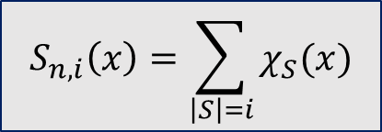
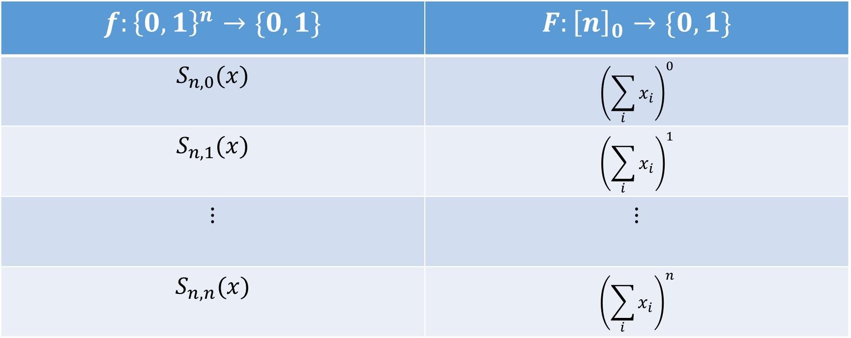
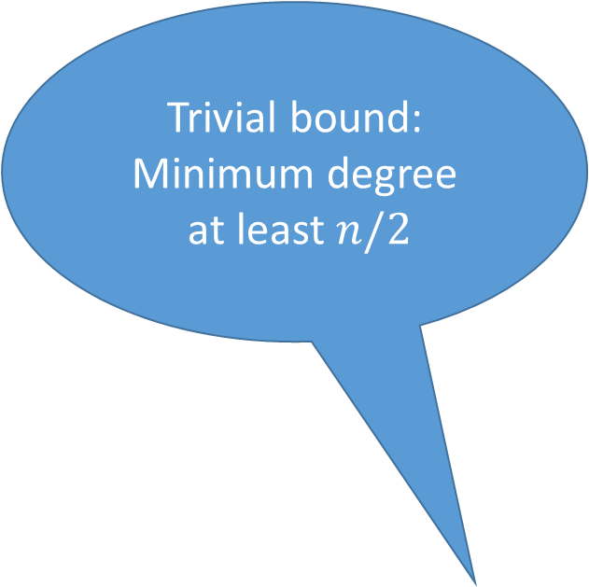
Equivalence: multivariate and univariate
Trivial bound:
Minimum degree
at least $n/2$
$$S_{n,i}\left(x\right)=\sum_{\left|S\right|=i}{χ_{S}(x)}$$
$$f:{\left\{0,1\right\}}^{n}→\{0,1\}$$ | $$F:{\left[n\right]}_{0}→\{0,1\}$$
$$S_{n,0}(x)$$ | $${\left(\sum_{i}{x_{i}}\right)}^{0}$$
$$S_{n,1}(x)$$ | $${\left(\sum_{i}{x_{i}}\right)}^{1}$$
$$⋮$$ | $$⋮$$
$$S_{n,n}(x)$$ | $${\left(\sum_{i}{x_{i}}\right)}^{n}$$

Slide 9
Outline
Problem description
Best bound (GR97)
Random function (GR97)
Known results
More than two values (CST10)
Conjecture
Number theory approaches
Possible approaches
Dual witness

Slide 10
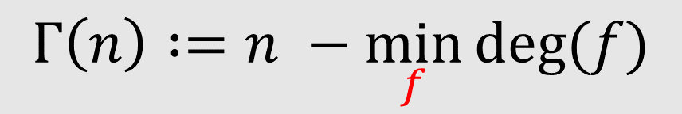
What is the minimum possible degree of a non-constant Boolean symmetric function?
$$Γ\left(n\right) :=n −\min_{f}{deg⁡(f)}$$

Slide 11
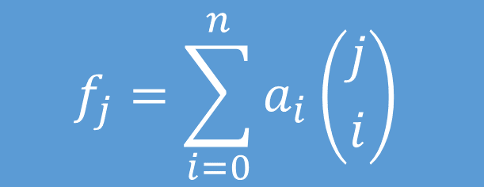

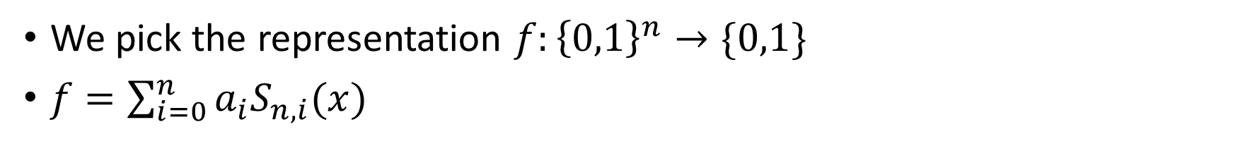
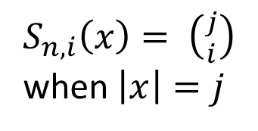
Finding the coefficients
We pick the representation $f:{\left\{0,1\right\}}^{n}→\{0,1\}$
$f=\sum_{i=0}^{n}{a_{i}S_{n,i}(x)}$
$$f(x)$$
𝑓(𝑥)
$f_{0}$ if $\left|x\right|=0$
𝑓_0 if |𝑥|=0
$f_{1}$ if $\left|x\right|=1$
𝑓_1 if |𝑥|=1
$$⋮$$
⋮
$f_{n}$ if $\left|x\right|=n$
𝑓_𝑛 if |𝑥|=𝑛
$S_{n,i}\left(x\right)= \left({j \atop i}\right)$
when $\left|x\right|=j$
$$f_{j}=\sum_{i=0}^{n}{a_{i}}\left({j \atop i}\right)$$
$$⇒$$

Slide 12
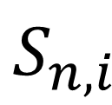
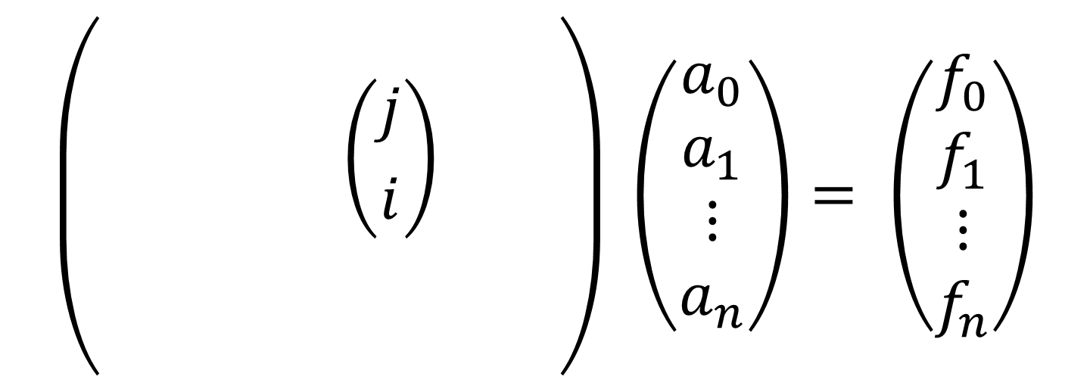
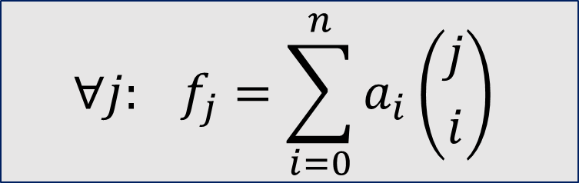
Matrix equation
$$∀j: f_{j}=\sum_{i=0}^{n}{a_{i}}\left({j \atop i}\right)$$
$$S_{n,i}$$
$$\left(\begin{matrix} & & & \\ & & \left({j \atop i}\right) & \\ & & & \\ & & & \end{matrix}\right) \left(\begin{matrix}a_{0} \\ a_{1} \\ ⋮ \\ a_{n}\end{matrix}\right)= \left(\begin{matrix}f_{0} \\ f_{1} \\ ⋮ \\ f_{n}\end{matrix}\right)$$
|x|=j

Slide 13
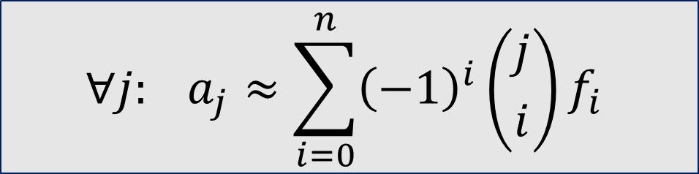
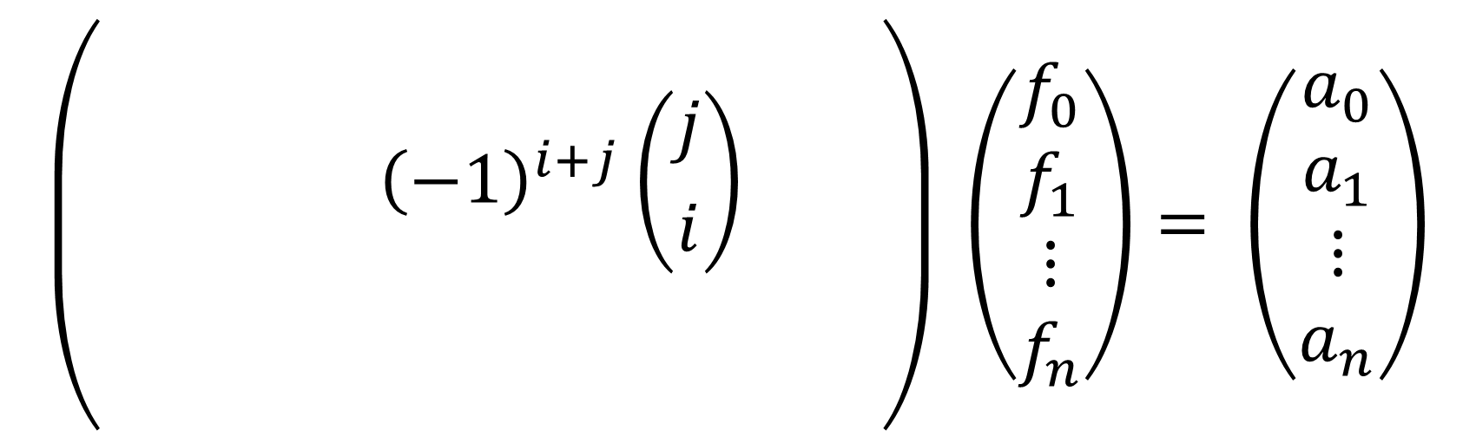
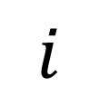
Taking inverse
$$∀j: a_{j}≈\sum_{i=0}^{n}{{\left(−1\right)}^{i}}\left({j \atop i}\right)f_{i}$$
j
$$\left(\begin{matrix} & & & \\ & & {\left(−1\right)}^{i+j}\left({j \atop i}\right) & \\ & & & \\ & & & \end{matrix}\right) \left(\begin{matrix}f_{0} \\ f_{1} \\ ⋮ \\ f_{n}\end{matrix}\right)= \left(\begin{matrix}a_{0} \\ a_{1} \\ ⋮ \\ a_{n}\end{matrix}\right)$$
$$i$$

Slide 14
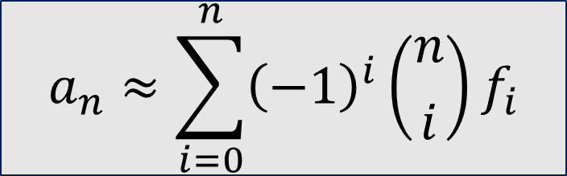

$$a_{n}≈\sum_{i=0}^{n}{{\left(−1\right)}^{i}}\left({n \atop i}\right)f_{i}$$
Lemma: $\left({p−1 \atop i}\right)={\left(−1\right)}^{i} mod p$
Idea: Look at $a_{n} mod p$
If $n+1=p$ then
$$a_{n} mod p =\sum_{i=0}^{n}{f_{i}}$$
$a_{n}=0 mod p$if and only if $f_{i}$ is constant

Slide 15
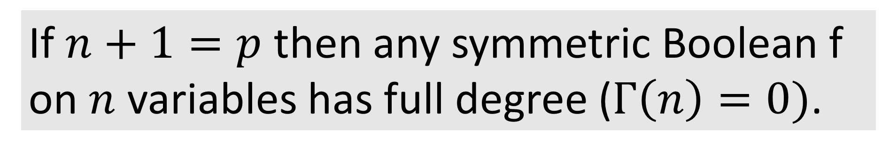
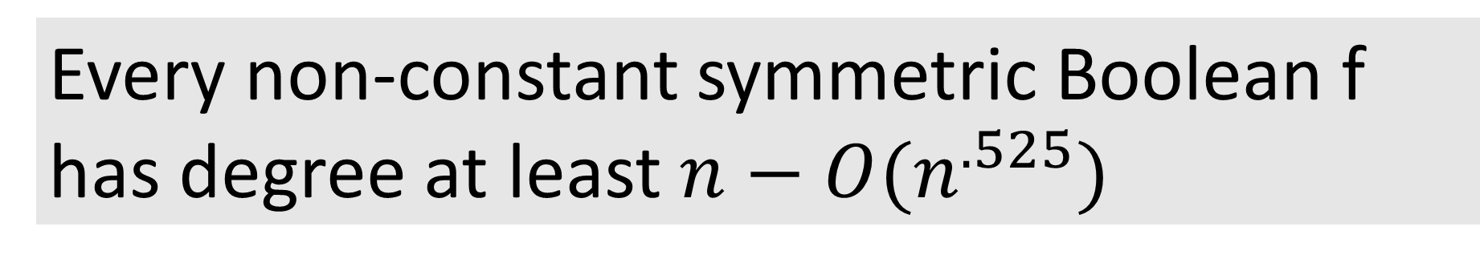
If $n+1=p$ then any symmetric Boolean f on $n$ variables has full degree ($Γ\left(n\right)=0)$.
Distance between primes
Every non-constant symmetric Boolean f has degree at least $n−O(n^{.525})$

Slide 16


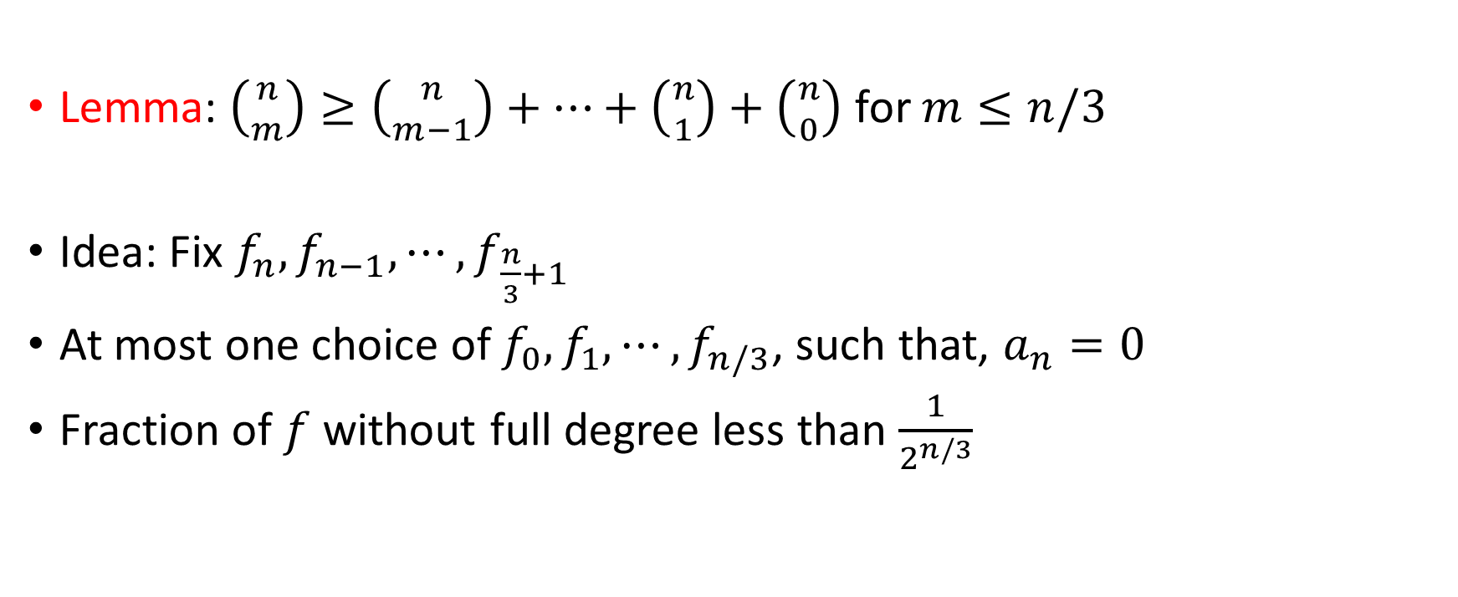
Random $f$
$$a_{n}≈\sum_{i=0}^{n}{{\left(−1\right)}^{i}}\left({n \atop i}\right)f_{i}$$
Lemma: $\left({n \atop m}\right)≥\left({n \atop m−1}\right)+⋯+\left({n \atop 1}\right)+\left({n \atop 0}\right)$ for $m≤n/3$
Idea: Fix $f_{n},f_{n−1},⋯,f_{\frac{n}{3}+1}$
At most one choice of $f_{0},f_{1},⋯,f_{n/3}$, such that, $a_{n}=0$
Fraction of $f$ without full degree less than $\frac{1}{2^{n/3}}$

Slide 17

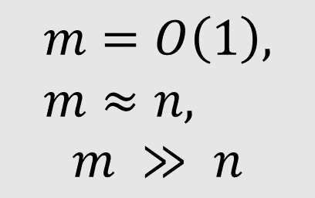

More than two outputs
Original Q: minimum possible degree of a univariate function $f:{\left[n\right]}_{0}→\{0,1\}$?
New Q: minimum possible degree of a univariate function $f:{\left[n\right]}_{0}→\{0,1,⋯,m\}$?
$$m=O\left(1\right), m≈n,$$
$$m ≫ n$$

Slide 18

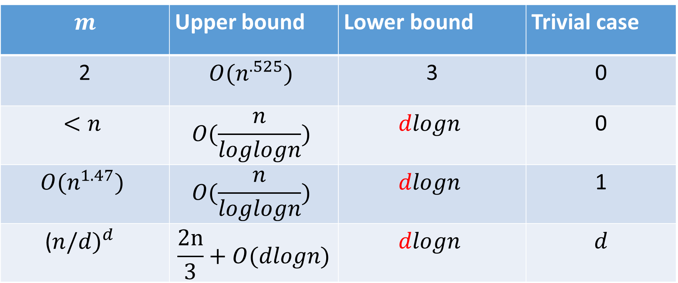
CST10: bound on $Γ\left(n\right)$
$$m$$ | Upper bound | Lower bound | Trivial case
2 | $$O(n^{.525})$$ | 3 | 0
$$<n$$ | $$O(\frac{n}{loglogn})$$ | $$dlogn$$ | 0
$$O(n^{1.47})$$ | $$O(\frac{n}{loglogn})$$ | $$dlogn$$ | 1
($n/{d)}^{d}$ | $$\frac{2n}{3}+O(dlogn)$$ | $$dlogn$$ | $$d$$

Slide 19
Outline
Problem description
Best bound (GR97)
Random function (GR97)
Known results
More than two values (CST10)
Conjecture
Number theory approaches
Possible approaches
Dual witness

Slide 20
Results
Define $Γ\left(n\right)=n −\min_{f}{deg⁡(f)}$ (maximum gap possible)
Define Γ(𝑛)=𝑛 −min┬𝑓⁡〖deg⁡(𝑓)〗 (maximum gap possible)
$Γ\left(n\right)=O(n^{.525})$ for all $n$
Γ(𝑛)=𝑂(𝑛^.525) for all 𝑛
Random $f$, full degree with high probability
Random 𝑓, full degree with high probability
$Γ(n){=o(n)}$, even with more outputs
〖Γ(𝑛)〗⁡〖=𝑜(𝑛)〗, even with more outputs

Slide 21
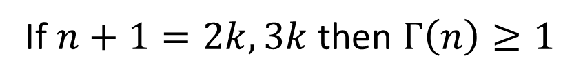
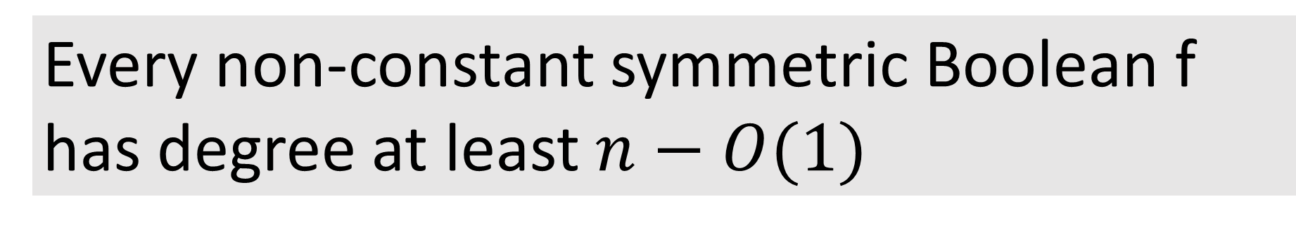
Conjecture
If $n+1=2k,3k$ then $Γ\left(n\right)≥1$
Every non-constant symmetric Boolean f has degree at least $n−O(1)$

Slide 22
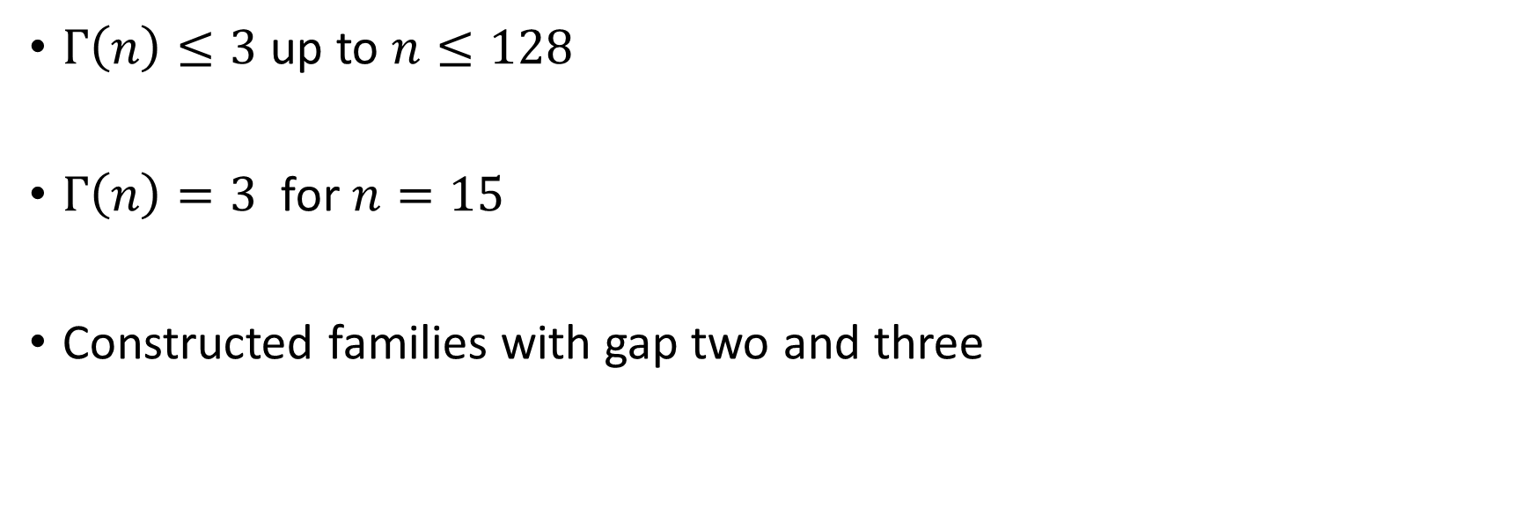
Experimental results (GR97)
$Γ\left(n\right)≤3$ up to $n≤128$
$Γ\left(n\right)=3$ for $n=15$
Constructed families with gap two and three

Slide 23
Outline
Problem description
Best bound (GR97)
Random function (GR97)
Known results
More than two values (CST10)
Conjecture
Number theory approaches
Possible approaches
Dual witness

Slide 24
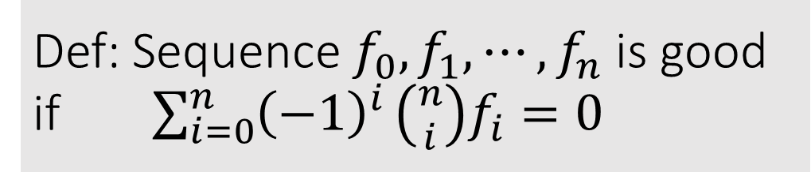
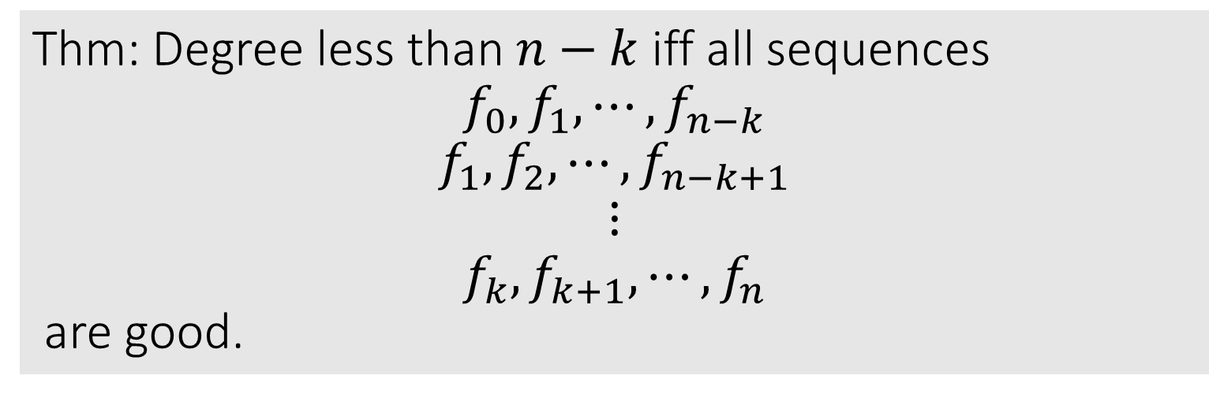
Good sequences
Def: Sequence $f_{0},f_{1},⋯,f_{n}$ is good if $\sum_{i=0}^{n}{{\left(−1\right)}^{i}}\left({n \atop i}\right)f_{i}=0$
Thm: Degree less than $n−k$ iff all sequences
$$f_{0},f_{1},⋯,f_{n−k}$$
$$f_{1},f_{2},⋯,f_{n−k+1}$$
$$⋮$$
$$f_{k},f_{k+1},⋯,f_{n}$$
are good.

Slide 25
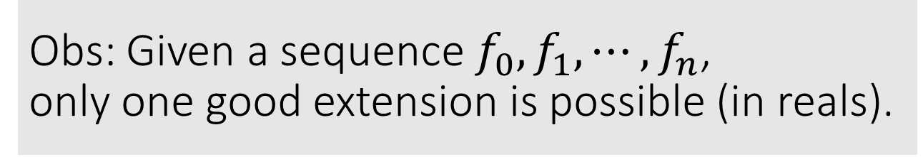
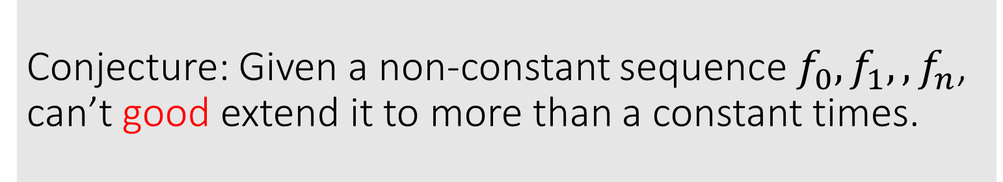
Good sequences
Obs: Given a sequence $f_{0},f_{1},⋯,f_{n}$,
only one good extension is possible (in reals).
Conjecture: Given a non-constant sequence $f_{0},f_{1},,f_{n}$,
can’t good extend it to more than a constant times.

Slide 26
Conjecture for school students
$$f_{0} { f}_{1} f_{2} ⋯ { f}_{n}$$
𝑓_0 〖 𝑓〗_1 𝑓_2 ⋯ 〖 𝑓〗_𝑛
$$⋮$$
⋮
$$g_{0} g_{1}$$
𝑔_0 𝑔_1
$$f_{0}−f_{1} ⋯ {f_{n−1}−f}_{n}$$
𝑓_0−𝑓_1 ⋯ 〖𝑓_(𝑛−1)−𝑓〗_𝑛
$${ g}_{0}−g_{1}$$
〖 𝑔〗_0−𝑔_1
At what level
does this become a constant sequence?

Slide 27
Outline
Problem description
Best bound (GR97)
Random function (GR97)
Known results
More than two values (CST10)
Conjecture
Number theory approaches
Possible approaches
Dual witness

Slide 28

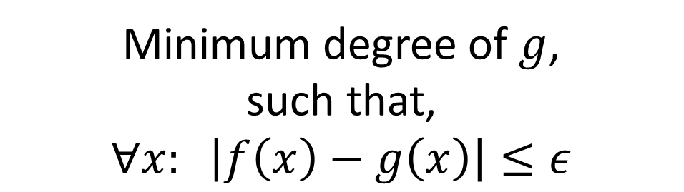
Approximate degree
Minimum degree of $g$,
such that,
$∀x: \left|f\left(x\right)−g\left(x\right)\right|≤ε$
Primal
Dual
$$φ:{\left\{−1,1\right\}}^{n}→R$$

Slide 29
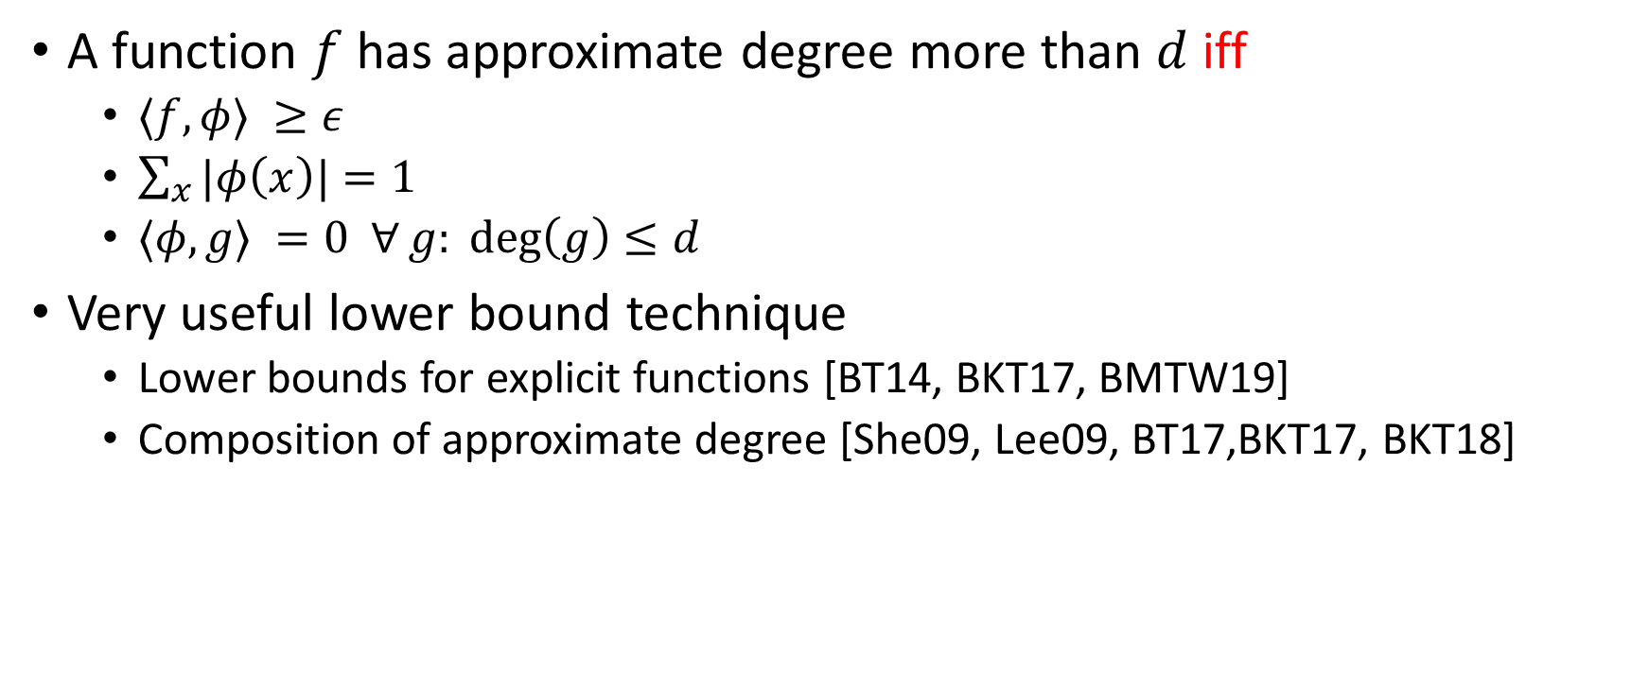
Dual Witness
A function $f$has approximate degree more than $d$ iff
  $〈f,φ〉 ≥ε$
  $\sum_{x}{|φ\left(x\right)|}=1$
  $〈φ,g〉 =0 ∀g: deg\left(g\right)≤d$
Very useful lower bound technique
  Lower bounds for explicit functions [BT14, BKT17, BMTW19]
  Composition of approximate degree [She09, Lee09, BT17,BKT17, BKT18]

Slide 30
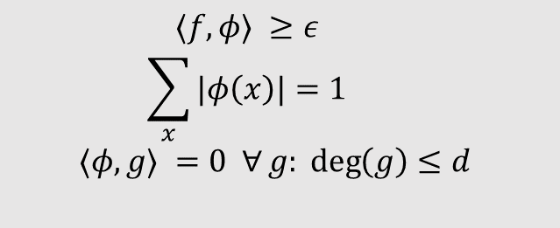
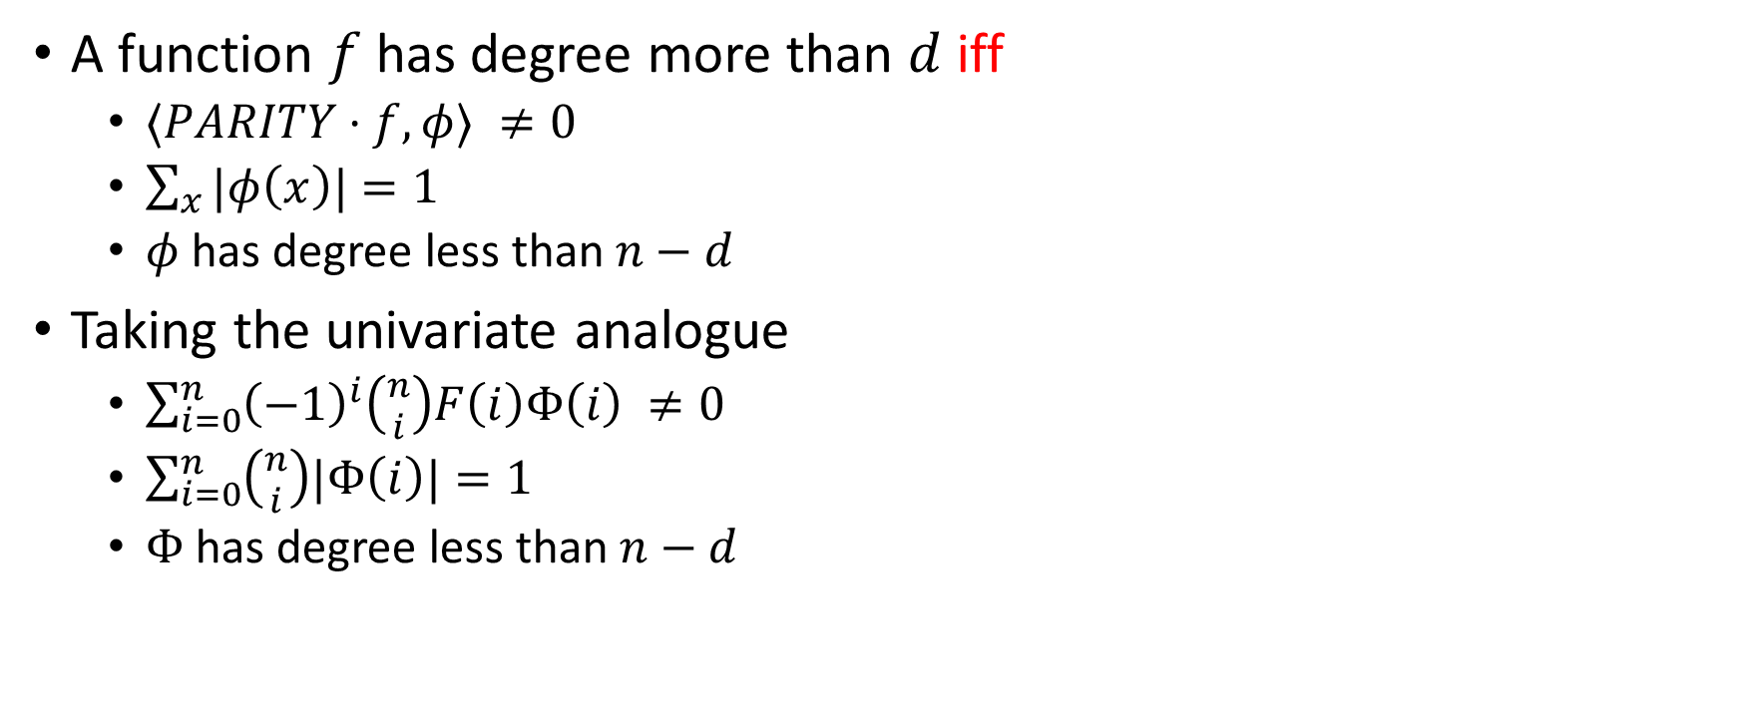
Witness: more formulations
  $$〈f,φ〉 ≥ε$$
  $$\sum_{x}{|φ\left(x\right)|}=1$$
  $$〈φ,g〉 =0 ∀g: deg\left(g\right)≤d$$
A function $f$has degree more than $d$ iff
  $〈PARITY⋅f,φ〉 ≠0$
  $\sum_{x}{|φ\left(x\right)|}=1$
  $φ$ has degree less than $n−d$
Taking the univariate analogue
  $\sum_{i=0}^{n}{{\left(−1\right)}^{i}\left({n \atop i}\right)F\left(i\right)Φ\left(i\right)} ≠0$
  $\sum_{i=0}^{n}{\left({n \atop i}\right)|Φ\left(i\right)|}=1$
  $Φ$ has degree less than $n−d$

Slide 31
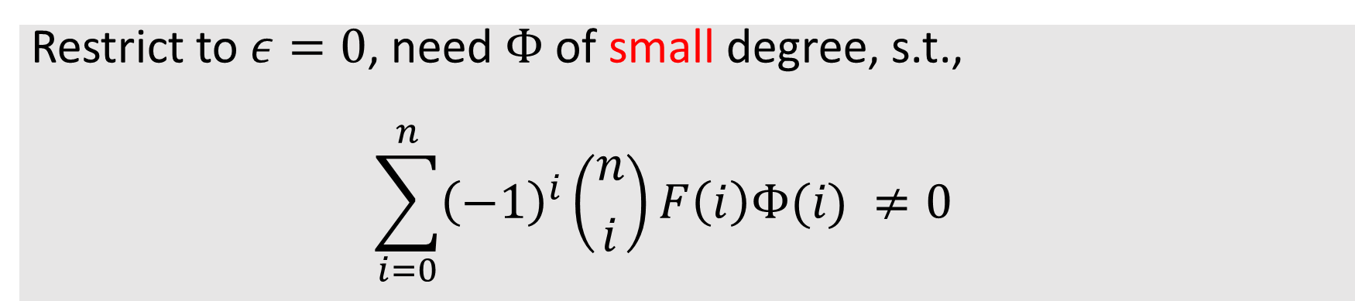
Restrict to $ε=0$, need $Φ$ of small degree, s.t.,
  $$\sum_{i=0}^{n}{{\left(−1\right)}^{i}\left({n \atop i}\right)F\left(i\right)Φ(i)} ≠0$$

Slide 32
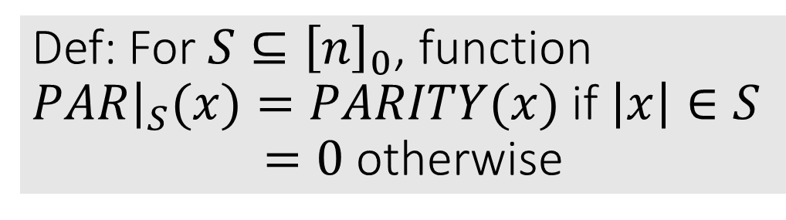

Def: For $S⊆{\left[n\right]}_{0}$, function
$PAR{\left.​\right|}_{S}(x)=PARITY(x)$ if $\left|x\right|∈S$
$=0$ otherwise
Another conjecture: For all $PAR{\left.​\right|}_{S}$, there is a small non-zero Fourier coefficient.

Slide 33


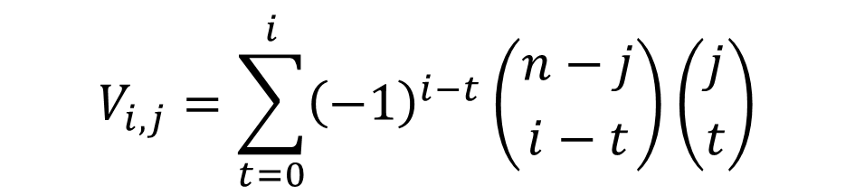
Almost Vandermonde identity
j
$$V= \left(\begin{matrix} & & & \\ & & & \\ & & & \\ & & & \end{matrix}\right)$$
$$V_{i,j}=\sum_{t=0}^{i}{{\left(−1\right)}^{i−t}}\left({n−j \atop i−t}\right)\left({j \atop t}\right)$$
i
Another conjecture: Arbitrary sum of first few rows can’t be zero up to first $Γ(n)$ columns

Slide 34
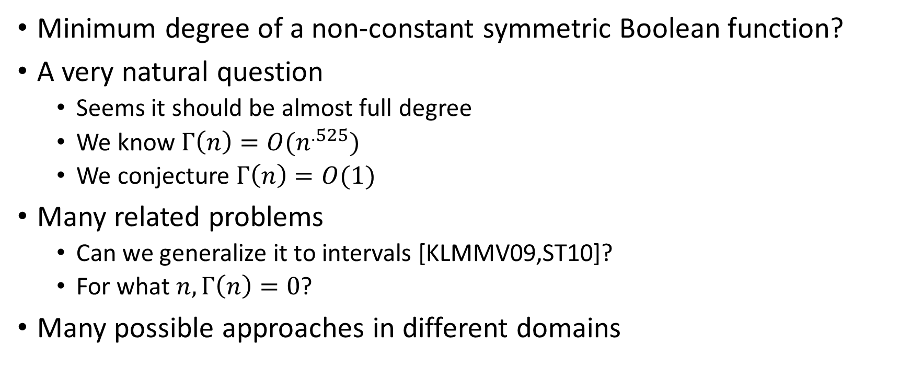
Conclusion
Minimum degree of a non-constant symmetric Boolean function?
A very natural question
  Seems it should be almost full degree
  We know $Γ\left(n\right)=O(n^{.525})$
  We conjecture $Γ\left(n\right)=O(1)$
Many related problems
  Can we generalize it to intervals [KLMMV09,ST10]?
  For what $n, Γ\left(n\right)=0$?
Many possible approaches in different domains

Slide 35

THANKS

